Slide 1
Creating Student E-Resources
for the London Project Center
Reagan Kayhart, Zach Rioux, Akshay Shinde, and Ben Tyler
April 24th, 2024
Notes:
Reagan
-We worked on Creating Student E-Resources for the London Project Center
-My name is Reagan

Slide 2
OUR TEAM
Zachary Rioux
Reagan Kayhart
Ben Tyler
Akshay Shinde
Notes:
Reagan
-We are a group of 4 students
-working with our project host Dominic Goulding

Slide 3
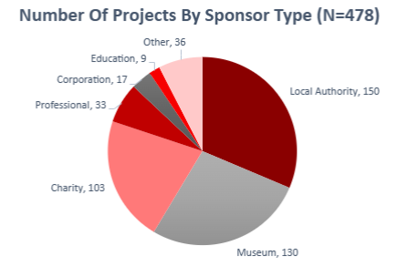
London Project Center
First International Project Center at WPI
From 1987-2024:
478 projects
1687 students
Notes:
Reagan
-The London Project Center is the first international project center at WPI
-and from 1987-2024
-They have hosted 478 projects
-worked on by 1687 students
-These projects are most frequently sponsored by Local Authorities, Museums, and Charities.

Slide 4
Project Workload
Buying Groceries
Learning about the Culture
Planning Itinerary Abroad
Getting Around
Packing
Buying Tickets
Notes:
Ben
Build up of information

Slide 5
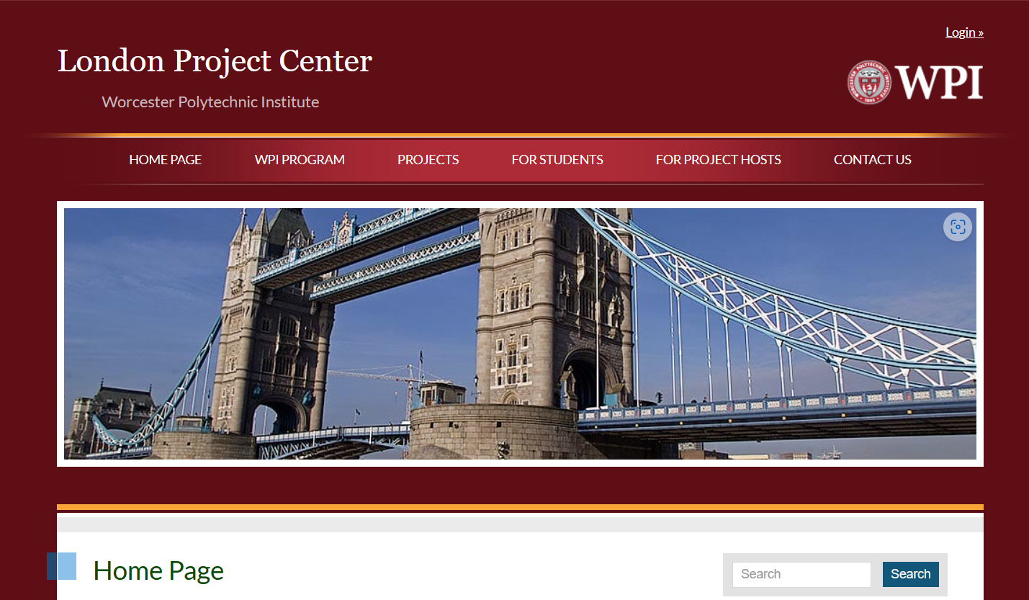
Project Goal
Develop online multimedia resources for students embarking on the London IQP
Notes:
Zach
We were tasked with evaluating current and developing new e-resources for future London IQP students
This includes information students felt was lacking and providing everything in one convenient, easily accessible location
The picture on the left is the current home page of the London Project Center website, which we updated the for students tab with quick links to a new Sharepoint website
This was necessary to keep everything behind a firewall and only accessible to LPC students

Slide 6
PROJECT
OBJECTIVES
Objective 1:
Identify best practices for communication
Objective 2:
Assess student preferences
Objective 3:
Construct preliminary tools
Objective 4:
Create Promotional
Video
Notes:
Akshayy

Slide 7
Data Collection
Surveys
Focus Group
Interviews
Qualtrics surveys for past and future London IQP students
Conducted a focus group with six students from our current cohort.
Conducted 25 in-person and zoom interviews
Notes:
Zach
Center Directors - 5
Sponsors - 8
Past Students - 5
WPI GEO Staff - 2
NAFSA - 1
Forum on Education Abroad - 1
Natalie Mello
Charlie Morse
Dominic Golding
Collected 49 out of 132 total responses for our surveys

Slide 8
Effective Information Sources
VENUS
30%
Notes:
Ben

Slide 9
Current Information Provided
VENUS
30%
Notes:
Ben

Slide 10
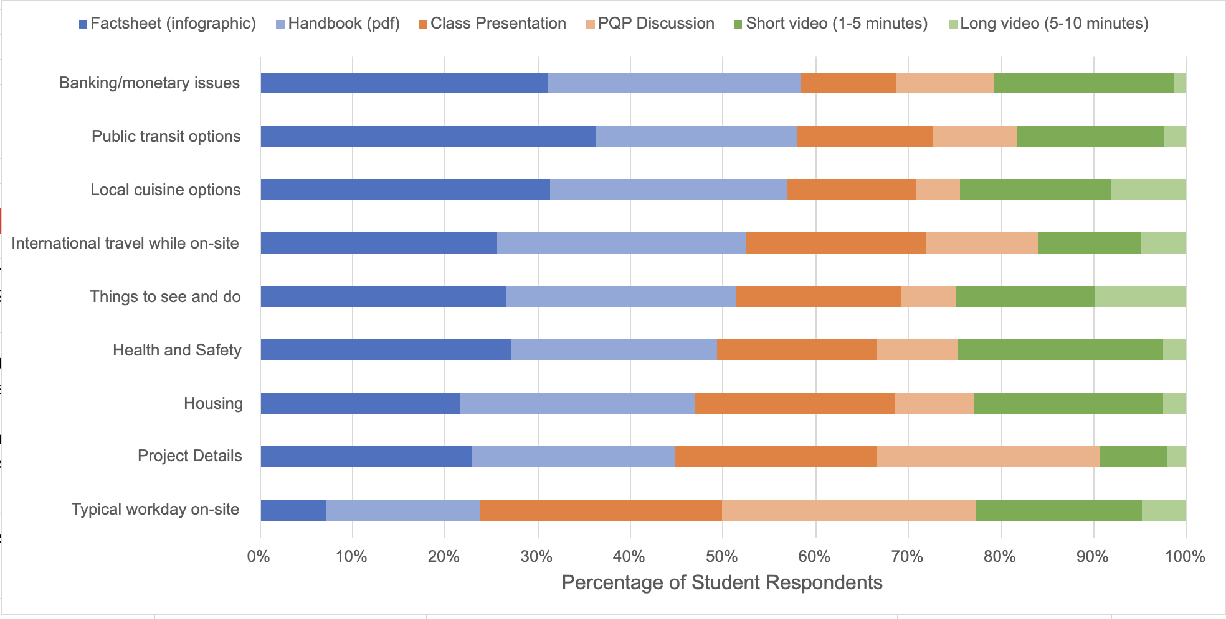
Preferred Communication
VENUS
30%
Banking monetary issues
Public transit options
Local cuisine options
International travel while on-site
Health and Safety
Housing
Things to see and do
Typical Workday on-site
Project Details
Notes:
Akshay Shinde

Slide 11
LPC STUDENT RESOURCE SHAREPOINT WEBSITE
Notes:
Akshay
Home
Academics
Week in the Life
Reagan
In London
Packing List
Covers what items students should think of packing for their IQP
Transportation
Covers Transportation from the Heathrow and Gatwick airports
Starts with Information about acceptable credit Cards
Zach
In London
Accommodations
Things to do
Health and Safety
Akshay
Travel
Ben
Student Recommendations Page
Form
Table
Map
Reagan
Handbook and FAQ
-Our faqs tab covers the most frequent questions asked by london iqp students,
-The questions link to the related topic page
for example the question about housing goes to the accommodation page
the question cover:
Where the housing is,
how to use the underground and the cost
What a typical work week is
Common forgotten items for packing
Where to find the handbook

Slide 12
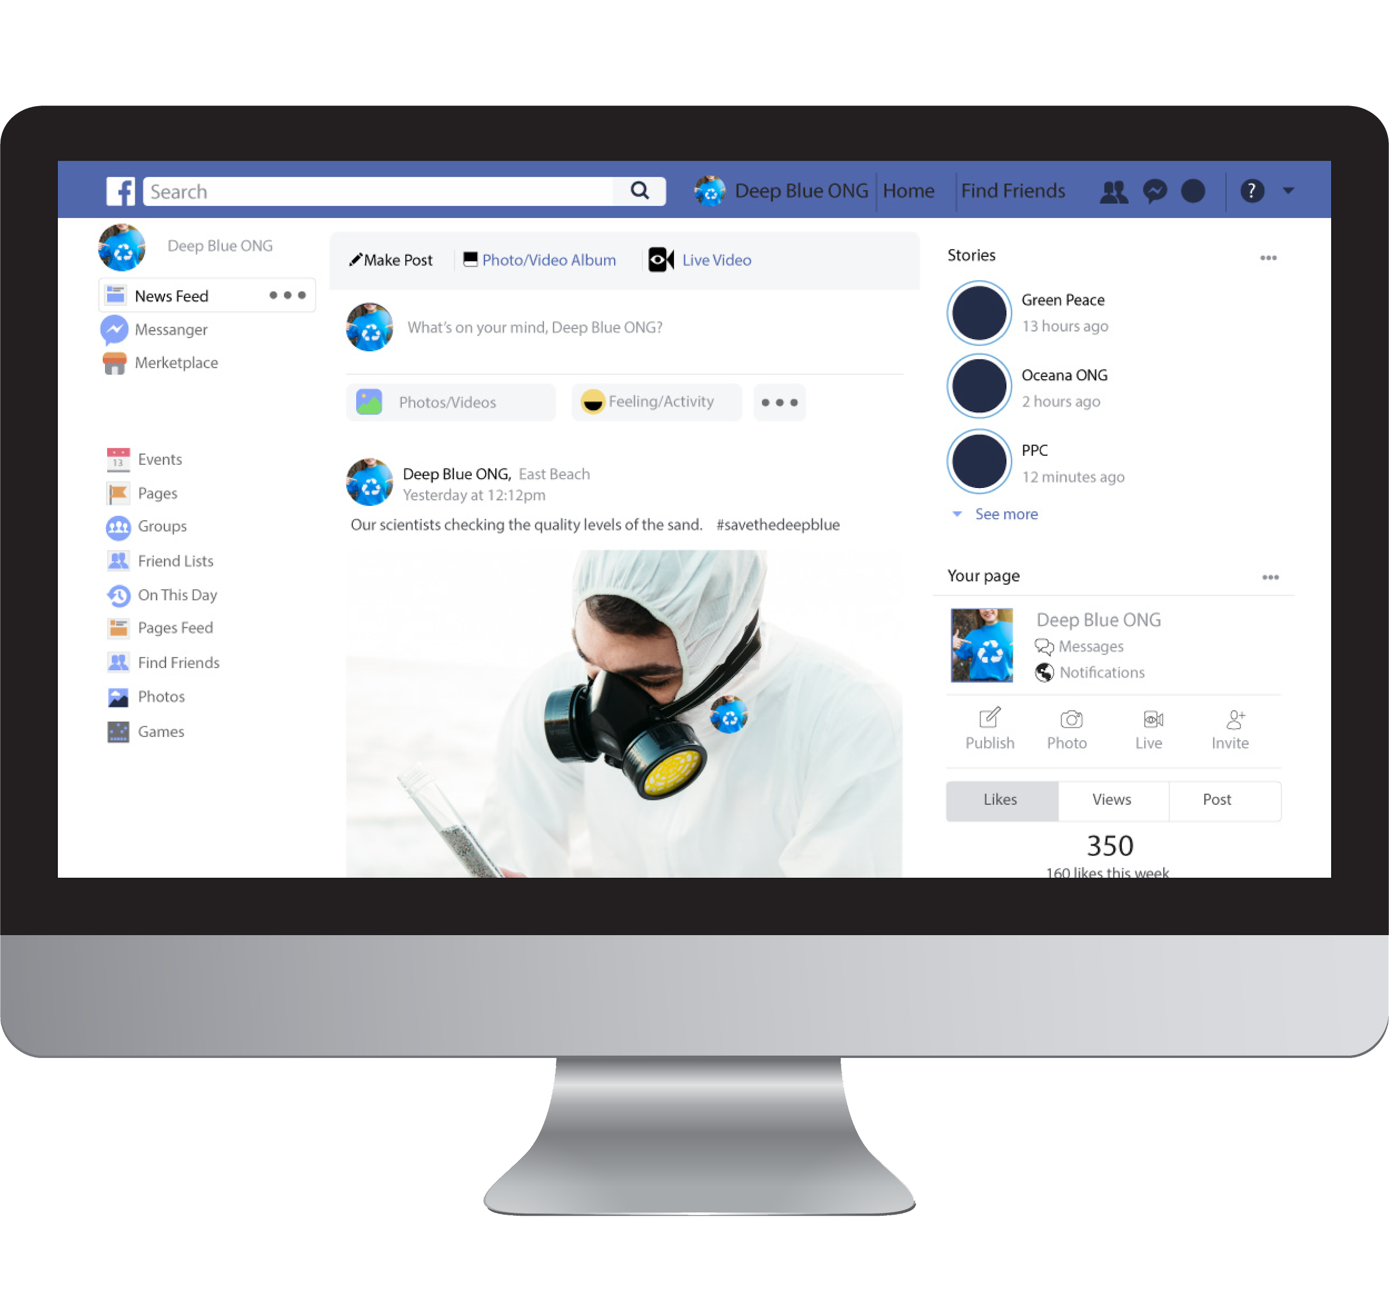
LPC PROJECT HOST PROMOTIONAL VIDEO
Special Thanks to:
Giuseppe Albano (Freud Museum London)
Stuart Frost (The British Museum)
David Houston (Transport Museum London and The Design Museum)
Naomi Martin (Commonside Community Development Trust)
Andy Richmond (The Postal Museum)
Notes:
Reagan
-We interviewed past project hosts
-and created a video highlighting the experience of hosting a WPI project Team
-We would like to give a special thanks to the project hosts who help with this video
-And it will be uploaded to the london Project Center website

Slide 13
Recommendations
01
02
Change the layout of the GEO Canvas site
Group meeting the term before ID2050 to connect students
03
Update the Handbooks on the SharePoint site
04
Manually add/remove students from SharePoint
Notes:
Zach

Slide 14
Notes:
Thank you!

