Slide 1
Car-Snow Clearing Drone
Major Qualifying Project
Final Presentation
Razan Andigani (RBE + ME), Jeremy Branch (ME), Ryan Keller (ME), Chioma Onyenokwe (RBE)
Notes:
All - introduce self

Slide 2
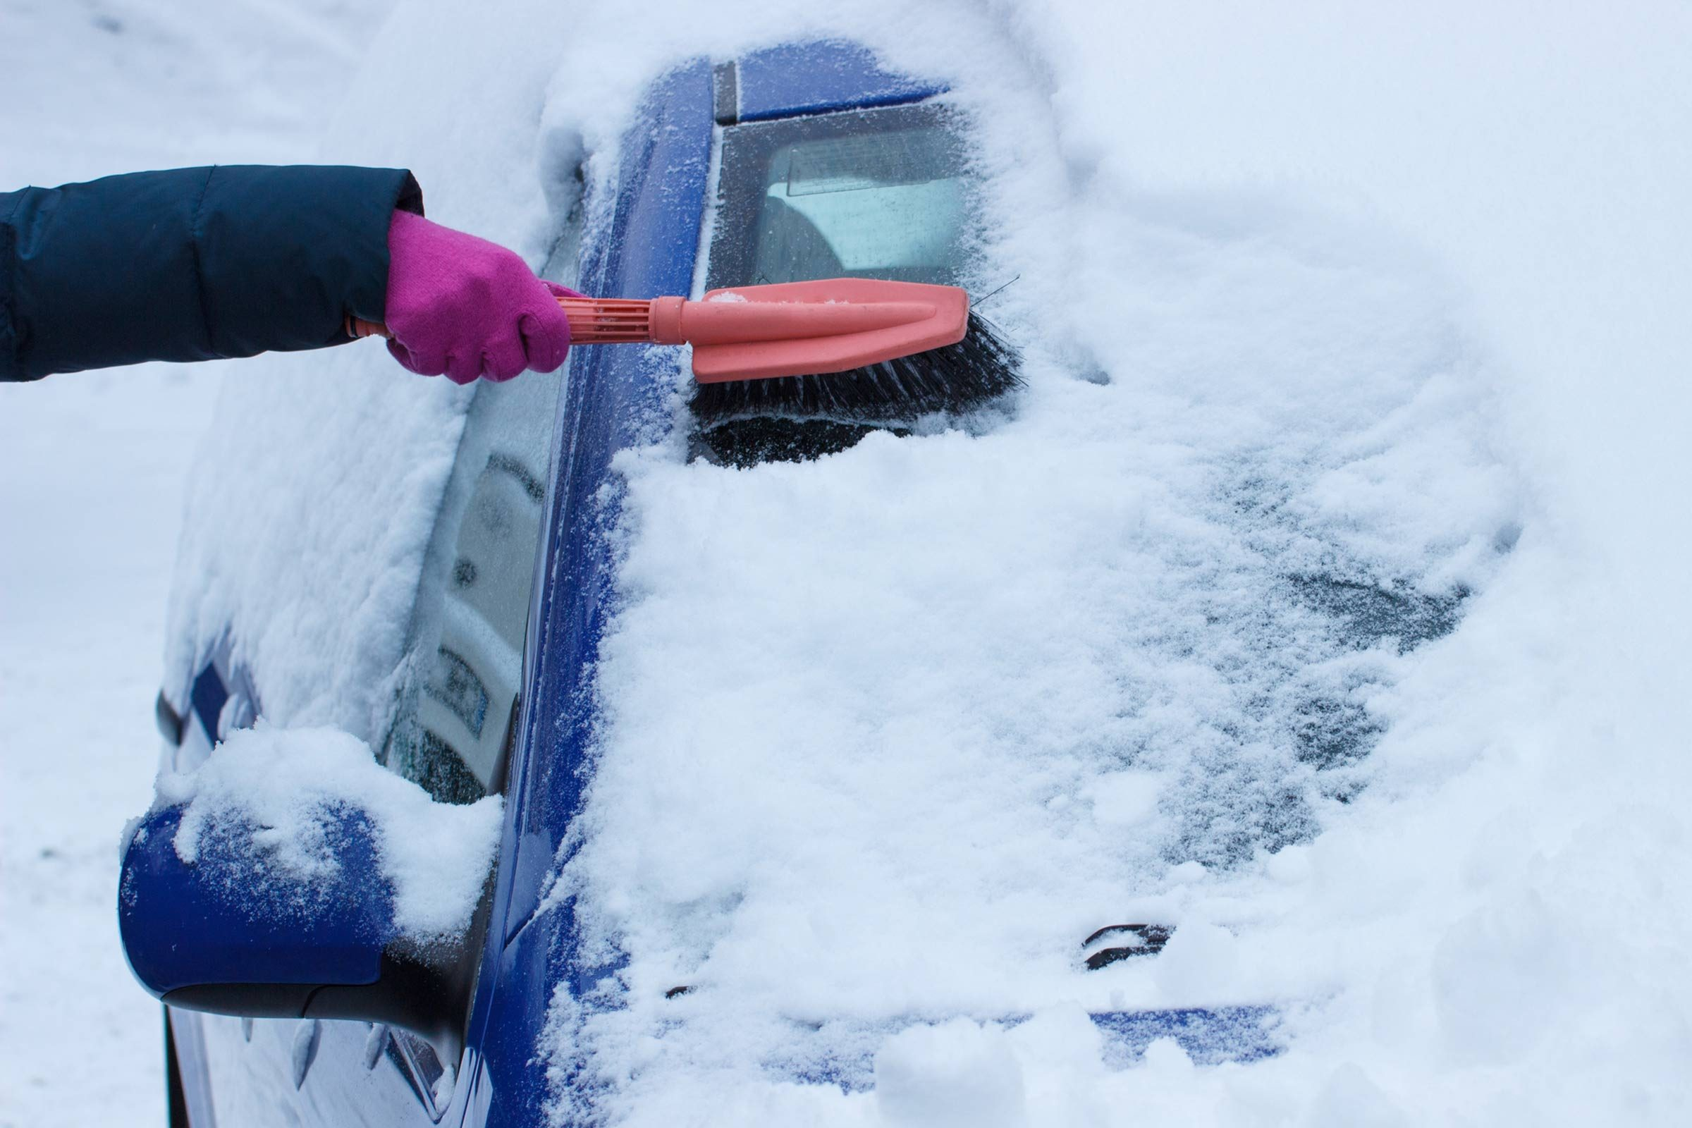
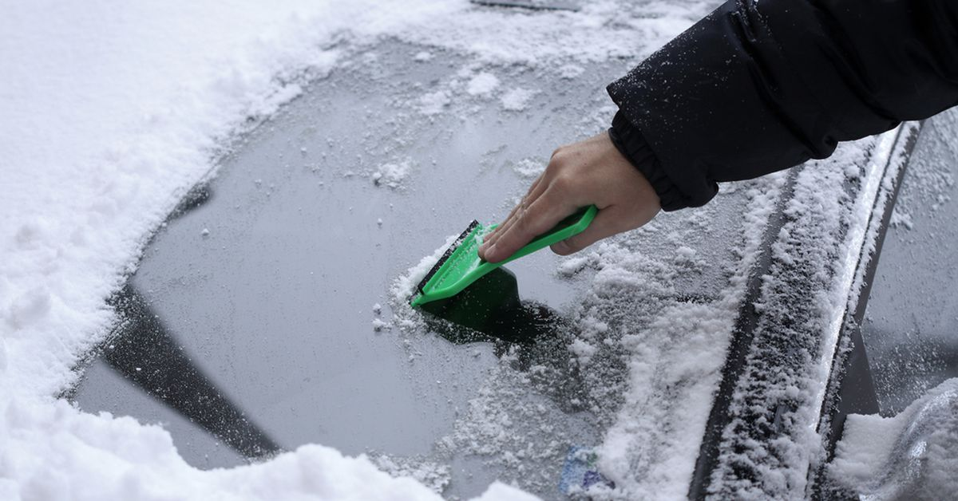
Problem
Notes:
Razan

Slide 3
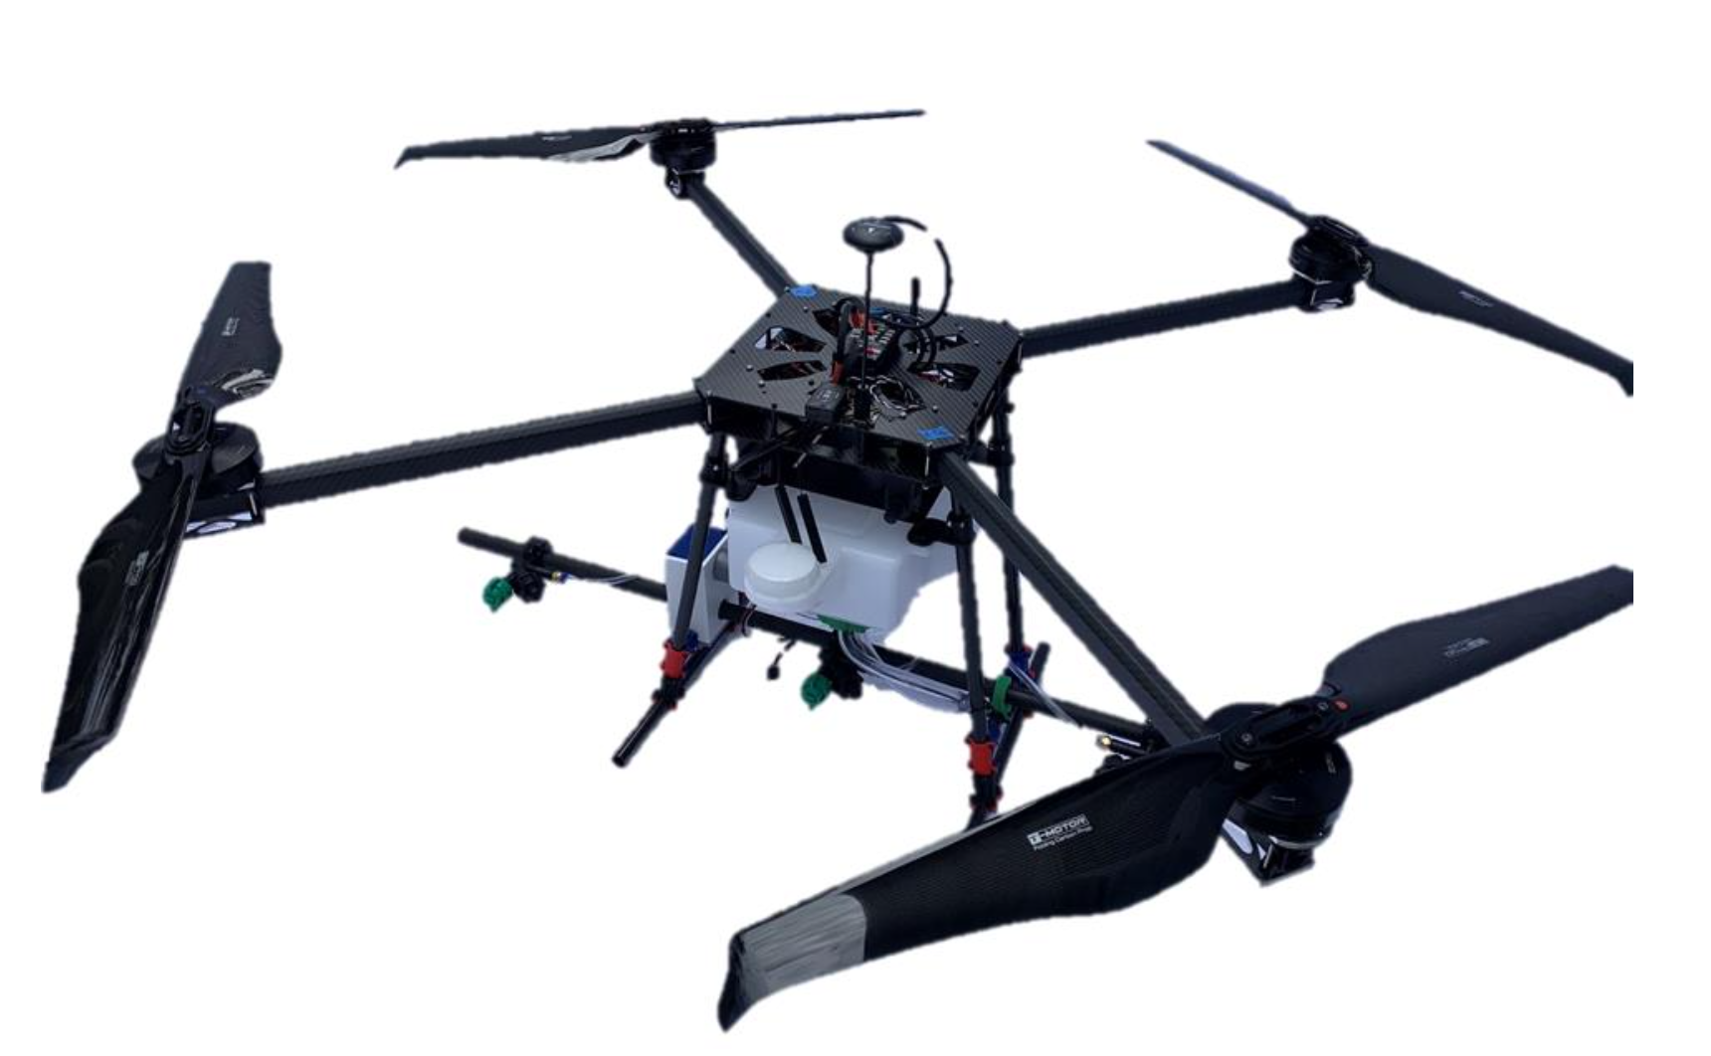
Solution
GPS &
Flight Controller
Custom Chassis
De-Icing Fluid Tank
Rotating spray bar
Pump
2 meter wingspan
Notes:
Razan

Slide 4
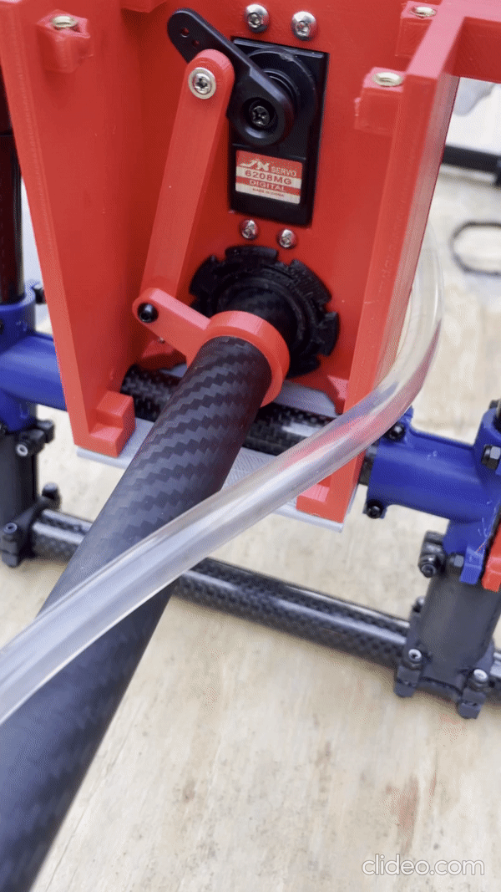
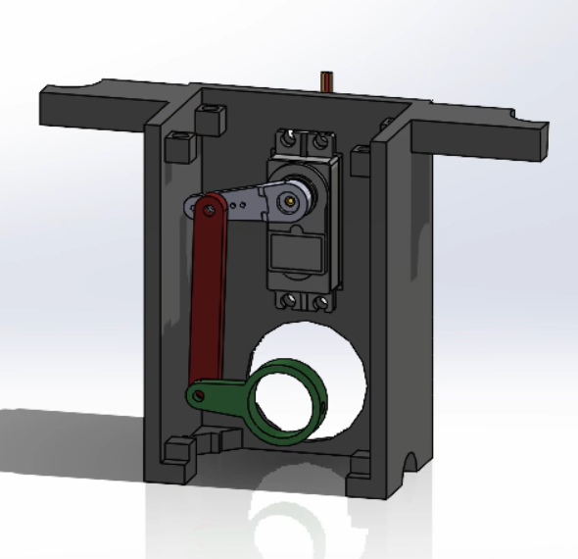
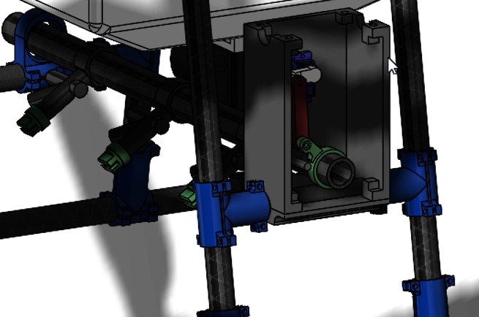
Mechanical Systems
Rocker
Coupler
Crank
Notes:
Razan

Slide 5
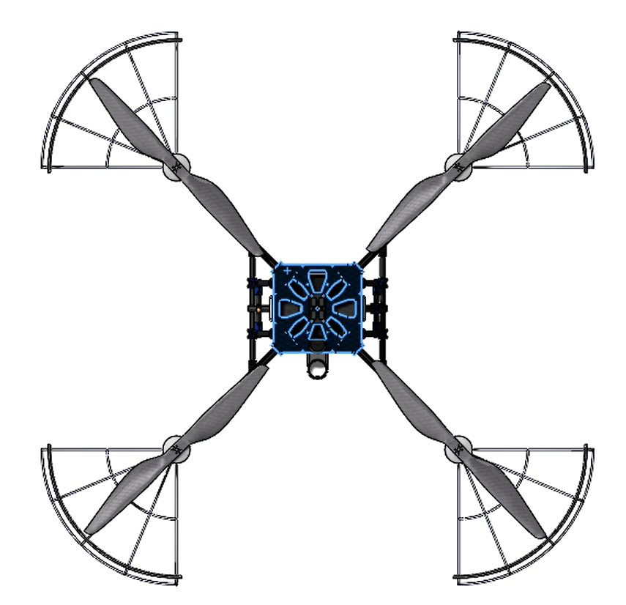
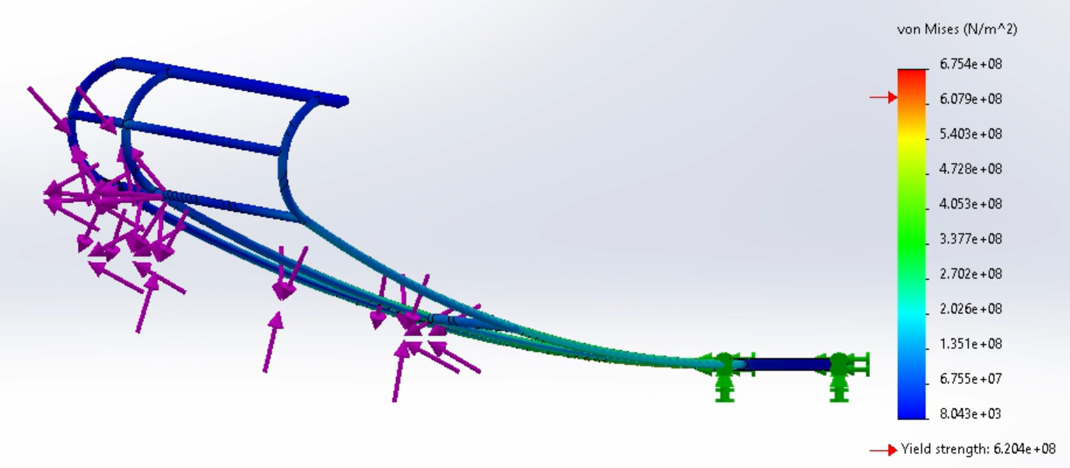
Mechanical Systems
Drone Propeller
Propeller guard
Notes:
Chioma →
Designed ~20-inch radius guards to protect drone’s 28-inch propellers and cars’ windshields in case of a crash
Top-right: Attached to the same base structure as the propellers
Bottom-right: SolidWorks FEA (finite element analysis) with ~70N of force shows minimal deflection on the cage
Future recs: Wire-bending, flexible but high-tensile metal like steel alloy

Slide 6
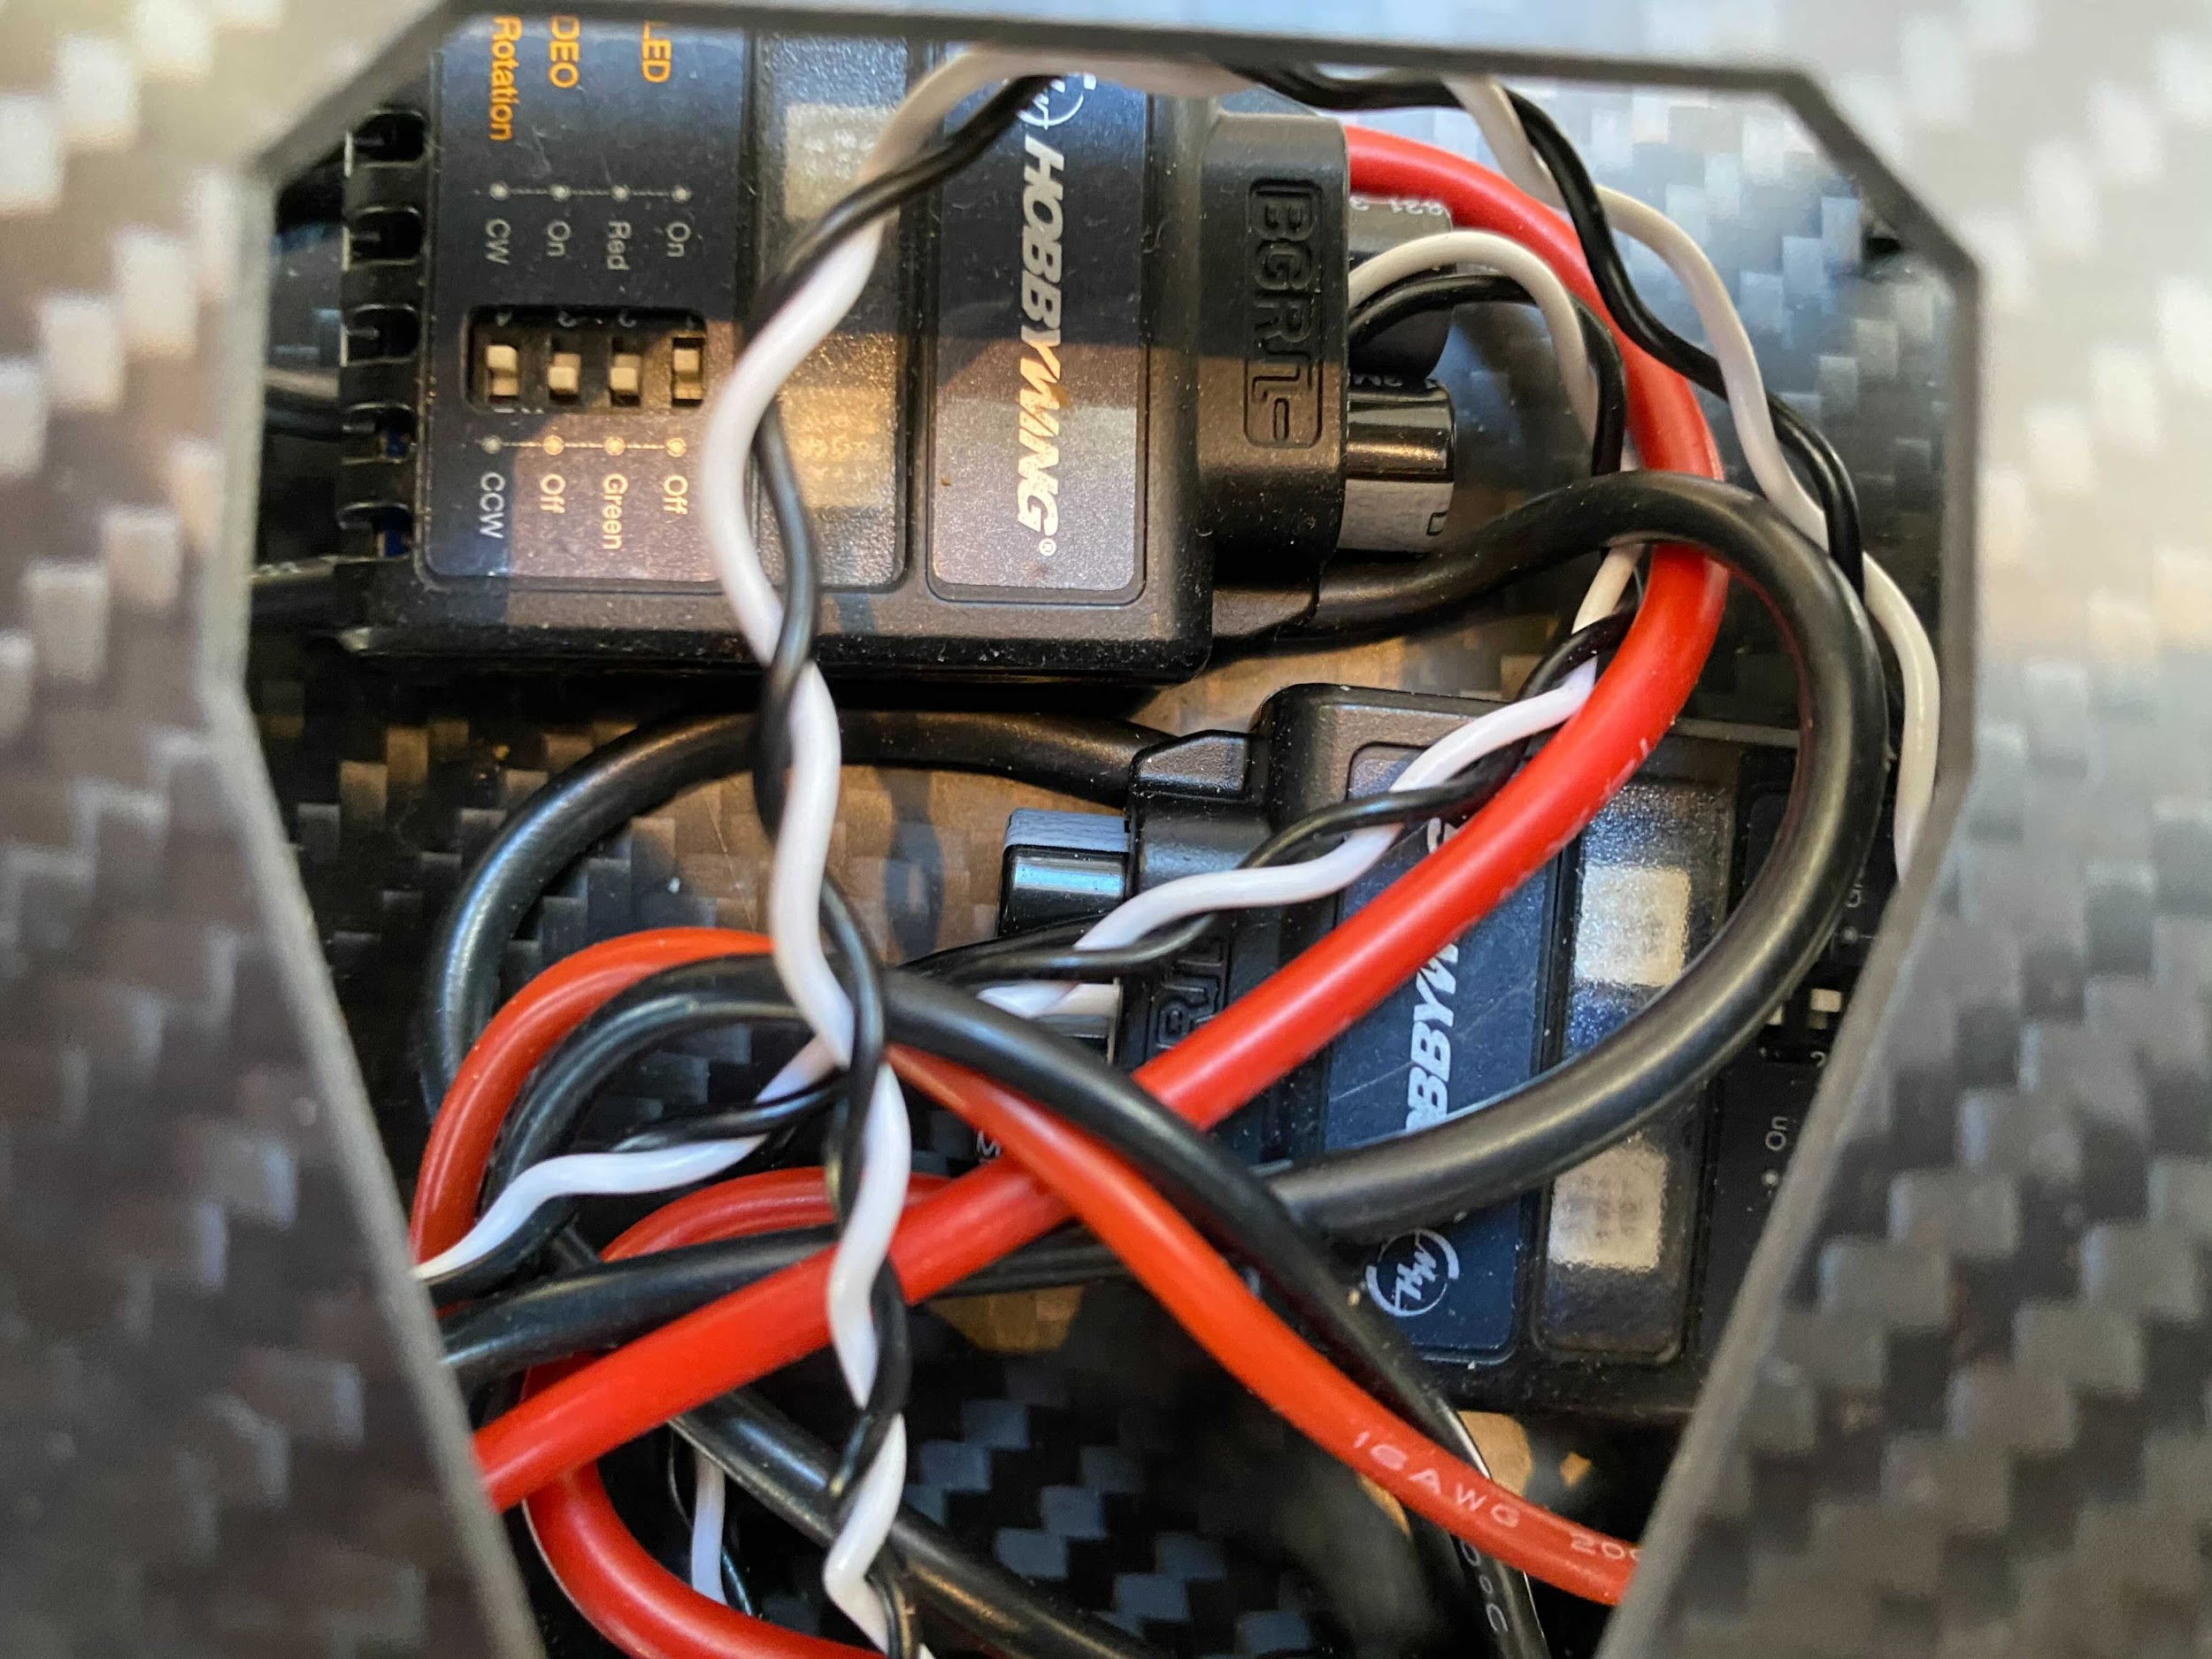
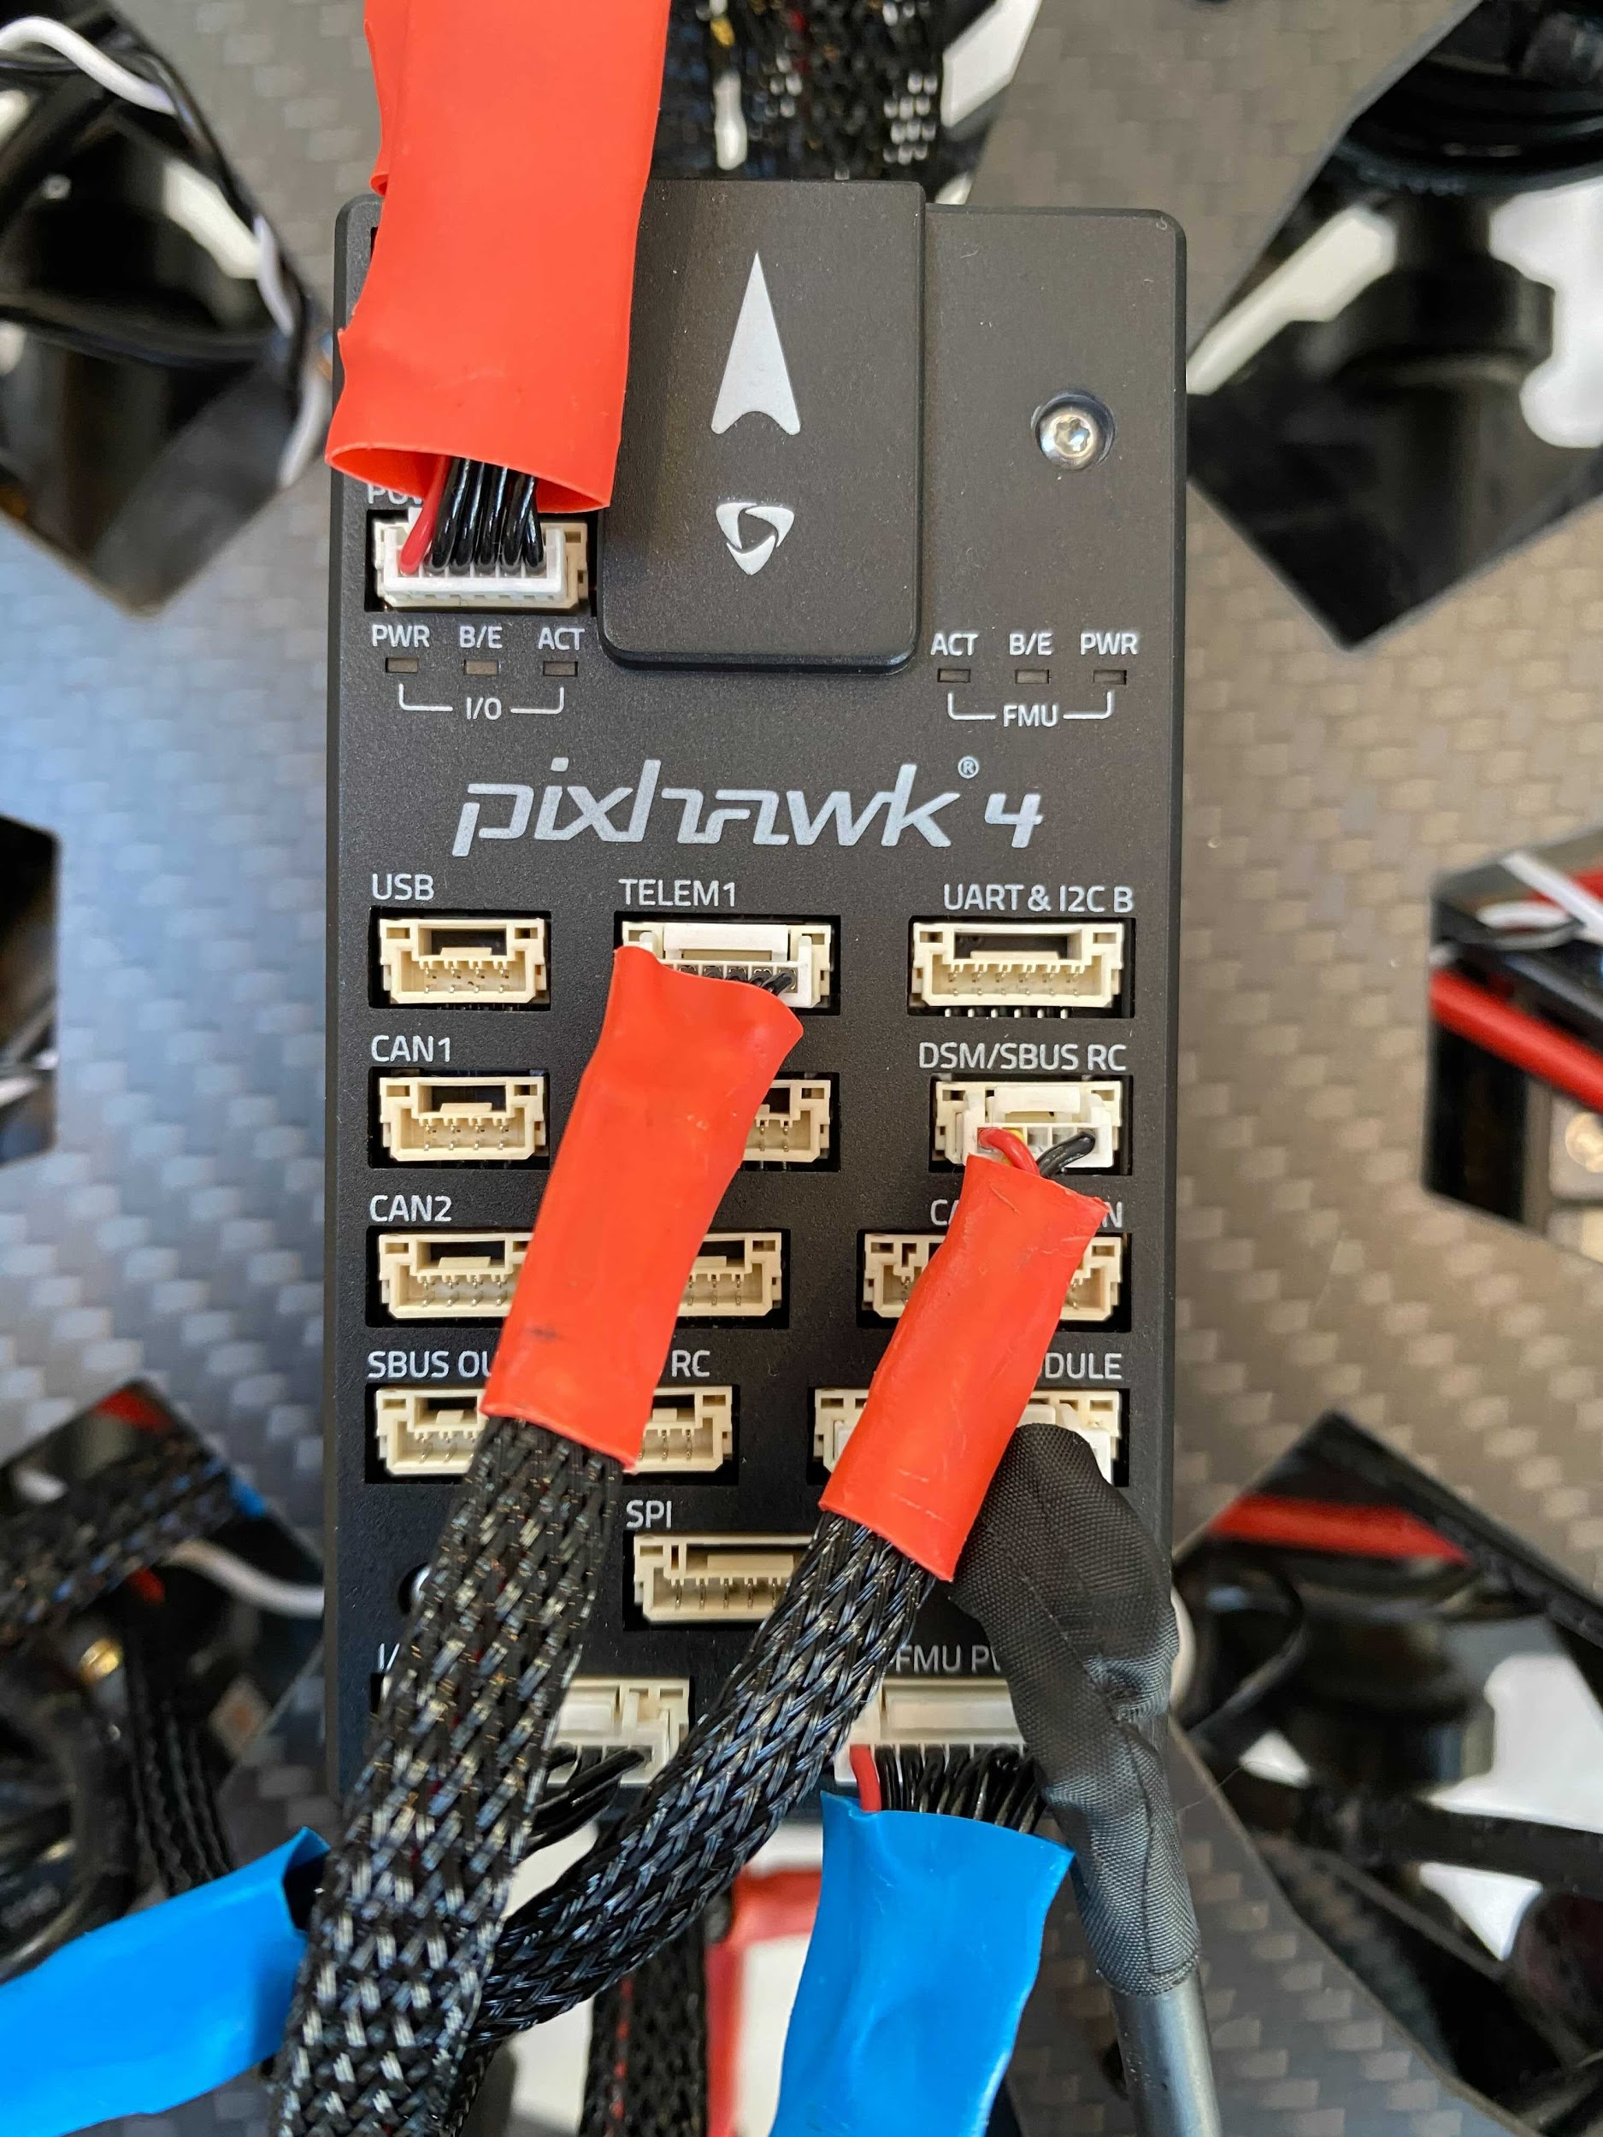
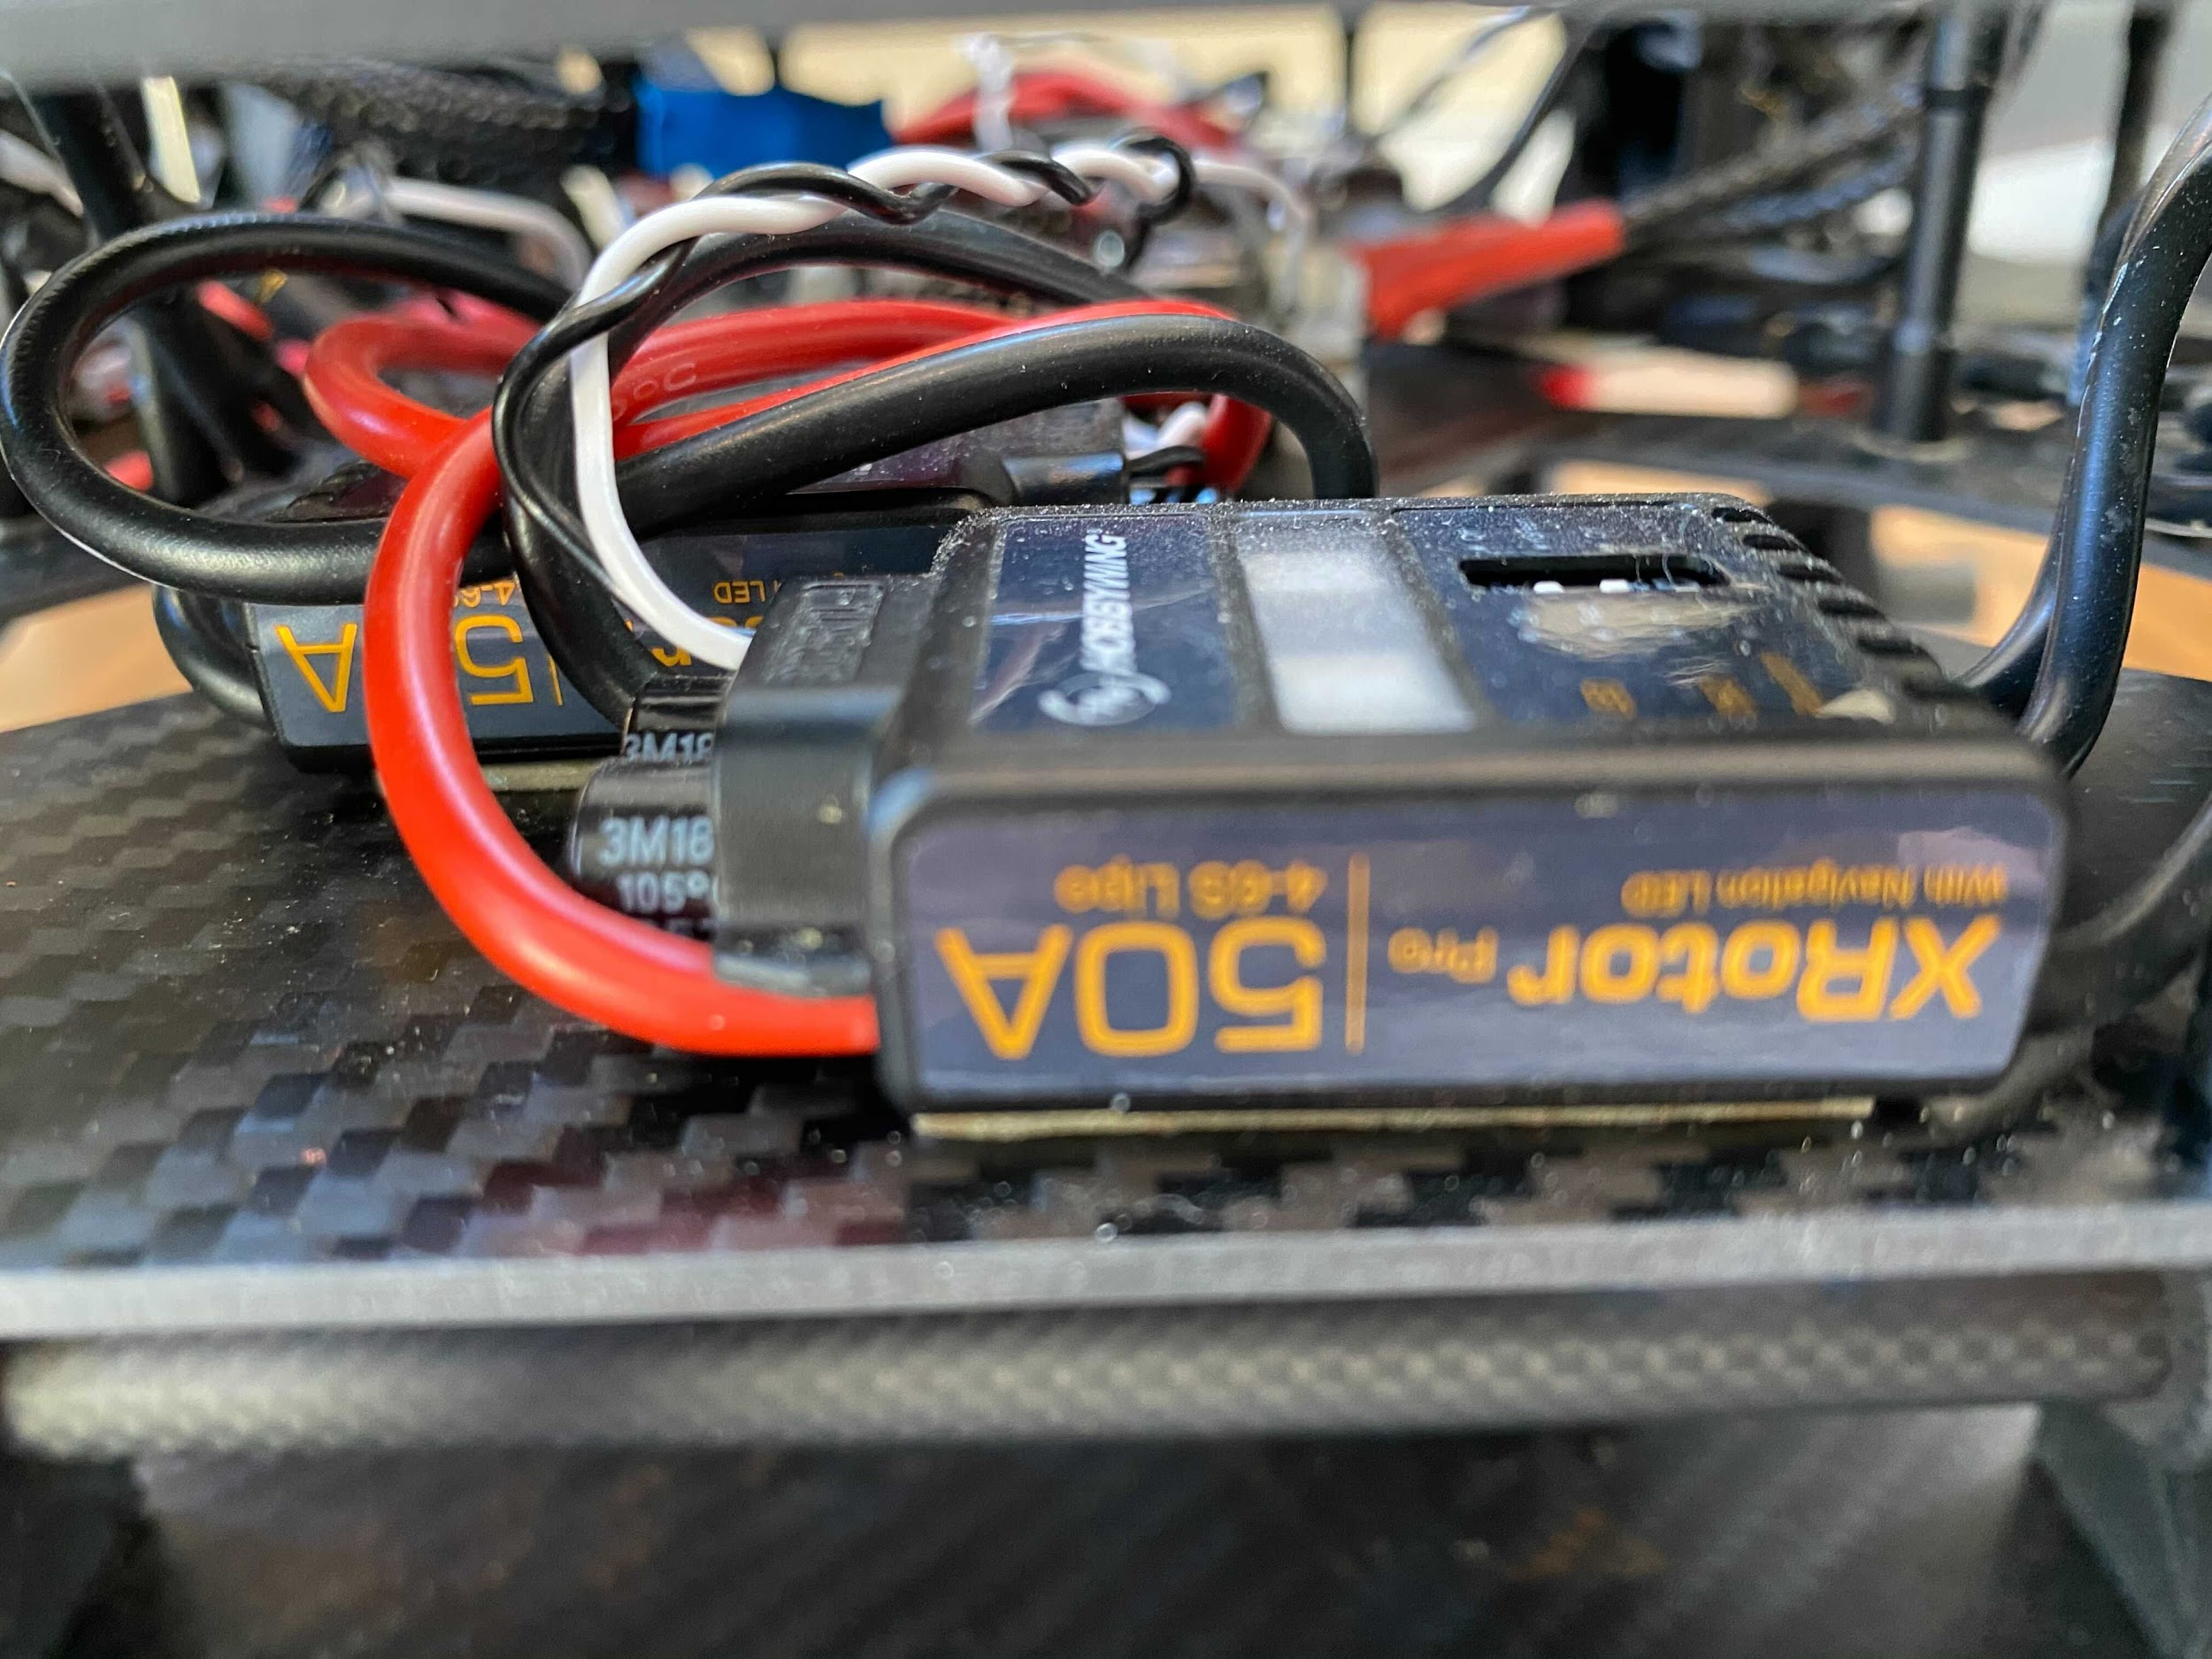
Electrical Systems
Pixhawk 4 Flight Controller
Hobbywing ESCs (5)
Notes:
To the left of the slide we see 5 Hobbywing ESCs; 4 of which control the 4 motors on the drone, and 1 that controls the pump that sprays the deicing fluid. To the right we see the Pixhawk 4 flight controller, which uses a GPS system to allow the drone to hover in-place and achieve semi-autonomous flight.

Slide 7
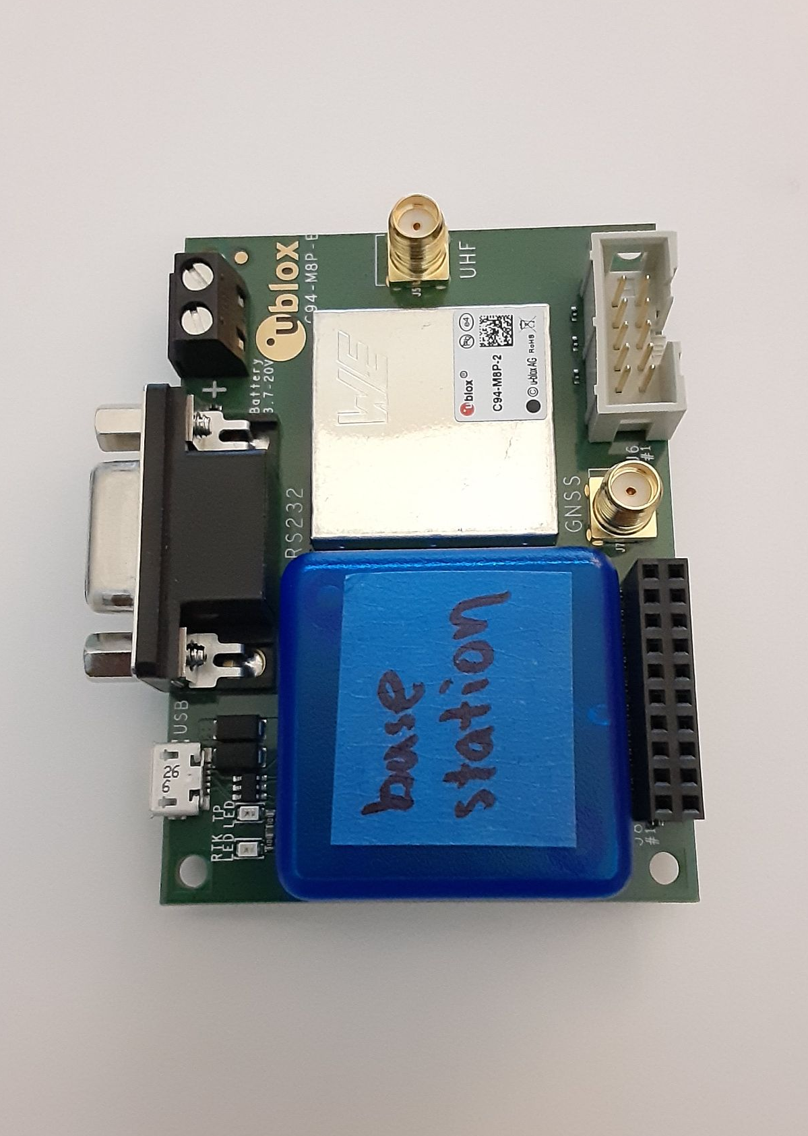
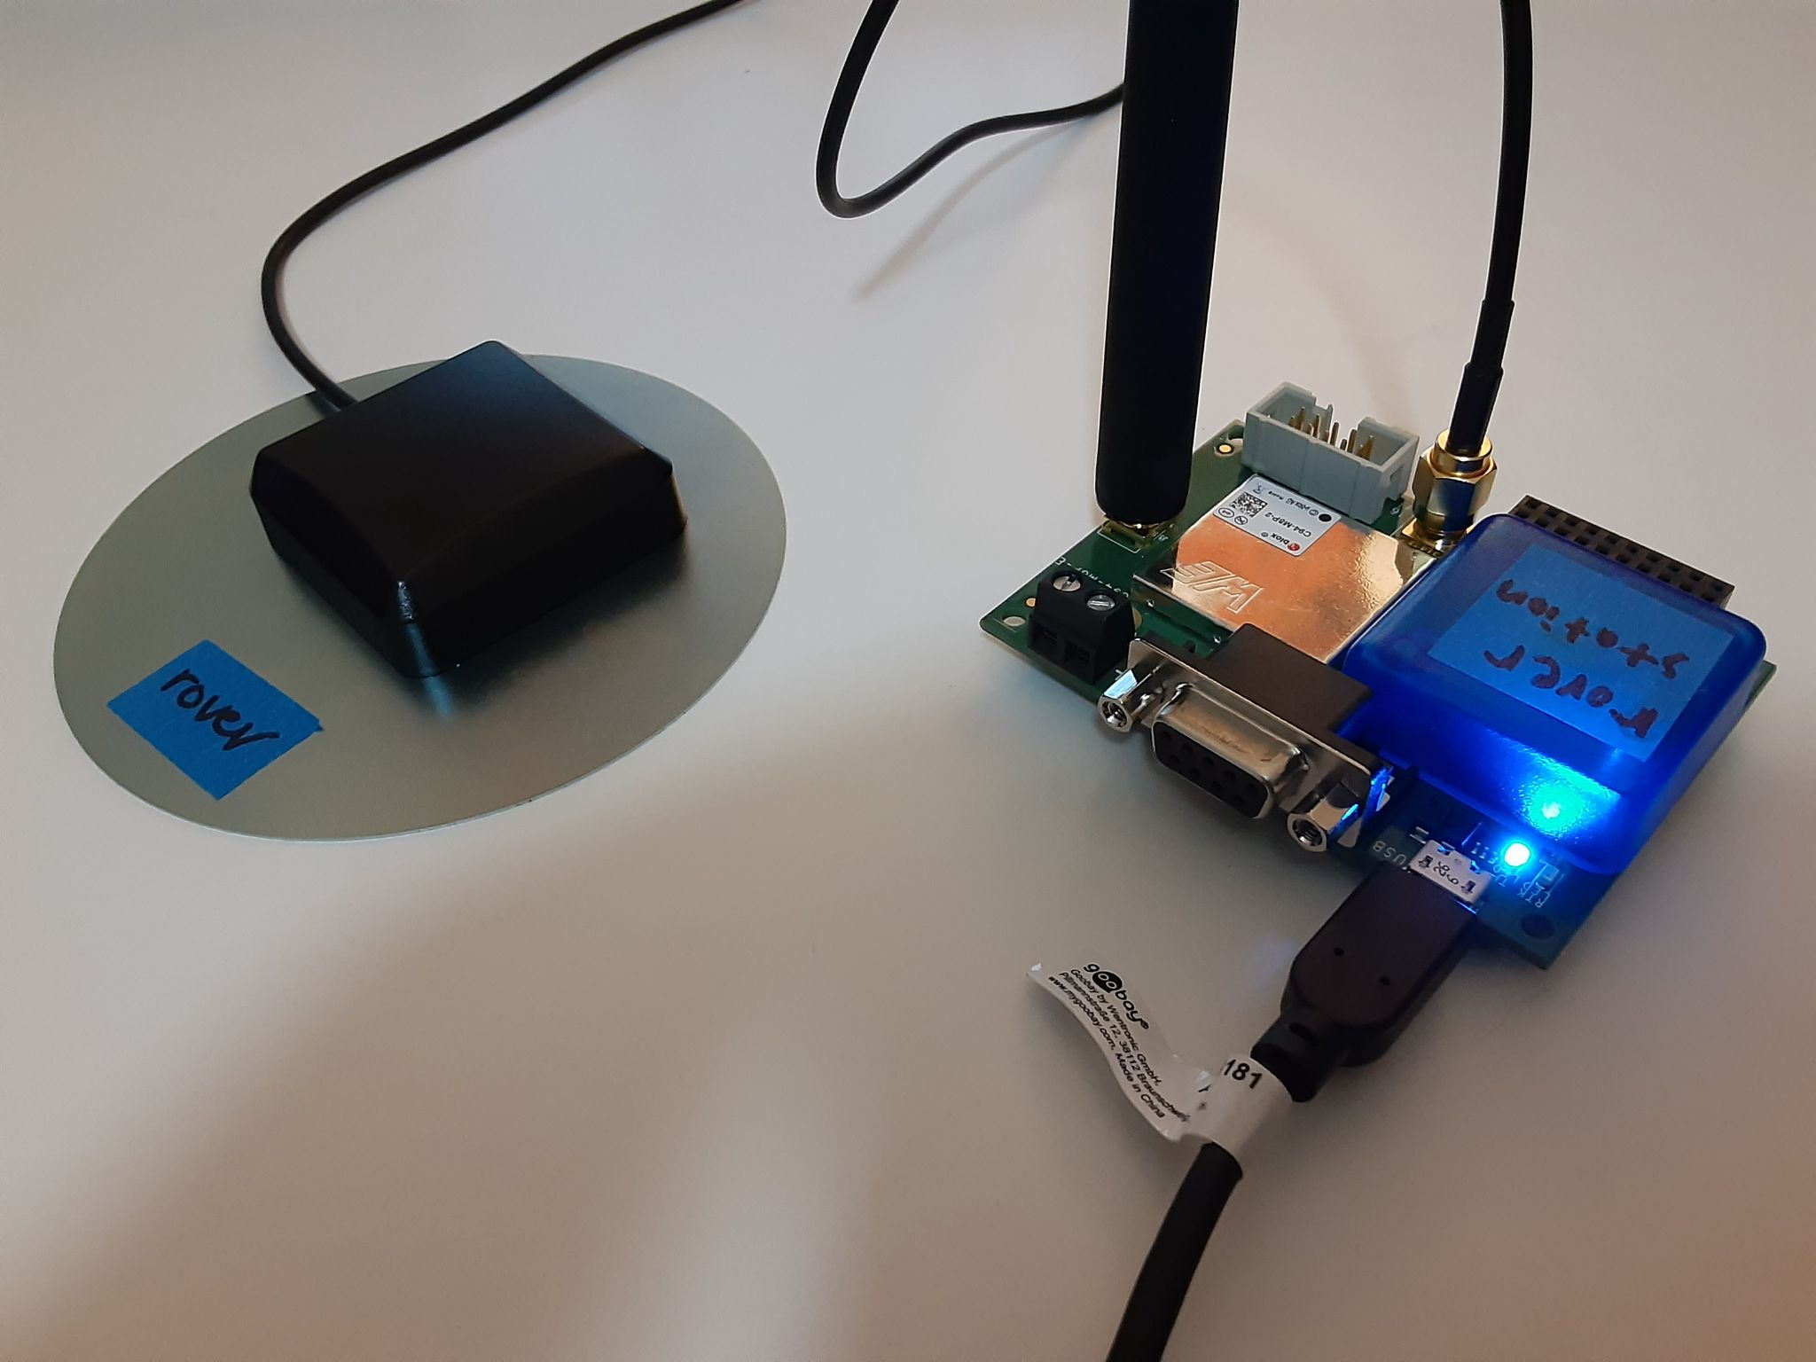
Electrical Systems
USB to micro USB wires (2)
UHF whip antennas (2)
GNSS patch antennas (2)
RTK Setup (rover station)
C94-M8P Boards (2)
C94-M8P Board
Notes:
The RTK system consists of two identical C94-M8P boards, two UHF whip antennas, and two GNSS patch antennas. There are also two USB to micro USB cables that are used to configure the boards using the ublox software on Windows PC.

Slide 8
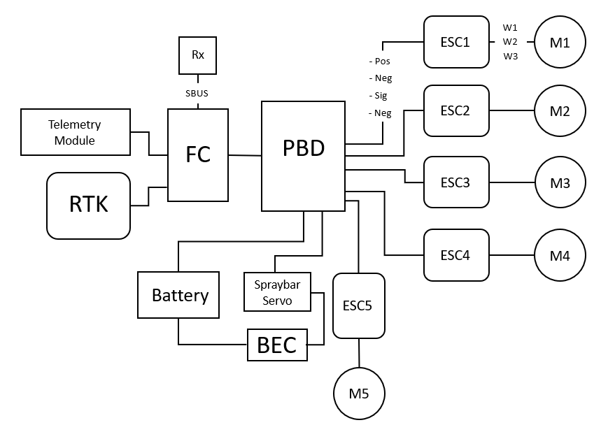
Electrical Systems
Pixhawk 4 Flight Controller
Hobbywing ESCs
C94-M8P
(rover station)
BEC
Battery Eliminator Circuit
Notes:
Here is the drone wiring diagram that shows the different electrical components installed on the drone. To the right are the 5 hobbywing ESCs, in the center is the Pixhawk 4 flight controller, and to the far left is the rover station of the RTK system. At the bottom there is a battery eliminator circuit (BEC) that powers the spraybar, removing the need for a second battery that will add more weight.

Slide 9
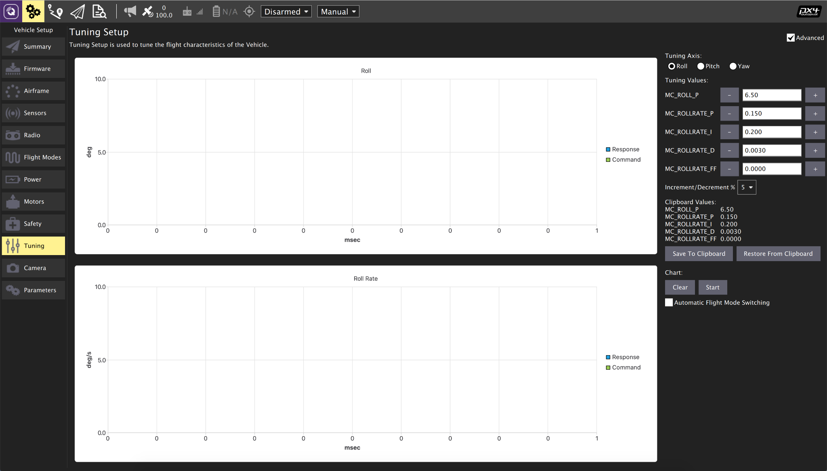
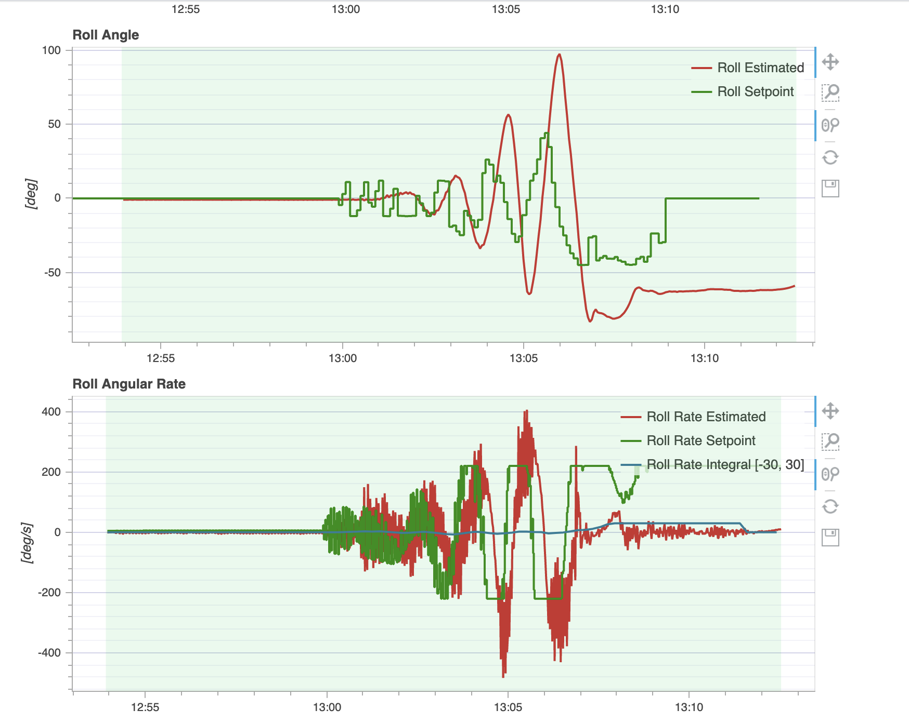
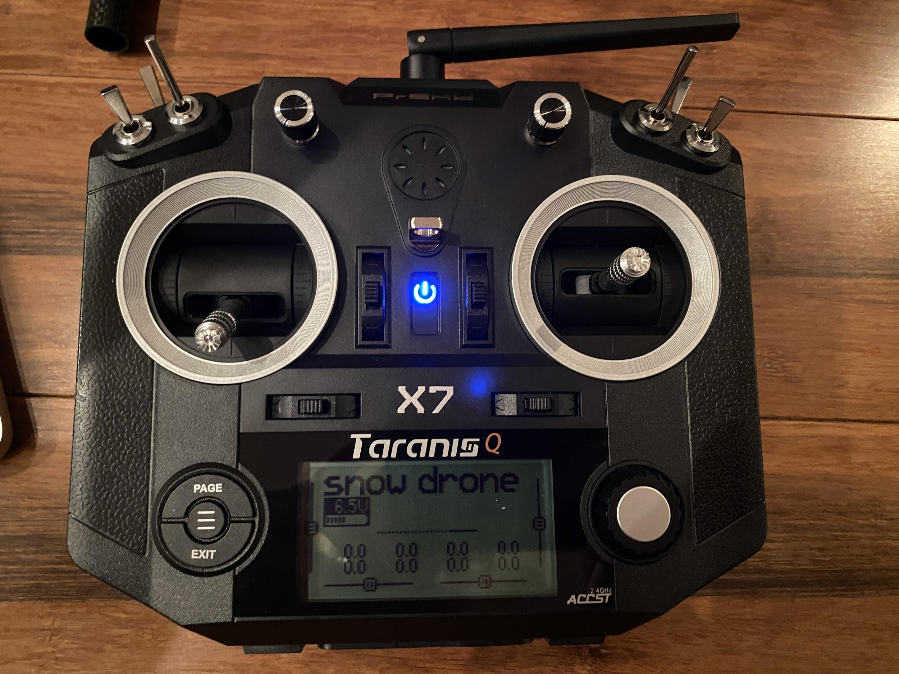
Software Systems
Notes:
For controlling the drone, we used a Taranis QX7 remote controller, QGroundControl as a base station, and a pixhawk 4 as the on board flight controller

Slide 10
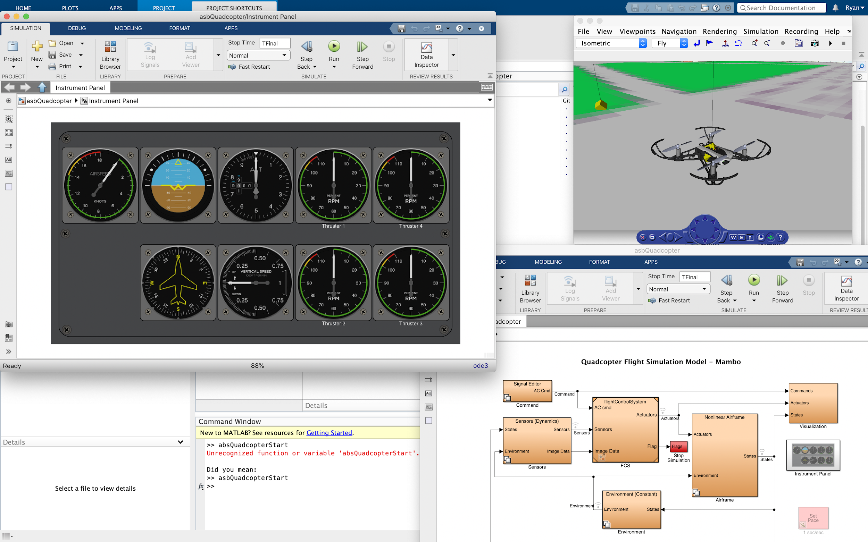
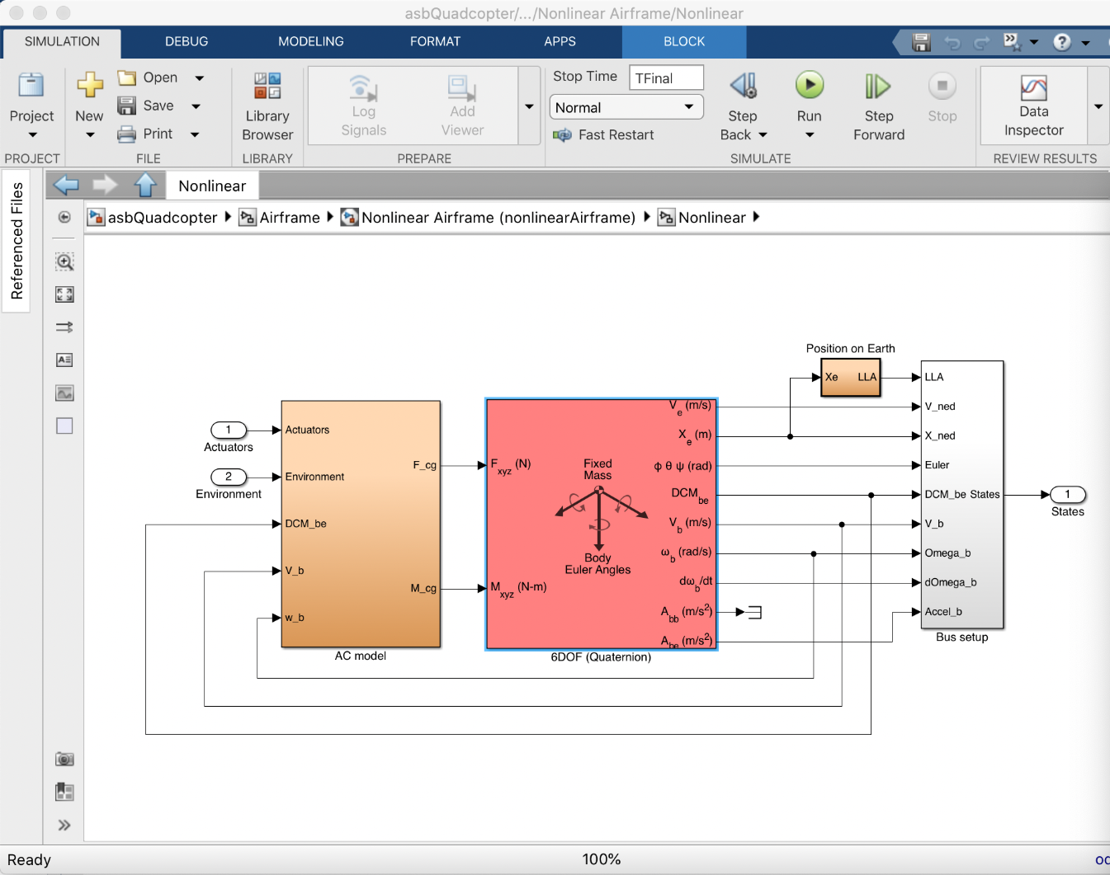
Software Systems
Notes:
While QGroundControl included auto-generated gains, we used MatLab with the aerospace blockset to build a simulation of the drone and its environment. Using this simulation, we attempted to tune the gains for the flight control software. Unfortunately, we were unable to make this model accurate enough to make useful progress, so we elected to rely on the pregenerated gains and manual tuning.

Slide 11
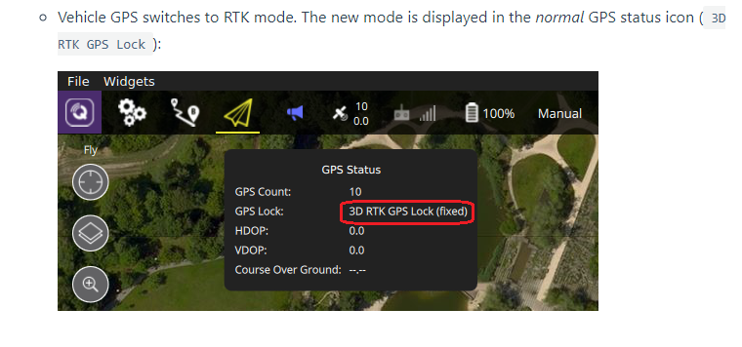
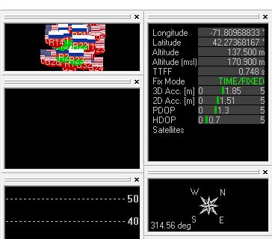
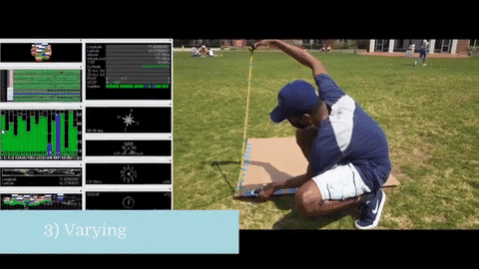
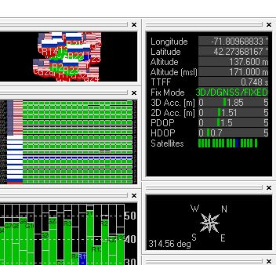
Software Systems
Base Station
Rover Station
Notes:
In addition we are working on integrating a Real Time Kinematics system, or an RTK. An RTK uses relative positioning to get a higher degree of accuracy than a traditional GPS. While it does mean that a base station is required, the improved positioning of the drone is very beneficial for its use around valuable objects.

