Slide 1
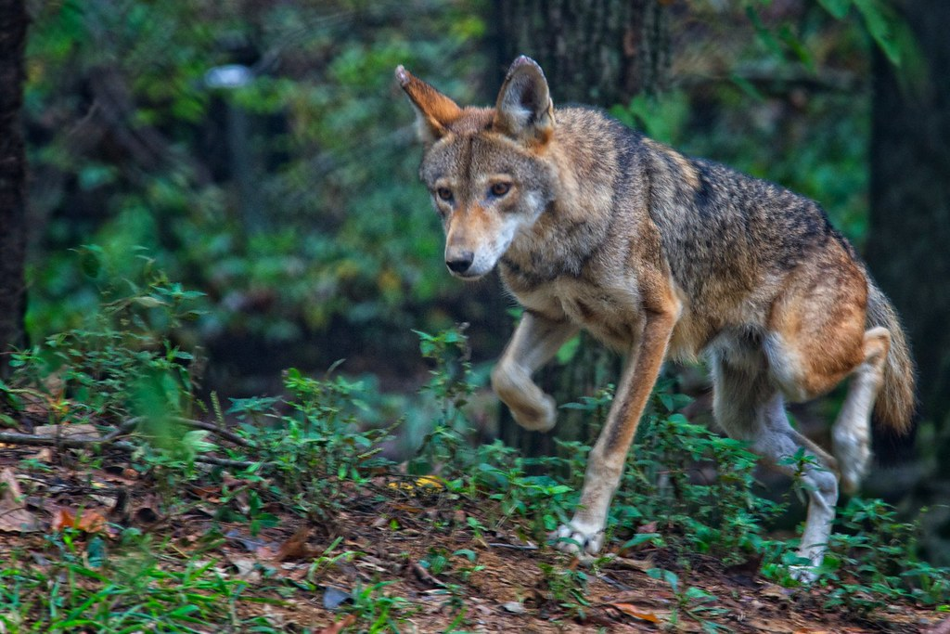
Day 2: The Case of the Red Wolf
"Red Wolf" by Jim Liestman is marked with CC BY-NC-ND 2.0.
What events led to the current state of the red wolf population, and what’s being done to save it?

Slide 2
Case Study Presentations!
For the first portion of class, we will present our restoration case studies
Be sure to:
Keep it 5-10 minutes
Address all questions/topics in the assignment
Speak loud and clear
Ensure all teammates have talking points
Answer any audience questions to the best of your ability!
"Audience microphone at APExpo 2010 022.jpg" by Guillaume Paumier is marked with CC BY-SA 2.0.

Slide 3
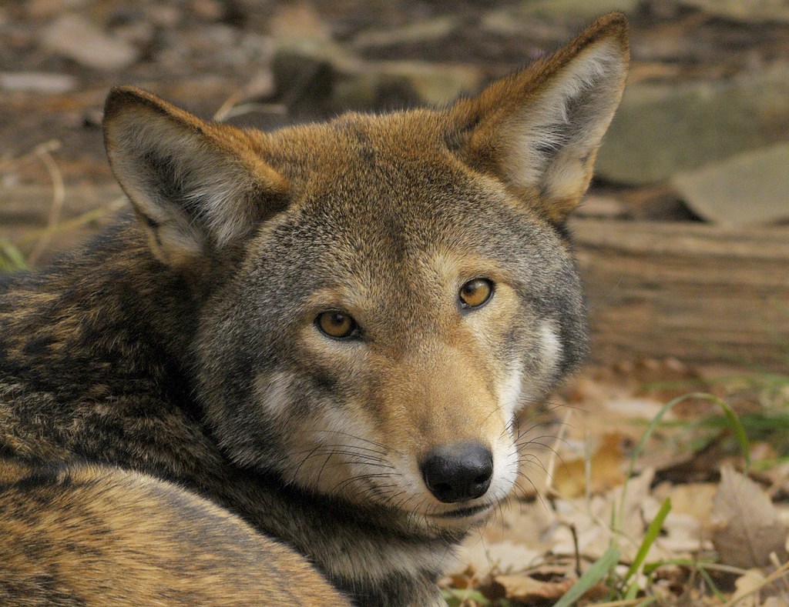
The Red Wolf (canis rufus)
The world’s most endangered wolf
15-17 in the wild
Nonessential experimental population in NC
Brown in color, black along back and tail
Reddish hue on legs, ears, & head
Slender legs & big feet
Wider head & pointed ears
Ranges 45-80 lbs
Between the size of a coyote and grey wolf
~26in tall & 4ft long (nose to tail)
"Red Wolf" by ucumari photography is marked with CC BY-NC-ND 2.0.

Slide 4
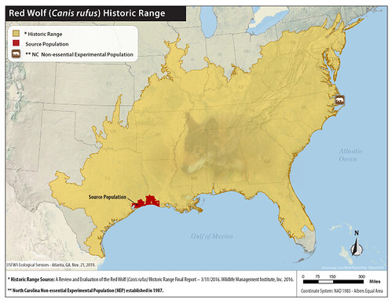
Diet & Habitat Requirements
Originally only in southeastern TX & southwestern LA
Coastal prairie/marsh habitat
Any habitat with suitable food, water, & shelter is acceptable
This ranges from TX to PA
Red wolves need ~20-80 sq mi of habitat space
Diet consists of white-tailed deer, raccoons, & small mammals
Can eat up to 2-5lbs daily
Can travel up to 20mi daily in search of food
"Red wolf historic range map" by USFWS/Southeast is marked with CC BY 2.0.

Slide 5
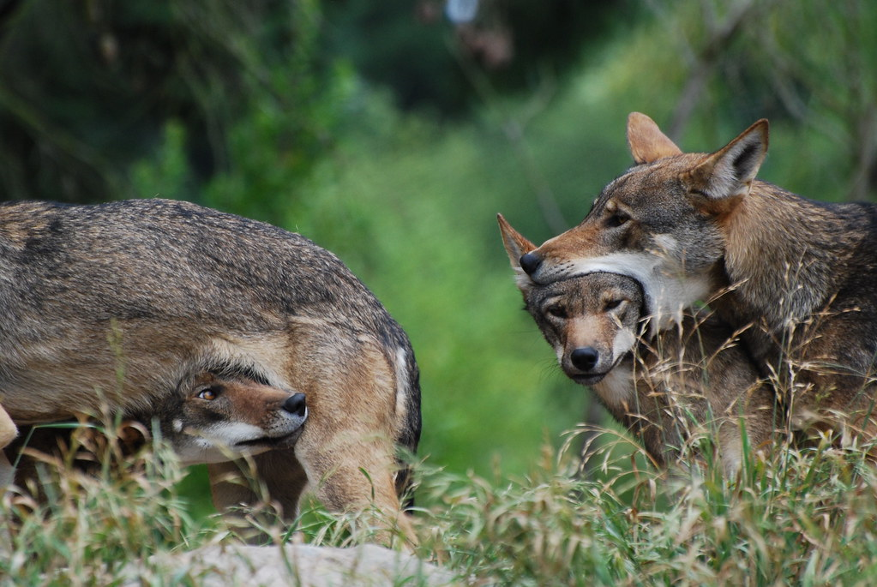
Behavior & Social Life
Social, close-knit packs
5-8 individuals
Breeding pair, offspring from different generations
Older offspring aid in caring for the pups
Wolves between ages 1-2 will leave and form their own pack
Packs occupy specific territories & will defend it from other wolves
Active at dusk & dawn
Avoid human activity
"Red Wolf Pups!" by OnceAndFutureLaura is marked with CC BY-NC-SA 2.0.

Slide 6
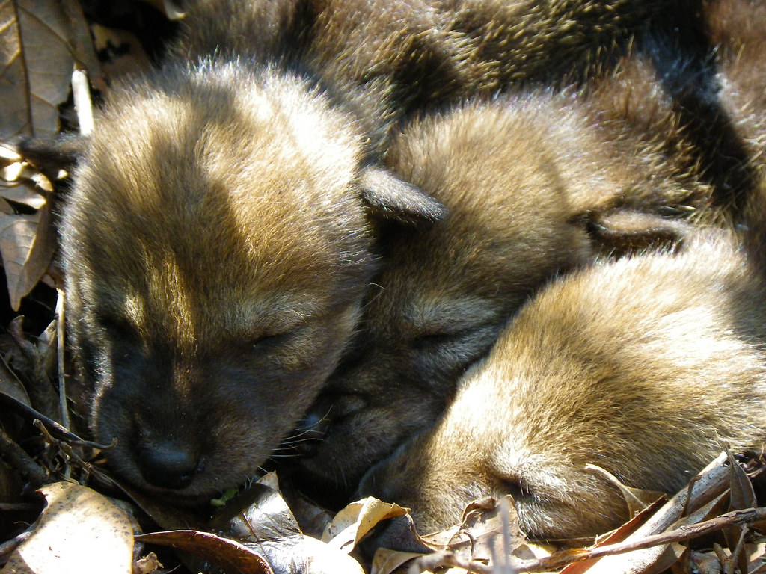
Reproduction
Pair-bonds for life
Mate once a year (Feb)
Pups born in Apr-May
Well-hidden dens
Stream banks, sand knolls, hollow trees…
Less than half survive to adulthood
Influenced by predation, malnutrition, & disease
"red wolf pups" by USFWS Headquarters is marked with CC PDM 1.0.

Slide 7
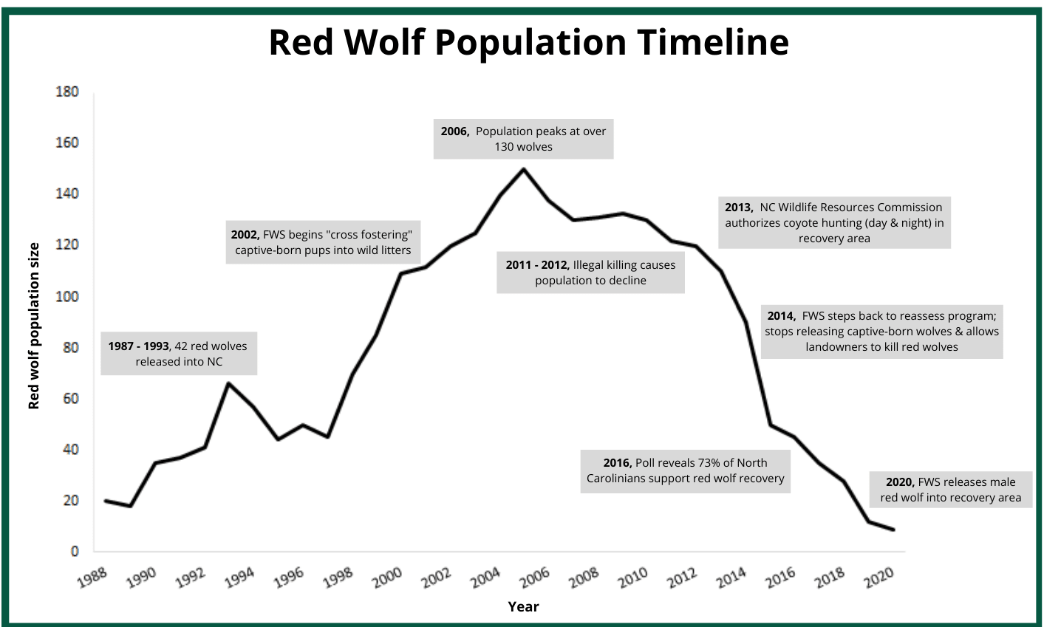
Current Status & Trends
1967: first labeled “threatened with extinction” under ESPA of 1966
Currently endangered under ESA 1973
As of October 2021 there are…
15-17 in the wild
241 in captivity
Population still on the decline
Red wolf population trend from 1988-2020. Data sourced from Hinton et al, 2016, Red Wolf Species Status Assessment 2018, USFWS

Slide 8
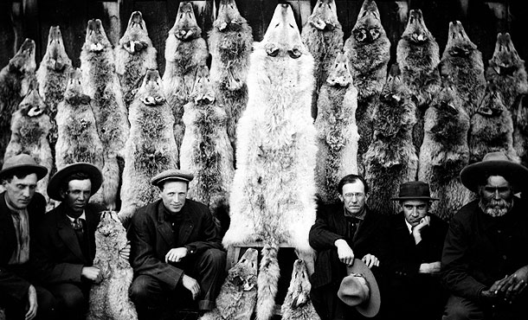
History of Wolves in the US: Mass Eradication Program
Wolves targeted livestock of European settlers
Sparked hatred towards the species
Physical violence and negative folklore continued this narrative
Private landowners and farmers begin baiting & trapping
Began as sport, grew into profession
Cattle ranchers would often turn to professional “wolfers” and bounty hunters
Ranchers & government agencies began eradication program that lasted as late as 1965
Wolves were shot, poisoned, dug from dens, hunted with dogs…
Bounty was around $20-$50 a wolf
Mid-20th century: government-sponsored eradication programs wiped out nearly all wolves
20th century wolf hunters. Available at: https://www.pbs.org/wnet/nature/the-wolf-that-changed-america-wolf-wars-americas-campaign-to-eradicate-the-wolf/4312/

Slide 9
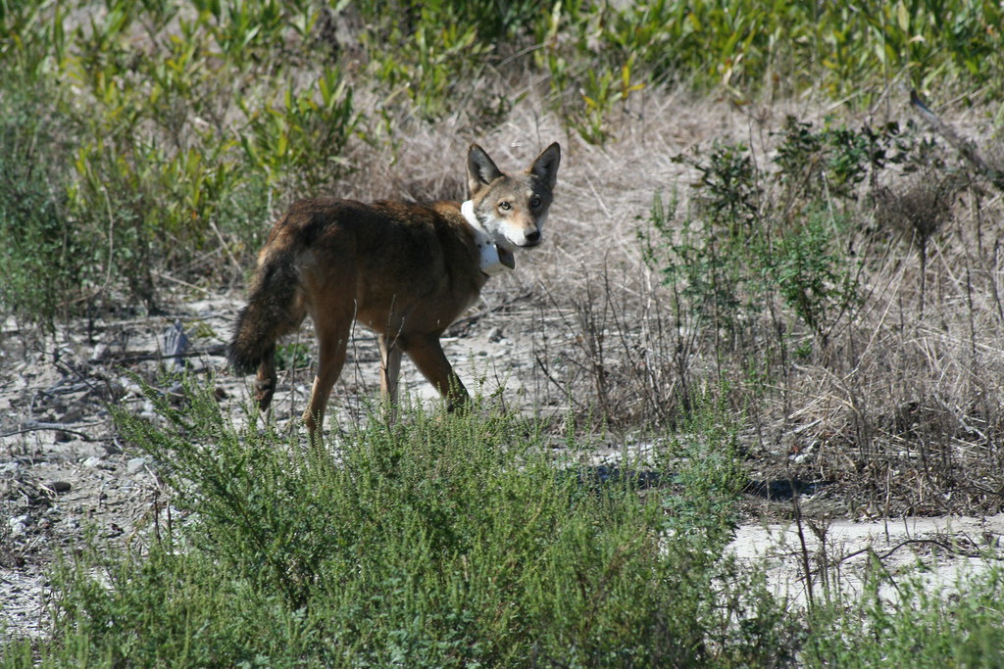
What’s Threatening the Red Wolves?
Initial populations were decimated by:
20th century predator control programs
Habitat loss
Logging, mineral exploration, drainage projects, road development…
Now, their main troubles are:
Human-induced mortality
Car crashes, hunting, mistaken for coyotes…
Hybridization with coyotes
Wolf population is so small & experiences inbreeding avoidance
"Endangered red wolf" by USFWS/Southeast is marked with CC BY 2.0.

Slide 10
Class Activity: Analysis of Red Wolf Inbreeding Data
Read the introduction and methods of the inbreeding case study in red wolves
Work with a partner to answer the short questions on the day 2 class activity worksheet

Slide 11
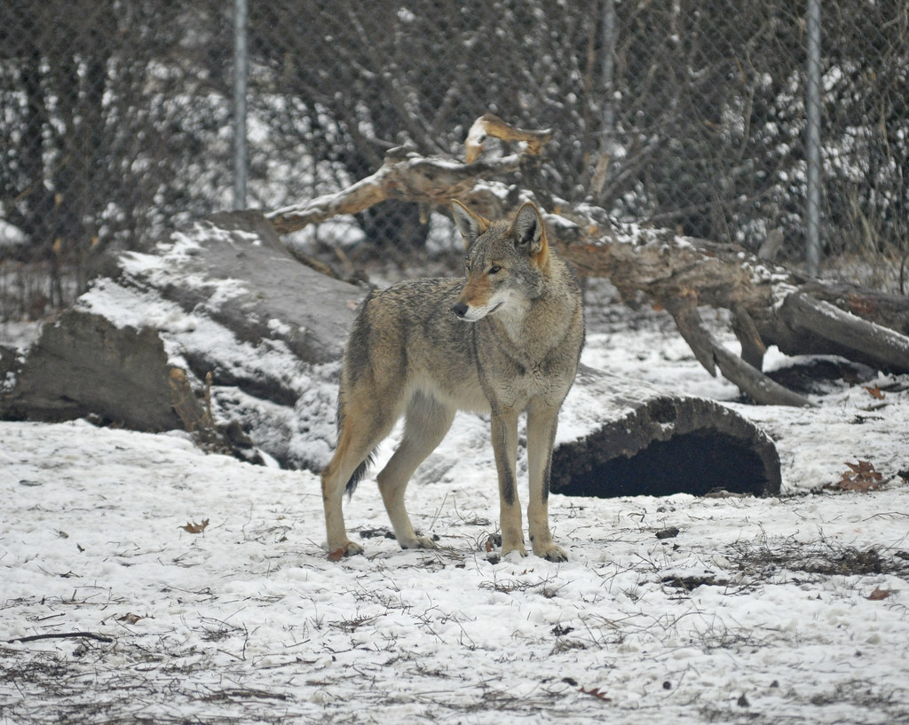
Captive Breeding
Red wolves granted protection under ESA in 1967
Fish & Wildlife Service (FWS) biologists took in all pure, wild red wolves (17)
1980: declared extinct in the wild
FWS & Point Defiance Zoo and Aquarium established a captive breeding program in the early 70s with just 14 wolves
First litters produced in 1977, added to Red Wolf Species Survival Plan (SSP) population
Human contact minimized: promotes avoidance behavior & supports healthy pack structure
Follow genetic management objectives to maintain health & diversity
1987: NC NEP established, 60+ individuals released into it from 1987-1994
Wolves released based on genetic makeup, reproductive performance/fitness, and physical & behavioral adequacy
"Red Wolf (Canis rufus)" by warriorwoman531 is marked with CC BY-ND 2.0.

Slide 12
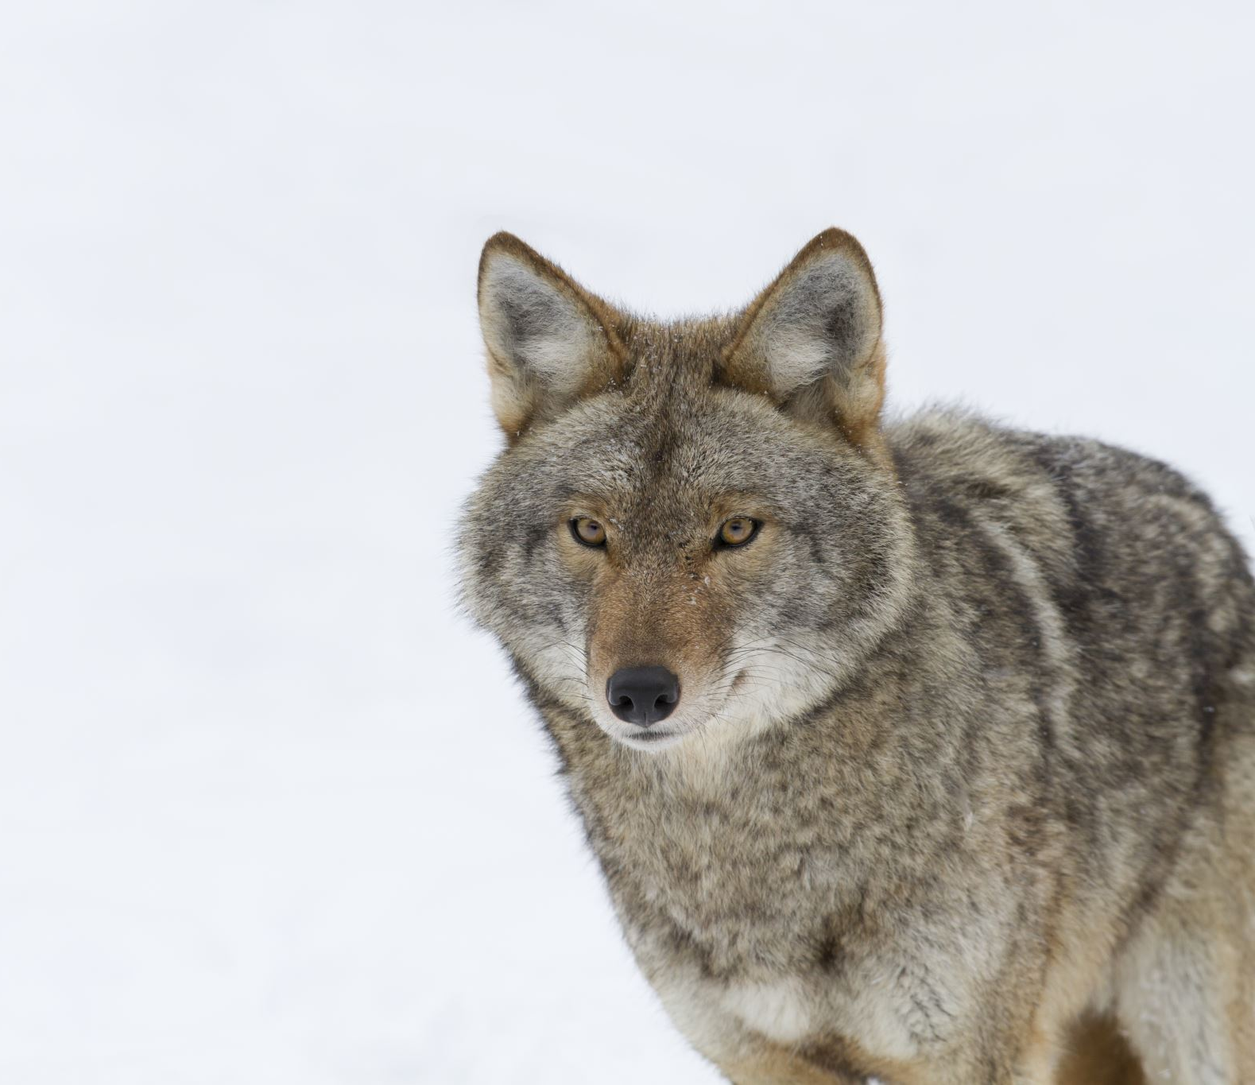
Successful Program Serves as Model
Mid 90’s: red wolves establish successful packs, breed with one another, and occupy territories in NC
Peak of 120 individuals reached in 2012
This was the first time in the U.S. a large carnivore was titled extinct in the wild & reintroduced
Influenced the recovery programs of several other species
Gray wolf in Yellowstone, black-footed ferrets, California condors…
Innovative restoration tactics successful
Pup fostering, coyote sterilization

Slide 13
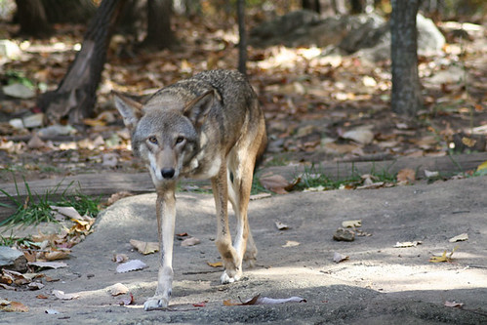
Efforts Dismantled
Political barriers & USFWS program mismanagement
2014: USFWS stopped introducing captive-bred wolves into the wild
Halted use of Red Wolf Adaptive Management Plan
Included limiting coyote hybridization
Issued kill permits to private landowners
2020: Southern Environmental Law Center (SELC) sued USFWS violating ESA
2021: Judge Terrence Boyle (U.S. District Court) ruled USFWS needs a plan by March 1, 2021 to resume red wolf restoration
2022: New SSP committee in place, plans still in progress…
Aim to collaborate more with private landowners
"red wolf" by mingos is marked with CC BY-NC 2.0.

Slide 14
What Should be Done to Help?

Slide 15
Final Project: Policy Brief
Restoration efforts for the red wolf have recently been dismantled and loosened, resulting in the sharp decline of restored wolf numbers.
Your task is to research deeper into the previous and current restoration efforts for the red wolf, as well as other case studies of mammal restoration
Write a policy brief (~2-3 pages minimum) explaining the situation, incorporating peer-reviewed sources, and offering recommendations for the best course of action in revamping the red wolf restoration program
The restoration of the red wolf was once successful, it can happen again!

Slide 16
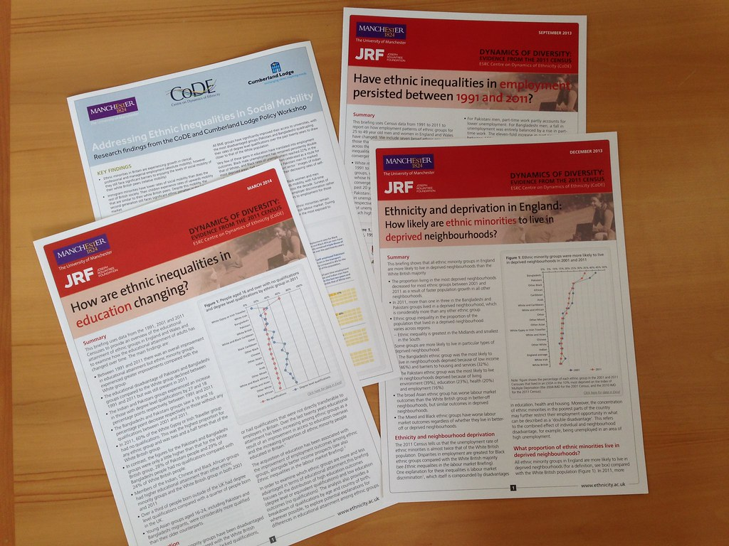
What Does a Good Policy Brief Look Like?
Overarching theme
Complimenting color scheme, consistent fonts
Various visuals
Images, graphs…
Well-researched sections
In-text citations, figures referenced
Good layout and flow
Order of paragraphs makes sense, content fills space
Descriptive headings and title
Titles tell reader exactly what they should expect to read
"Papers by Centre on Dynamics of Ethnicity" by Office for National Statistics is marked with CC BY 2.0.

Slide 17
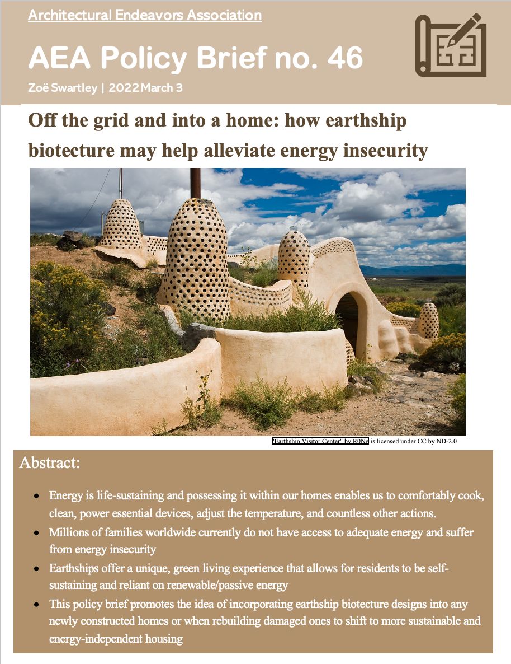
Example:

