Slide 1
An Experimental Doppler Study of a Table-Top Galactic Model
By: Robert Lowry and Caleb Teske

Slide 2
Project Outline
Introduction
Summary of Previous Project
Motivation for Continuing Project/Problem Statement
Design & Construction of Doppler Machine
Spinning Arm Improvements
Motor Mount/Housing Improvements
Angular Velocity Test Results Using Logger Pro Software
Motor Stand/Base Improvements
Background
General Doppler Effect
Doppler Effect for Uniform Circular Motion
Doppler Effect for Tilted Platform in Uniform Circular Motion
Testing/Results
Experimental Procedure
Spectrum Lab Results
Conclusions
Recommendations for Future Project Groups

Slide 3
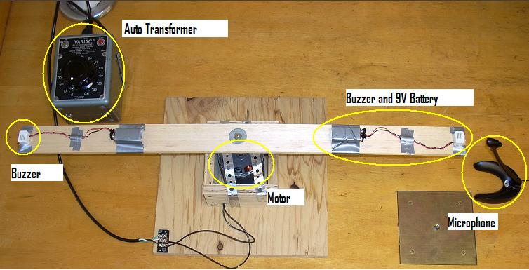
Summary of Previous Project
Doppler Machine conceived by IQP group in 2008 and described in 2009 report entitled: Ongoing Advancement of the Physics Toolbox
Equipment Used for Doppler Experiment Until C-Term 2009

Slide 4
Motivation for Continuing Project
This project was recognized as having potential for improvement and application in future undergraduate freshmen lab experiments
To gain a deeper understanding of the meaning of the sound spectrum as observed in Spectrum Lab
Derive our own equations (which include the angle of tilt) to model the new Doppler device
Hands-On aspect of Doppler experiment with redesigned machine allows all students to learn about the Doppler effect in a new and exciting way

Slide 5
Problem Statement/Goals
Problem Statement
While the prototype Doppler machine is an excellent starting point, in order to create a repeatable lab experiment, a new version of the Doppler device needed to be created and new data collected
Goals
To understand the observed sound spectrum
Eliminate vibration in the machine that is caused by the motor and the spinning arm, and eliminate ambient noise in the observed sound spectrum
Improve overall design of device and results to advance this project towards being ready for use in a laboratory setting

Slide 6
Spinning Arm Improvements
Light-weight Balsa wood with tapered edges
Dual buzzer mounts which can be moved to various distances along the length of the arm
Higher quality buzzers that produce a single frequency
High quality hardware that improves balance
Emergency release set-screw

Slide 7
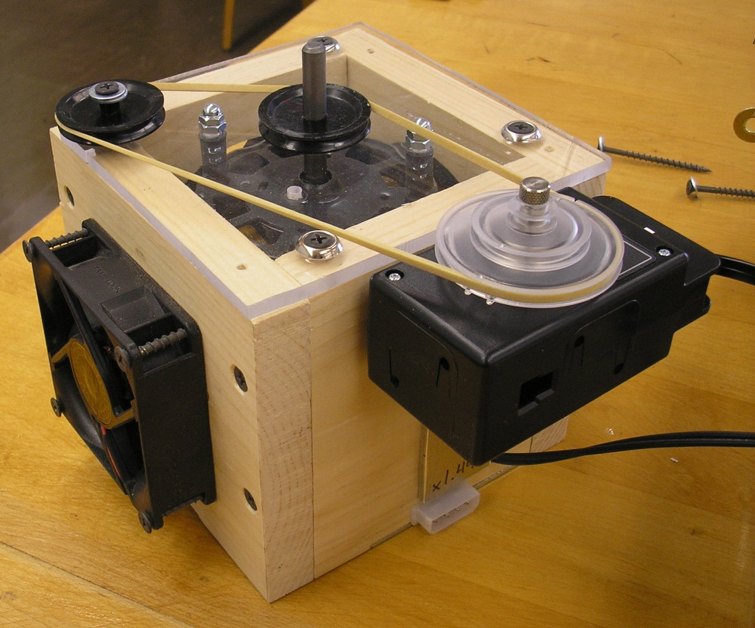
Motor Mount/Housing Improvements
Redesigned with thick pine walls and plexiglass top
Rubber vibration isolation pads underneath motor and connecting motor screws to motor housing
Three large computer fans to aide in cooling
Vernier LabPro attached to housing which can be used measure angular velocity

Slide 8
Logger Pro Results
Vernier LabPro was used to measure angular velocity for various buzzer positions (results below)
Step-by-step Logger Pro tutorial included in report

Slide 9
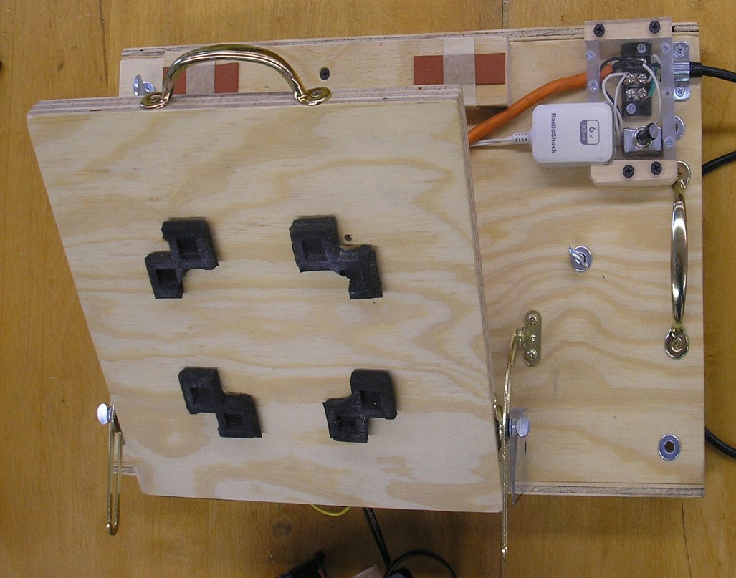
Motor Stand/Base Improvements
Thicker plywood
Convenient On/Off Switch
Hinged platform that rotates to 90 degrees with built-in protractor
Durable metal handles for carrying and tilting
Metal rails that allow machine to slide easily on to a lab pedestal
Thumb screws for tightening the machine to the lab pedestals
Rubber vibration isolation pads to reduce vibration from motor and arm

Slide 10
Before and After Photos
Old Machine
New Machine

Slide 11
The Doppler Effect
Generalized Doppler Equation in 2-D: the observed
frequency f is related to the emitted frequency of the source f₀
by the equation
where ν is the velocity of waves in the medium,
ν_{r} is the velocity of the source relative to the medium and
ν_{s} is the velocity of the receiver relative to the medium
In the case of a stationary observer (or microphone), the equation reduces to
where ν_{s} is positive if the source is moving away from the observer, and negative when
moving towards the observer
These equations assume that the source is directly approaching
or receding from the observer.

Slide 12
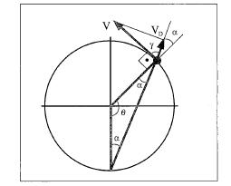
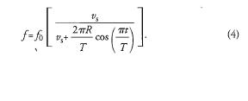
Doppler Equation for Uniform Circular Motion
Geometry Used to Calculate Approaching/Receding Speeds
***Derivation and Image Taken from The Doppler Effect of a Sound Source Moving in a Circle by Marcelo M.F. Saba and Rafael Antonio da S. Rosa***

Slide 13
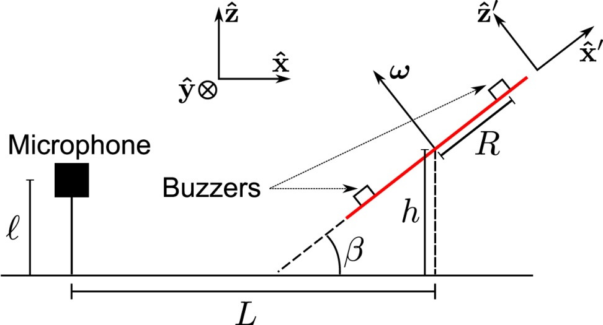
Doppler Equation for Tilted Platform in Uniform Circular Motion

Slide 14
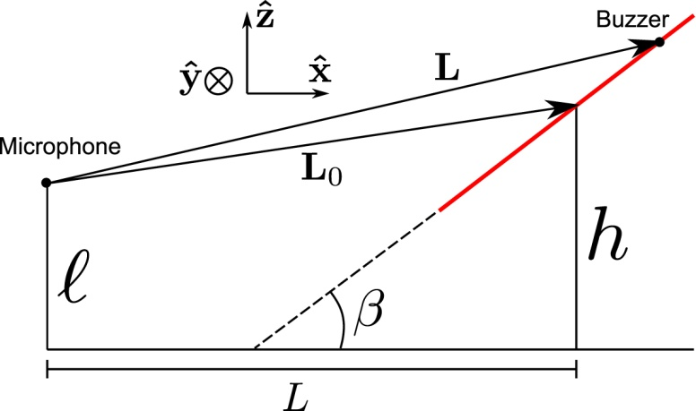
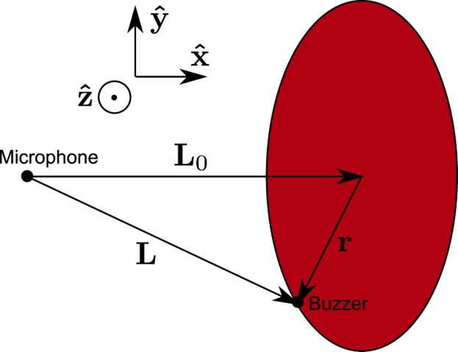
Doppler Equation for Tilted Platform in Uniform Circular Motion (cont’d)
(Plug v_{s} into Equation 1 from Uniform Circular Motion Slide to calculate freq. shift)
= v_{s}
→

Slide 15
Experimental Procedure
Series of experiments for each parameter
Distance
Angular Dependence
Tilt Dependence
Buzzer Radius/Angular Velocity
Proper setup is important for this experiment
Results can be highly sensitive to room conditions and computer configurations
Read the full report for a detailed list of preparations that need to be made in the lab before acquiring Doppler data

Slide 16
Spectrum Lab Results
Comparison of newly acquired data with data from
previous project group indicated:
The clarity of the observed sound signal from the new Doppler machine with the monotonic buzzers was dramatically improved
Overall noise levels in the system were greatly reduced
Doppler shifting can be observed at all different angles of tilt
The microphone receives a broad range of harmonic frequencies that need to be systematically analyzed

Slide 17
Comparison of Results
Old Machine with Old Buzzers

Slide 18
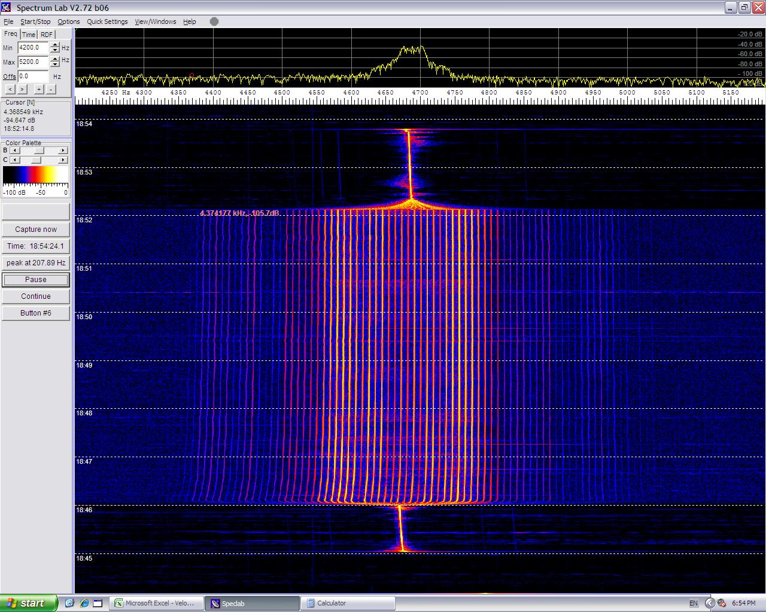
Comparison of Results
New Machine/New Buzzers

Slide 19
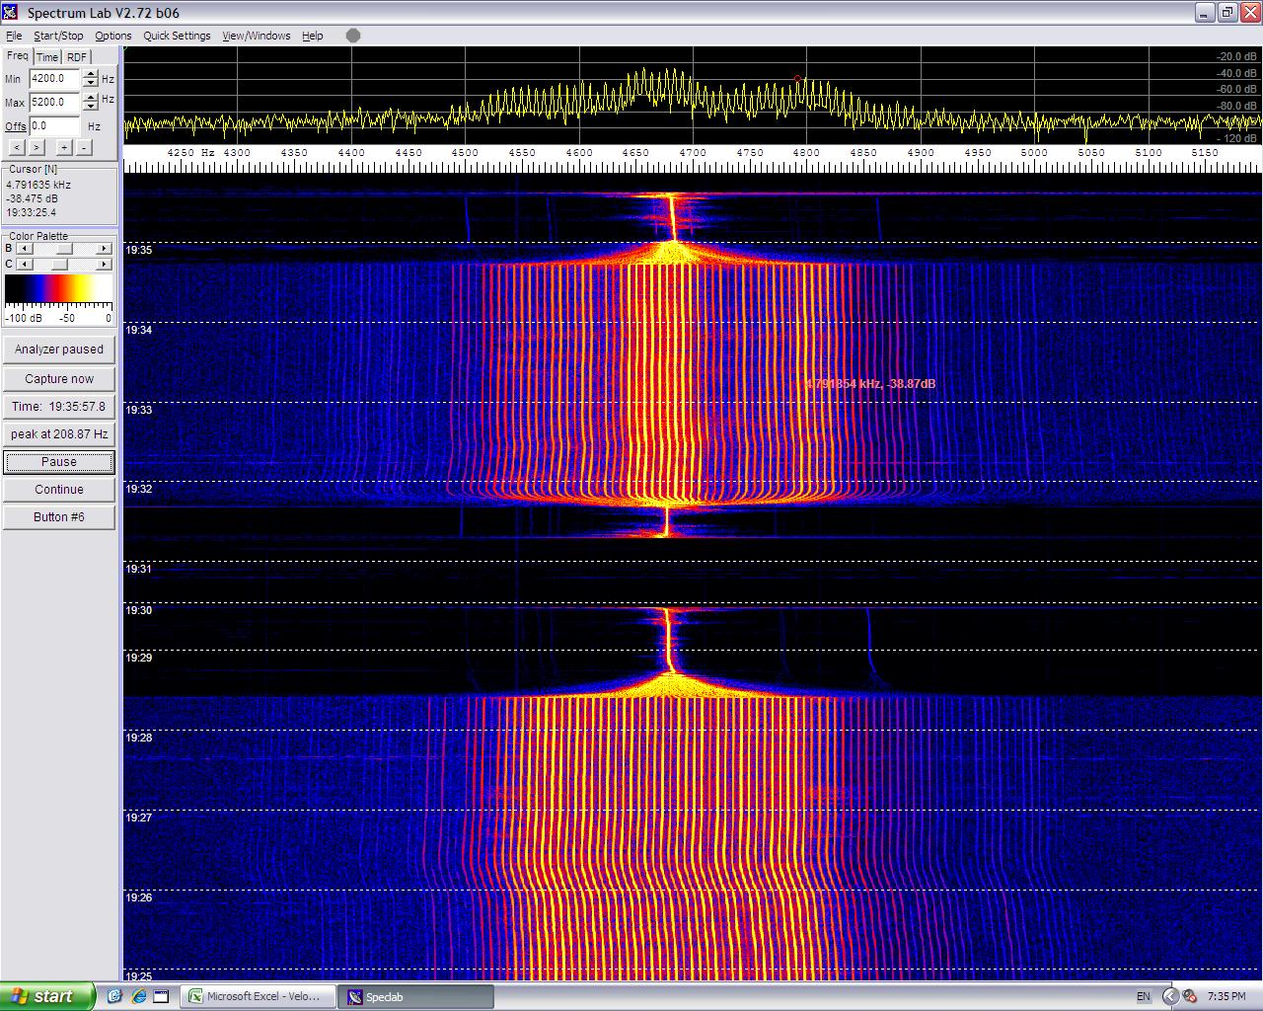
Comparison of Results
New Machine/New Buzzers (tilted to 90⁰)

Slide 20
Conclusions
We have gained great control over all adjustable parameters
This machine is capable of generating repeatable, reliable data under proper laboratory conditions
This experiment, if done properly, is a fun way to show a known concept in a new and exciting format
Rob is continuing this project as part of his Masters Degree, so there is plenty of time to collect more data
Analogous to planets in orbit where the source would be the light from the planets and the observer would be a telescope instead of a microscope

Slide 21
Recommendations
Conduct testing with lower frequency buzzers for more dramatic effects
Move a computer to the attic and spend more time collecting data in the Anechoic Chamber
Derive equations to calculate the harmonic properties of the buzzers and analyze intensity distribution
Consider using different batteries that would take up less space

