Slide 1
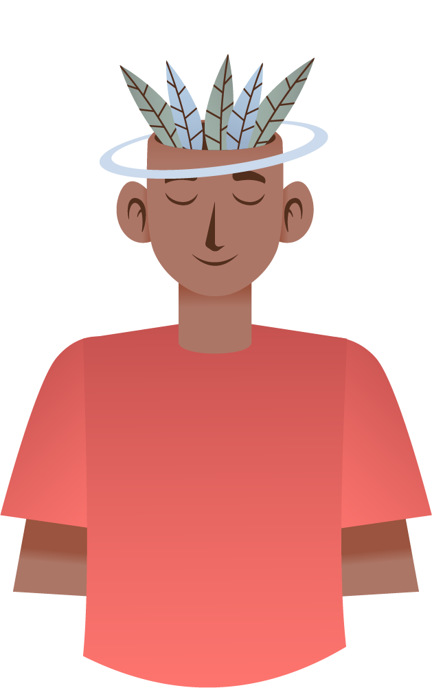
Nantucket Youth Behavioral Health Assessment
Town of Nantucket Heath and Human Services Department
Director of Human Services Dept., Jerico Mele
By Simeon Hoffler Jr., Mary Laurens,
Elisia McLean, Myles St. Jean
Notes:
Elisia
add something along the lines of "this project was brought to you in part by the town Contract Review Committee, who first identified the need for research in this area"
^ this covers our bases in terms of providing context as to why we're here, without interrupting the flow we've already grown accustomed to ^

Slide 2
What Is Mental Health?
1
Notes:
Elisia

Slide 3
"A state of mental well-being that enables people to cope with the stresses of life, realize their abilities, learn well and work well, and contribute to their community." - The World Health Organization
2
Notes:
Elisia

Slide 4
"A state of mental well-being that enables people to cope with the stresses of life, realize their abilities, learn well and work well, and contribute to their community." - The World Health Organization
2
Notes:
Elisia

Slide 5
Relevance to Nantucket
Minimal Data
No surveys since
COVID-19
Efficient use of resources
Survey specific to Nantucket
3
Notes:
Sim
>> EXPAND THIS INTO A FULL COHERENT SCRIPT <<
Memorize if you want and use bullets as reminders
Brief Intro to how this project came to be
Start as a Youth Grant process
A needs assessment was identified as something that needed to be done
Minimal data
No current data on youth mental health on Nantucket
No surveys since COVID-19
There hasn’t been a youth behavioral health assessment since 2021 Pride surveys
Efficient use of resources
In order for HHS to properly offer their services and apply for grants to fund specific resources they need data showing which demographics what types of programs/resources in place or added to existing resources/services
Survey specific to Nantucket
Pride surveys are given nationally to schools so a survey specific to nantukcte will allow to adapt questions to certain populations and communities in Nantucket

Slide 6
Project Goal
Design a data-driven survey tool that the Health and Human Services Department of Nantucket can implement to track the mental health of the youth community on the island.
4
Notes:
Sim

Slide 7
Objectives
Notes:
Myles

Slide 8
Identify factors that impact mental health
Identify barriers to using resources
Document the impact of COVID-19 ​
Assess the impact of peer & family engagement
5
Notes:
Identify factors (e.g. social or cultural) that contribute to the students’ sense of belonging.
Identify the barriers that impede the students' willingness to use current mental health resources available in their schools and communities.
Document the impact that the COVID-19 pandemic had on the students’ mental health and academic performance.
Assess how the students’ involvement, or lack of involvement, in their schools and homes impacted their mental health.

Slide 9
Methods

Slide 10
Interviews and Surveys
Executive Directors of youth-oriented services
Our House and Fairwinds
WPI Undergraduate Behavioral Health Survey
Nantucket Youth Behavioral Health Survey
6
Notes:
Sim
Nantucket Youth Behavioral Health Survey
HHS distributed to schools
WPI Undergraduate Behavioral Health Survey
Distributed to friends and affiliated club organizations

Slide 11
Results
Notes:
Because we were able to get some data, we decided to do some preliminary analysis of the responses we received.

Slide 12
Scoring System
Almost Always
1
Q12: "How often do you experience feelings of anxiety?"
2
Often
Mental Health Score
3
Sometimes
4
Not often
5
Almost Never
7
Notes:
To analyze data and make correlations between mental health factors, we devised three scoring systems for quantifying a student's mental health, sense of belonging and difficulty with virtual learning during the COVID-19 pandemic. For the first scoring system, the Mental Health Score, students were asked to rate the frequency of feelings of anxiety, depression and hopelessness. These answers were then numericized and averaged to calculate an individual's Mental Health Score. A score of 1 indicates the student has very poor mental health and feels anxiety, depression and hopelessness a lot, while a score of 5 refers to a student with good mental health.

Slide 13
Scoring System
1
Q35-2: "I can connect with my peers on an emotional level"
Disagree
Somewhat Disagree
2
Belonging Score
3
Neutral
Somewhat Agree
4
5
Agree
8
Notes:
Similarly, students were asked to rate on a Likert scale their agreement to three statements about fitting in with their schools and peers. These responses were also numericized and averaged to determine a student's Belonging Score, which is a measure of how much they feel they "belong" with their schools, peers and friends. 1 means they feel completely isolated and outcasted, whereas 5 means they feel very connected to their schools, peers and friends.

Slide 14
Scoring System
Harder to Learn
1
Q41: "Was it hard for you to learn virtually during the pandemic?"
Somewhat Harder
2
COVID Score
No Change
3
Easier to learn
4
9
Notes:
Students were asked to state how much harder it was for them to learn virtually during the COVID-19 pandemic. Their responses were numericized into a COVID Score. 1 means the student struggled a lot during the pandemic, and 4 means the student thought it was easier to learn virtually than in person.

Slide 15
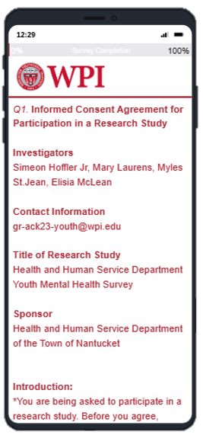
WPI Survey
Total responses: 129
Mean Mental Health Score (MH): 3.2/5
Mean Belonging Score (B): 4.0/5
Mean COVID Score: 3.2/4
Mobile view of survey from Qualtrics
10
Notes:
Elisia
Mention "out of ___”

Slide 16
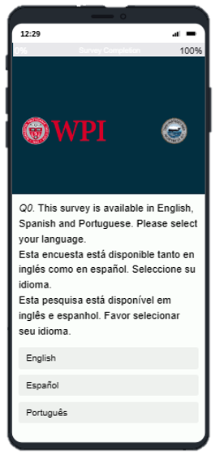
Nantucket Youth Survey
Total responses: 204
Mean Mental Health Score (MH): 3.9/5
Mean Belonging Score (B): 3.6/5
Mean COVID Score: 2.1/4
Mobile view of survey from Qualtrics
11
Notes:
Elisia
Mention "out of ___”
So, the primary purpose of our project was to design a survey, so the limited data analysis that we conducted is less to identify correlations as it is to test the survey efficacy and identify areas of improvement. Not necessarily to get statistically significant data.
The survey responses ranged from ages 11-14 and grades 6-8.
the results in the next slides are from the Nantucket Youth Survey
Mention that 200 responses were from CPMS
Age range: 11-14

Slide 17
Q6: How would you describe your ethnicity?
12
Notes:
The first correlation we looked at with our Youth data is the correlation between ethnicity, mental health and belonging score. These are the aggregate scores for each ethnicity that students identified themselves as, and each number on top of each column shows the number of students in each ethnicity that answered these questions. Our survey did not list any questions as "required", so some students did not answer every single question.
The ethnicity of the student who took the survey did not have a strong correlation with Mental Health or Belonging Score. All of the categories with a significant population did not have an average score that was far enough from the mean, so we cannot conclude that ethnicity plays any role in mental health or sense of belonging, or vise versa.
Don't forget to mention that we are now talking about nantucket data
And maybe take a second to explain the layout of a graph before jumping in? such as the counts. Just to give the audience a tour of sorts
Also for any weak correlations or small data sets we can say "more research needed" and relate it to national data

Slide 18
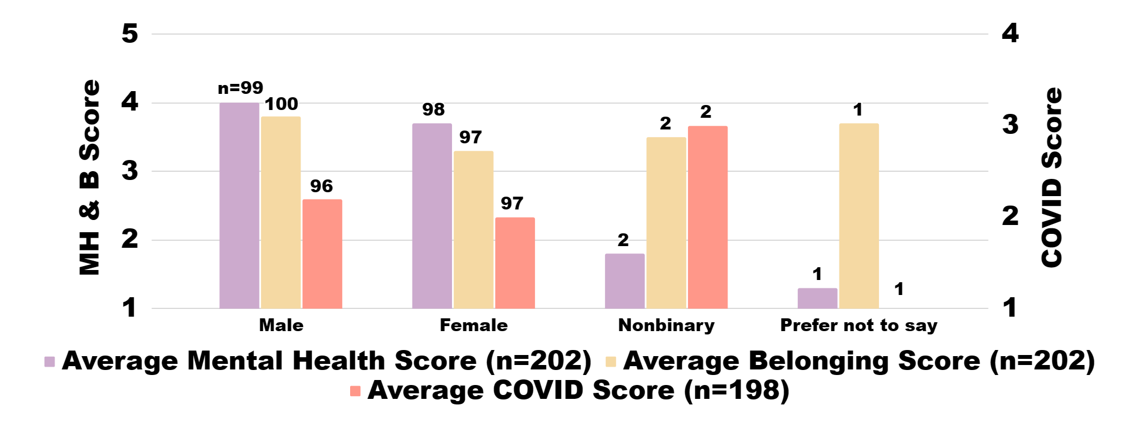
Q4: What gender do you identify with?
13
Notes:
However, gender does seem to play a role in mental health and belonging score. The average for both scores for male-identifying students is higher than female or nonbinary students. Gender balance in the Cyrus Peirce Middle School is about equal between men and women.

Slide 19
Q23: How would you describe your grades in school this year?
14
Notes:
Academics are important to measure when it comes to students. We did see a drop in mental health and belonging score as a student's grades decrease, meaning they are correlated. However, we are not able to glean which factor influences which. We are unsure if having poor mental health will cause students to achieve lower grades, or if seeing their low grades will negatively impact a student's mental health. In order to distinguish this, more concentrated research will have to be conducted. Additionally, there is a trend that students who reported struggling more in the pandemic received lower grades, as you can see by the green bars.
Definitely mention weird second covid axis thing beforehand

Slide 20
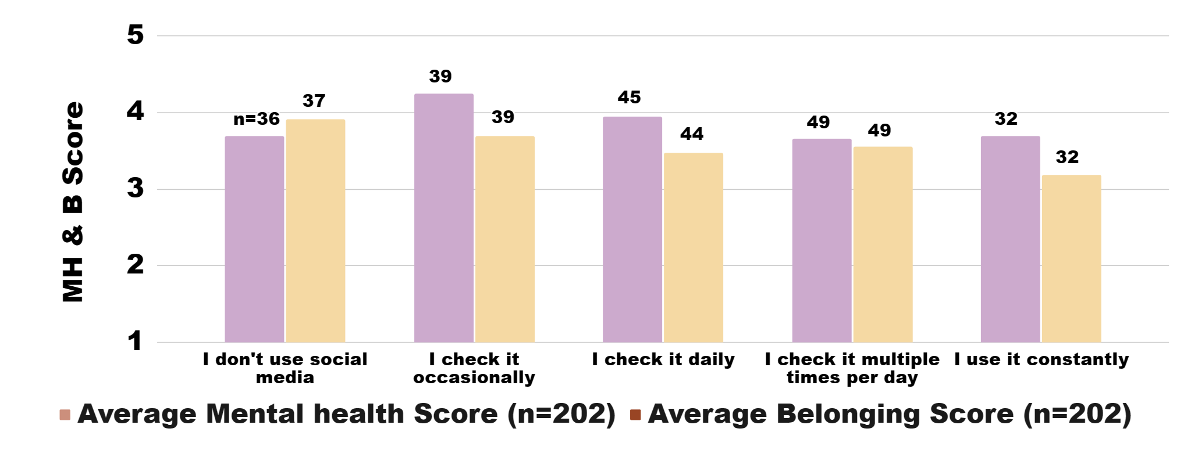
Q10: How much do you use social media
15
Notes:
We found an interesting trend with social media use and mental health and belonging scores: Overall, more frequent social media use correlated with lower scores, but students who did not use social media at all did not have the highest average scores. This could be due to social pressure or feeling left out for not having social media, though more research needs to be conducted to confirm this. Please note that these students are of ages 11-14, and most social media apps have a minimum age of 13.

Slide 21
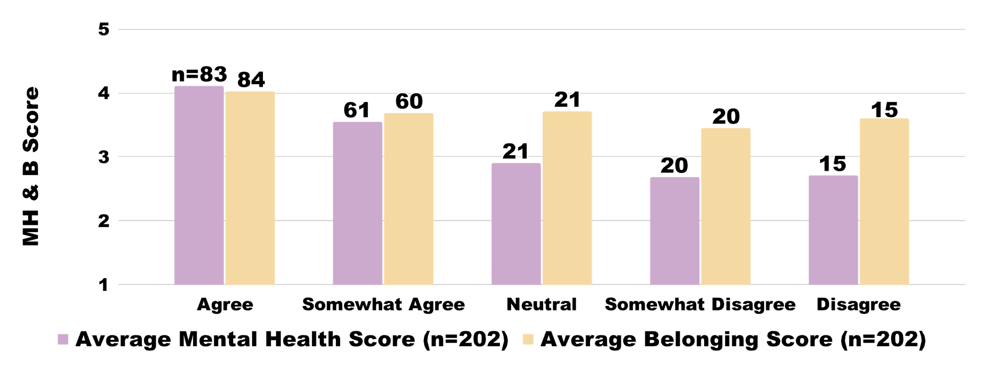
Q18-3: I feel like I can talk to my friends if I need help.
16
Notes:
We asked students if they felt they could talk to their friends if they need help, and we saw a strong correlation in average scores: students who didn't feel they could confide in their friends tended to have much worse mental health and senses of belonging.

Slide 22
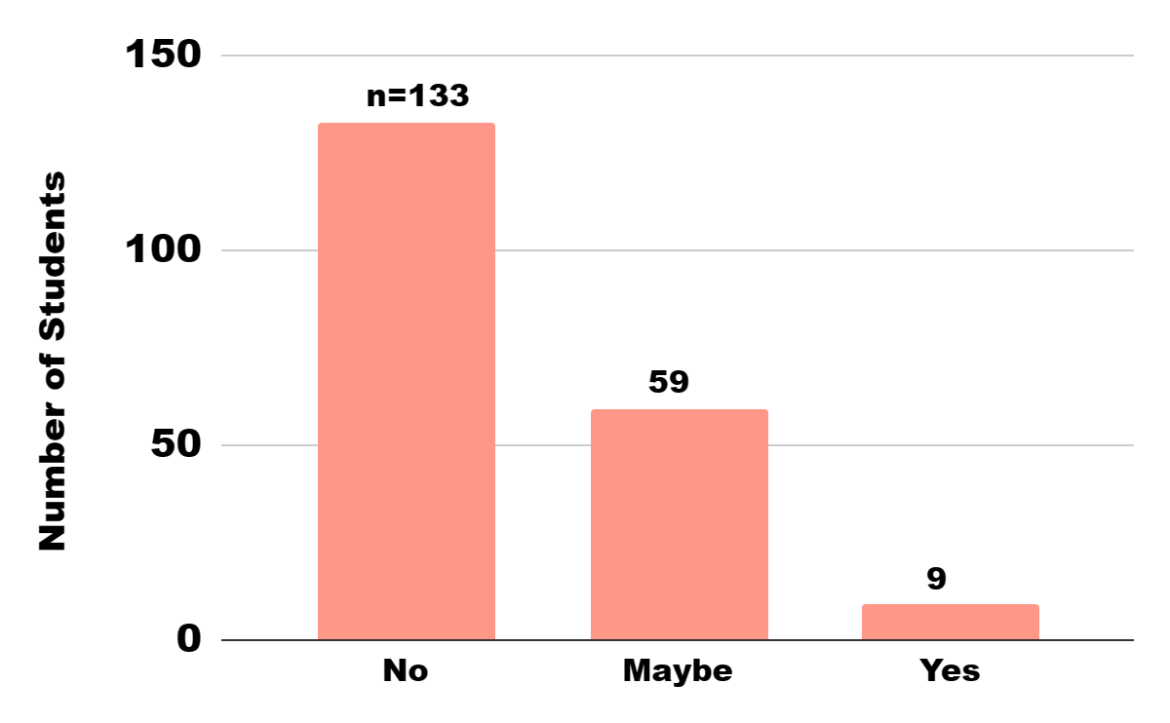
Q37: Would you ever use mental health services offered at your school? (n=201)
17
Notes:
sim

Slide 23
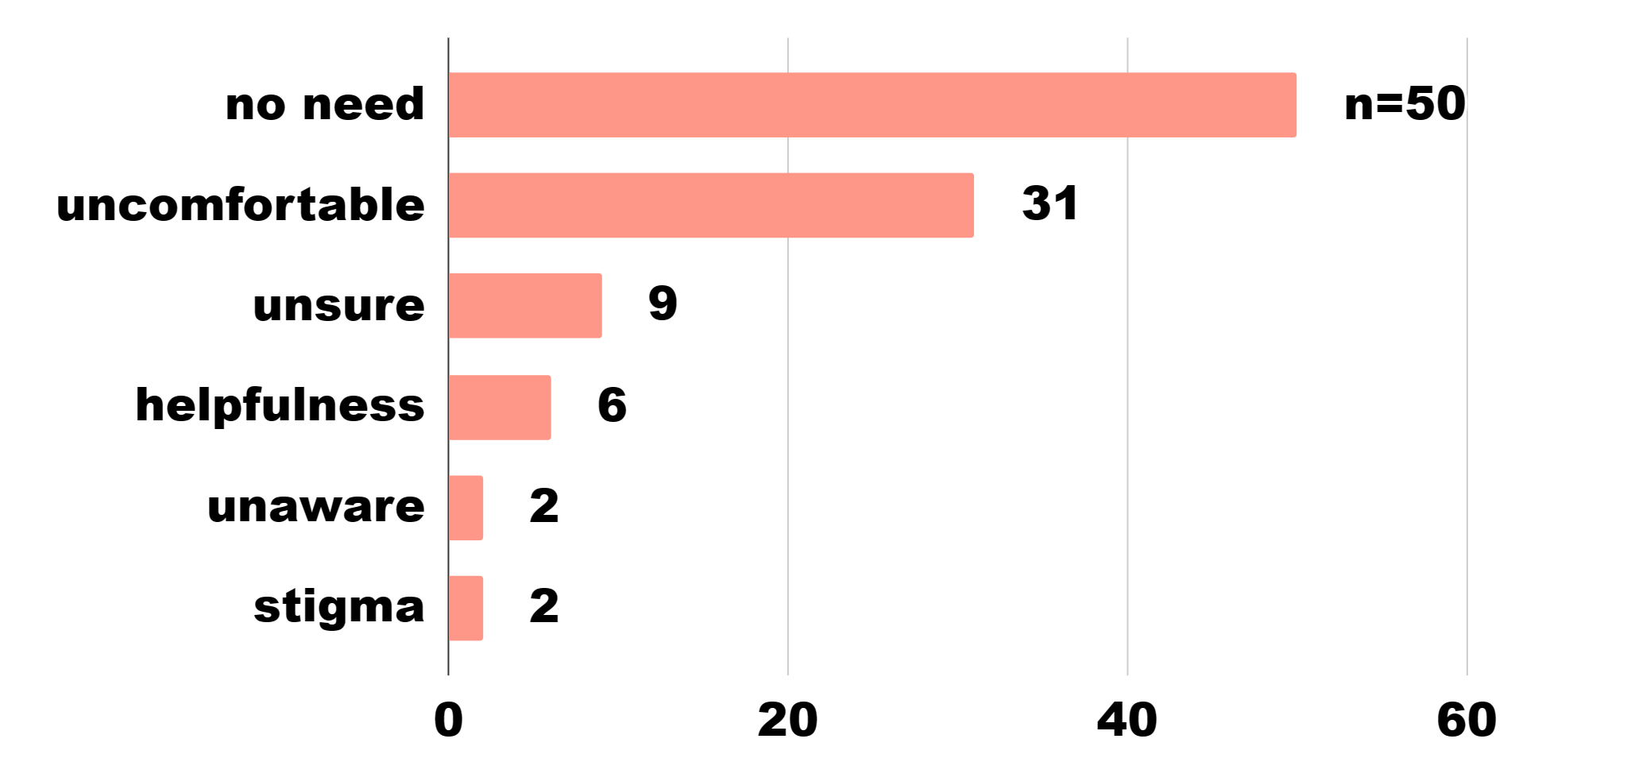
Q38: Why would you use or not use these services? (n=100)
Number of Students
18
Notes:
Sim
>> EXPAND THIS INTO A FULL COHERENT SCRIPT <<
Memorize if you want and use bullets as reminders
Trends found in the students that said No to using mental health resources at their school
These are the common barriers that we identified when asking why or why the students wouldn’t use the mental health resources offered at their school.
The main barrier was that students said that they had no need for the services
People commented that they had no issues or already had other resources to go to
The second barrier was that some students said that they would feel uncomfortable
People commented that they feared potential consequences that might come from using these resources
They also commeted about not trusting other people knowing personal information

Slide 24
Recommendations
Schedule in-class time for students to complete survey
Monitor minority demographics
Add questions to survey
Homelife
Academic/Career endeavors
Reduce stigma through service advertisement
19
Notes:
For the sake of survey response rate, it is crucial for students to be able to complete surveys at school, rather than having them do it on their own time. We saw a large spike of responses during the window Cyrus Peirce had scheduled, so it would be beneficial to repeat that in the future.
We also recommend that more research be conducted into the behavioral health of students whose identity is underrepresented by a quantitative needs assessment of this scale. As we mentioned, we saw a few trends that we just couldn't justify with data alone, due to insufficient sample size. So incorporating another angle of investigation would help gather more information within those demographics.
And we suggest that more emphasis is placed on advertising and promoting the use of services to anyone who needs them, because just getting a conversation started can do a lot towards reducing stigma and misconceptions.

Slide 25
Acknowledgements
Health and Human Services Department
- Jerico Mele
Contract Review Committee​
- Joanna Roche​
Our House​​
- Pauline Proch​​
Fairwinds
- Jason Bridges
Advisors​​​​
- Professor Fred J Looft​​​​
- Professor Susan M Jarvis​​​​
20
Notes:
For being an excellent sponsor to work with, we would like to thank Jerico Mele from HHS
And for helping bring this project into existence, Joanna Roche and the rest of the CRC
For providing the team with new perspectives during interviews, thank you to Pauline Proch from Our House and Jason Bridges from Fairwinds
For their consistent guidance and support, a sincere thank you to our advisors, professor looft and professor jarvis

Slide 26
Questions & Comments
21

