Slide 1
Assessing and Addressing the Needs of Urban Agriculture in Copenhagen
Brendan Cicione, Parrish Garver, Allison Kloeckner, Johanna Whitwell
Urban Farming IQP
Worcester Polytechnic Institute
Notes:
Good morning, we are the Urban Farming Team. Introduce alphabetically.
We worked with our sponsor Growing Pathways to address and assess the needs of the urban agriculture community in Copenhagen.
Introduce Bydyrkerne
Based on the collected data, the team provided a networking tool that will allow for the exchange of knowledge, skills, and work in an effort to encourage the spread of urban farming initiatives

Slide 2
Increasing urban agriculture can help Copenhagen achieve its environmental goals
Community Involvement
Social
Economic
Environmental
Sustainability
Bolsters Local Economy
Notes:
Allie
Copenhagen is a city focused on environment…. Urban farming can help them achieve their goals -> talk about benefits
Urban agriculture has a variety of benefits for the citizens in the urban area and earth
Social
Direct connection to food
Green space benefits
Environmental
Water runoff, waste management
Economic
Increases surrounding property values
Project goal is to increase urban agriculture for these reasons as there is not much here - sponsor wants to provide resources (using tools) to farmers to make them more resilient
Cover why it is important to farmers

Slide 3
Resilience is a farm’s ability to recover following the removal of a key contributing component
GROWER
KEY COMPONENTS
PLACE
PROJECT
Notes:
Resiliency – introduce for reference

Slide 4
This project investigated the resilience of urban farming through global research and local interviews
Notes:
Allie
Our project looked at urban farming through both global and local perspectives
Global research to find successful examples
Conducted interviews in CPH to gather qualitative data
Data collected was use to determine what the UAC needed and a networking tool was selected and piloted.

Slide 5
Networks built upon strong community investment can increase the resiliency of urban agriculture
Notes:
Allie
Established networks are built upon strong community investment
Found successful examples throughout the world and were able to compare those networks to copenhagen and take ideas from how they operate
Parisculteurs in Paris, France
Successful due to network involving government
Green Thumb in NYC
Successful due to network with community business partners

Slide 6
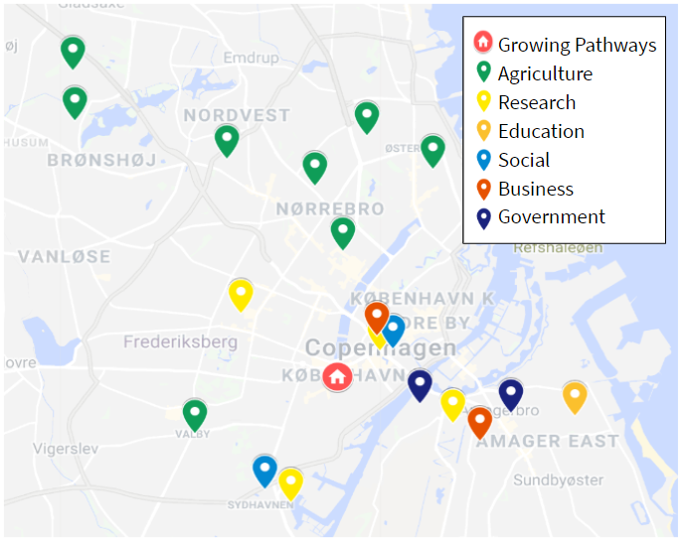
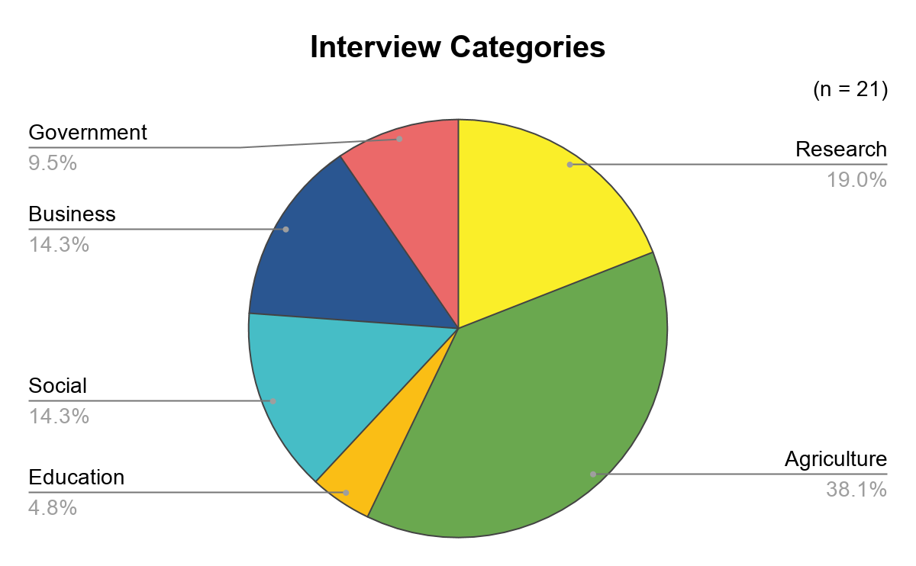
Interviews conducted across Copenhagen evaluated the urban agriculture community
Notes:
Allie
Point out the map, and explain the categories - talked to 21 people all over cph
Agriculture
Many urban farmers and community garden organizers
Research
Professors
Business
Successful agriculture businesses
Social
Local organizations that focus on community outreach
EX: sabine sørenson from miljøpunkt indre by and christianshavn
Government
Politician to talk about government policy regarding urban agriculture
Education
School

Slide 7
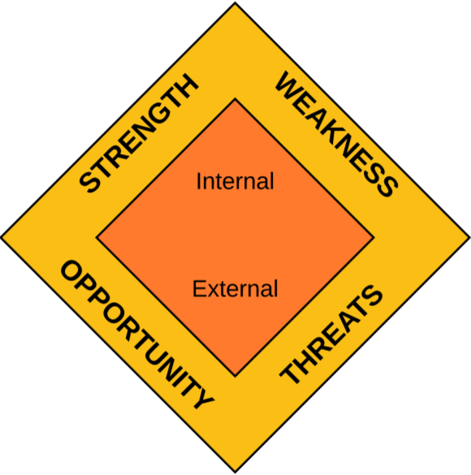
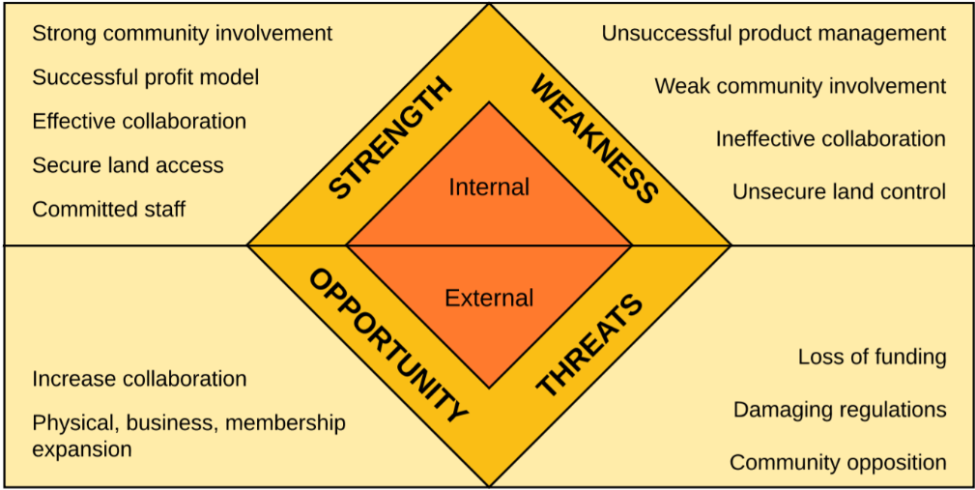
Interviews revealed common strengths, weaknesses, opportunities, and threats within the community
Strong community involvement
Weak community involvement
Notes:
Allie
SWOT: Strength, Weakness, Opportunity, Threats
Identify internal and external factors
9 Categories (Mission and passion, Community involvement, Product management and method of profit, Staff , Land-related, Network and collaboration, Funding, Physical/business/membership expansion, and Policy.
Two-sided → What works for some farms will not work for others
Conclusion: mention opportunities ---- network (collaboration)

Slide 8
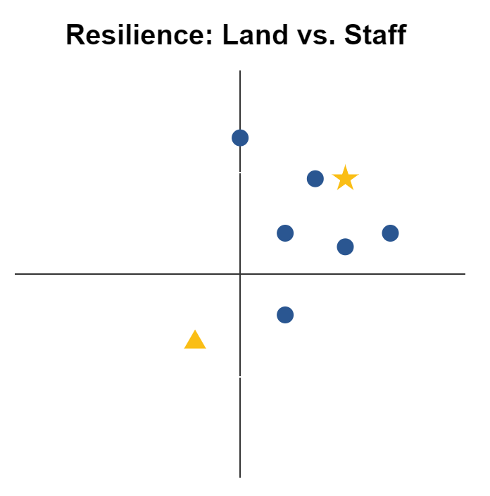
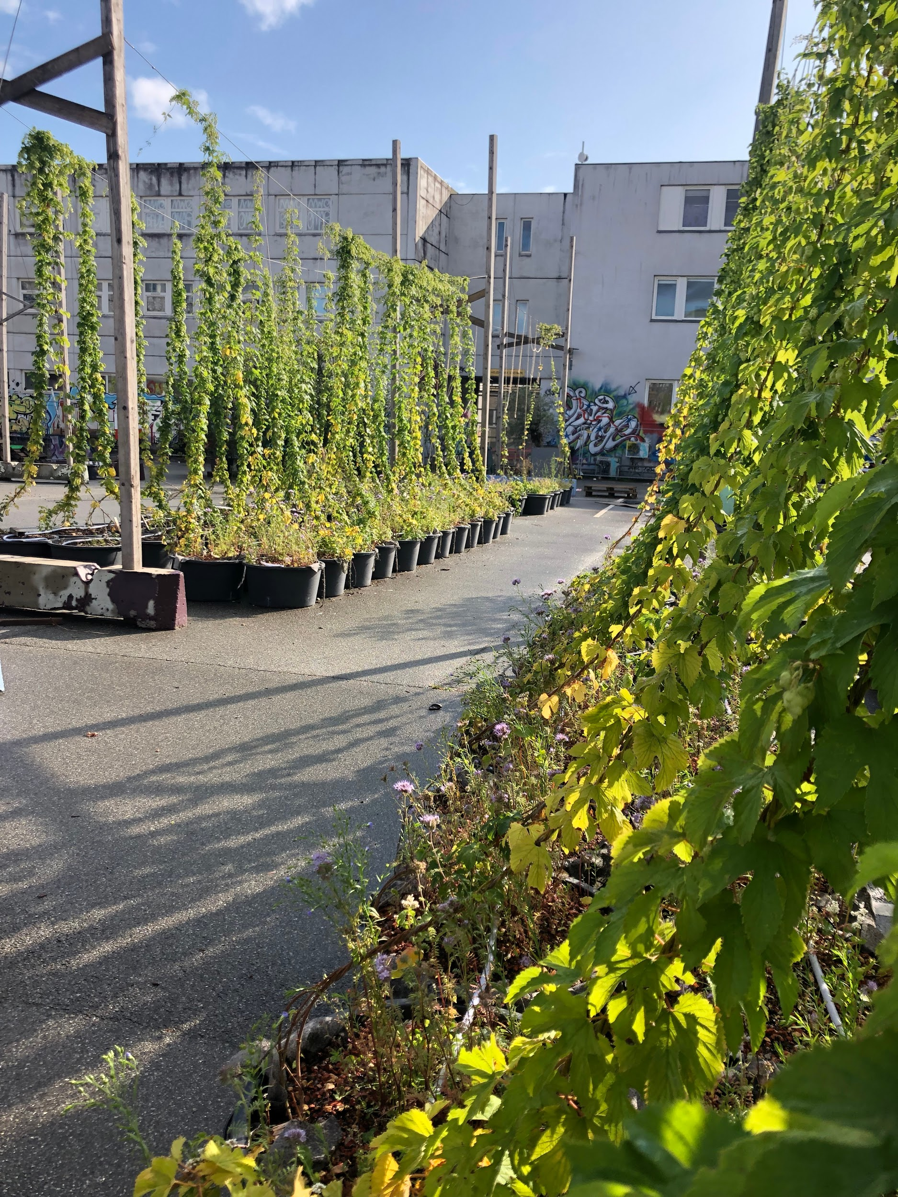
Farmers that own arable land and have paid employees are more resilient than those who do not
Owns arable land
Owns arable land
II
I
Paid employees
No volunteers or paid staff
Paid employees
No volunteers or paid staff
III
IV
Owns no land has no place to grow
Owns no land, has no place to grow
n = 8
Byhumle
Notes:
JOEY
**might look skewed towards farm with higher resilience because (as limitation of interviews), failed farms were not included
graph shows relationship between land, staff, and resilience
Quadrant III represents farms with no paid staff and insecure or no land
The triangle in Quadrant III represents Byhumle, a small-scale urban farm focused on growing hops that operates solely through a volunteer force. Byhumle is located in a parking lot in the Nordvest area called Garage Park, which is set to be redeveloped within 5 years. Byhumle does not currently have an official plan for relocation. This, combined with low structure in their volunteer force, indicates low resilience and potential danger of failure.

Slide 9
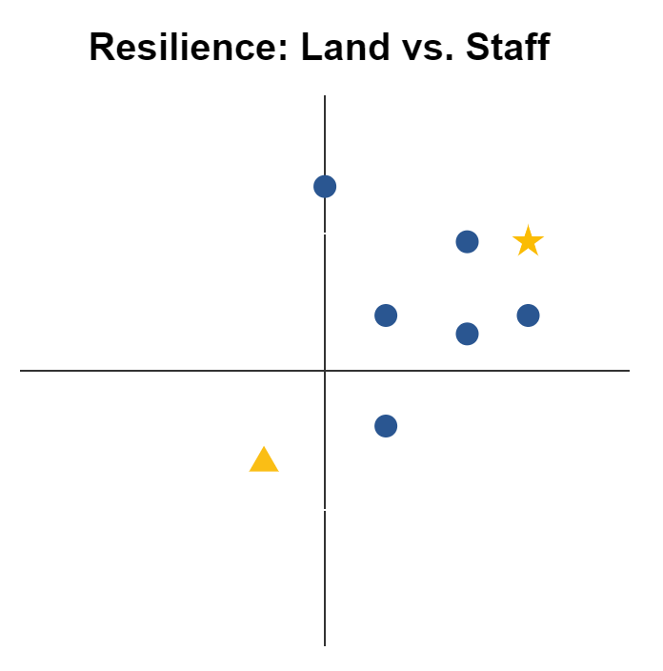
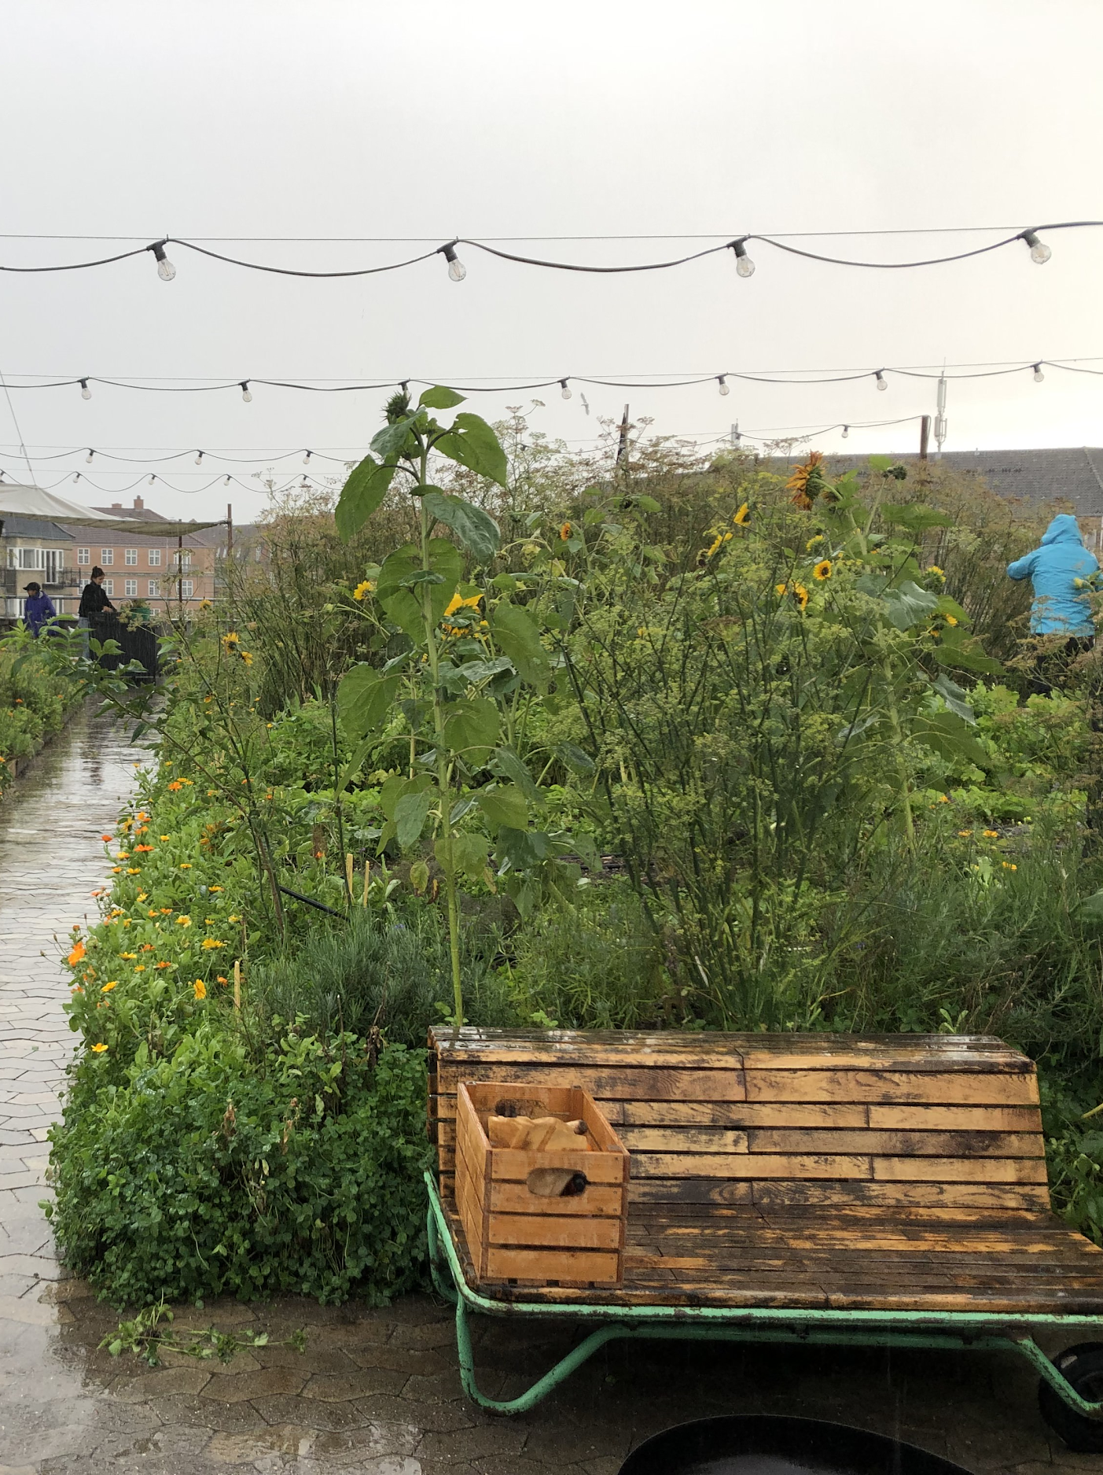
Farmers that own arable land and have paid employees are more resilient than those who do not
Owns arable land
Owns arable land
Owns arable land
I
II
I
II
No volunteers or paid staff
Paid employees
Paid employees
No volunteers or paid staff
Paid employees
No volunteers or paid staff
III
IV
III
IV
Owns no land has no place to grow
Owns no land has no place to grow
Owns no land has no place to grow
n = 8
ØsterGRO
Notes:
JOEY
Quadrant I: strong resilience from paid staff through various sources of funding or income, and secure land based on stable, long-term contracts
The star in Quadrant I represents ØsterGRO. Following struggles with the municipality over zoning, ØsterGRO’s land access has stabilized
Stable volunteers, talk about incentive
Resilient example

Slide 10
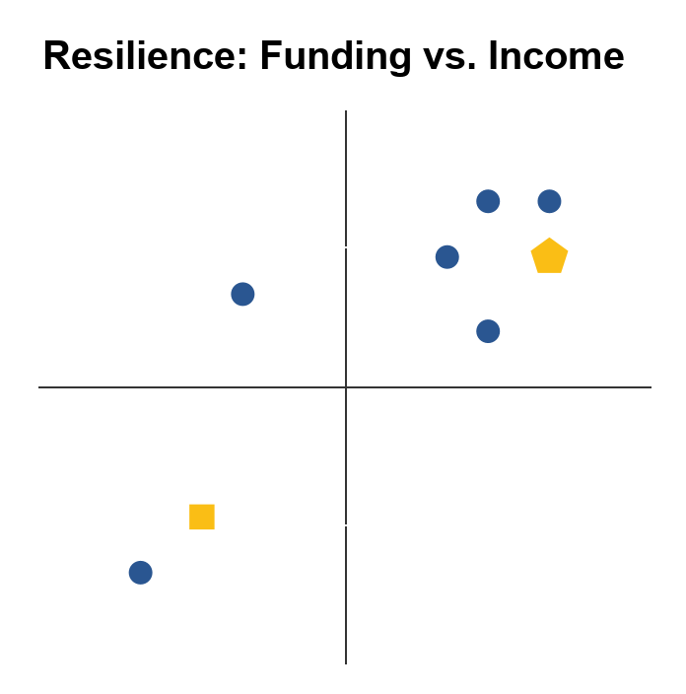
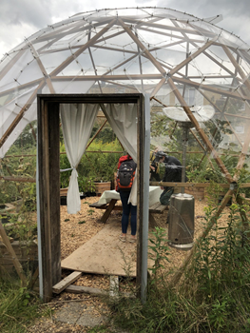
Farms with high resilience are self-sustained based on income and do not rely on outside funding
Does not require outside funds
II
I
II
I
No income
III
IV
Income covers all costs
III
IV
Depends on outside funding only
n = 8
Haven i Tingbjerg
Notes:
JOEY
Resources - especially money - are a significant concern in the establishment and resiliency of urban farms
Initial funding is crucial during the early stages of growth, particularly for expanding staff and purchasing start-up resources.
Haven i Tingbjerg relies on outside funding
A lot of times, outside funding is less stable the longer you receive (should be able to stand on your own 2 feet after a while)
If they lost funding, there is no real recourse

Slide 11
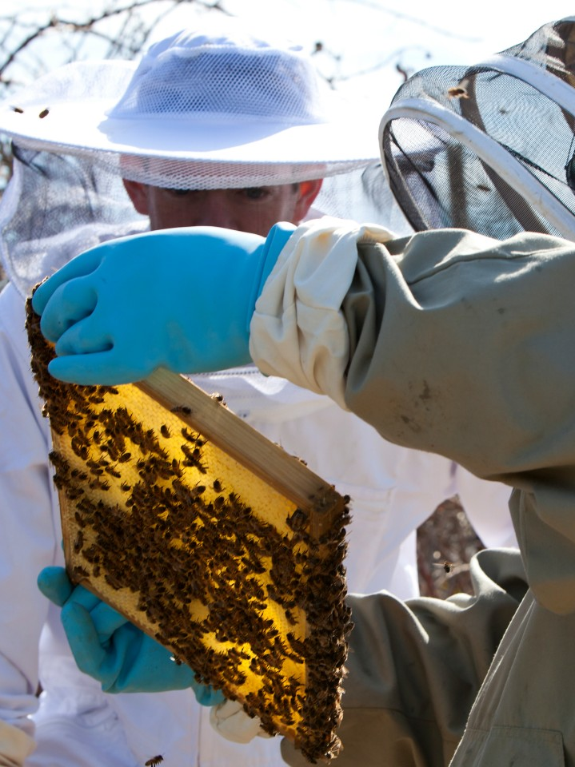
Farms with high resilience are self-sustained based on income and do not rely on outside funding
Does not require outside funds
II
I
II
I
No income
III
IV
Income covers all costs
III
IV
Depends on outside funding only
n = 8
Bybi
Notes:
JOEY
Oliver Maxwell from Bybi explained that the most difficult task for his business was finding consistent funding at the beginning.
Bybi is represented by the pentagon in Quadrant I.
As shown by the graph, Bybi is now fully self-sufficient through profit and now no longer relies on any outside funding. In this way, the funding models of farms can morph to become more stable and resilient.
People pay them to put the beeson the property and then to collect the honey

Slide 12
A farm connected to an institution of some kind will have greater support, leading to increased resilience
Housing Board
School
Social Org
HappyHumans
DYRK Nørrebro
Sydhavns Compagniet
“Connect to an institution that is sustainable” - Jais Hammerlund, KlimaTV
Notes:
JOEY
Housing board - HappyHumans
Permaculture in courtyards
Still making edible things, but different than an urban farm by our definition
School - DYRK Nørrebro
Social/community outreach org - sydhavn compagniet bees
Following this analysis, we looked into how to increase resilience through networking

Slide 13
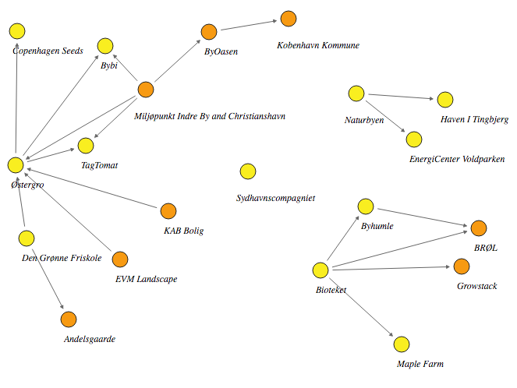
Higher number of social connections between actors correlates with higher resilience
Related Organizations
Urban Farm
Notes:
Brendan
Connections on the map were based on who interviewees said they knew
As previously mentioned Ostergro is an example of a resilient farm
While having a lot of connections is not indicative of high resilience, there is a correlation between the two
This led to our decision of expanding the established network in Copenhagen

Slide 14
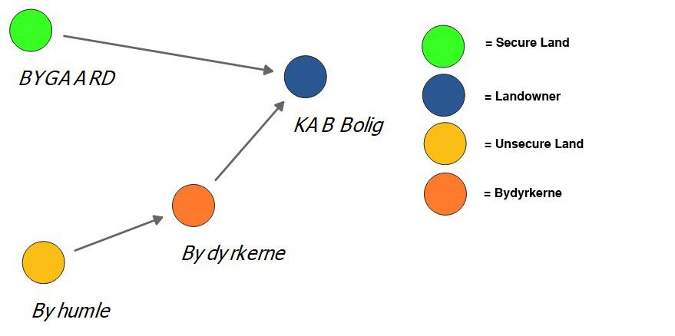
Social connections between network actors could increase resilience related to land access
Notes:
Brendan
Connecting farmers with land owners interested in urban agriculture creates a unique opportunity to increase resilience
This has already been done with a farm BYGAARD and KAB Bolig
A possible example is Byhumle. Through bydyrkerne they have the potential to be connected with KAB Bolig, a landowner interested in urban agriculture

Slide 15
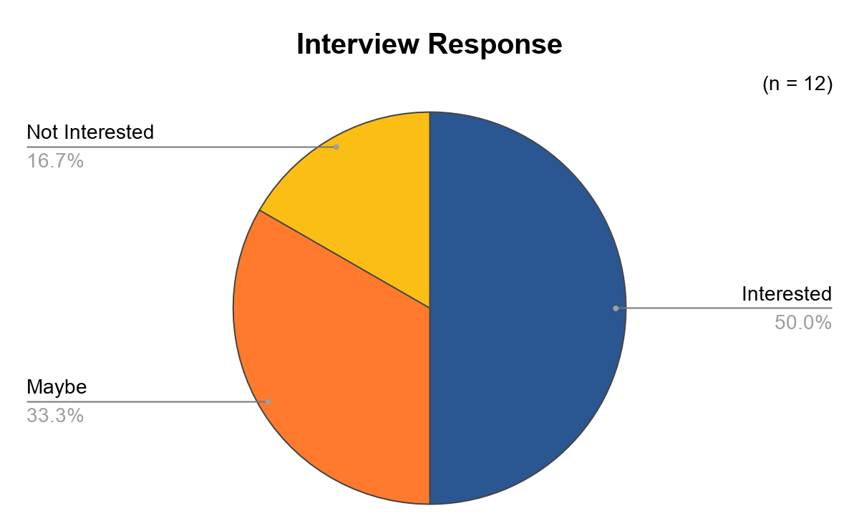
Urban farmers have expressed interest in using a networking tool
Notes:
Brendan
Expressed interest in a networking tool
Many of the maybes were primarily not interested in piloting the tool, but expressed interest when the tool is fully developed
Digital tools have the benefit of high accessibility in that there are no geographic constraints

Slide 16
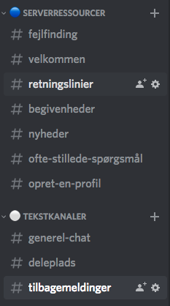
Discord was chosen for its user friendliness, customization, and dedicated channels
Notes:
Brendan
From the tools we researched we chose Discord (looked into fb bc it is already used)
Chose Discord for several reasons
It’s user friendly -- directions are clear on how to use the software
We’ve been able to customize the server with automated messages and custom commands
Discord supports dedicated channels, which allows us to focus discussion and reduce clutter often associated with other platforms
explain channel deleplads
Increase communication with farmers

Slide 17
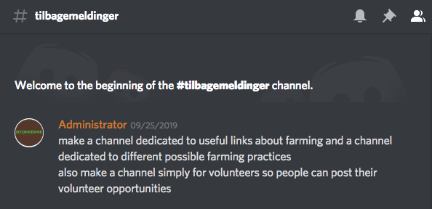
Bydyrkerne should actively moderate and participate in the server during initial stages of growth
Notes:
Parrish
Active participation
Send messages regularly
Engage with the community
Make people feel welcome
Will lead to a more engaged and active community
People may feel intimidated when first joining
This will help to prevent that
Set the example
People will follow by example
Active moderation
Monitor the status of the discord
Ensures technical difficulties can be addressed swiftly

Slide 18
Bydyrkerne should conduct a pilot study to further test and improve the Discord server
Pilot Test
Feedback
Design iteration
Further testing
Structured test protocol
Discord Instruction Manual
Feedback prompts
As needed
1
2
3
4
Notes:
Parrish
Discord add value for the community
In-depth testing to find improvements
Conduct pilot study
Given prompts for those testing
Individuals involved in various areas
Feedback
Use feedback to improve the server
Ensure user-friendly
Free of errors
Periodic testing
As deemed fit
Meet the needs of an expanding community
As more people enter, more unknown variables will appear

Slide 19
Bydyrkerne should ask individuals who’ve joined the server to invite their volunteers to the server
Volunteers
Farmers
Pilot Group
Notes:
Parrish
More users → more effective server
Pilot group → Farmers
Reach out to farmers that they are in contact with
Create a strong base of farmers
Have farmers reach out to their support groups (volunteers)
Grow strong base of volunteers with interest of urban agriculture
Volunteer opportunities posted on the server
Increased workforce security

Slide 20
Bydyrkerne should organize periodic events to strengthen and expand the existing community
Related Organizations
Urban Farm
Notes:
Parrish
Recommendation → encourage periodic events via the Discord server
Further deepen connections between network members
There are a few different current communities
Bridge the gaps and build one strong community
People will be more willing to communicate and collaborate within the Discord
Events do not have to strictly be related to farming
This will strengthen the community network

Slide 21
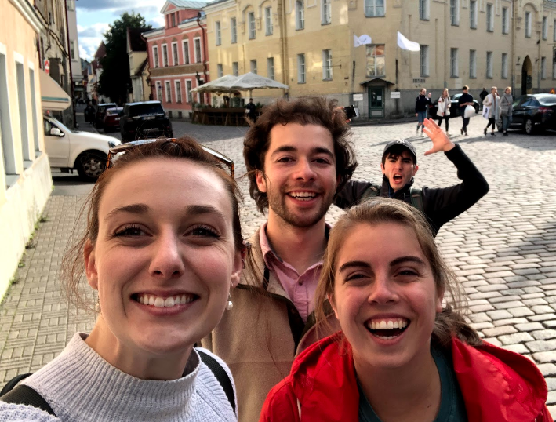
Acknowledgments
Tak!
Questions?
Thank you to…
our sponsor, Oleg Koefoed,
our interviewees,
Professor Holly Ault,
and Professor James Hanlan!
Notes:
Parrish

