Slide 1
Using Behavior-Change Strategies to Reduce Littering in Lambeth
Prepared By:
Paul Bonarrigo
Matt Iaconis
Ryan Johnson
Brendan McCann
Notes:
Hello We are littering in Lambeth
*Give names*
The goal of our project is to address the problem of littering in Lambeth. Lambeth council is sponsoring us to do this project because the previous IQP in Lambeth addressed enforcement policies and they now want to move toward changing people’s behaviors instead.

Slide 2
Why is Addressing Littering Important?
Unattractive
Expensive
Burden to Society
Environmental Effects
81% of British people frustrated or angry at the sight of litter
Reduces tourism
Taxpayers of Great Britain pay £500+ million each year to clean streets of litter
£7+ million just in Lambeth
Contaminates water systems
Alters and obstructs marine habitats, damaging aquatic life
Poses physical and toxicological dangers to wildlife
Dangerous chemicals can enter the food chain
Damages community spirit, well-being, and health
Impacts national prosperity and happiness ranking
2015-17: delayed 1,348 Underground trains for 121.32 total hours
2

Slide 3

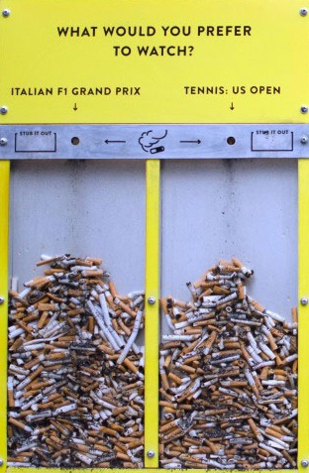

Behavioral Change Strategies for Litter Reduction
Research
Identity Motivations
Environmental Motivations
Accountability
Advertisements
Community involvement
Bin design and appearance
Notes:
Two major factors that affect people’s littering habits.
These are identity and environmental motivations
Examples of Identity motivations include ideas such as Community Involvement and Accountability
Accountability is the idea of making one feel accountable for the actions they are committing which can be seen through the Love Essex campaign poster seen here. It calls on people to specifically through away “Your” litter which is very powerful as it makes them rethink the act of simply throwing the litter on the ground due to the effect it will have on their county. This campaign also has a sense of community involvement as it pushing people to join. In the end enough people joined in and Essex was able to decrease littering by 41% over three years
Constant Reminder over time
Next are environmental motivations which include things such as advertisement messaging and bin design and appearance.
Bin design and Appearance can majorly affect how anyone interacts with a bin this could be anywhere from cleaner bins getting more use or bins with interesting designs such as the ballot bin campaign being able to decrease cigarette litter by 46%. The innovative design of the ballot bins allow for individuals to answer questions such as Do you like pineapple on pizza while disposing of their cigarettes. Advertisements and tailered messaging as seen through the questions on the ballot bins add slight nudges to the environmental for people to realize think about and possibly change their behavior based upon.
All of these motivators where considered for the campaign we created which will be explained later on

Slide 4
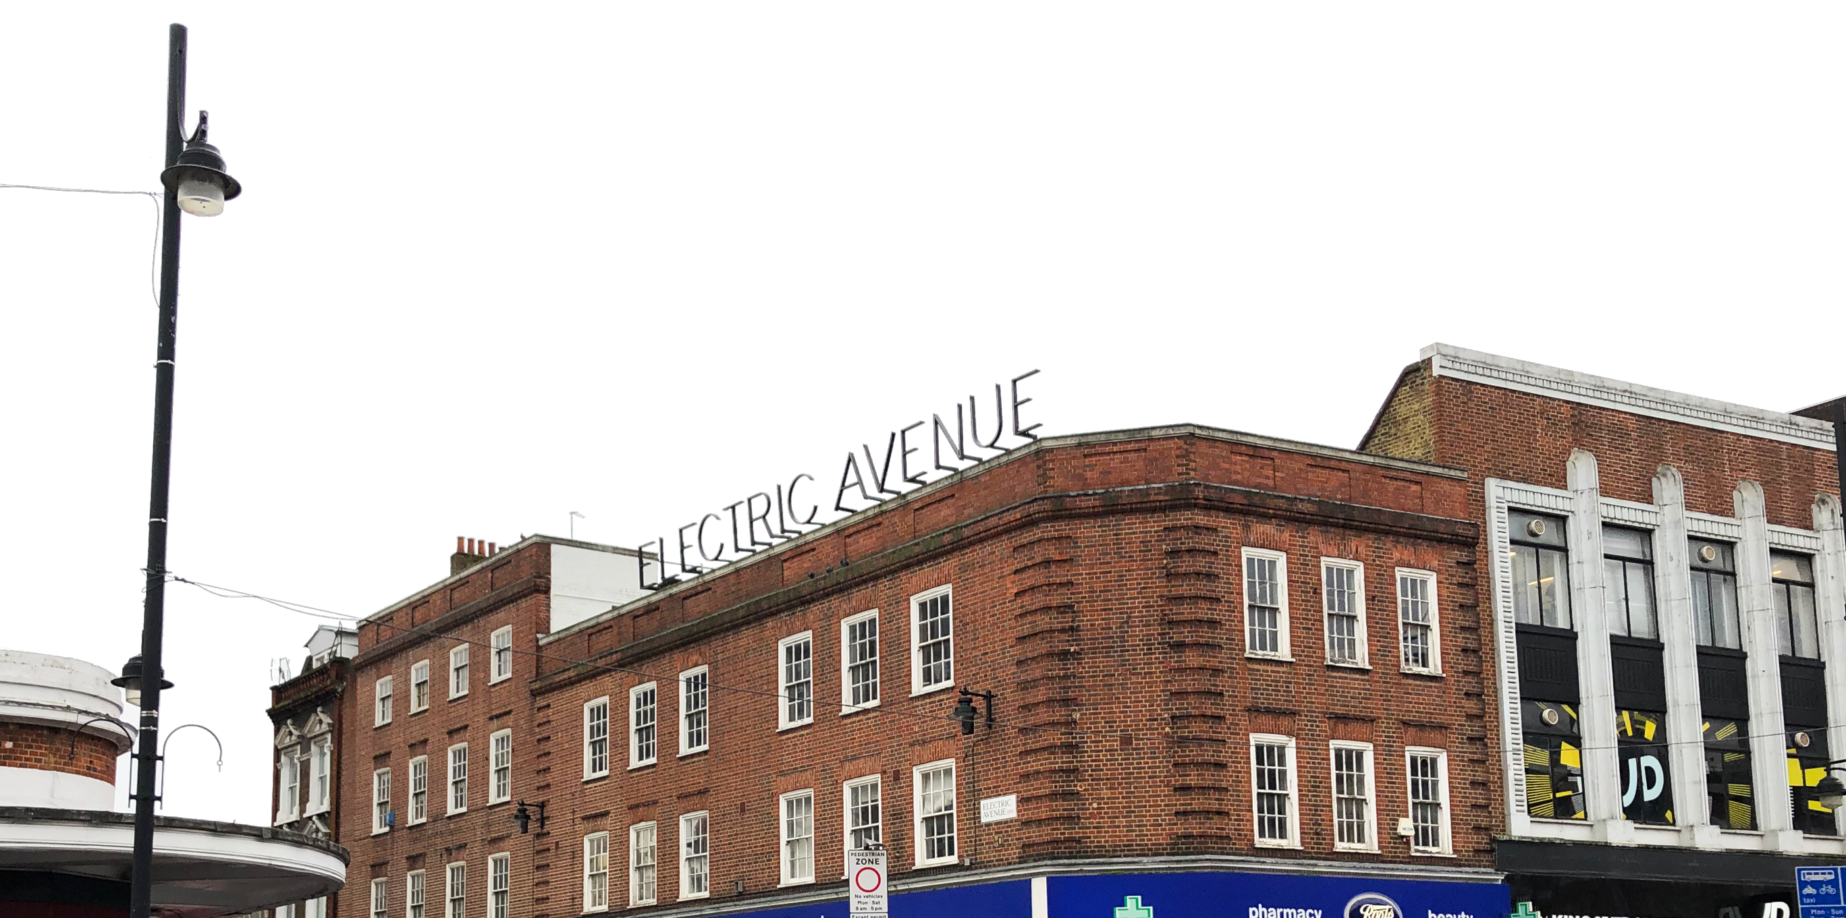
Project Goal
To develop and test an implementable anti-littering strategy that will assist Lambeth Council in addressing the problem of excessive littering in their borough.

Slide 5
Project Plan
Objective 1: Understanding individuals’ attitudes towards littering
Objective 3:
To design and test methods of preventing littering
Objective 4:
Developing a litter reduction plan for Lambeth
Goal
Objective 2: Characterizing litter in Lambeth
Weeks 1-3
Weeks 4-5
Weeks 6-7

Slide 6






Resident + Visitor Survey
Design
13
Questions
Multiple choice,
rating scales,
optional free response
5 Minutes
Objective 1: Littering Attitudes
Measuring attitudes towards littering and gathering opinions from residents and visitors
Distribution
(80 responses)
Paper Survey (21%)
Lamnet (19%)
Email (49%)
Twitter (11%)

Slide 7






Resident + Visitor Survey
Survey Opinion Trends
Believed littering is a significant issue
Supported recent FPN increases
Litter seen on street, at public transportation, near businesses
Objective 1: Littering Attitudes
Wanted more litter bins
Most not in favor of higher FPNs
Supportive of public education initiatives

Slide 8
Resident + Visitor Survey
Results Discussion
Littering is primarily an opportunistic behavior
  Environmental nudges (posters, etc.)
People blame external factors for littering rather than internal factors
  Promote sense of ownership by using community attachment
Most residents of Lambeth identify as Londoners rather than residents of Lambeth or their ward
  Use broad or London-centric messaging
  Use widely-recognizable Lambeth landmarks
Objective 1: Littering Attitudes

Slide 9
Civil Enforcement Officer Interviews + Observations
Topics Included:
Experience of litterer demographics
Objective Goals:
Understand Lambeth's littering dynamics
Where, when, and what
Refine the target of our anti-littering campaign
Workings of their job
Opinions on efficacy of FPNs
Objective 2: Characterizing Litter
Characterize the littering problem

Slide 10
Civil Enforcement Officer Interviews + Observations
Results Summary
Litter is most often:
  In areas and times of high foot traffic (i.e. transportation hubs, rush hours, lunch break)
  Cigarette ends
FPNs alone do not change littering behavior
  Most officers recommended advertising FPN prices with anti-littering policy
Many smokers improperly dispose of their cigarettes due to current bin designs
  Some officers agreed that improvements to bin or ashtray designs would reduce litter
Objective 2: Characterizing Litter
Which led to…

Slide 11
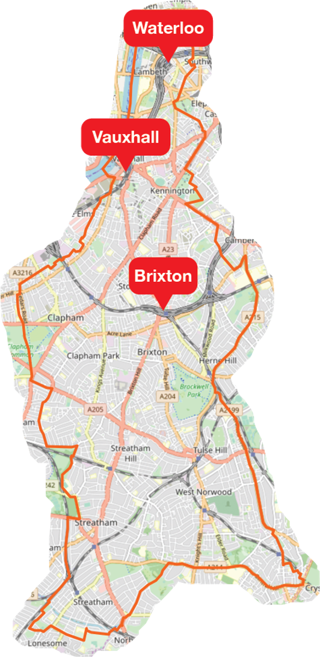
Civil Enforcement Officer Interviews and Observations
Updates to Our Campaign Focus
Where?
Underground stations
When?
Morning commute and lunch rush hours
What?
Cigarette ends
Brixton, Waterloo, and Vauxhall
Objective 2: Characterizing Litter

Slide 12
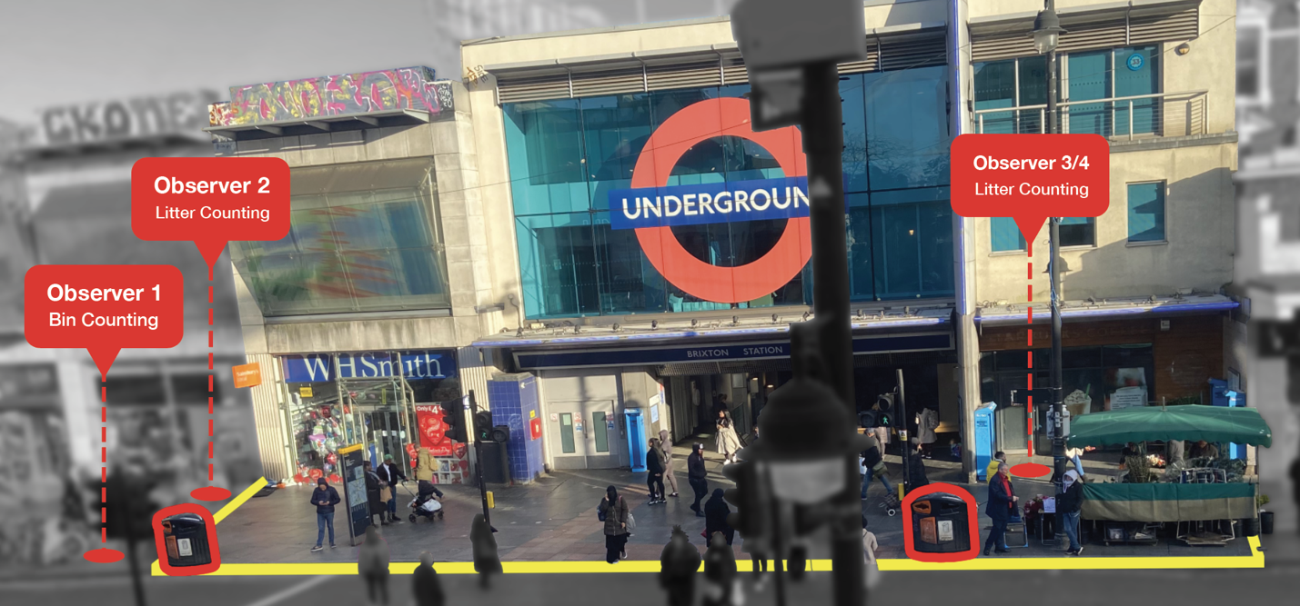
Cigarette Littering Observations
Method of Observation
Tallied total number of cigarettes disposed of properly, improperly, or littered in our zone
2 hours of observation per day
1 day per location
Objective 2: Characterizing Litter

Slide 13
Cigarette Littering Observations
Baseline Results Summary
45%
of all 213 discarded cigarettes observed ended up as litter
Objective 2: Characterizing Litter

Slide 14





Pilot Litter Reduction Campaign: Bin Posters
Objective 3: Designing a Campaign
Main components:
Target community attachment
Post FPN price
Use recognizable imagery
Notes:
With the information gathered, we determined that an advertisement campaign that targeted people’s community attachment as well as educated people on the negative repercussions of littering would be the best strategy towards changing people’s behaviors
Biggest Points:
Your and the landmarks make People feel accountable and get them involved in cleaning up their landmarks
Imposing black box at the bottom left includes the instructions on how to dispose of the cigarettes as well as the repercussion for not following said instructions
Lambeth council logo to give the posters an extra sense of legitimacy
Traingle Bin topper
- Since we observed many people using the bins incorrectly, we made the bin topper stickers seen here which clearly explain the correct method for one to dispose of their cigarettes in hopes that it would be able to decrease the amount of improper disposals we observed

Slide 15
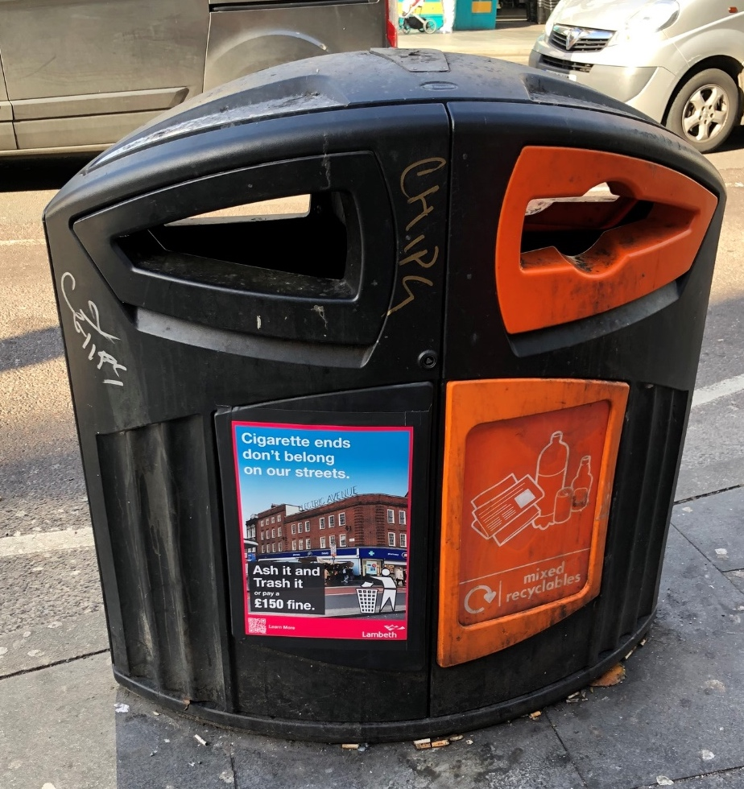
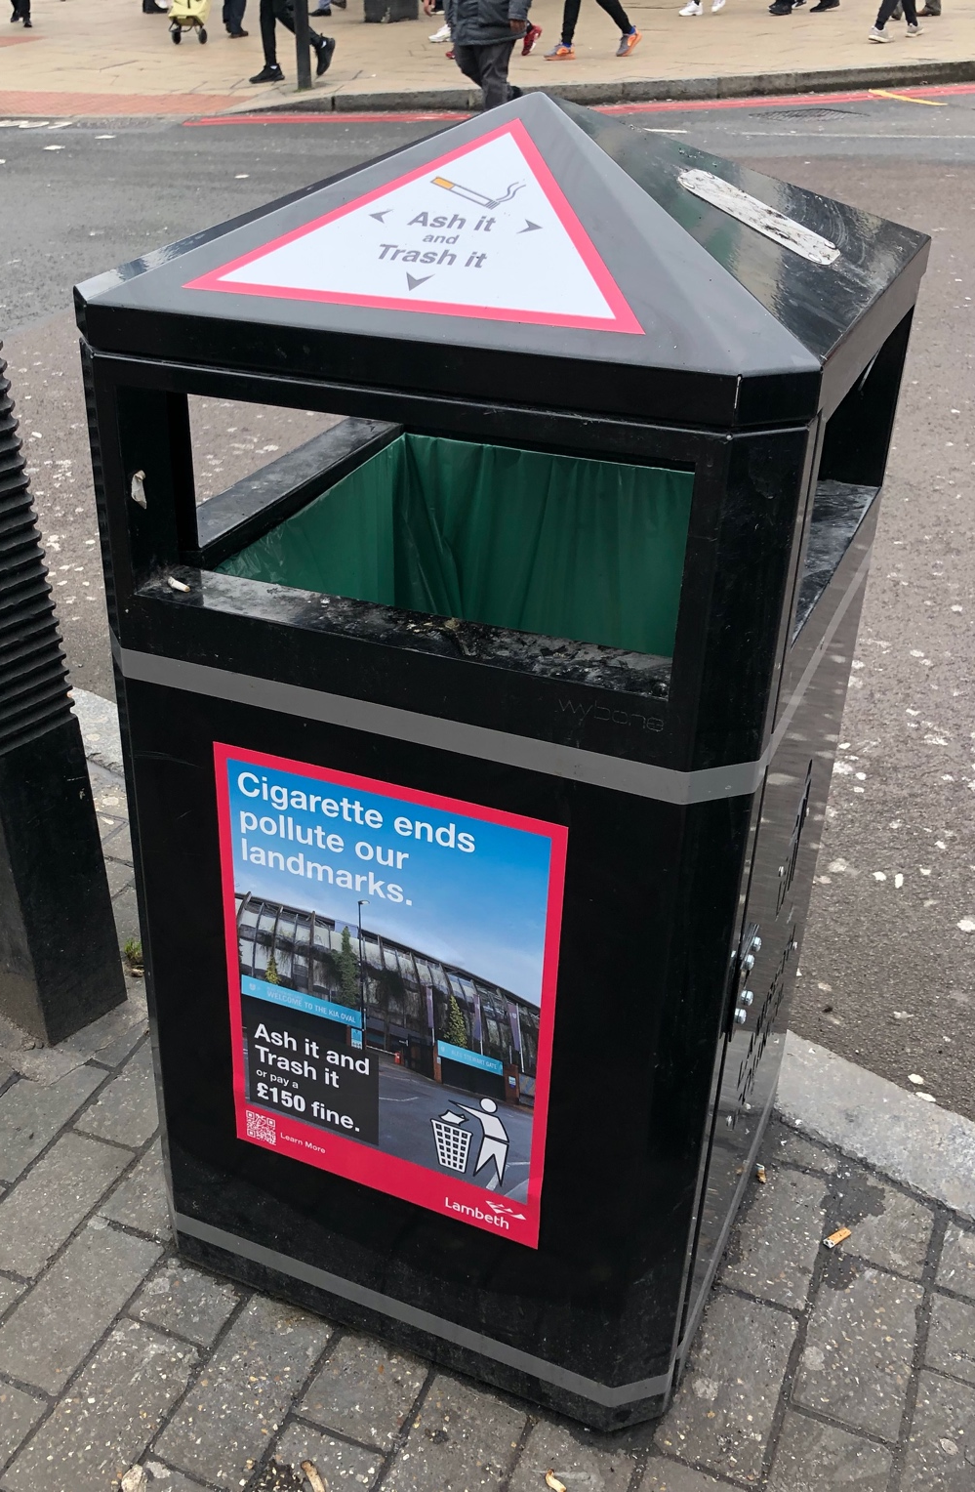
Pilot Campaign: Posters in Action
Objective 3: Designing a Campaign
Notes:
The bin topper can be seen here on the litter bins.
These were effective as they were clearly visible to smokers when they were attempting to dispose of their cigarettes and we hoped that this would educate them and stop them from properly disposing.
Here the other posters can be seen on the bins and once they were all affixed we ran out observations with the same method as matthew explained earlier

Slide 16
Pilot Campaign: Observations
Post-Campaign Results Summary
27%
of all 186 discarded cigarettes observed ended up as litter
Objective 3: Testing a Campaign
Notes:
Once these were run, we found that …

Slide 17


Pilot Campaign: Efficacy
Baseline
Post-Campaign
45%
27%
39%
Objective 3: Testing a Campaign
Confounding variables:
less
cigarette littering
and improper disposal

Slide 18





Advertisement Campaigns
Poster Design Suggestions
Build off residents’ community attachment
Post the price of FPNs
Use Bin Toppers
Educate smokers
Have officers start to enforce improper disposals
Objective 4: Recommendations
Reasoning:
Success of our campaign
Locations
High foot traffic locations
Transportation hubs

Slide 19
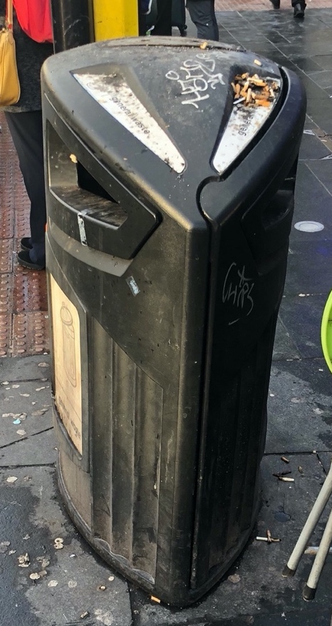
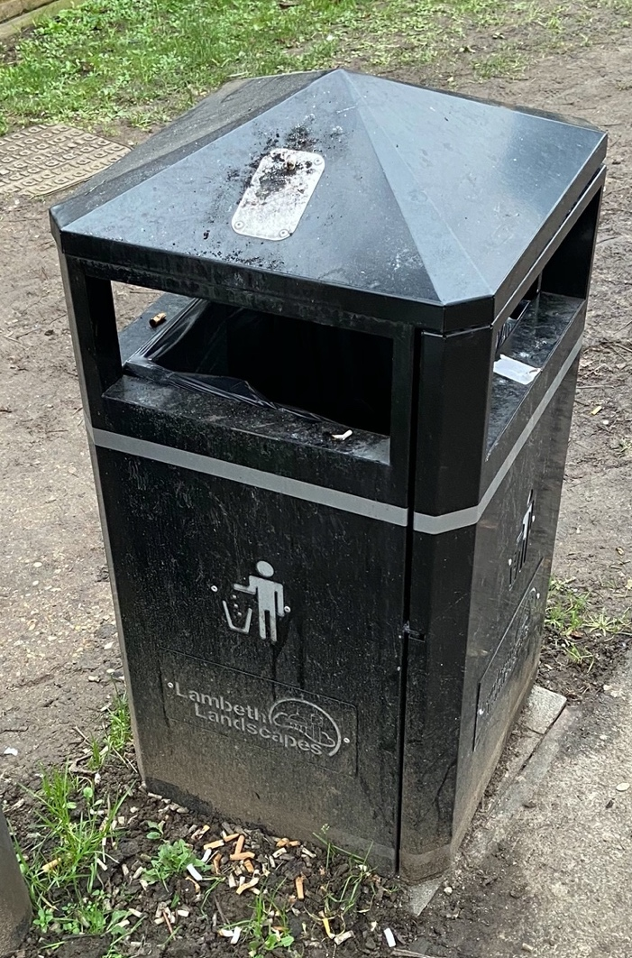
Bin Designs: Current
Brixton Bins
Waterloo & Vauxhall Bins
Objective 4: Recommendations
Reasoning:
Officer interviews
Our own observations
Has an ashtray
Two compartments
Easy to use
Stubber plate
Small ashtray openings
Small trash compartment openings
No recycling
Trash blows out of bin
No ashtrays
Pros | Cons
Has Ashtray | Small holes difficult to use
Recycling and Trash | Trash gets jammed in openings
Pros | Cons
Ease of use | No recycling
Stubber Plate | Trash blows out

Slide 20
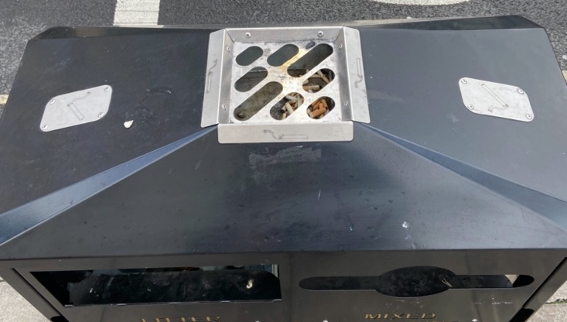
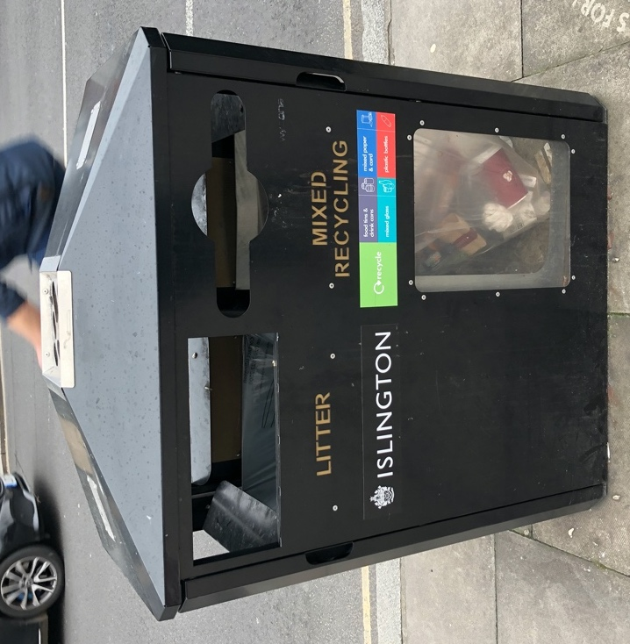
Bin Designs: Our Suggestion
Our Proposed Design
Separate compartments
Accessible openings
Stubber plates
Large, easy to operate ashtray
Objective 4: Recommendations
Reasoning:
Our research and personal observations

Slide 21
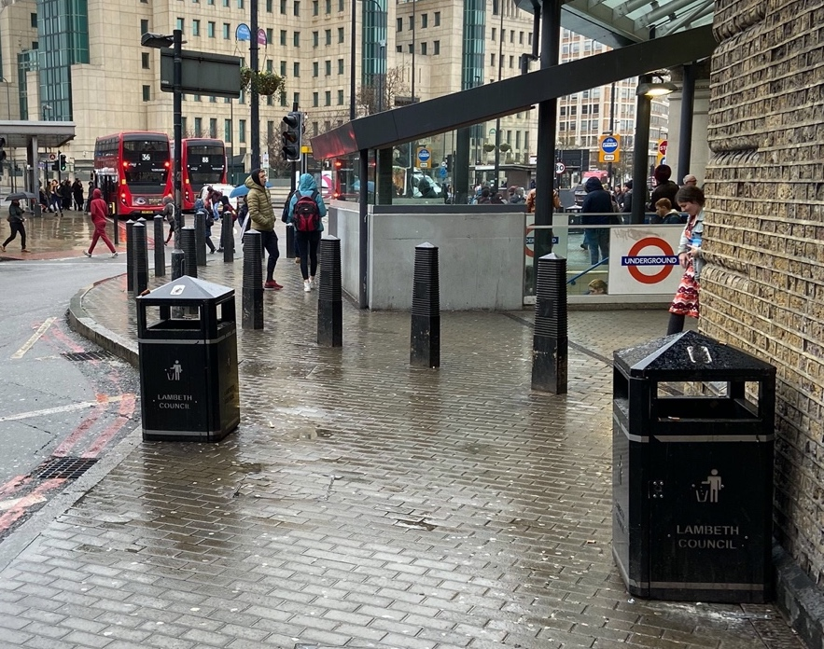
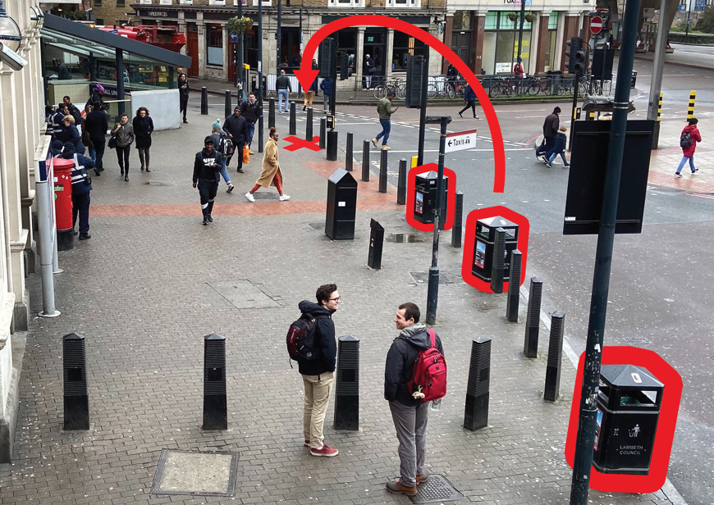
Bin Locations
Bins should be spread out more to cover larger areas & placed in high-visibility locations
Objective 4: Recommendations
Reasoning:
Our own observations
Survey responses
Consider placing bins or ashtrays where people typically smoke
Notes:
People in the survey said they wanted more litter bins, but we saw plenty of litter in areas with many litter bins
We observed a few cases where bins were clustered close together
We suggest that in these instances some bins should be moved further apart to service a larger area
Additionally, we found that bins were mostly placed near the street on the edge of the pavements.
We saw that many smokers congregated closer to the buildings, in the shade, and under awnings.
Current bin placements aren’t near where cigarette litter is generated, and this means that there is a higher chance that smokers will litter their cigarette either because they didn’t see a bin from where they were smoking or they didn’t want to walk to it

Slide 22
Community Cleanup
54% of residents
In four weeks,
the Great British Spring Clean accumulated over
Objective 4: Recommendations
showed interest in a cleanup event
Reasoning:
Background research
Survey responses
950,000
bags of litter
Notes:
Your residents show interest and they have shown to be effective so do them
IF the cost seems to high you can also ask for sponsorship to help mitigate this issue

Slide 23


  Educational Campaign for School Children
Educate
Apply
Information sessions on litter
Create campaign materials
Objective 4: Recommendations
Reasoning:
Background research
Survey responses
Notes:
67.5% of people suggested Public Education as a possible solution to littering as well as Litter Less Campaign
Have council run educational campaigns for young students as they are the most open to new ideas with either people from the council or CEOs
With this information the students could then apply the knowledge and create either campaign posters or paint a litter bin provided by the council. This material could then be used as it will be eye catching, interesting, and have a lesser chance of being defaced

Slide 24
Thank You for Listening!
And a special thank you to our sponsors at Lambeth Council:
Ashley Brandon,
Gaynor Brown,
and Andy Skilton
Notes:
Thank you all for listening and to Lambeth council for sponsoring our project as well as a special thanks to Ashley Gaynor and Andy for supporting us throughout the project

Slide 25

Using Behavior-Change Strategies to Reduce Littering in Lambeth
Questions?
Prepared by:
Paul Bonarrigo
Matt Iaconis
Ryan Johnson
Brendan McCann
Notes:
Paul has the big gay

Slide 26
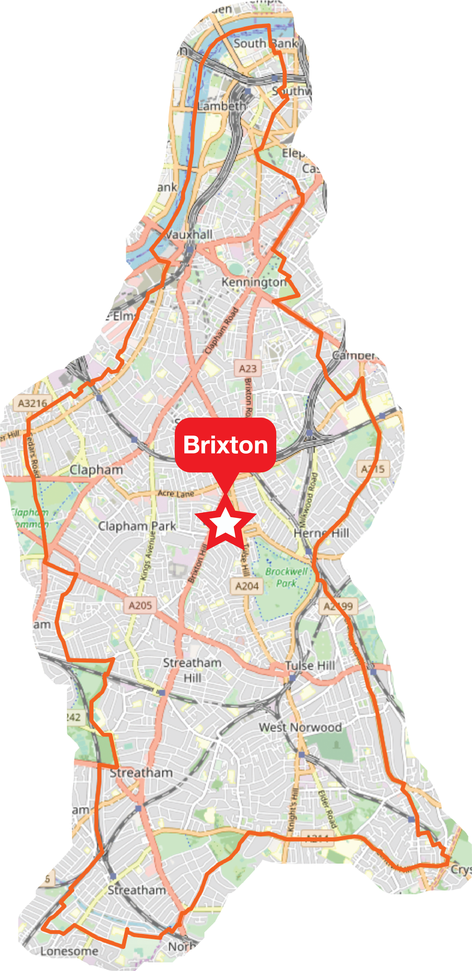
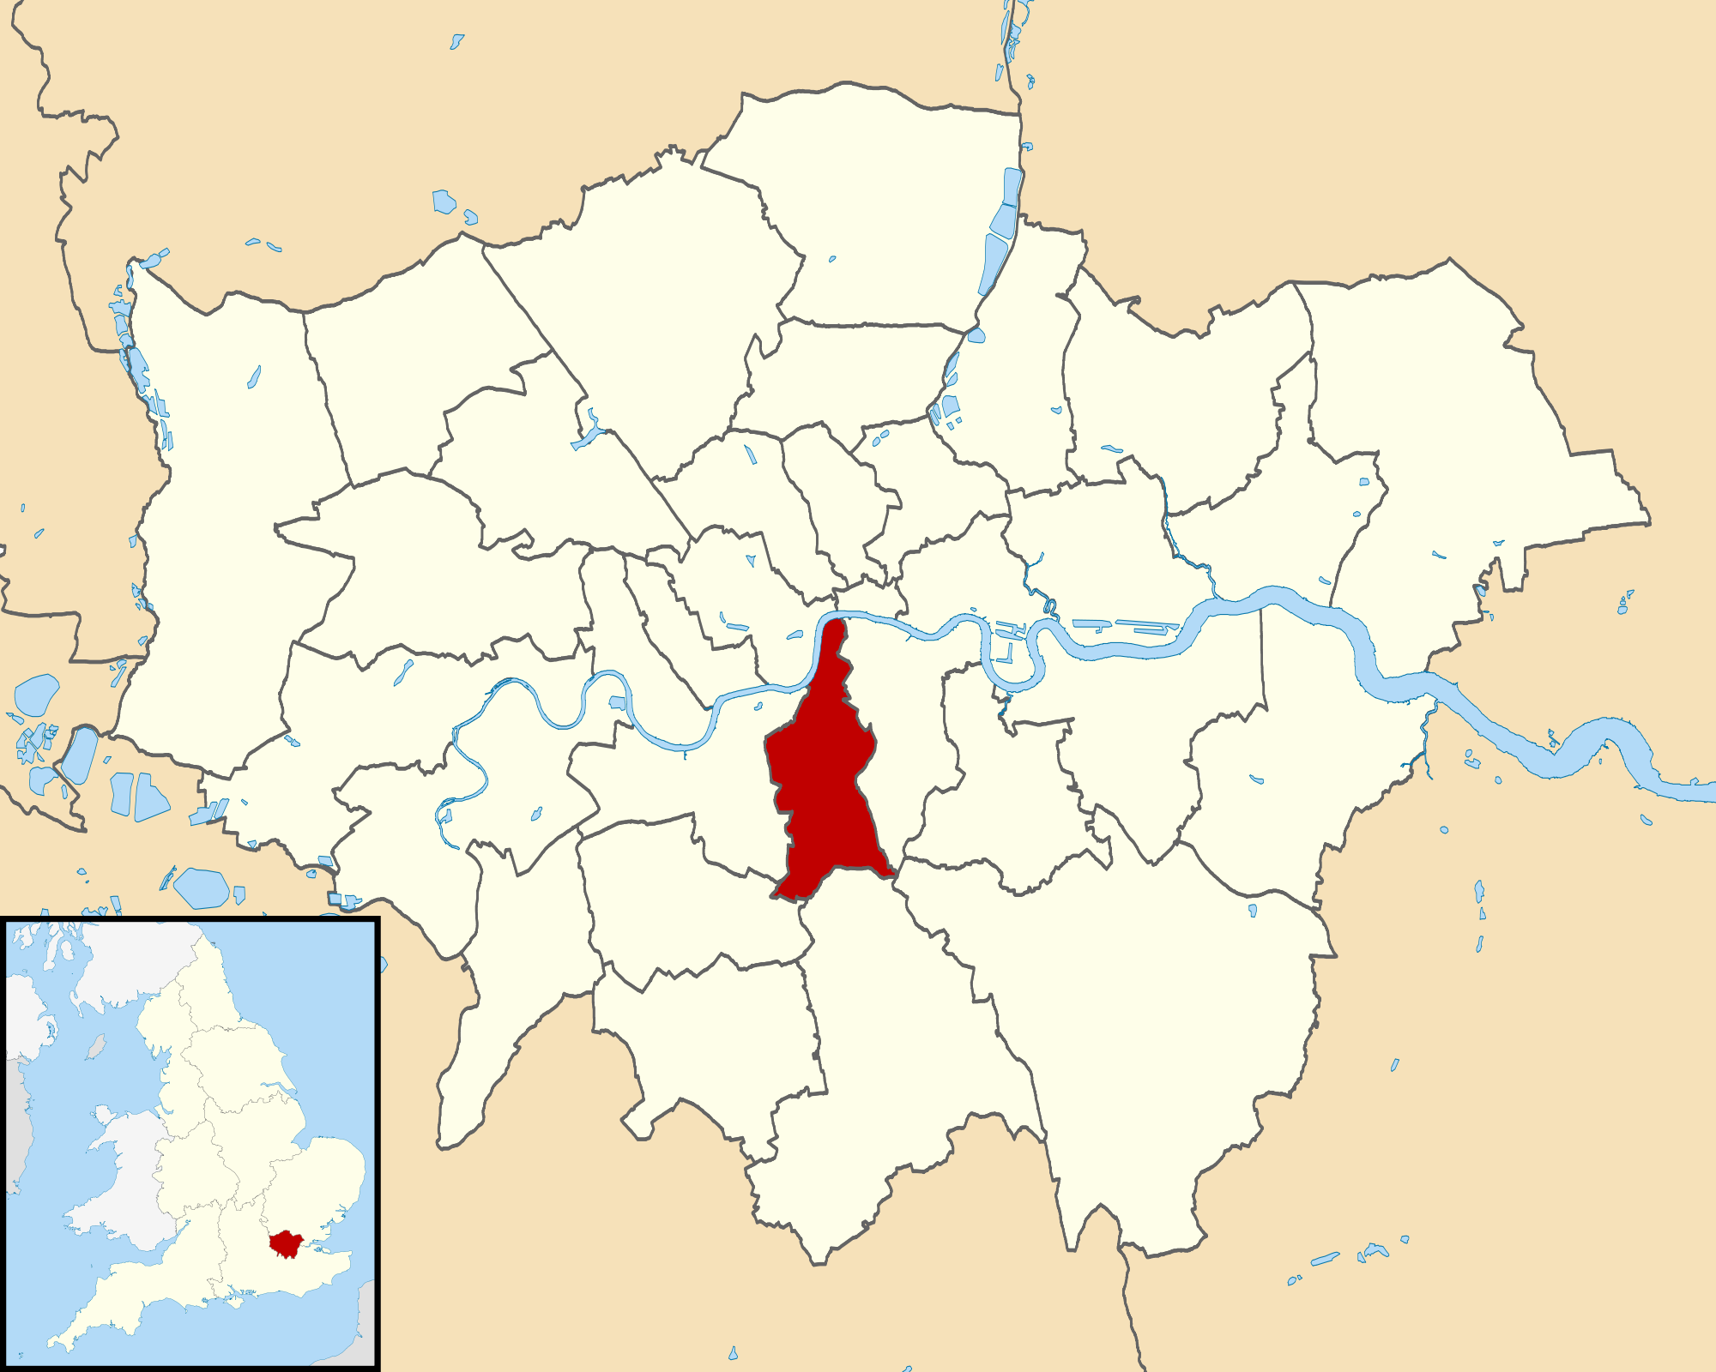
Lambeth Council
Highways and Environmental Enforcement Team
Lambeth ​
Central London ​
Over 325,000 residents
Highways and Environmental Enforcement Team
Work to decrease littering
26

