Slide 1
Applying Cluster Computing With Raspberry Pis to Numerical General Relativity
By: Zack Chester
Advised by: Shanshan Rodriguez and Leo Rodriguez (Assumption College)

Slide 2
General Overview
Project Introduction
Background/General Formulation
Schwarzschild and Kerr Metrics
Cluster Computing
Gravitational Waves
Future Applications
Questions

Slide 3
Project Introduction
Focused on applying cluster computing to numerical general relativity
Goals:
Create an analytic solution to the Kerr Metric
Simulate gravitational waves
Develop a cluster computer capable of aiding in the previous two goals

Slide 4
Einstein’s Big Predictions
Perihelion precession of Mercury (~43”/century)
The bending of light
Gravitational waves

Slide 5
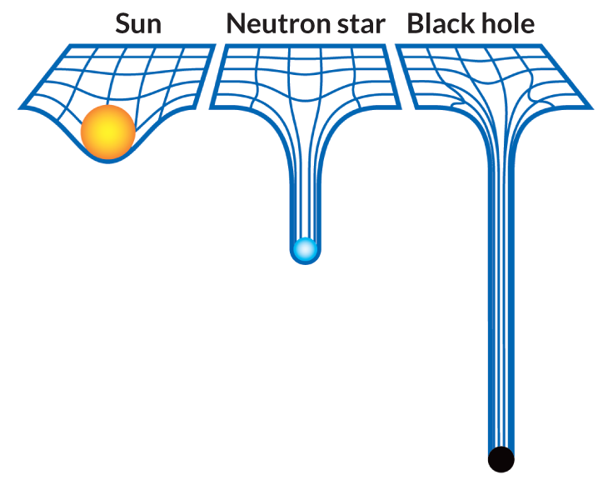
General Relativity Considerations
Consider gravity as a geometry
Flat plane:
2-Sphere:

Slide 6
Metrics
Metrics describe the geometry of a surface
The simplest metric, after Lorentz transformation, is the metric for flat space
This is the Minkowski metric
η = $\left[\begin{matrix}−1 & 0 & 0 & 0 \\ 0 & 1 & 0 & 0 \\ 0 & 0 & 1 & 0 \\ 0 & 0 & 0 & 1\end{matrix}\right]$
Other metrics are used to describe black holes

Slide 7
Einstein Field Equations
Set of 16 coupled partial differential equations used to describe gravitational effects on a given mass
Defined as:
Rµν - $\frac{1}{2}$Rgµν + Λgµν = $\frac{8πG}{c^{4}}$Tµν

Slide 8
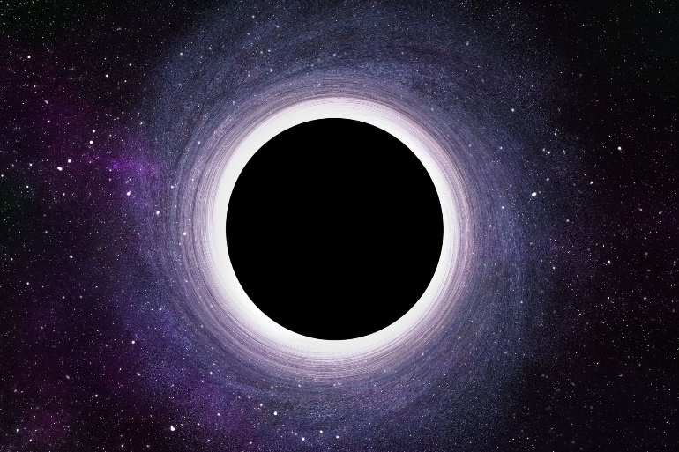
Black Hole Metrics
Metrics of varying complexity used to describe black holes
‘Simpler’ Schwarzschild metric describes uncharged, non-rotating black holes
Kerr metric describes a rotating, uncharged symmetric black hole

Slide 9
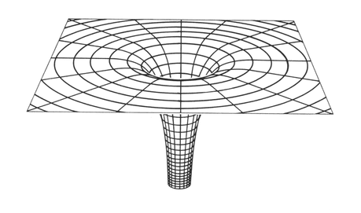
Schwarzschild Metric
Describes and uncharged, non-rotating black hole
Has coordinates:
($x^{0}$, $x^{1}$, $x^{2}$, $x^{3}$) = (t, a, Ɵ, ɸ)
Identified as:
gµν = $\left[\begin{matrix}−(1−\frac{2GM}{ac^{2}}) & 0 & 0 & 0 \\ 0 & {(1−\frac{2GM}{ac^{2}})}^{−1} & 0 & 0 \\ 0 & 0 & a^{2} & 0 \\ 0 & 0 & 0 & a^{2}\sin^{2}Ɵ\end{matrix}\right]$

Slide 10
Kerr Metric
Describes a rotating uncharged symmetric black hole
Defined as:
With:
$Ω$ considered to be an arbitrary constant
f($a$) = $\frac{△}{a^{2} + b^{2}}$
A($a$) = $\frac{b}{a^{2} + b^{2}}$
△($a$) = $a^{2}$ + $b^{2}$ $−2GMa$
$ɸ$ the goal to solve for

Slide 11
Solving for $ɸ$ and $Ω$
Multiple ways to complete
By hand
Through computation software
Mathematica
Matlab
Ultimately Mathematica was chosen

Slide 12
Benefits of Mathematica
Ability to analyze complex operations in a short amount of time
Easy to use symbolic math
Capable of parallel integration
Computations performed with EDRGTCcode package
Mathematica Version 11.2 used

Slide 13
Scalar Curvature

Slide 14
Ricci Tensor

Slide 15
Stress Energy Tensor

Slide 16
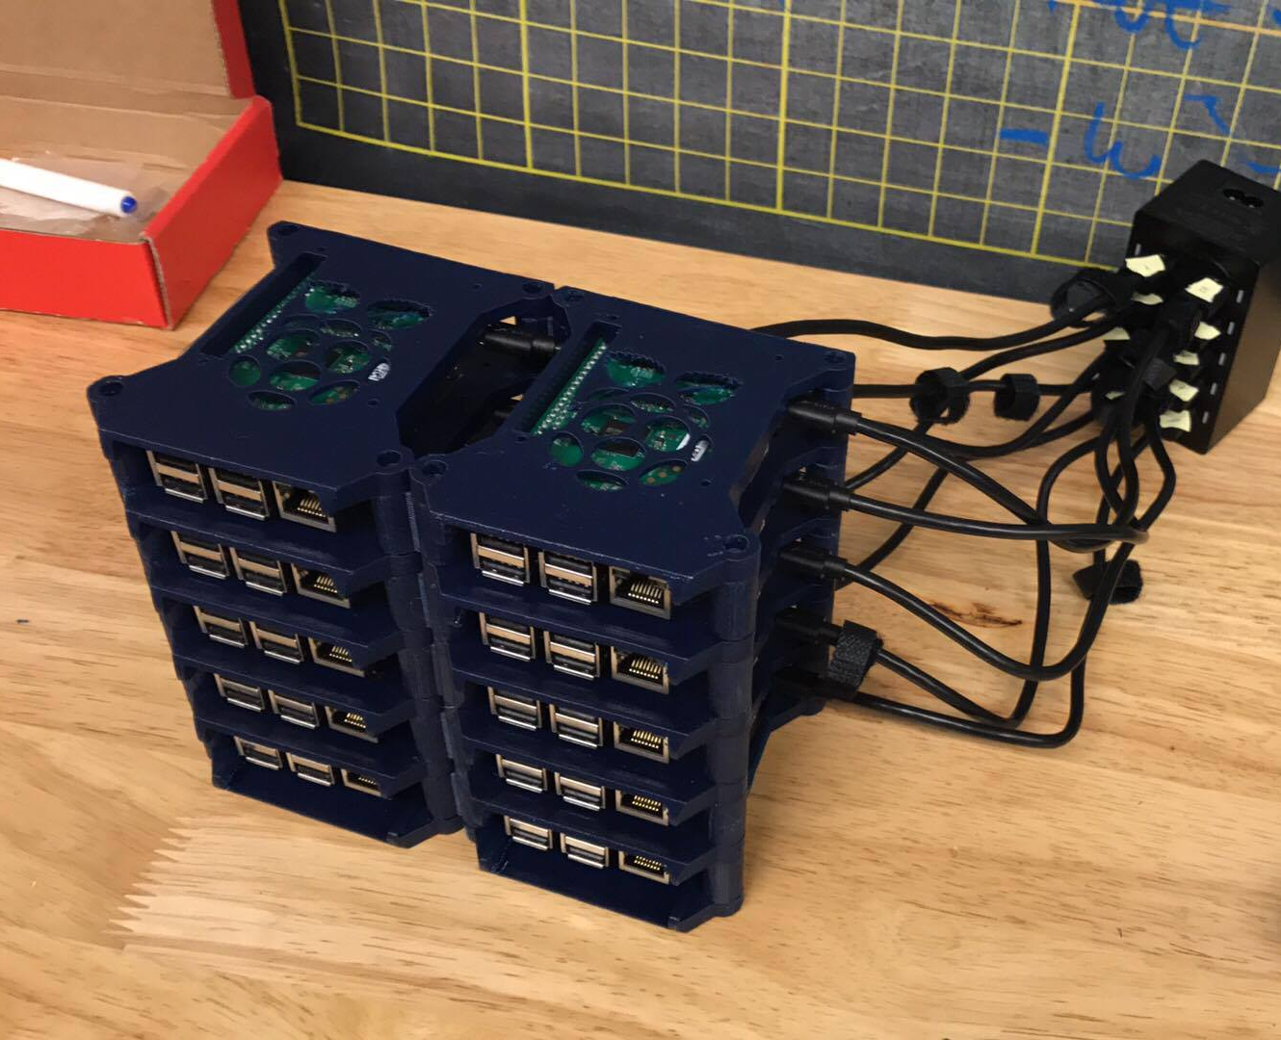
Cluster Computing
Set of computers tethered together to act as a single system
Each node is set to perform the same task with its own operating system
Together, the computers act like one massive computer

Slide 17
Benefits
Lower cost than a computer with comparable specifications
Easy to increase and decrease nodes
If certain nodes fail, data may easily be recovered
Reliable data storage/recovery

Slide 18
How Does It Work?
A “master” node directs computational “slave” nodes
User interacts with the master node, which directs slave nodes
Slave nodes have their own operating systems, memory, and disk space

Slide 19
Direct Applications
Effective
Sustainable
Learning Experience

Slide 20
Times Where Clustering Is Not Optional
Calculating simple values
Sparse matrices
Calculating pi:
1 node: ~0.0014 seconds
3 nodes: ~0.0046 seconds
10 nodes: ~0.0086 seconds

Slide 21
Other Applications for Cluster Computing
Simulating gravitational wave calculations
Specifically those measured by LIGO and Virgo
Done with Mathematica

Slide 22
LIGO and Virgo
Interferometers used to detect gravitational waves
LIGO is composed of two interferometers, Virgo is composed of one
All are Michelson interferometers

Slide 23
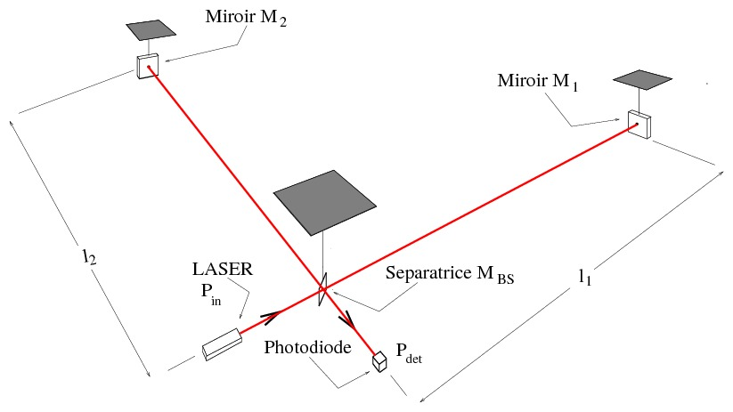
Michelson Interferometer

Slide 24
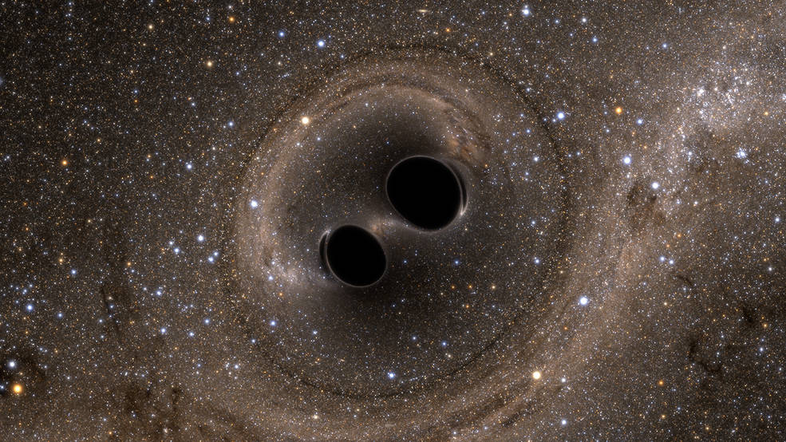
Calculations Associated With LIGO and Virgo Observations
Rely on Post-Newtonian theory
Approximate version of general relativity that applies to weak gravitational fields and slow motion of matter
Provides a foundation to calculate gravitational waves emitted by compact binary systems and can show orbital evolution under radiative losses
${\text{(}\frac{v}{c}\text{)}}^{n}$ is of ($\frac{n}{2}$)PN order

Slide 25
Creating an Expression for Waveforms
Need a formulation to describe a gravitational wave as it propagates through a detector of the form:
h$\begin{matrix}TT \\ ij\end{matrix}$ = ${\left\langle g_{ij}−{\text{η}}_{ij}\right\rangle }^{TT}$
Detector is sensitive to waveforms described as:
h(t) = $F_{+}$ $h_{+}(t)$ + $F_{x}$ $h_{x}(t)$

Slide 26
Final Form

Slide 27
Numerical Results

Slide 28
Simulations
Source: LIGO Scientific Collaboration and Virgo Collaboration

Slide 29
Other Applications
Einstein Toolkit
Charged rotating black holes
More precise gravitational field calculations

Slide 30
Any Questions?

Slide 31
Extra Slides

Slide 32
Matlab vs. Mathematica
Matlab Benefits
Easy to set up scripts to run in parallel
Can run symbolic scripts
Experience with the language
Free for WPI students
Cons
Not as widely used for general and numerical relativity research
Mathematica benefits
Easy to set up scripts to run in parallel
Free with Raspberry Pi’s
Easily evaluates symbolic scripts
Existing use in general and numerical relativity research
Cons
Minimal personal experience

Slide 33
Cluster Specifications
10 Raspberry Pi 3 Model B’s
10 ethernet cables
1 USB 10 Way Power Splitter
9 16GB SD cards
1 64GB SD card
1 10 port ethernet switch
A monitor, mouse, and keyboard

Slide 34
Arriving at h$\begin{matrix}TT \\ ij\end{matrix}$
Start at Reimann tensor
Get the Ricci tensor and scalar curvature
This gives the Einstein tensor
Create a trace-reversed perturbation
Using an infinitesimal coordinate transformation, can arrive at h$\begin{matrix}TT \\ ij\end{matrix}$

Slide 35
Ricci Tensor

Slide 36
(1, 1)

Slide 37
(1, 4)

Slide 38
(2, 2)

Slide 39
(3, 3)

Slide 40
(4, 1)

Slide 41
(4, 4)

Slide 42
LIGO/Virgo Specifications
Detect a shift smaller than 1/10,000 the diameter of a proton
Each about 2.5 miles long
6 detections so far
5 of black holes
1 of a binary system

