Slide 2
Tissue-Engineered Skeletal Muscle Stimulator
Syed Asaad Hussain
Spencer Ryan Keilich
Stephanie Jo Lindow
Shreyas Renganathan
Notes:
Asaad

Slide 3
Overview
Background
Significance
Drug Approval Process
Background Research
Current Devices
Project Direction
Problem Statement
Goals
Objectives and Constraints
Design Specifications
Alternative Designs
Design Evaluations
Final Design
Final Design Diagrams
Proof-of-concept
Design Validation
Demonstration (Video)
Conclusions & Recommendations
Notes:
Asaad

Slide 4
Background

Slide 5
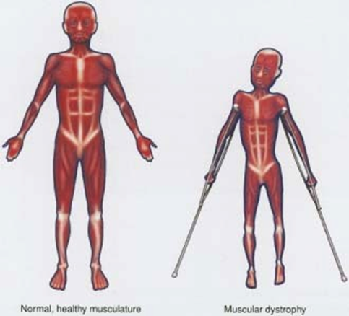
Significance
Serious injuries and disease can lead to the loss or damage of skeletal muscle tissue
Example: Muscular Dystrophy affects 32,000 people between the ages of 5-24 annually in the USA [1]
Annual cost of treatment is $4,600/person [1]
In vivo animal models lack the essential genetic component to model disease
Example: Facioscapulohumeral Muscular Dystrophy
There is a need for accurate human in vitro skeletal muscle models
[2]

Slide 6
Drug Approval and Our Device
Our Device saves money and time
Drug Discovery
Pre-Clinical
Clinical
2-10 Years
3-6 Years
6-7 Years
90% Failure

Slide 7
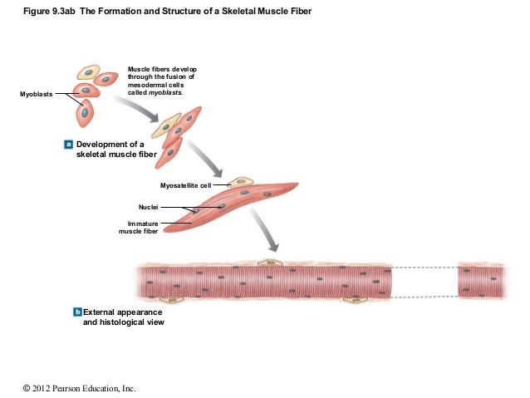
Muscle Formation from Cells

Slide 8
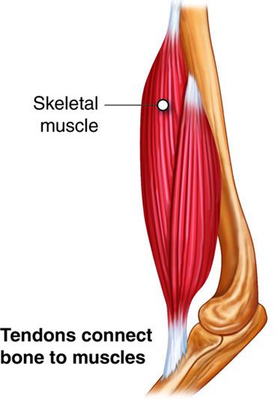
Key Characteristics of Muscle
Anchorage
Stimulation

Slide 9
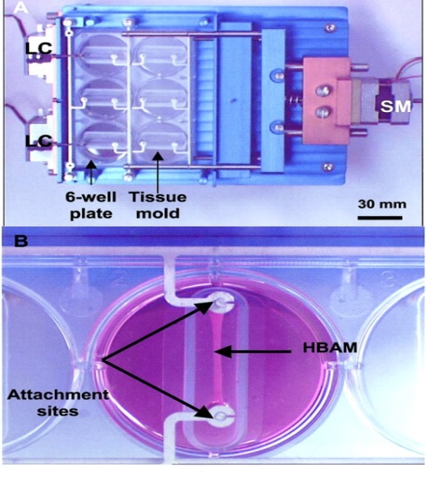
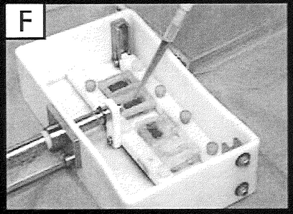
Current Devices
[1]
[2]
[1]
[3]

Slide 10
Problem Statement
No in vitro system that produces accurate models of in vivo skeletal tissue.
Current Systems:
Device | Sample Quantity | Cell Density (cells/construct) | Construct size | Anchorage | Standard Incubator | Stimulation Location
Vandenburgh | 8 | 1-4 × 10⁶ | 25mm | Dog-bone | No | In incubator
Vandenburgh | 24 | 0.4 x 10⁶ | 176.5mm^2 | 2D tissue | No | In incubator
Myomics | 96 | 0.2 x 10⁶ | 3.5mm | Dog-bone | No | No stimulation
Powell | 6 | 1×10⁶ | 21.4mm | Dog-bone | Yes | In incubator
Christ | 6 | 2 x 10⁶ | 15mm | Clamped | No | Out of incubator
Dennis | 4 | 0.5 x 10⁶ (Growth Media) | ~40mm | Sutured | Yes | Out of Incubator

Slide 11
Flaws in Current Systems
Device | Sample Quantity | Cell Density (cells/construct) | Construct size | Anchorage | Standard Incubator | Stimulation Location
Vandenburgh | 8 | 1-4 × 10⁶ | 25mm | Dog-bone | No | In incubator
Vandenburgh | 24 | 0.4 x 10⁶ | 176.5mm^2 | 2D tissue | No | In incubator
Myomics | 96 | 0.2 x 10⁶ | 3.5mm | Dog-bone | No | No stimulation
Powell | 6 | 1×10⁶ | 21.4mm | Dog-bone | Yes | In incubator
Christ | 6 | 2 x 10⁶ | 15mm | Clamped | No | Out of incubator
Dennis | 4 | 0.5 x 10⁶ (Growth Media) | ~40mm | Sutured | Yes | Out of Incubator

Slide 12
Goals
Goal: Design an in vitro stimulation system that produces accurate models of in vivo skeletal muscle tissue in terms of cell density and tissue maturation by focusing on
Tissue Anchorage
Tissue anchorage representative of muscle-myotendinous junction attachment
Minimizing Resources
Use of minimal functional units of engineered muscle, to minimize seeded-cell quantity and maximize throughput
Mechanical Stimulation
Stimulation in in vivo like conditions
Mechanical stimulation representative of in vivo passive and active muscle movement

Slide 13
Objectives and Constraints
Objectives:
Reliability and Consistent Results
Mechanically Stimulate Tissue
Efficient
Reusable
High throughput
User Friendliness
Constraints:
Sterilizable
Must withstand in vitro culture conditions
37 ºC
99% humidity
5% CO₂
Non-cytotoxic
Operate while in incubator

Slide 14
Design Specifications
Stimulation Specs:
Mechanical Stimulation
Uniaxial strain
Controllable strain between -50% to 50%
Static and cyclic capabilities
Controllable strain rate
Controllable frequency of stimulation
Tissue Culture Specs:
Tissue Structure
Dog-bone shape
Minimal Functional Unit
Length: 3-4 mm
Diameter: 1 mm
Cell Source
C2C12 (Myoblast)
500,000 cells/120uL

Slide 15
Alternative Designs

Slide 16
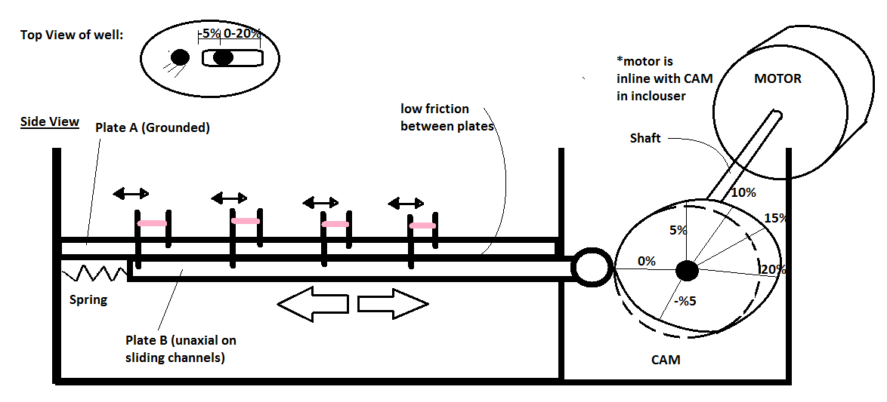
Motor Driven

Slide 17
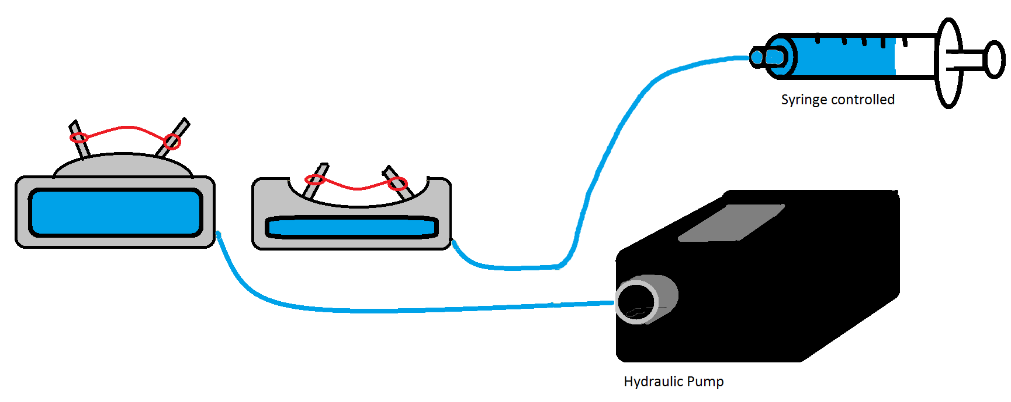
Fluid/Hydraulic Driven

Slide 18
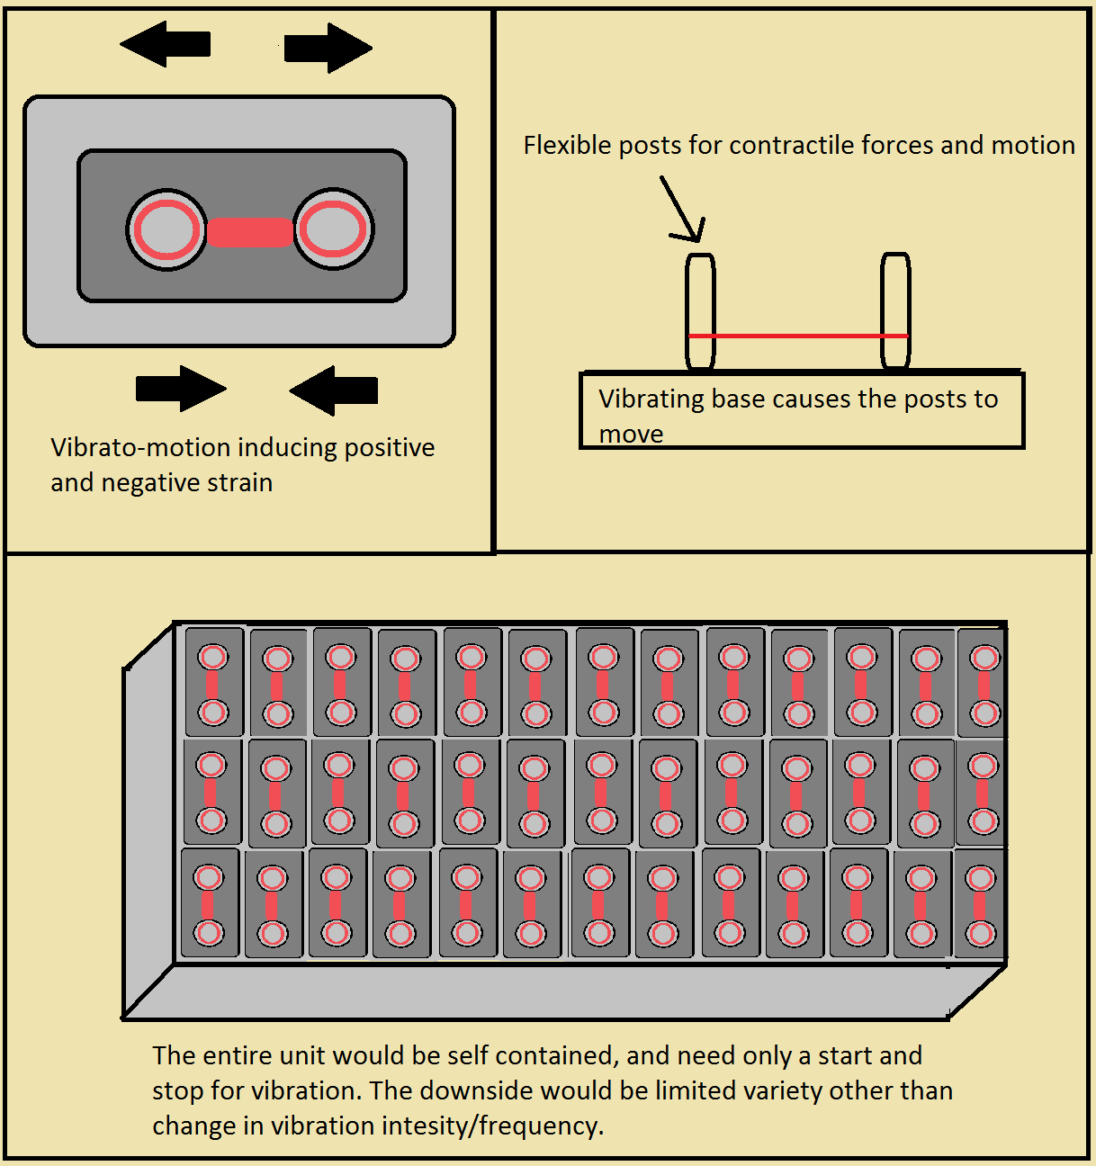
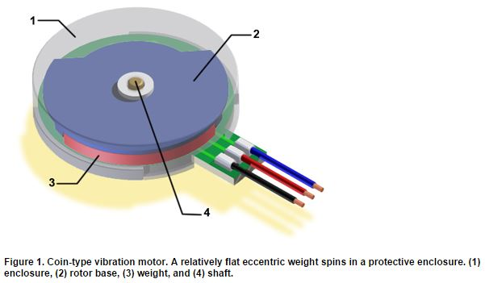
Vibration Driven
[1]

Slide 19
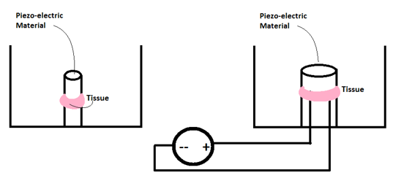
Materials Design

Slide 20
Design Evaluation
Design Means | Strain -50% to 50% (with initial length of 3.5 mm) | Representative of muscle bone attachment (uniaxial) | Expandable for high throughput | Electric/power components outside incubator | Controllable by user settings | Number of Functions Fulfilled
Stepper Motor and Cam | Yes | Yes | Yes | No | Yes | 4/5
Screw Driven | Yes | Yes | Yes | No | Yes | 4/5
Vibration | No | Yes | Yes | No | No | 2/5
Scissor Linkage | Yes | Yes | No | Yes | Yes | 4/5
Hydraulic/ Pneumatic | Yes | Yes | Yes | Yes | Yes | 5/5
Piezoelectric Material | Yes | No | Yes | Yes | Yes | 4/5
Thermo-responsive | Yes | No | Yes | Yes | No | 3/5
Conductive Polymer | yes | No | Yes | Yes | Yes | 4/5

Slide 21
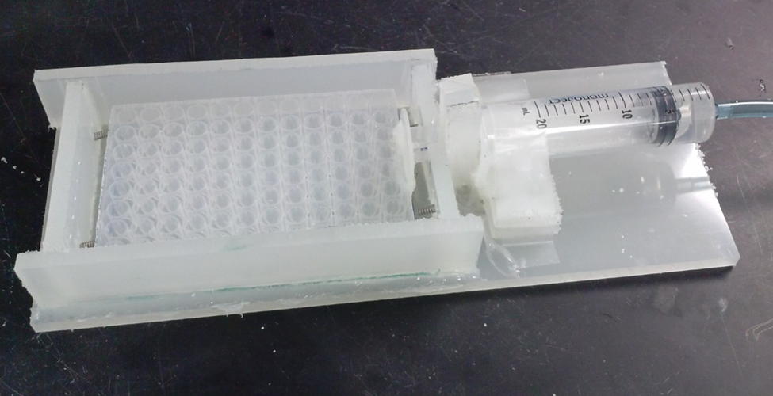
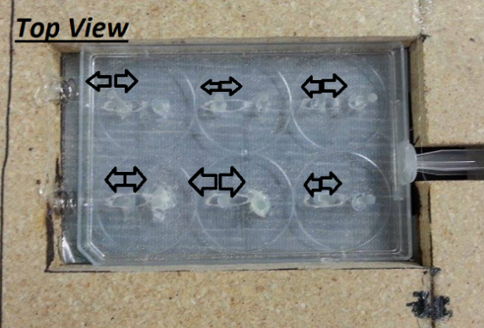
Final Design Prototype Progression

Slide 22
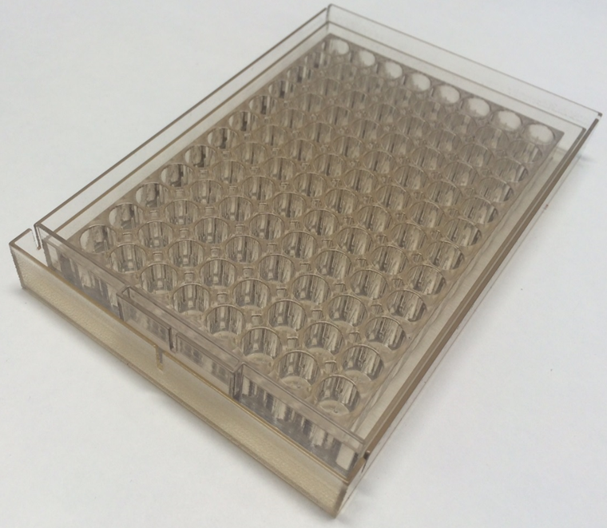
Final Design

Slide 23
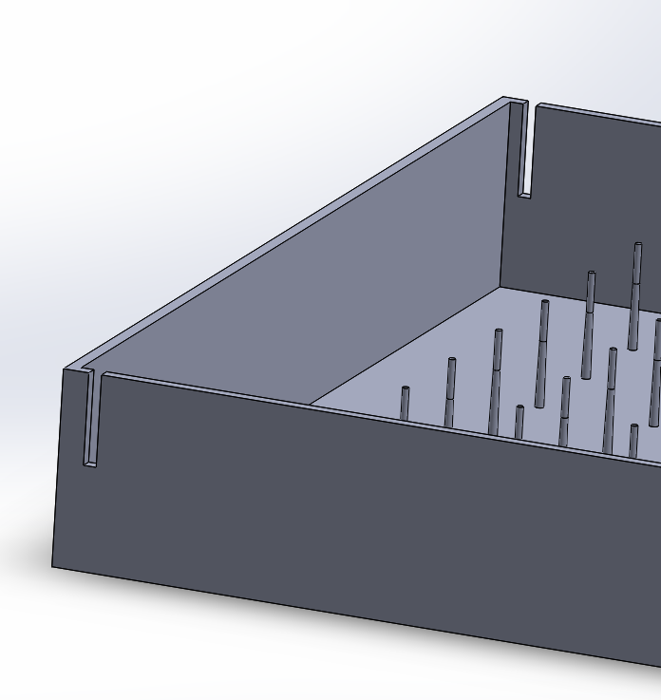
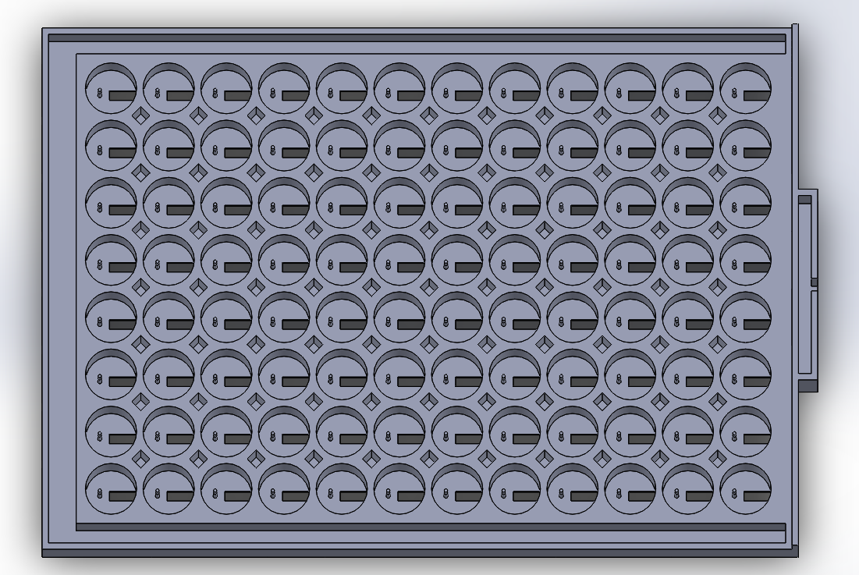
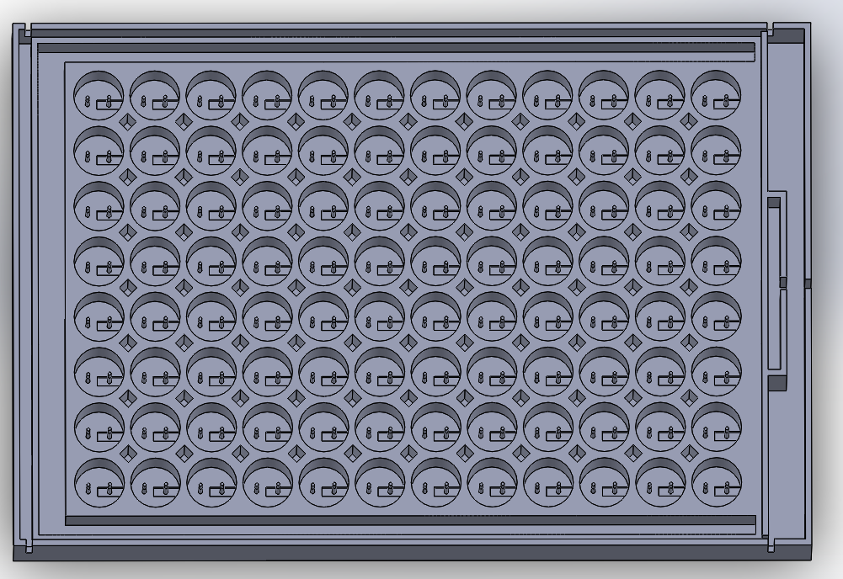
Final Design: Plates
Bottom Plate
Top Plate
+
=

Slide 24
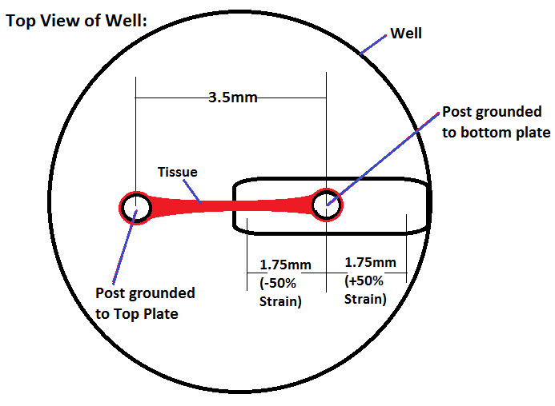
Final Design: Well and Post Design

Slide 25
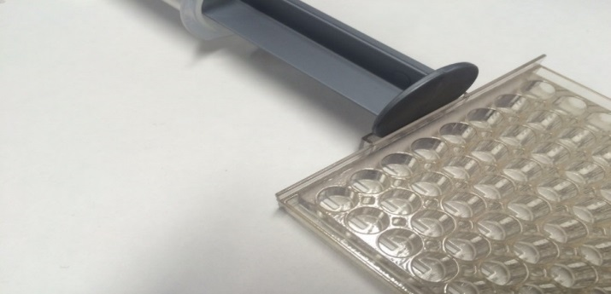
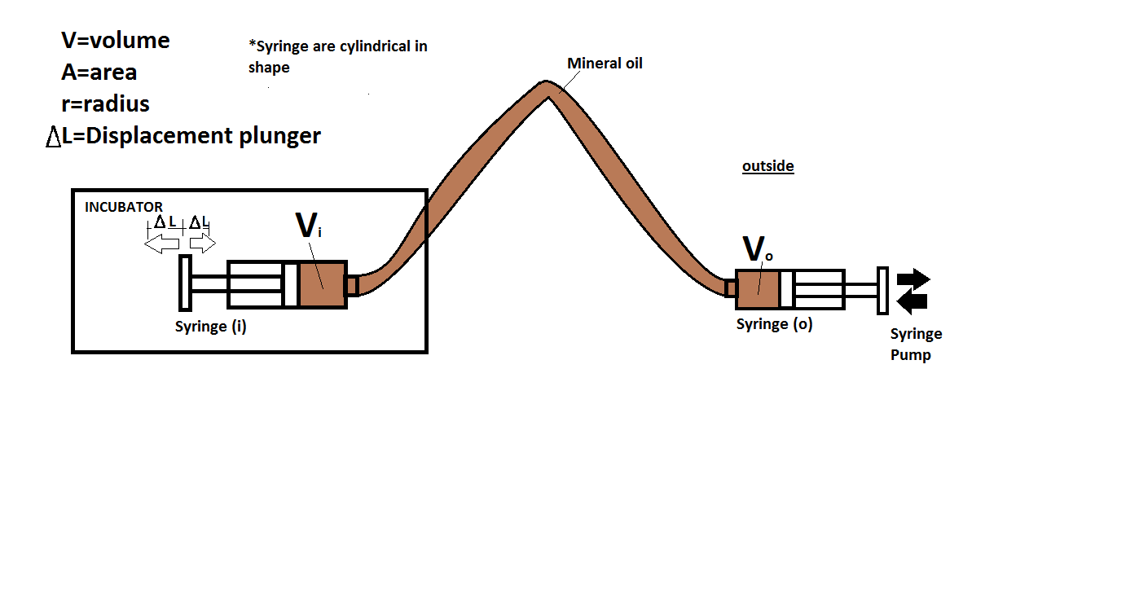
Final Design: Syringe Pump

Slide 26
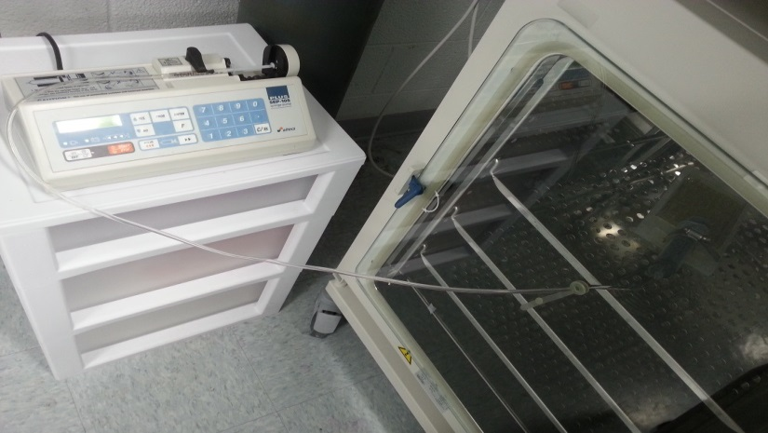
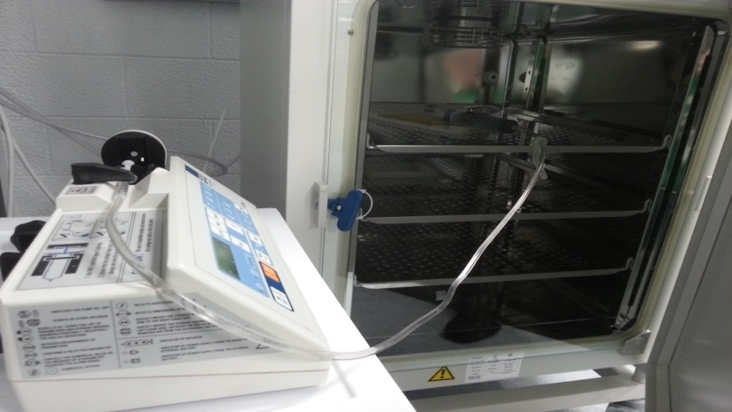
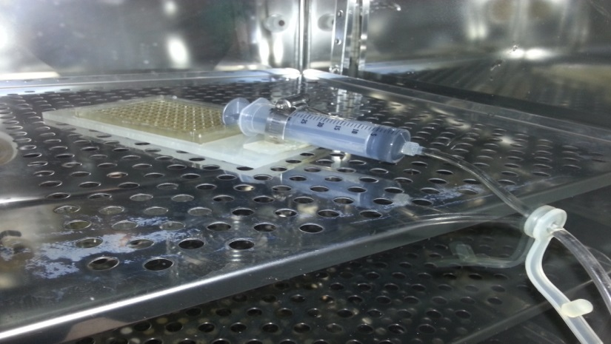
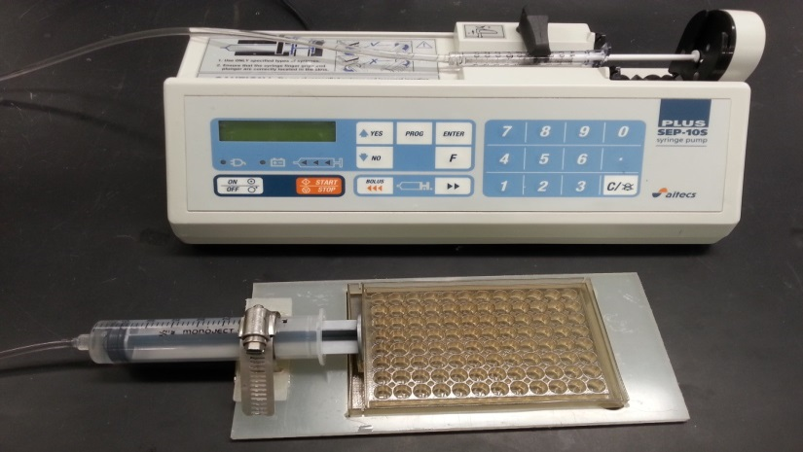
Final Design: Complete

Slide 27
Tissue Culture
Flood outer wells with differentiation media
heating block (50ºC)

Slide 28
Tissue Culture
NIPAAm
30min @50ºC
heating block (50ºC)

Slide 29
Tissue Culture
C2C12 cells in Thrombin + Ca²⁺
Fibrinogen/DPBS(-)
60min @ 37ºC
Fibrin gel
Myoblast cells
heating block (37ºC)

Slide 30
Tissue Culture
Construct Formation
Tissue Construct

Slide 31
Tissue Culture
Aspirate media
Aspirate NIPAAm
30min @ 4ºC
DPBS(+) rinse (100μL)

Slide 32
Tissue Culture
Flood outer wells with diff. media
Add diff. media
DPBS(+) rinse

Slide 33
Tissue Culture
Stimulation

Slide 34
Tissue Culture: Flow Diagram
Flood outer wells with diff. media
NIPAAm
C2C12 cells in Thrombin + Ca²⁺
30min @50ºC
Myoblast cells
heating block (50ºC)
heating block (50ºC)
Fibrinogen
Construct Formation
Flood gently (diff. media)
Tissue Construct
Overnight incubation (37ºC)
60min @ 37ºC
Fibrin gel
heating block (37ºC)
30min @ 4ºC
Stimulation
Aspirate media
Flood outer wells with diff. media
Add diff. media
Aspirate NIPAAm
DPBS(+) rinse

Slide 35
Gold Standard Comparison
Parameter | MQP | Myomics
Sample Quantity | 96 | 96
Cell Density (cells/volume) | 5 x 10⁵ / 120 μL (C2C12) | 2 x 10⁵ / 120 μL (primary myoblasts)
Construct size | 3.5mm | 3.5mm
Anchorage | Dog-bone | Dog-bone
Stimulation Location | In incubator | n/a
Number of Samples Stimulated at a Time | 96 | 0

Slide 36
Operational Cost Analysis
MQP | Estimated Cost:
Full Device | $203.89
NIPAAm | $87.10/gram
Fibrinogen (bovine) | $170.50/gram
Thrombin (human) | $288.50/150UN
Cell culture agents | $187.30
TOTAL: | $937.29
 | Estimated Cost:
96 well culture plate with PDMS molds | $350.00
NIPAAm | $87.10/gram
Fibrinogen (bovine) | $170.50/gram
Thrombin (human) | $288.50/150UN
Cell culture agents | $250.00
TOTAL: | $1,146.10

Slide 37
Strain/Volume Relationship

Slide 38
Video Demonstration

Slide 39
Proof of Concept
Device Verification

Slide 40
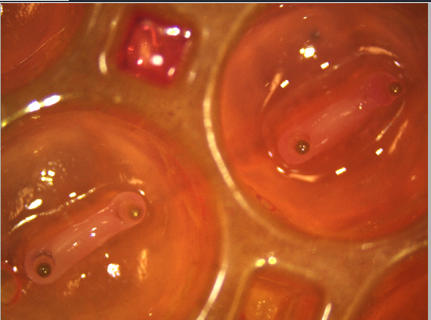
Tissue Results
Mechanical strain tests
Exercise: 5%-15%
15 minutes
1 cycle/minute
4 days
Stimulated vs. Control
H+E Stain
Myosin Stain

Slide 41
H+E Tissue Results
50 µm
50 µm
Control Tissue
Stimulated Tissue

Slide 42
Myosin Tissue Results
50 µm
50 µm
Control Tissue
Stimulated Tissue

Slide 43
Conclusions & Recommendations

Slide 44
Conclusions
DEVICE
Produces reliable and consistent results
Uniaxial mechanical stimulation of tissue
Efficient: High Throughput and Reusable
User friendliness
Market Comparison
Higher functionality
Device: $203<Others: $350
Higher content testing
No need for live animal model
Observation of human tissue interaction
Deliverable:
A mechanical stimulator of skeletal muscle tissue that produces tissue samples with improved fiber alignment, increased fiber density, and more accurate modeling of in vivo tissue when compared to non-stimulated in vitro tissue constructs.

Slide 45
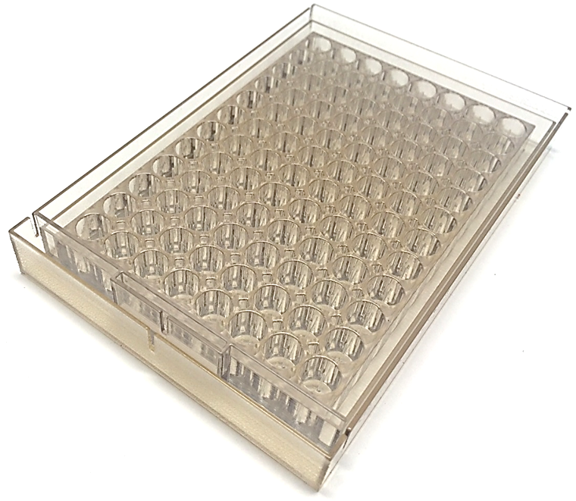
Recommendations
Test Recommendations:
Device Recommendations:
Perform more stimulation experiments and statistically validate results
Adapt to engineered tissue by cell self-assembly
Increased fiber density
More alike native tissue
Optimize media composition
Tissue maturation
Hypertrophy
Fiber size
Replace post to PDMS
Replace MED610
Use more rigid tubing to reduce error
Electrical stimulation component

Slide 46
Questions?

Slide 47
References
Page, R. (2014). Client Statement.
“Tissue engineering and regenerative medicine”, 2012. Osaka Institute of Technology, from http://www.oit.ac.jp/english/engineering/img/bioEngneer/pht_bio_02.jpg
Guilak et al. (2003). Functional Tissue Engineering. Springer-Verlag New York, Inc.
Aschettino, M., Delfosse, S., Larson, K., Quinn, C. (2011). BioMimeticSkeletal Muscle Tissue Model. Major Qualifying Project. https://www.wpi.edu/Pubs/E-project/Available/E-project-042512-122709/unrestricted/RLP-1101_Biomimetic_Skeletal_Muscle_Tissue_Model.pdf
Milano, Shaun. (2014). Allegro MicroSystems, LLC.
Vandenburgh, H., Tatto, M. D., Shansky, J., Lemaire, J., Chang, A., Payumo, F., ... & Raven, L. (1996). Tissue-engineered skeletal muscle organoids for reversible gene therapy. Human gene therapy, 7(17), 2195-2200. http://online.liebertpub.com/doi/pdf/10.1089/hum.1996.7.17-2195
Vandenburgh, H. H., Hatfaludy, S., Karlisch, P., & Shansky, J. (1991). Mechanically induced alterations in cultured skeletal muscle growth. Journal of biomechanics, 24, 91-99.
Powell, C. A., Smiley, B. L., Mills, J., & Vandenburgh, H. H. (2002). Mechanical stimulation improves tissue-engineered human skeletal muscle.American Journal of Physiology-Cell Physiology, 283(5), C1557-C1565.
Radisic, M. (2005). U.S. Patent No. 20050112759. Washington, DC: U.S.
Dennis, R. (2001). U.S. Patent No. 6114164. Washington, DC: U.S.
Christ, G. (2013). U.S. Patent No. 20130197640. Washington, DC: U.S.

Slide 48
Appendices

Slide 49
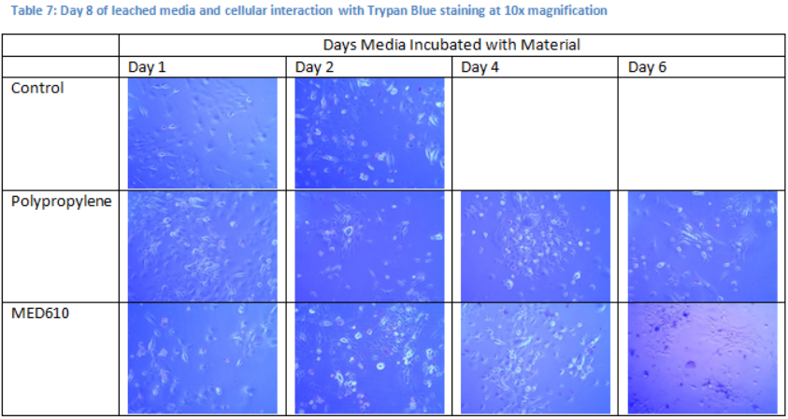
Appendix: Cytotoxicity
Materials:
Polystyrene (Control), Polypropylene (Blocks), MED610 (3D Printed), and Polyethylene (tubing)

Slide 50
Appendix: Cytotoxicity Graphed
Experimental groups compared via ANOVA analysis p-value: 0.092

Slide 51
Appendix: Myogenic Potential
C2C12 Cell Differentiation
Phase contrast
Day 9
Fluorescence
Myosin & DAPI

Slide 52
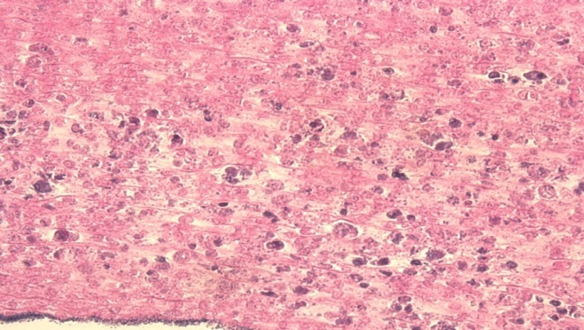
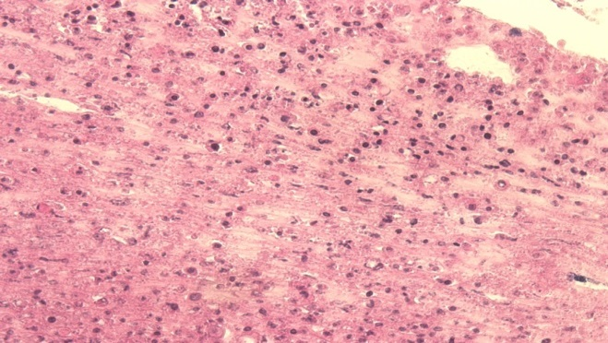
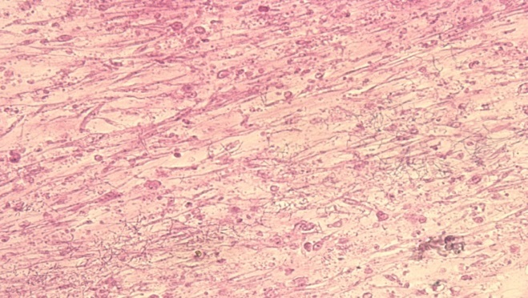
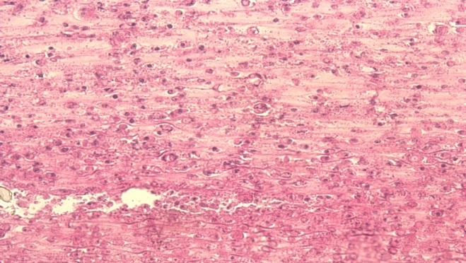
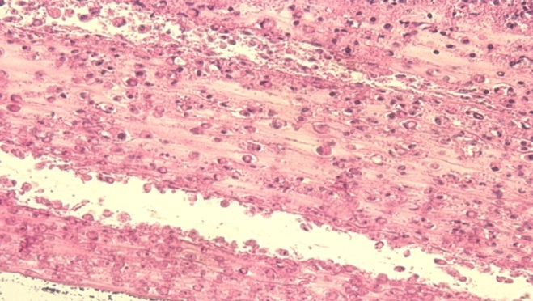
Appendix: Tissue Results
Control Tissue 1
Experimental Tissue 1
Experimental Tissue 3
Control Tissue 2
Experimental Tissue 4
Experimental Tissue 4

Slide 53
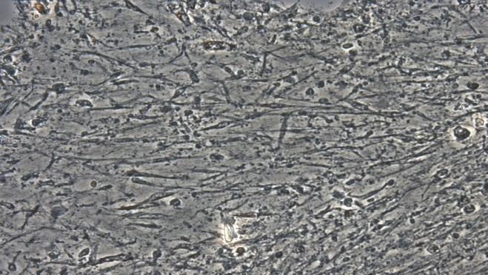
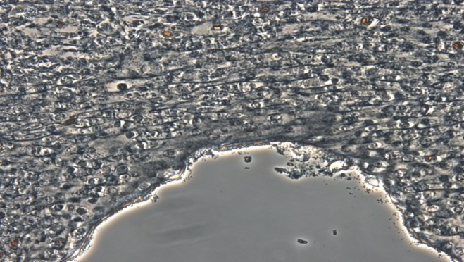
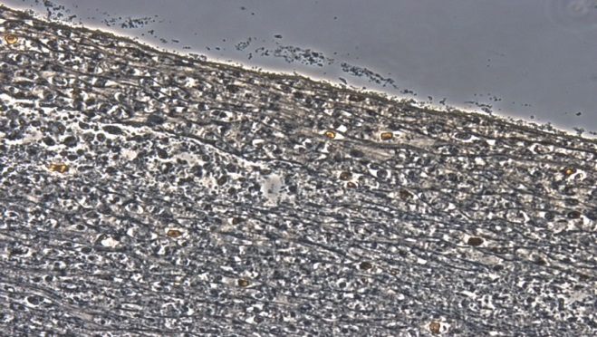
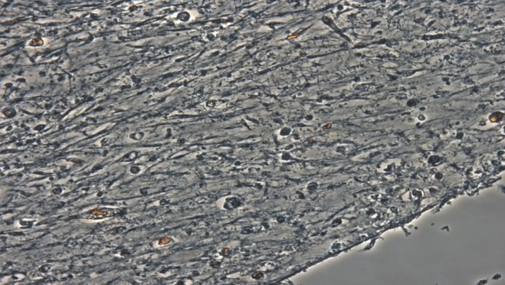
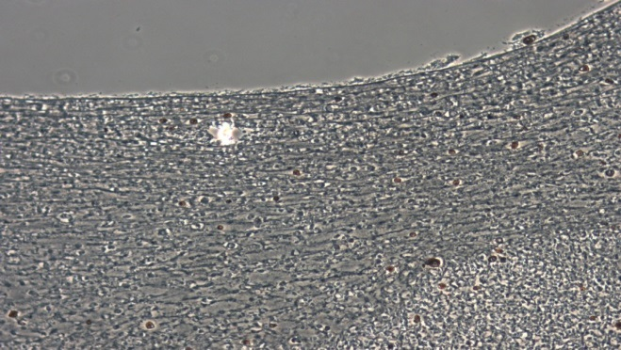
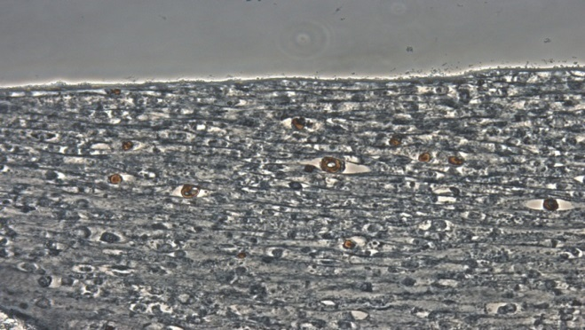
Appendix: Tissue results analysis
Control Tissue 1
Experimental Tissue 1
Experimental Tissue 3
Control Tissue 2
Experimental Tissue 4
Experimental Tissue 4

Slide 54
Appendix: Thermal Expansion Testing

Slide 55
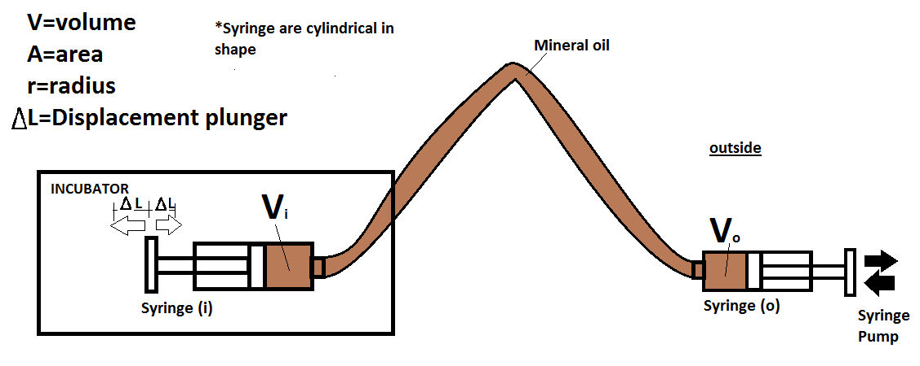
Appendix: Syringe Pump Relations

Slide 56
Appendix: Syringe Pump Relations
Calculations: Desired Strain: $ε=\frac{∆L}{L_{i}}$
Input: Desired strain (ε)
Output: ∆V_{o} required to reach desired strain
$∆V_{incubator}={∆V}_{outside}$ (1)
Volume of Cylinder: $V=πr^{2}∗∆L$
$∆L= ε∗L_{i}$ (2)
$V=πr^{2}∗ε∗L_{i}$ (3)
${∆V}_{outside}=π{{∗r}_{i}}^{2}∗ε∗L_{i}$ (4)
${∆V}_{outside} is in \left({mm}^{3}\right)must convert to milliliters (mL)$
${∆V}_{outside}\left({mm}^{3}\right)∗\frac{0.001 mL}{1 {mm}^{3}}={∆V}_{outside}\left(mL\right)$

Slide 57
Appendix: Device Verification Test
Dry Test
Media Test

Slide 58
Appendix: Drug Approval Process
Notes:
Highlight Phase II → this device will give more accurate data at phase II
90% of drugs fail in phase to clinical trials (we are bridging this gap)

Slide 59
Appendix: Marketability
Impact
Stakeholders
Researchers and Pharmaceutical Companies
Cheaper and more efficient means of testing
No live animal or human testing required
Patients with Muscular Diseases
Improved treatment methods for diseases
Observation of human tissue interactions
Notes:
Stakeholders:
Researchers and pharmaceutical companies searching for the treatment of muscular defects
Patients with muscular disease
How does it impact them?
Cheaper and more efficient means of high throughput testing
No live animal or human testing required
Observe human tissue interactions

Slide 60
Appendix: Marketability
Engineering and Biological Applications
Improve discovery rate
Improve treatment of muscle defects
Entrepreneurial Applications
Reduce cost
Easily manufactural and distributable
Produce more accurate representations of ANY muscle tissue
Open market and field to smaller organizations
Open product to non-consumers

Slide 61
Appendix: Objective Tree
Stimulator
Reliability
Consistent Results
High Throughput
Minimal Functional Unit
User Friendly
Automated
Programmable
Reusable
Function
Stimulation
Accuracy
Mechanical
Dogbone
Uniaxial
Efficiency
Cyclic and Static
Culture in Device

Slide 62
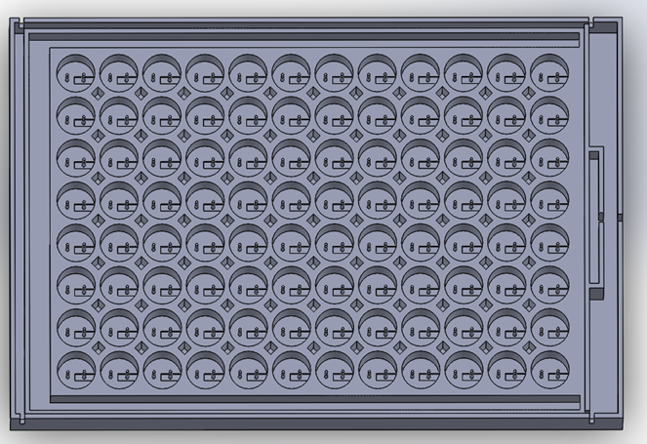
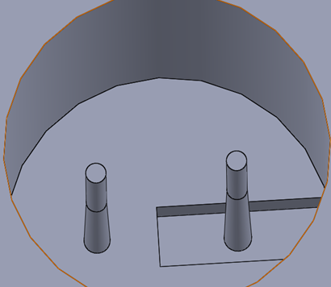
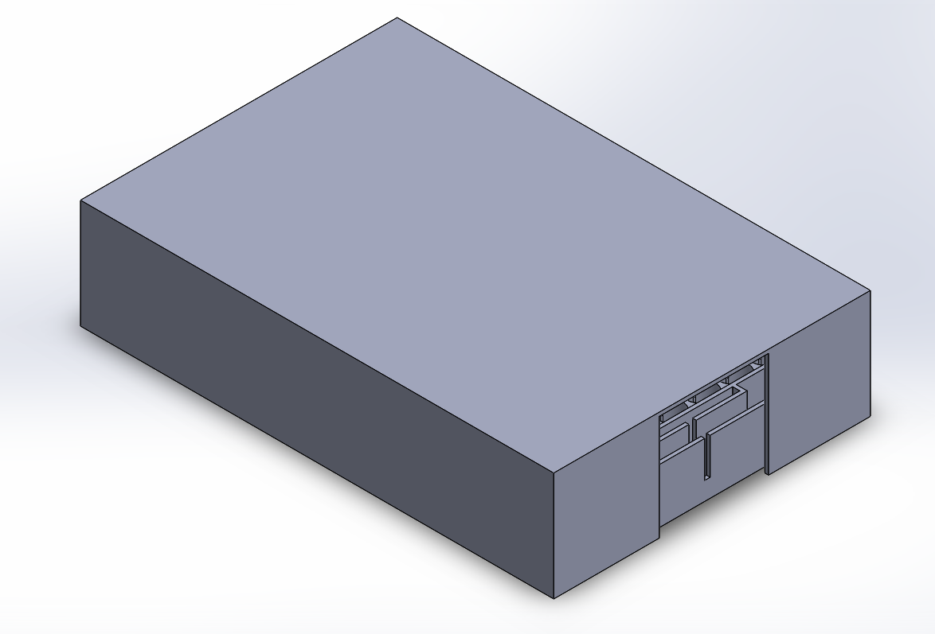
Appendix: Device Pictures

Slide 63
Appendix: Laboratory Protocols
Diagram from main presentation
Page Lab cell protocols
Strain regimen
1-2% strain at 1 cycle per minute for 15 minutes on stim day 1
2-4% strain at 1 cycle per 2 minutes for 15 minutes on stim day 2
2-4% strain at 1 cycle per minute for 15 minutes on stim day 3

Slide 64
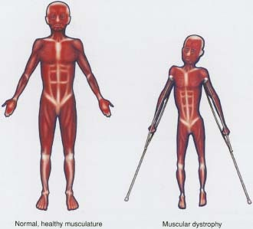
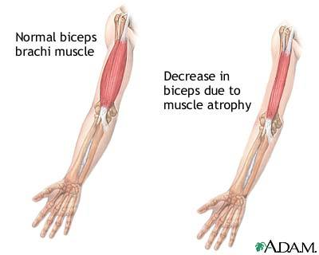
Appendix: Degenerative Muscle Disease
Diseases:
Muscular Dystrophy
Facioscapulohumeral
Duchenne MD
Multiple Sclerosis
Amyotrophic Lateral Sclerosis
Myasthenia Gravis
Common Symptoms:
Loss of muscle mass
Loss of coordination
Signal transduction problems
No cure
Average cost of care (MD):
$18,930 per 4 years (per case)
Emery, Alan E. 1994 M. Muscular Dystrophy
"Muscular Dystrophy: Hope Through Research," 2013 NINDS. No. 13-77

Slide 65
Appendix: Key Characteristics of Muscular Tissue
Stimulation
Fiber Alignment
Anchorage
Muscle-Tendon Attachment
[1]
[1] Brock, R. “NIH study uncovers details of early stages in muscle formation and regeneration. May 2013.

Slide 66
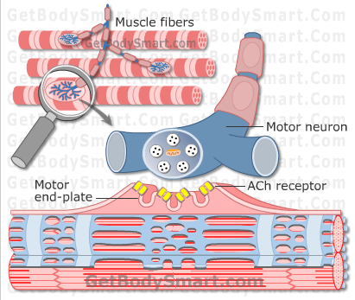
Appendix: Tissue Physiology

Slide 67
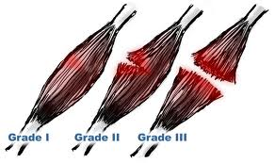
Appendix: Constraints (incubator conditions)
Device needs to withstand incubation
Muscle cells passively contract and rupture
Cells culture complications
Protein denaturation
Limits temperature
pH
cell density
Viability range
Temperature
pH
Density

Slide 68
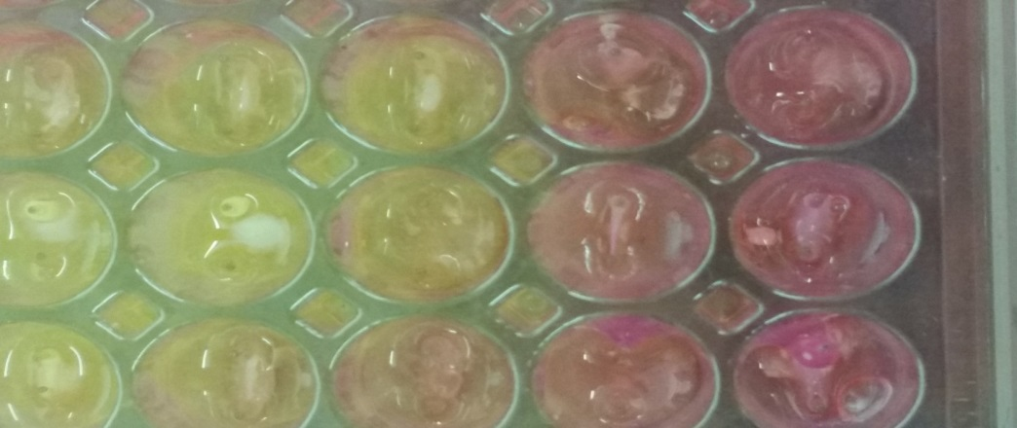
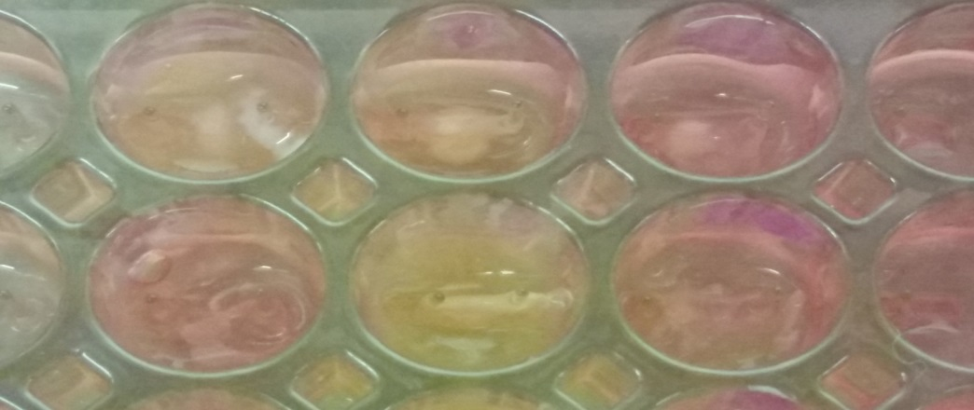
Appendix H: Raw data from tests

