Slide 1
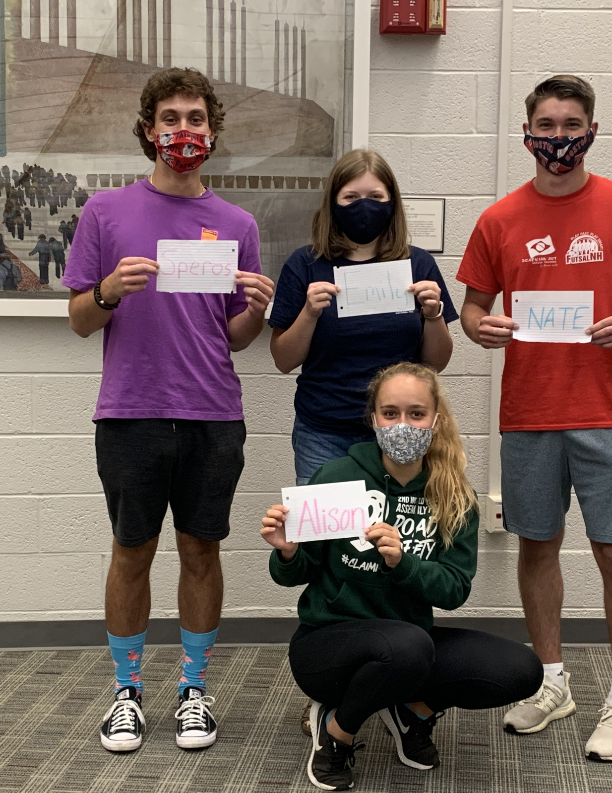
Enhancing Angels-Net Foundation’s STEAM Program & Visibility
Speros Perakis, Alison Collard De Beaufort,
Emily Minch, and Nathan Hyde

Slide 2
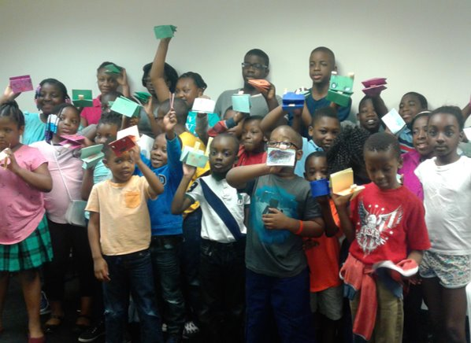
Angels-Net Foundation
A support organization for refugees and immigrants
Programming for adults & families, and children & youth

Slide 3
Immigrants & STEAM
Immigrants have a huge positive impact on STEAM fields in the US
Worcester SAT scores highlight the difficulties faced by immigrants

Slide 4
Visibility for Non-Profits
Credible website
Active social media presence
Partnerships and collaborations

Slide 5
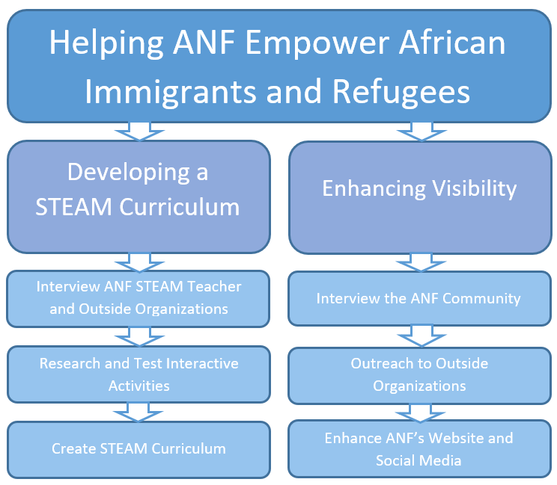
Goals & Objectives

Slide 6
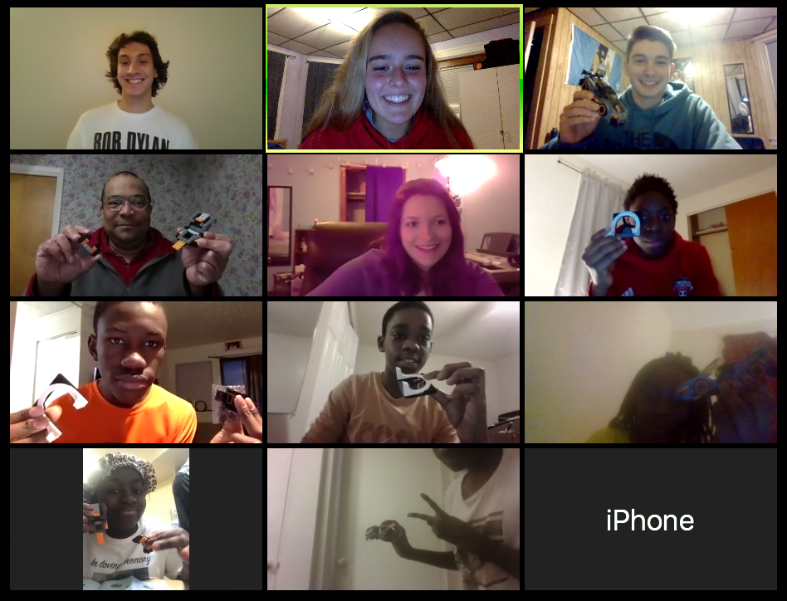
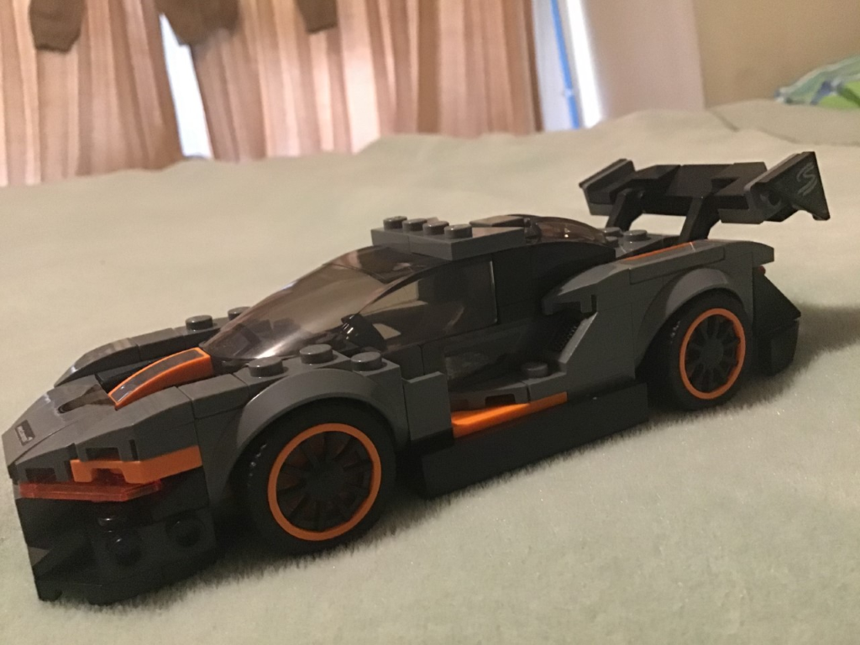
Testing STEAM Beta Activities
3 Beta Activities
Paper Airplanes
Lego Car Build
Lego Car Ramp
13/15 positive feedback responses from students

Slide 7
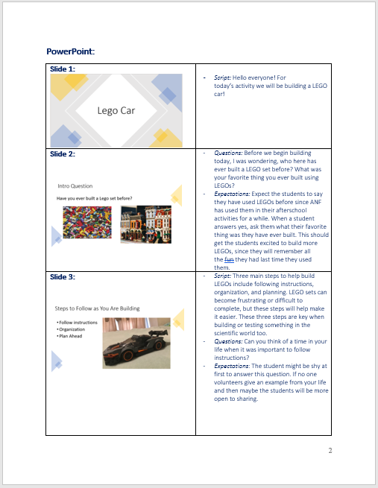
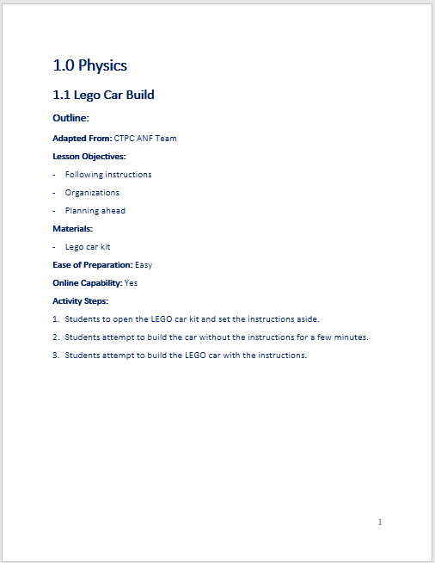
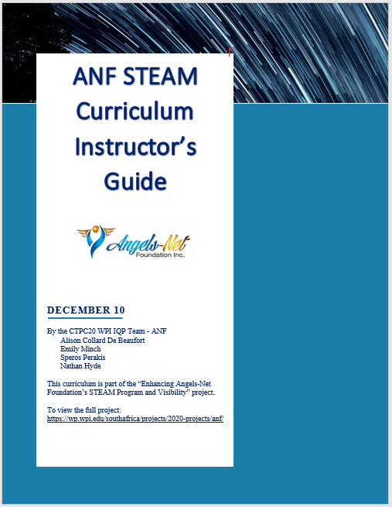
STEAM Curriculum Instructor's Guide
Activity Outline
Script and guidance for volunteer
Supplementary Materials/Worksheets

Slide 8
Designing Steam Curriculum PowerPoint
20+ Lessons
Organized by 6 Subjects
Present before each corresponding activity

Slide 9
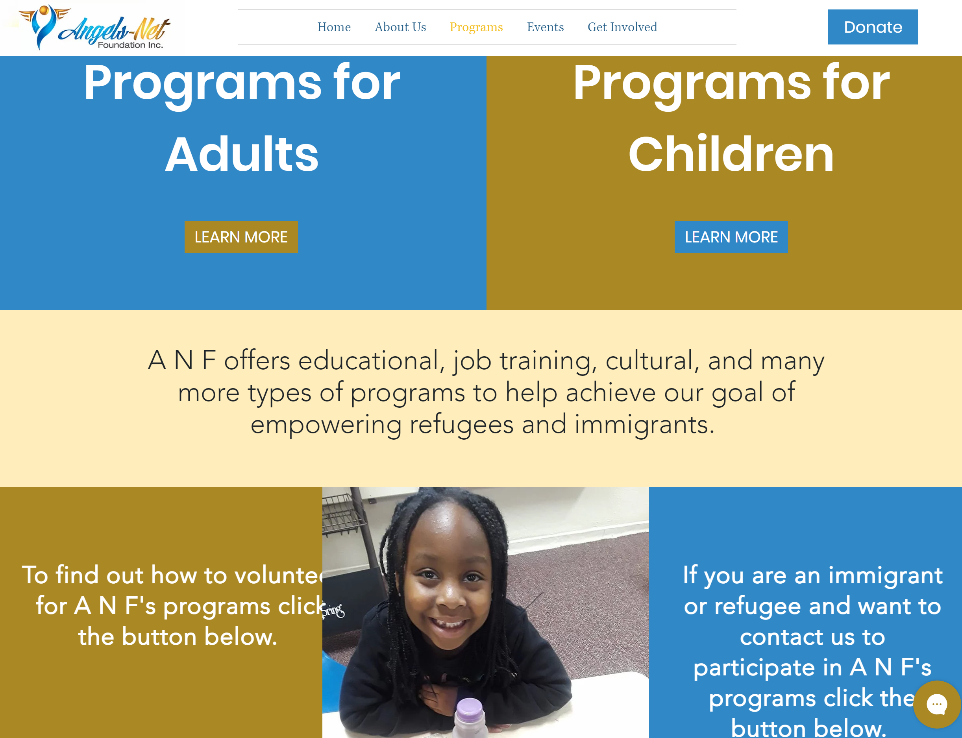
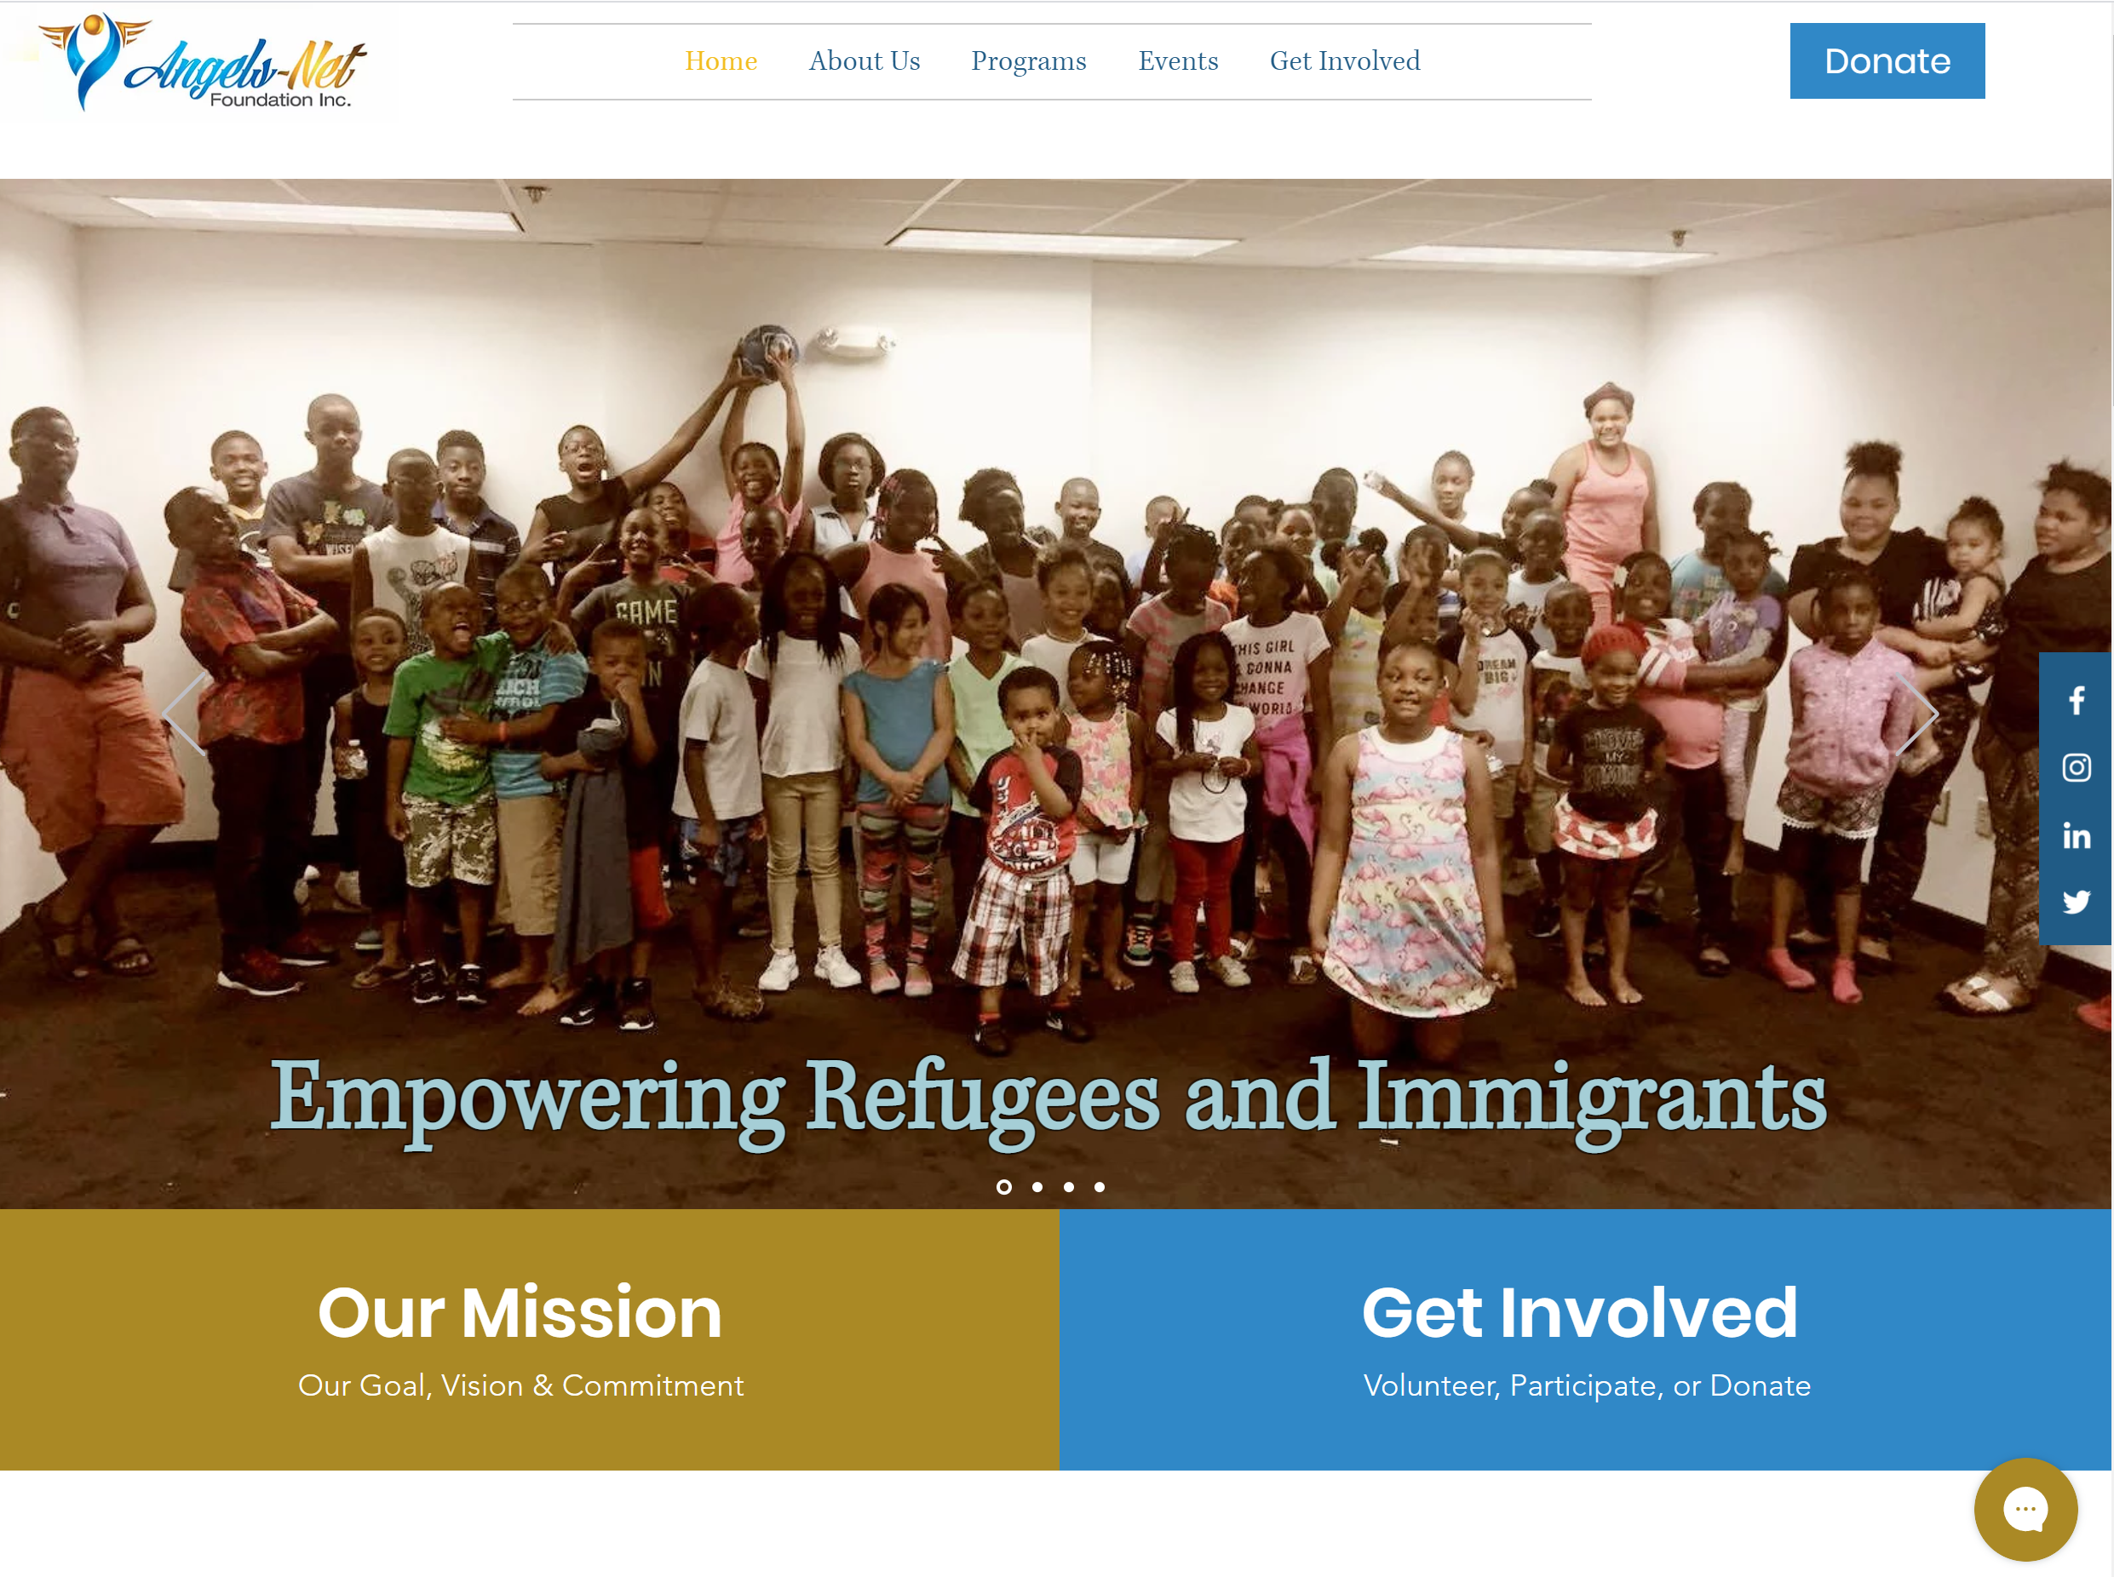
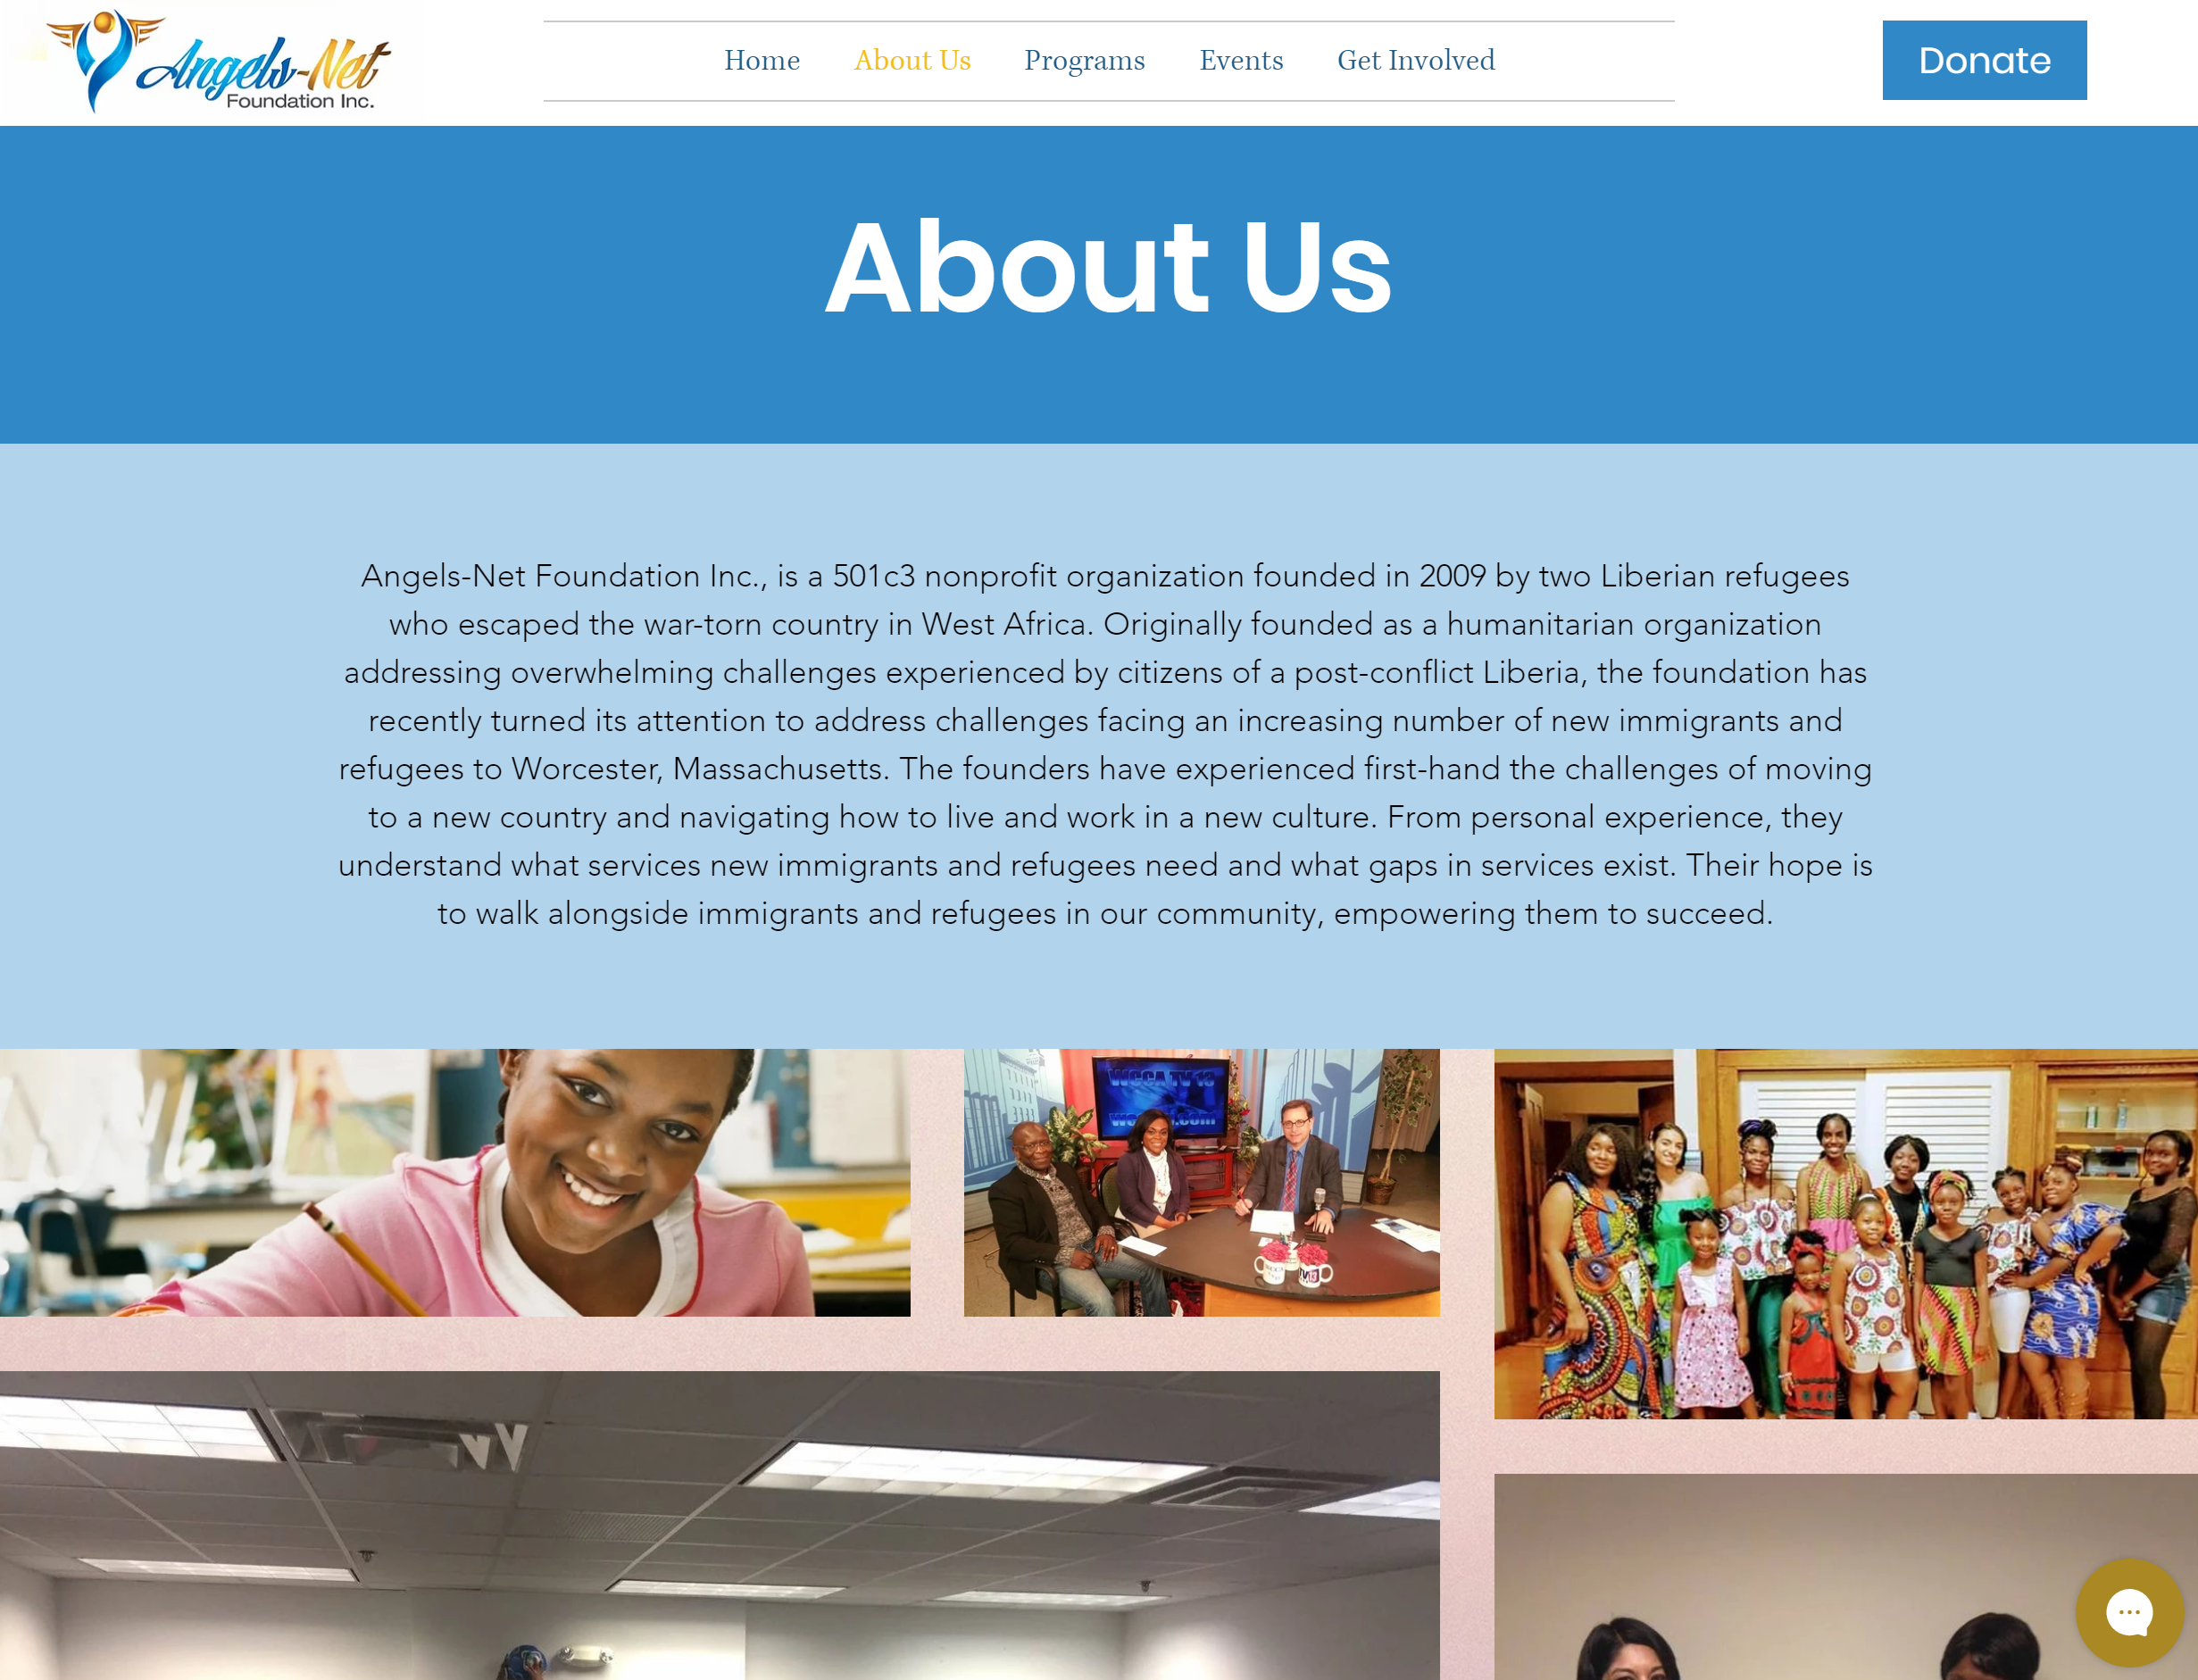
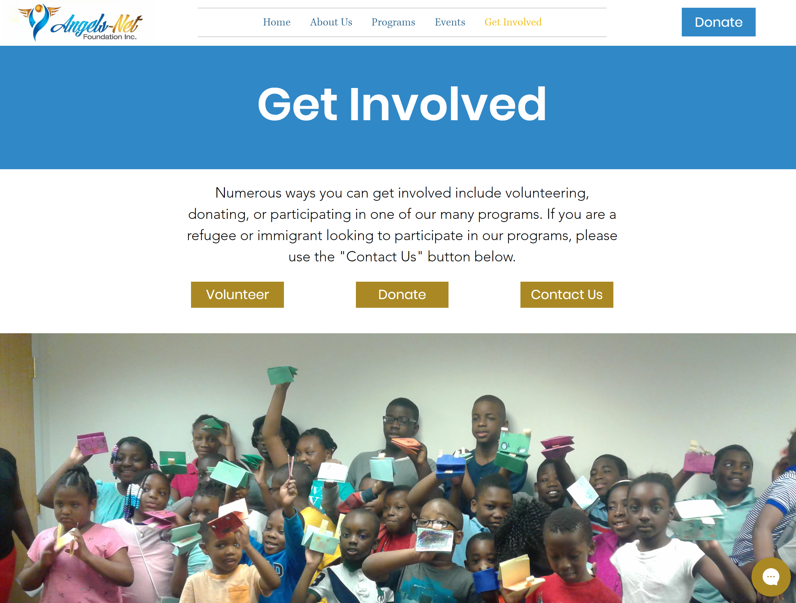
Creating the Website

Slide 10
Social Media Development
@angelsnetfoundation
Angels-Net Foundation
@ANFAfterSchoolProgram​

Slide 11
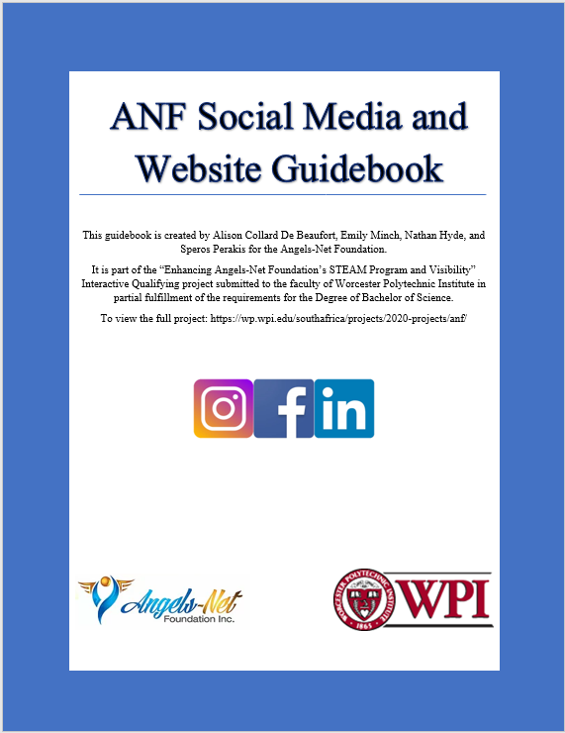
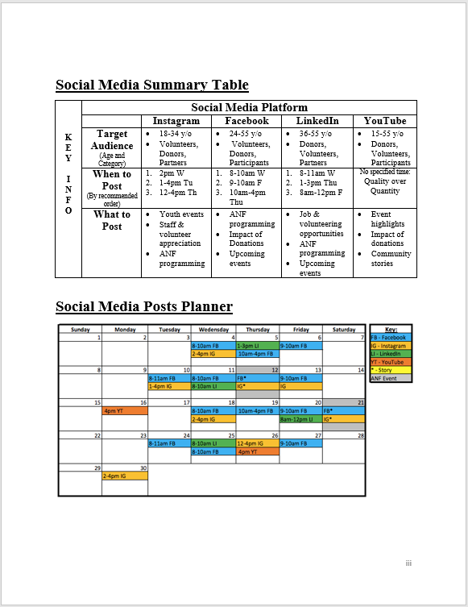
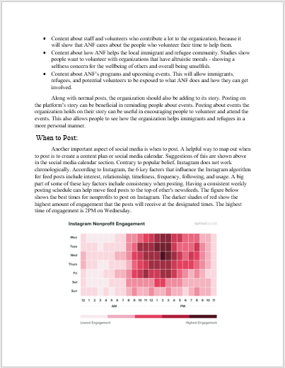
Social Media Guidebook
What/When to Post
Operations
Analytics

Slide 12
Outreaching to Organizations
Updated ANF's partnering letter
WPI campus organization
Recommended local businesses for ANF to reach out to

Slide 13
Thank You
Angels-Net Foundation
Maggie Jentzen and Yvonne Harrison
Bil Gardner
ANF Board Members
Gbetonmasse Somasse and Scott Jiusto
Our WPI Cape Town Project Center Peers
The WPI CTPC MOAD Project Group
WPI Engineering Ambassadors
WPI National Society of Black Engineers
Alpha Phi Omega – Omicron Iota

Slide 14
Thank you for your attention! Any questions or comments?

