Slide 1
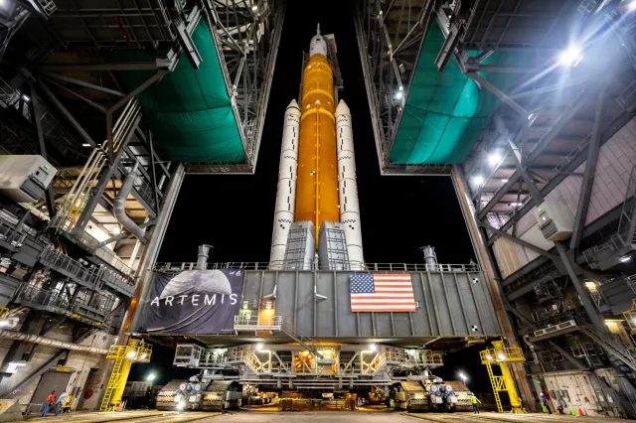
The Challenger
Case Study

Slide 2
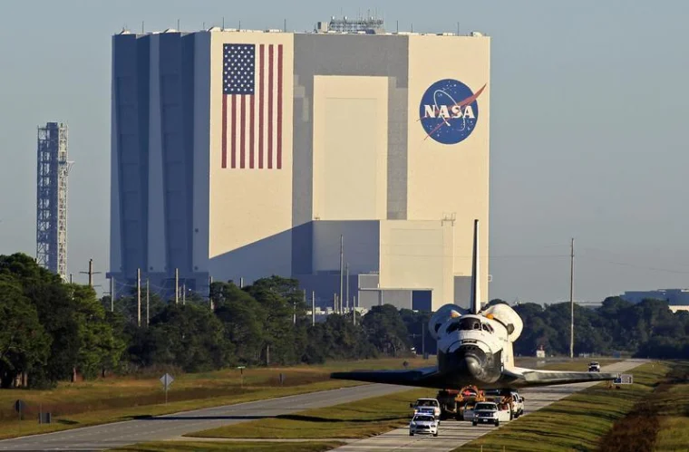
Game Instructions
Setup:
Narrator deals cards, giving each player A and B cards.
Narrator sets the scene and introduces the case study background.
Players can ask questions about the case before starting.
Rounds:
Narrator reads a question with A and B options.
Players choose A or B, keeping their answers face down.
Narrator shuffles cards for anonymity, reveals choices, and discusses outcomes.
Kindly respond to the questions to the best of your understanding and judgment.

Slide 3
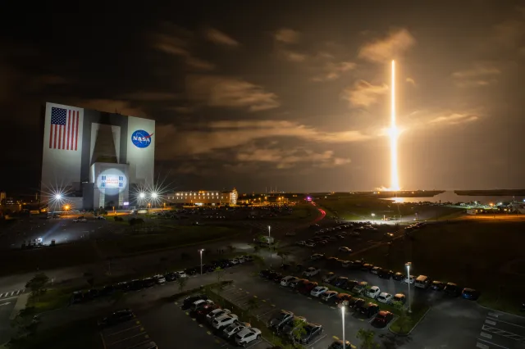
Background Information
When and Where: The United States of America during the mid-1980s.
Social and Economical: In the mid-1980s, the US face economic challenges. They were slowly recovering from a recession and everyone was feeling the pressure of high debts and inflation. The space industry faced challenges from other nations and the US wanted to maintain their position in space exploration.
Attitudes Towards Safety: Safety concerns were not adequate addressed leading up to the disaster. There was a focus on maintaining schedules and keeping the public’s interest in space exploration. Legal systems were prioritized over safety.
The Challenger: Apart of NASA’s Space Shuttle program, designed for reusable space travel. It aimed to make missions more cost-effective and accessible. However, there were critical issues with the O-rings, which were crucial for preventing hot gases from escaping during the ascent.
Society's Environment: The desire to showcase technological achievements were very high. However, the lack of safety led to tragedy during the shuttles ascent; all seven crew members including a schoolteacher.

Slide 4
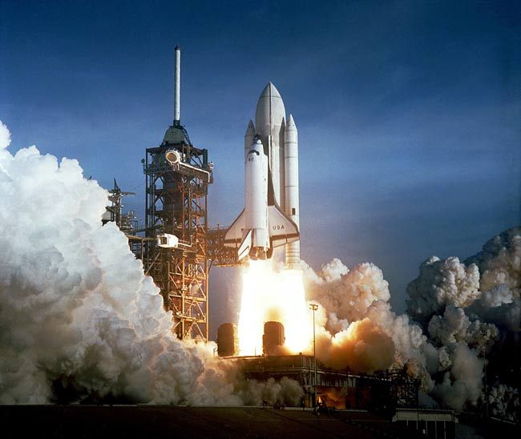
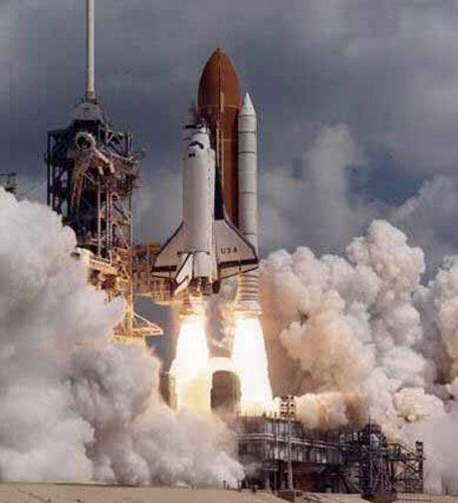
Q1: Given the safety concerns with the O-rings and the impact of cold weather on the launch, how do you approach risk management?
A
B
Prioritize safety modifications and acknowledge that they may lead to launch delays, increase spending, and fall behind competitors.
Go with the original launch plan, prioritize meeting the deadline, and save the additional funds; this maintains a competitive edge.

Slide 5
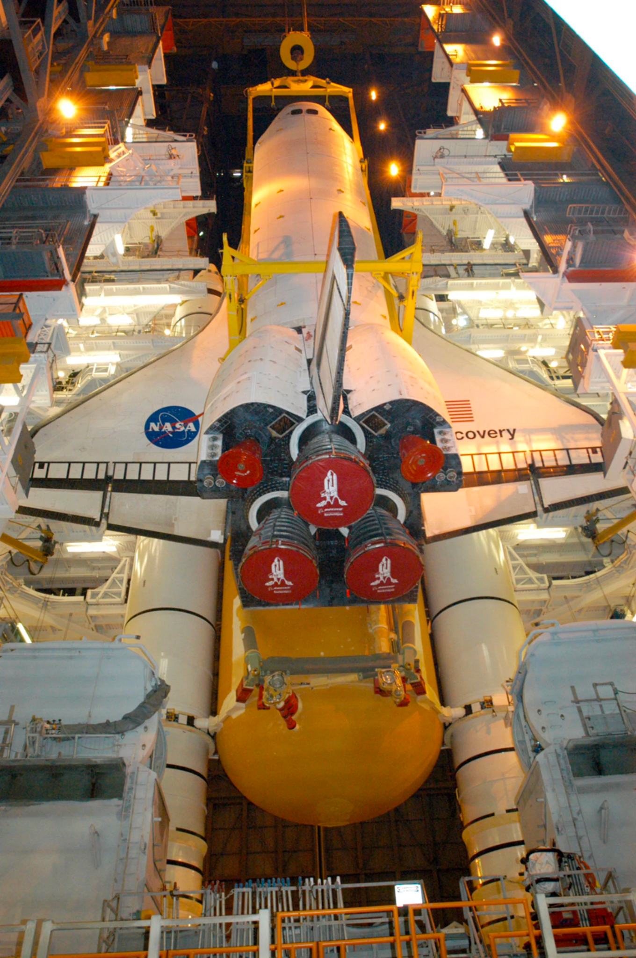
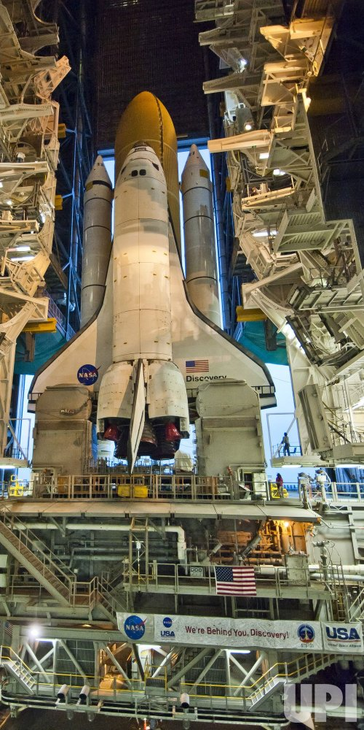
Q2: The project conflicts with NASA’s safety, integrity, and excellence values. How would you proceed, considering these values?
A
B
Deviate from NASA’s values if it brings more value to the space program, and understand that there may be a potential impact on the organization.
Adjust the project to align with NASA’s commitment to all three; aim to uphold the organization’s reputation.

Slide 6
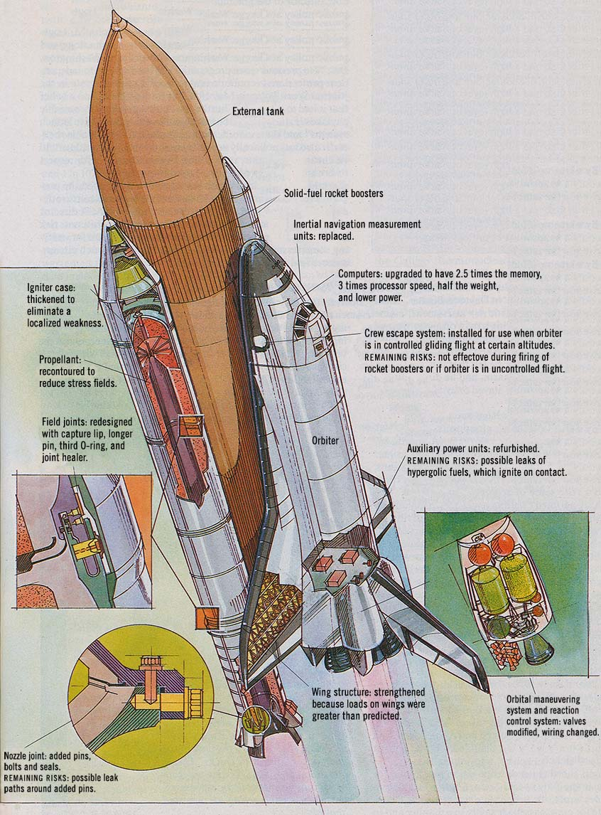
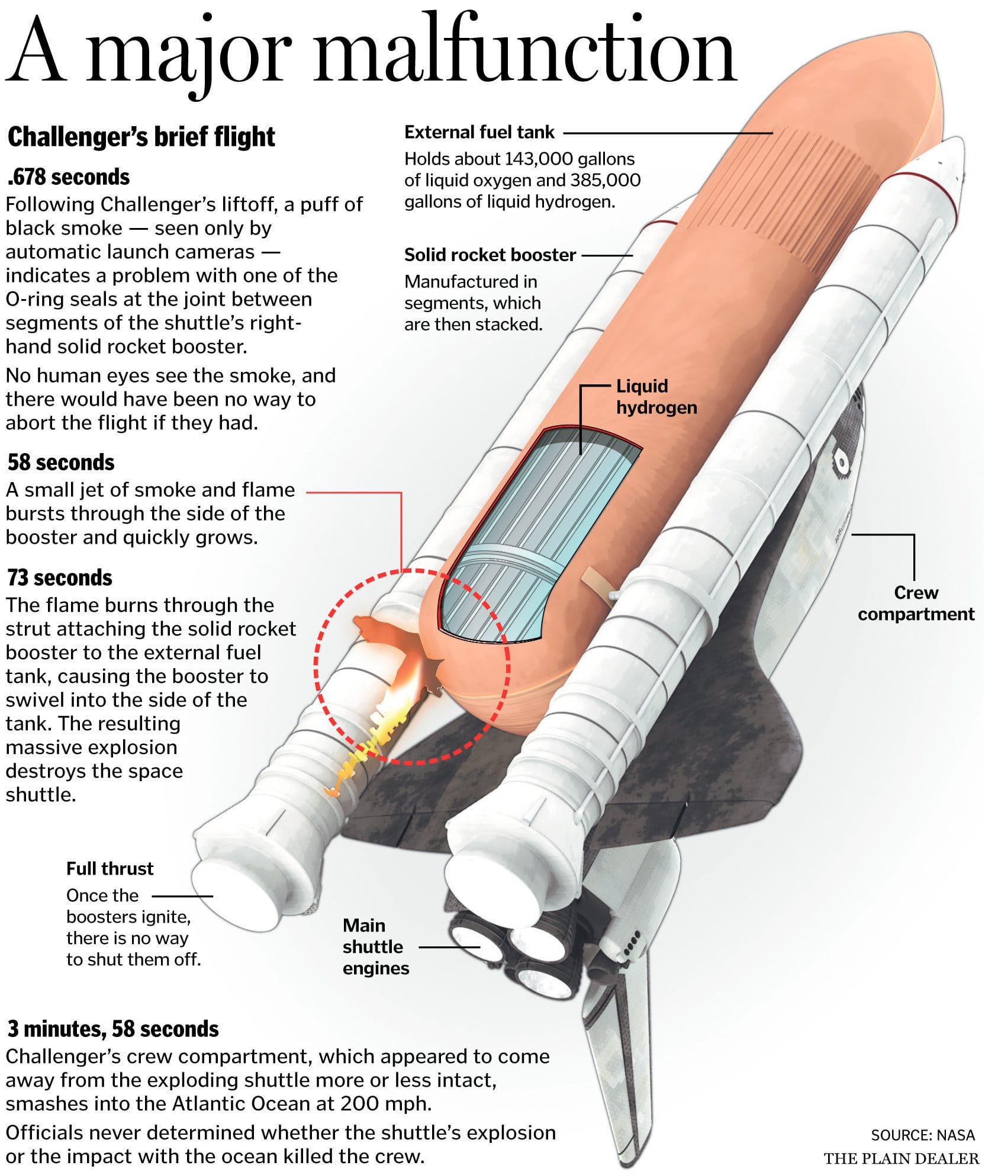
Q3: Other engineers are expressing their concern about the O-rings and their potential risks in the upcoming Challenger launch. What is your response?
A
B
Be transparent, communicate O-ring concerns to the board, and persuade them to delay the launch for safety improvements and further testing.
Reassure the other engineers that the O-ring issues are manageable, downplay concerns, and avoid over budgeting.

Slide 7
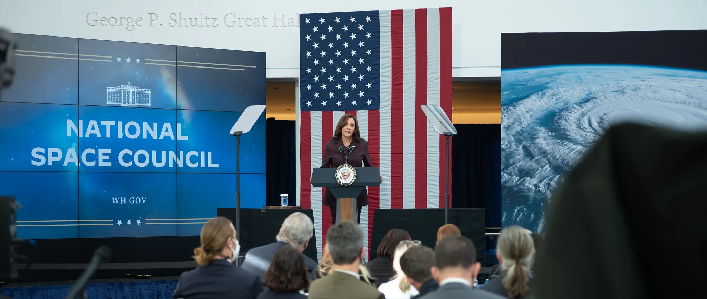
Q4: Before the launch, the engineering team attempted to communicate concerns about the O-rings to the board, who ignored them. How would you address this issue to prevent a disaster?
A
B
Implement measures to improve communication between both teams and ensure that any concerns about the O-rings are discussed and addressed before proceeding with the launch.
Maintain the existing communication structure and proceed with the original launch plan.

Slide 8
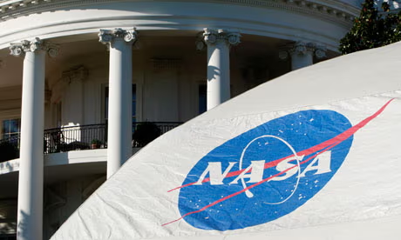
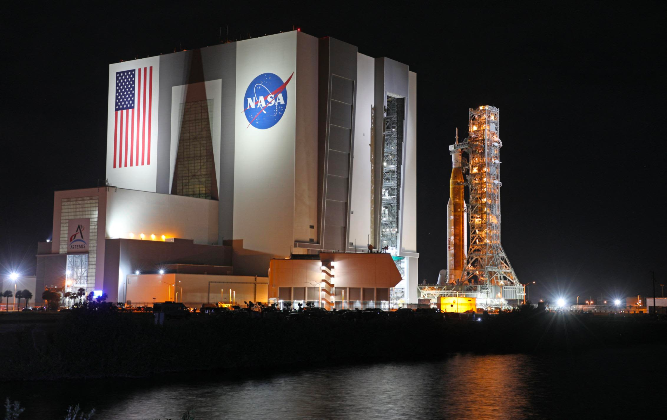
Q5: The launch has faced backlash from the public, and there is a risk of lawsuits. How do you respond?
A
B
Take responsibility for the accident, implement corrective actions, and work on rebuilding the public’s trust, even if it involves legal consequences.
Defend the project, emphasize legal defenses, and prioritize paying off those planning to sue.

Slide 9
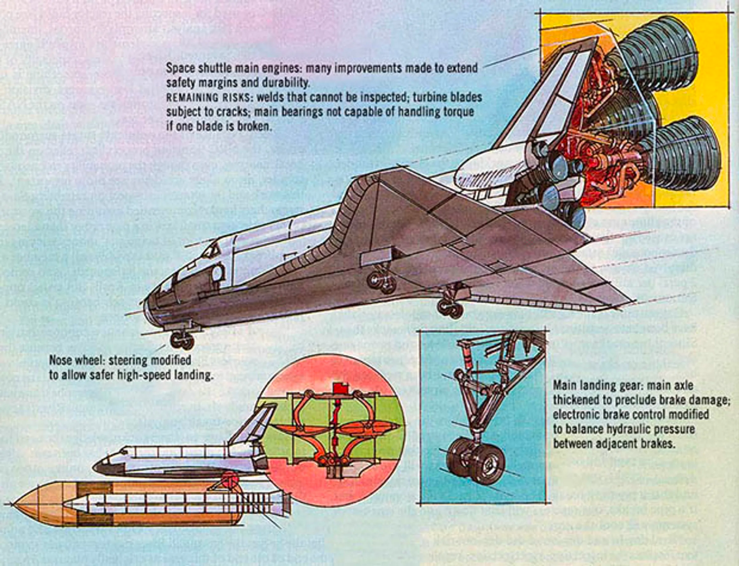
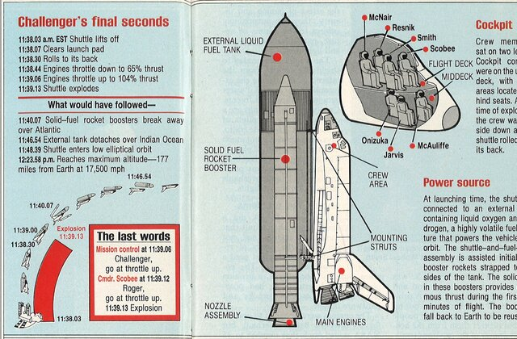
Q6: NASA’s reputation has suffered following the accident. How do you plan to rebuild it?
A
B
Focus on short-term damage control and legal strategies to protect NASA without addressing the underlying problems that led to the accident.
Engage in transparent communication with the public, take initiatives to rebuild trust over time, and address the causes of the accident.

Slide 10
THANK YOU FOR PLAYING!
Post-Game Questions:
How can we make the game better?
What would you do differently?
What did you learn from playing the game?
Is there anything you wish was in the game?
Data Collection Questions
Age
Major and Year
Do you have work experience? If yes, what field and do you think it impacted how you made your decisions?
How do you feel about the decisions you made?

