Slide 1
Insurance to Protect Against Online Shopping Fraud
Safeshop
Name: Qiyang Zhou
Major: Actuarial Science
Class of 2014
Advisor: Jon Abraham

Slide 2
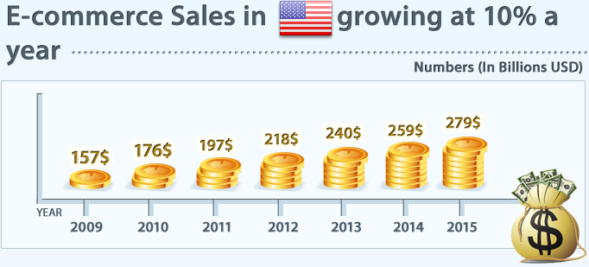
E-Commerce Growth
Milestones:
1979 – Michael Aldrich invented Online Shopping
1990 – Tim Berners-Lee created the first World Wide Web server and browser
1994 – Netscape launches first commercial browser: Navigator
Pizza Hut offers online ordering on their web page
1995 – Amazon starts selling books online
Ebay is founded by Perre Omidyar as auction web

Slide 3
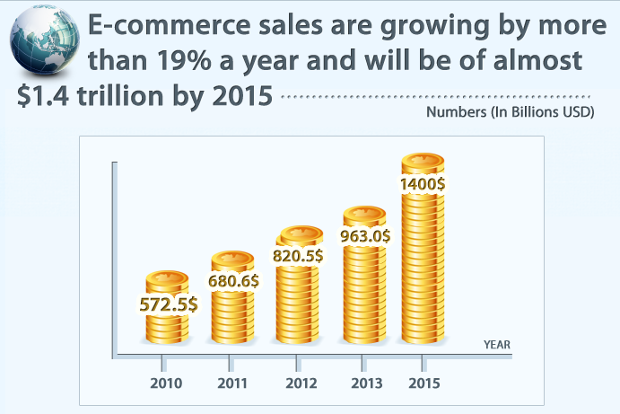
Global Growth

Slide 4
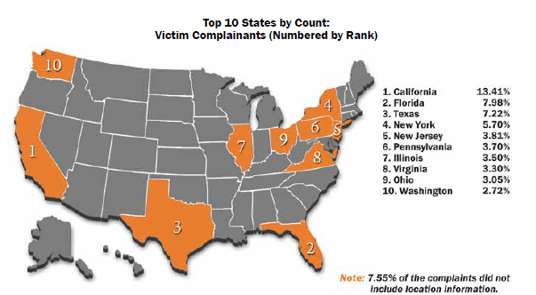
What is E-Commerce Insurance (Safeshop)?
Have you ever shopped online?
Have you ever get fraud online?
Have you ever paid something but didn’t get it?
This insurance will cover your loss if online shopping fraud happened to you

Slide 5
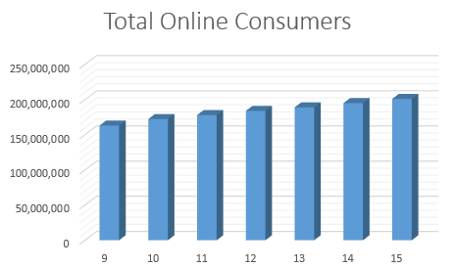
How many people are shopping online?

Slide 6
How many people have suffered from online fraud?

Slide 7
Total loss from online fraud

Slide 8
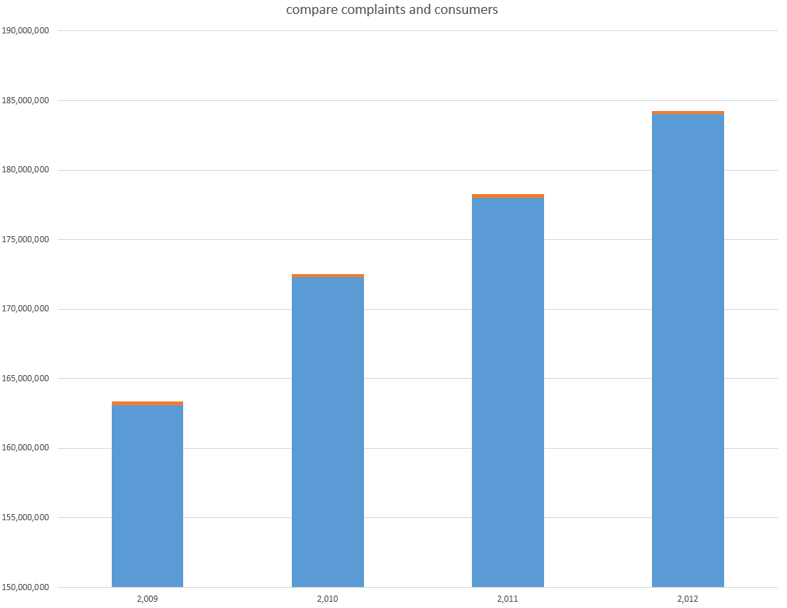

Slide 10
Why should we have this insurance?
Save time and money for complaints
Reduce the financial burden of the government
Transfer the loss risk of the online shoppers
Protect the legitimate interests of the victims
No such insurance to protect the loss of online shoppers

Slide 11
Build the loss model
Collect data
Analyze data
Predict future data

Slide 12
Where can did I get the data?
http://www.census.gov
http://www.comscore.com/
http://www.nielsen-online.com Nielsen/NetRatings
http://www.ic3.gov
http://www.fbi.gov/

Slide 15
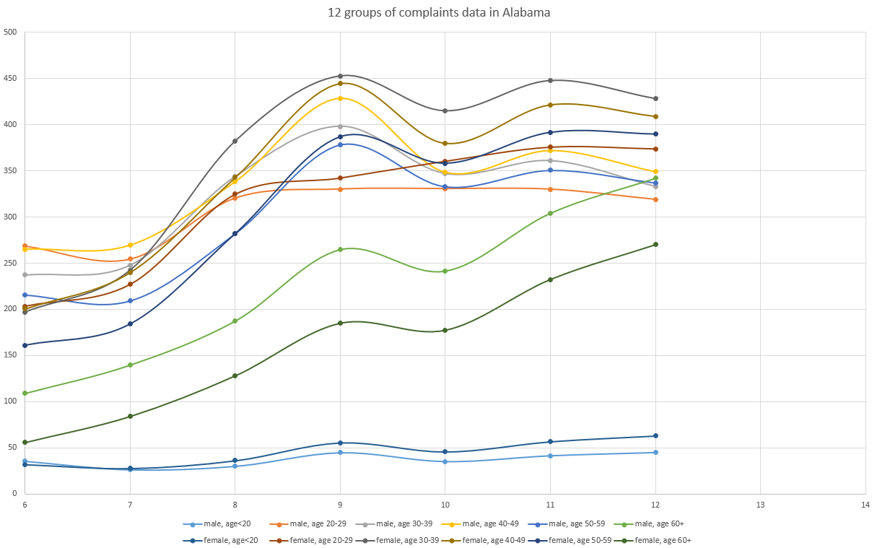
Predict future data (2013, 2014)

Slide 16
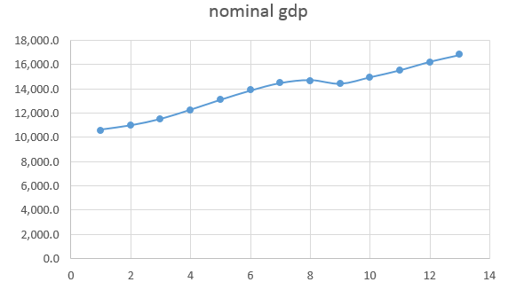
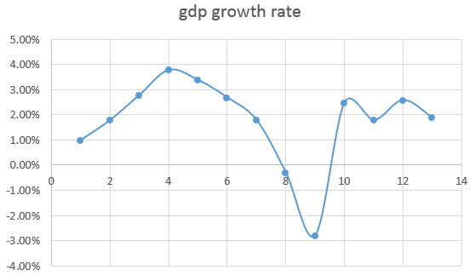
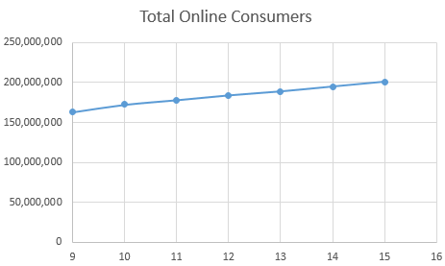
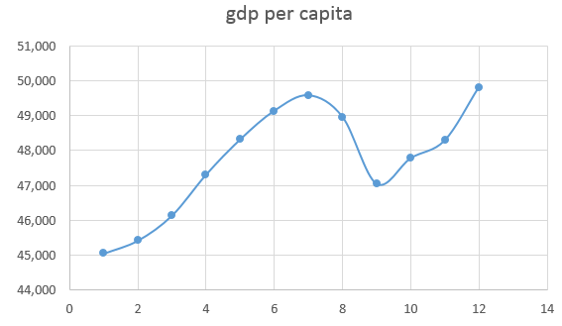

Slide 17
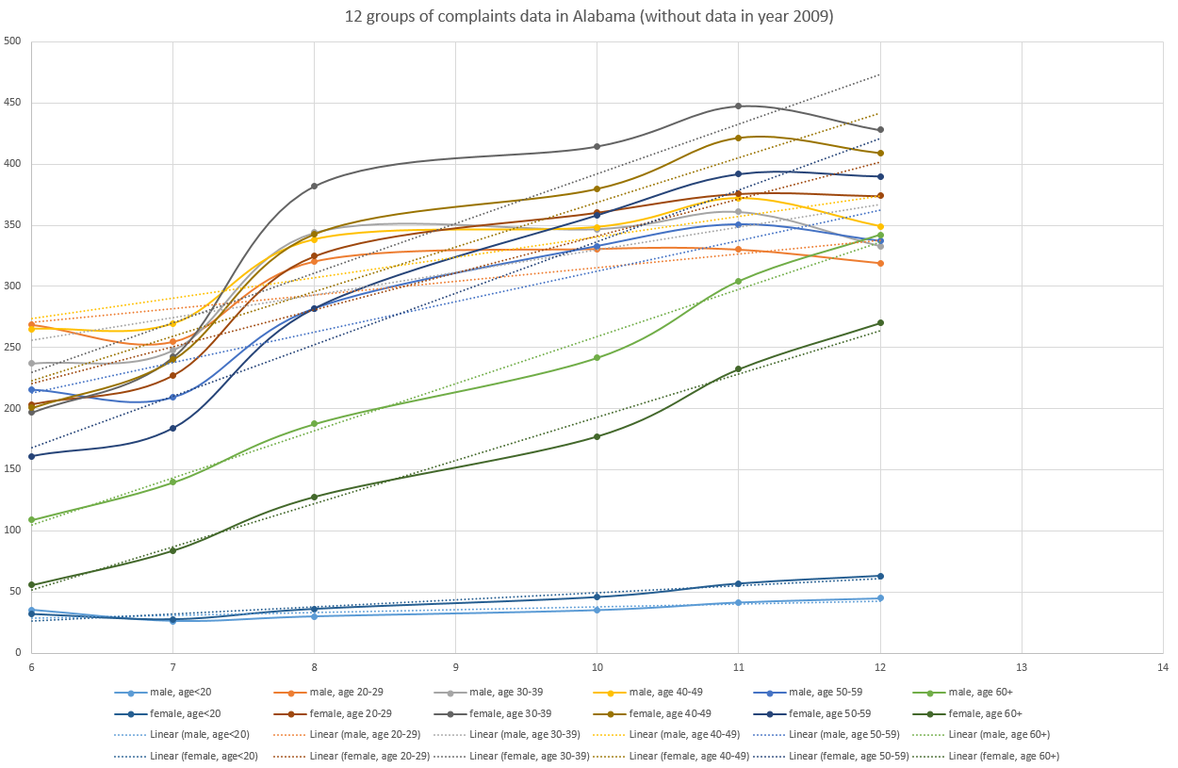

Slide 18
Predict each group of data using linear least square

Slide 19
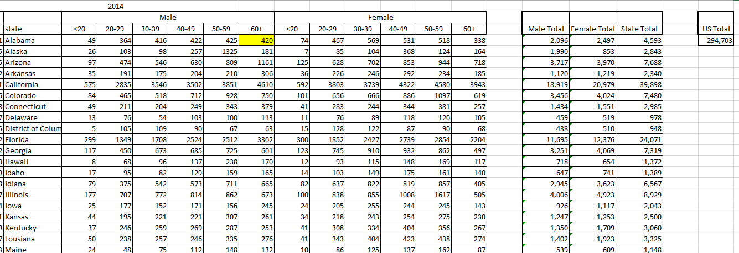
Complaints Data for 2014 (from prediction)

Slide 20
Use relative value

Slide 21
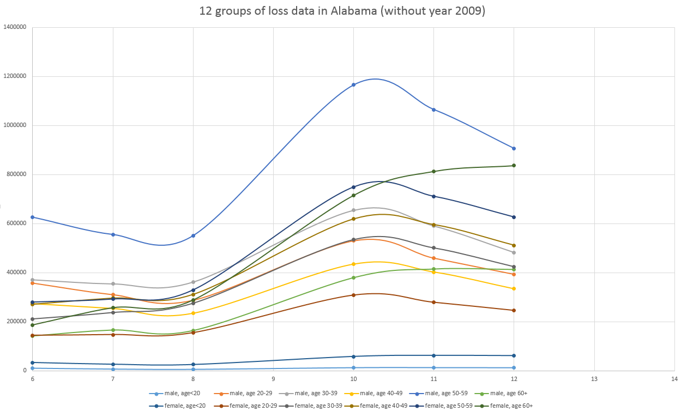

Slide 23
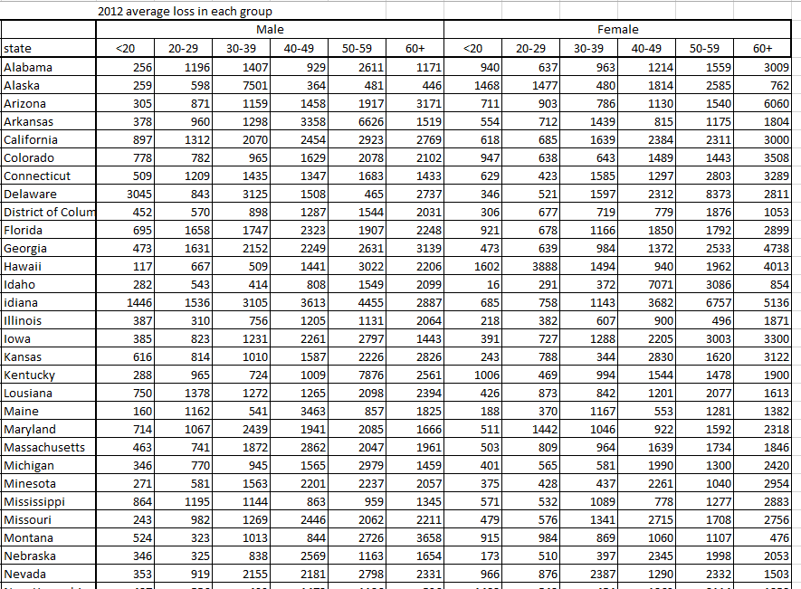
Loss Data for 2014 (from prediction)

Slide 24
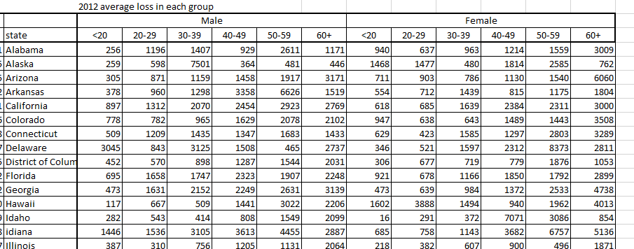
Calculate the average loss data from 2006 to 2014

Slide 25
Calculate the parameters for loss distribution
Mean
Standard deviation
Use Alabama, Male, <20 as an example
9,952.25+6,755.84+5,745.60+15,163.20+11,995.20+12,474.00+11,865.60+13,754.00+14,749.00
Mean=
35+26+30+45+35+42+45+46+49
= 284.71

Slide 26
Use Alabama, Male, <20 as an example
Calculate the standard deviation
4.63+16,086.20+260,551.88+122,835.49+117,765.65+6,340.05+19,908.71+9,388.55+12,996.96
Variance=
35+26+30+45+35+42+45+46+49
= 1591.3379
Standard Deviation= 39.89

Slide 27
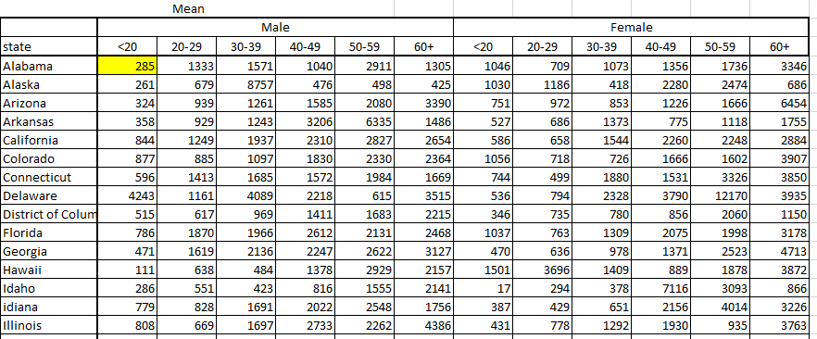

Slide 28
Determine the cost of the insurance
Use matlab to do simulations to a 100,000 insured plan for 2014
Example:
Step 1: get the total number of complaints of the sample
Total comsumers:195,000,000
Total complaints: 294,703
Temp=randi(195,000,000)
Temp<=294,703
Temp>294,703
Loss
No loss
Do it for 100,000 times
Number of loss: 160
Number of no loss: 99840

Slide 29
Step 2: get the number of complaints in each state
Step 3: get the number of complaints in each group (612 groups)
Step 4: assign complaints in each group to loss distributions with corresponding mean and standard deviation
Normrnd(mean, standard deviation, number of complaints)
Step 5: count the total loss
Step 6: do iterations (back to step 1)

Slide 30
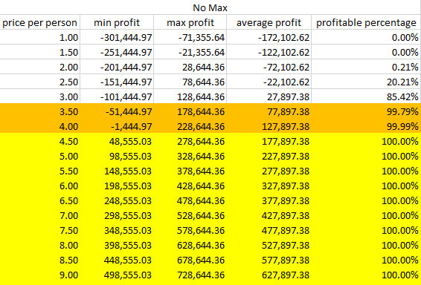
100,000 insured each time for 10,000 times

Slide 31
Profit table with different maximum payment

Slide 32
Work with an anti-virus software company
Do people use anti-virus software more often than insurance programs?
Help reduce the risk of the insurance (price could be more competitive)
Advertisement
More accurate to calculate the cost of insurance
Introduce traditional insurance company to E-commerce market
Help the anti-virus software be more competitive
Help keep track of the insured’s shopping activities

Slide 33
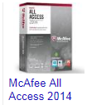
Normal
VIP
Super VIP
$49.99
$49.99+$4.99
($1,000 compensation)
$49.99+$9.99
($12,000 compensation)

Slide 34
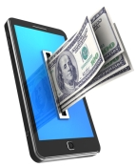
Future possibilities
Work with more software companies
Introduce other insurance product to users
Personalize users

Slide 35
Why do I do it?
Brand new idea in America
Build a safe world for online-shopping
Transfer the loss risk of the online shoppers
Open new market for actuaries and insurance companies
May sell it for a good price
May be good for my career
In several years, people will probably come up with the same idea and make tons of money and I will regret that I did not do it.

Slide 36
Thanks!

Slide 37
References
http://lavishgiftz.com/index.php?main_page=page&id=23
http://www.measuringworth.com/
http://blogs.cio.com/business-intelligence/16877/how-big-data-can-reduce-big-risk
http://www.datacenterdynamics.com/focus/archive/2013/04/comparing-data-center-energy-efficiency
http://allfacebook.com/tag/payments
http://www.ic3.gov
http://www.census.gov

