Slide 1
Protecting Danish Consumers from the Hazards of Payday Lending
Robert Dwan, Mitchell Holman, Ethan Merrill, Junhong Zhang
Advisors: Holly Ault, Katherine Foo
Notes:
Protecting consumers from them selves: solving Denmark’s culture of Debt
Payday lending and Denmark’s problems
Halting the Cycle of Debt
Targeting payday lendings problems
Fixing danish payday lending
How to fix danish payday lending
Protecting consumers from the hazards of payday loans
The hazards of payday loans: how to protect consumers
Protecting Danish Consumers from the Hazards of Payday Loans
Danish consumer debts and how to reduce ‘em
The end of excessive debt in Denmark
Denmark’s consumer debt problem and how to fix it
Do you really need that pizza?: COnsumer debt in Denmark
BUy now pay later: the problem with consumer lending
Everyday is payday with loans
Spending more and earningless
Borrowing to the edge all my loans are ded
Borrowing to oblivion
Living the loan lyfe
loan lyfe
Livin la vida loans
More money more problems
Living loan to loan
Consumers and debt
Consumer risk from payday loans
Consumers need protection
Are consumers at risk?
How do
Payday loans predatory lending or useful financial tool?
Cycle of debt
Font size for title
'''Going through slides -
1. Denmark has a consumer debt problem
2. Youth compose a significant proportion of this debt
3. Payday loans are one component of this debt
4. Payday loans are short term/etc loans
5. The companies operate online
6. They target impulse buying in youth
7. Our task is to...
8. Then shift into objectives (include methods graphic)'''
You might want to make changes to the flow, but this is one sequence that I think makes sense

Slide 2
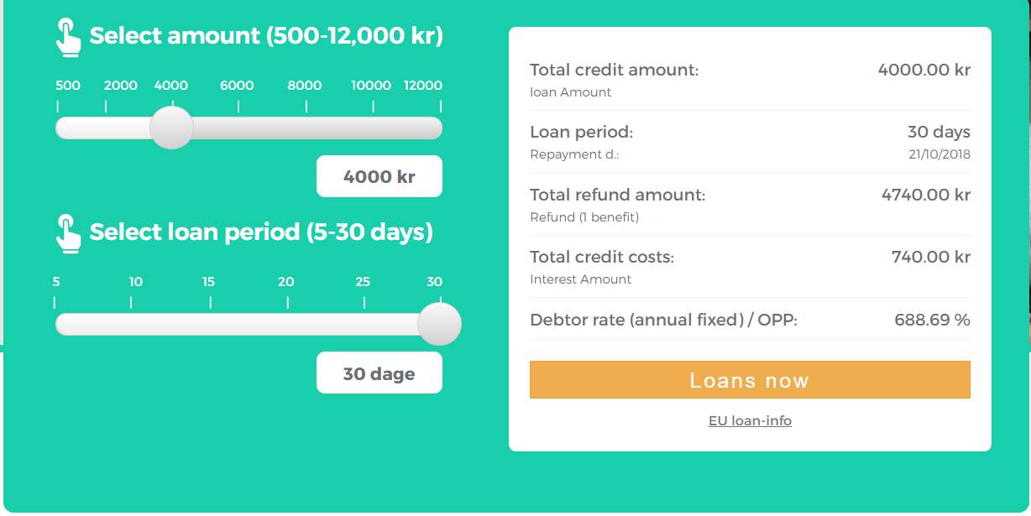
Payday loans are high interest consumer liabilities
Notes:
Mitchell: Define APR***
Payday Loans are a form of Consumer Credit, a category that includes credit cards and financing plans for larger purchases. Payday loans are different in that they are a short term cash loan. The loans are for small dollar amounts with Annual Percentage Rates is often upwards of 500%. This value represents the amount a lender would charge you if the money was borrowed for a year. This specific lender has an apr of almost 700 percent
Payday loans were originally designed to help in financial emergencies, but many people use them for consumer goods instead.

Slide 3
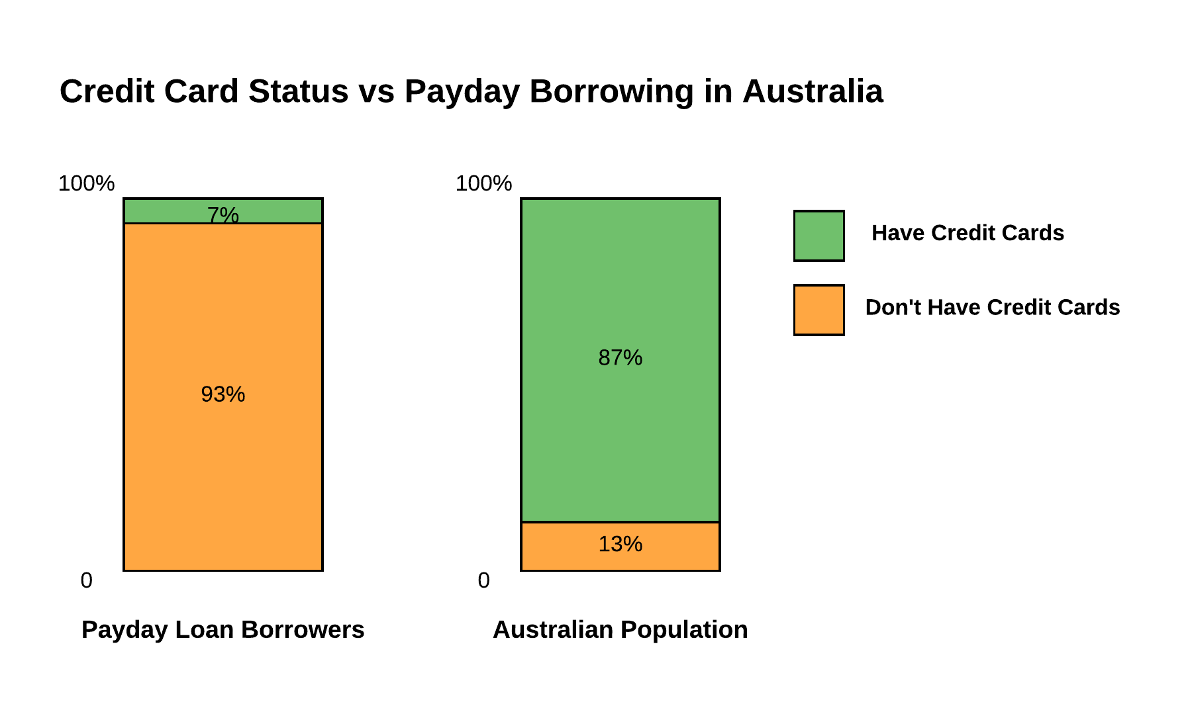
Consumers use payday loans because alternative financial products are not available
Notes:
Ethan:
Consumers use these products because they do not have access to anything else. For instance in Australia payday loan borrowers are far less likely to have a credit card than the average consumer.

Slide 4
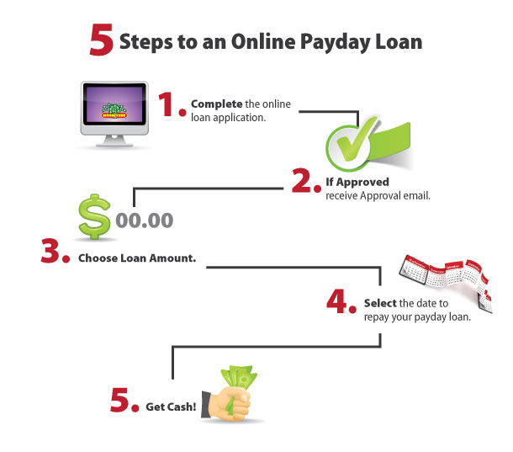
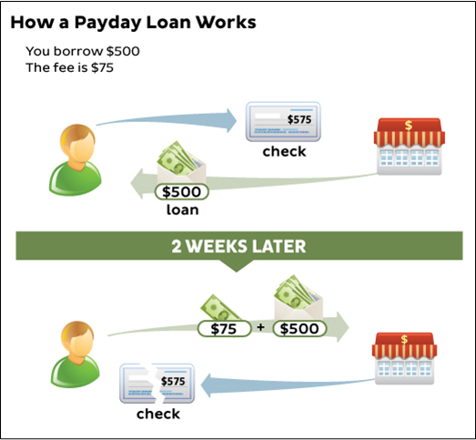
Payday loans are easy to utilize
How a Payday Loan Works
You borrow 500 Kr.
The fee is 75 Kr.
Lender’s Site
Payday Lender
Application
Loan Paid to Customer
Loan Repaid in Full
500 Kr Loan
‘Fees’ (Interest)
(After Credit Check)
Customer
75 Kr
500 Kr
Notes:
Knighton-
Unlike other types of financial products, a payday loan is very easy to get. A customer simply need spend a few minutes to fill out an application with no more than 10 information fields. Once the application is approved, customers can choose their desired amount and term of the loans, and money will be paid to their account immediately.
This graph here also shows the ideal way to utilize payday loans, where the customer pay back their debt once their financial emergency is resolved

Slide 5
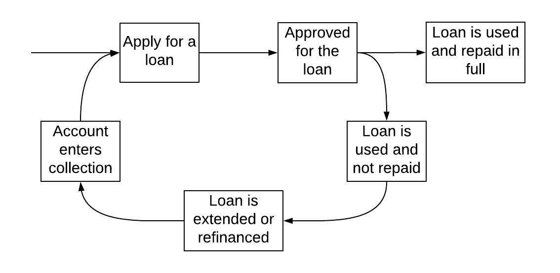
Payday loans can trap consumers in a cycle of debt
Customer Life Cycle
Notes:
Robert:
The ideal situation for a payday loan is to use the loan for a financial emergency and then repay in full on your next payday, however, this is not always the case. Due to the high interest rate and short term consumers are not always able to repay their loans. This leads them to extend a loan which again cannot be paid back due to the extra rollover fees along with the interest. Since the borrower has not yet repaid, their account will enter collections. They will then take out a new loan to repay the old and the cycle continues. This cycle increases the consumers debt and can be difficult to get out of. This has been seen in the United States and the United Kingdom
In 2009, 12 million of the 19 million Americans who took out payday loans found themselves trapped in a cycle of debt. Nearly two thirds of payday loan customers are repeat borrowers who had at least 12 loan transactions per year (Lim, 2014). The United Kingdom payday lending market observed a similar situation with 52% of payday loan borrowers experiencing debt problems between 2009 and 2014. In 2011 alone, 28% of payday loans were rolled over at least once and 5% were rolled over more than 4 times (Szilagyiova, 2015).
Due to the high interest rates and the short term of the loan consumers can get trapped in a cycle of debt. The ideal situation would be taking out the loan, taking care of the emergency and then repaying the loan in full on the next payday. However, many consumers are not able to pay the loan back which starts the cycle. Consumers in need of money fast will apply for a payday loan. The loan is then approved with little to no check in credit score or other necessary information about the consumer. The consumer then exhausts the loan and is unable to repay the loan when the time comes. This the leads to a refinancing on the loan or an extension to the loan. Having to make more payments to repay the original can be hard for the consumer which will lead to their account entering collections. Since they need money to pay off their original loan the apply for a new payday loan and the cycle continues. As illustrated by this image once in the cycle it can be hard to break free from it especially when you do not have a steady income and the stress created from not being able to pay off the lender.
Original Image:
https://lending-times.com/2017/10/12/thursday-october-12-2017-daily-news-digest/

Slide 6
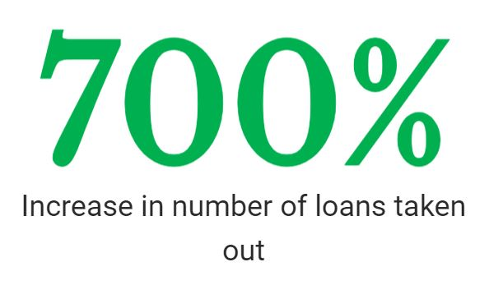
Danish payday loan use has increased dramatically
Year | Number of Loans | Amount of Loans
2010 | 20,000 | 37 Million DKK
2014 | 160,000 | 430 Million DKK
Notes:
Robert:
In 2010, a total of 20,000 payday loans, adding to 37 million DKK were taken out. This increased to 160,000 loans, totaling 430 million DKK in 2014. In just 4 years 140,000 more loans were taken out and almost 400 more million DKK. That is a 700% increase in the amount of payday loans taken out.
https://taenk.dk/om-os/presserum/oekonomisk-pressede-forbrugere-lokkes-til-dyre-laan
http://www.stniniansday.co.uk/payday-loans-the-progression-of-consumer-debt-in-scandinavia/
https://www.prnewswire.com/news-releases/uk-online-payday-lending-market-insight-report-2016-300233638.html
Number of open loans at the end of the year (DKR industry trade group. Covers 80% of the market
2015, 2016 2017
43487 55232 83872

Slide 7
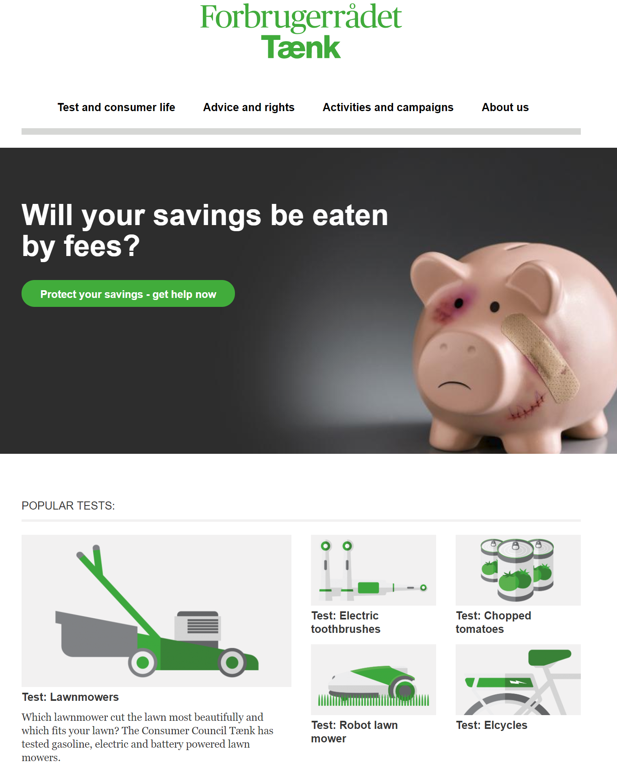
Our Sponsor
Danish Consumer Council is a Consumer Rights Advocacy Group
Vision: Create a Denmark where all consumers can make a safe choice.
Mission: To strengthen consumer empowerment.
Notes:
Ethan:
Because of the cycle of debt in the industry elsewhere and the drastic increase in Danish payday lending,
Our sponsor, the Danish consumer council, is concerned. Our sponsor provides financial counseling, market reports, and suggests legislation to protect consumers.

Slide 8
Our Goal is to Find Possible Initiatives that will Protect Consumers from Payday Loans

Slide 9
Methodology
Notes:
Ethan:
To accomplish this goal we are takinroach involving business models, customer acquisition methods of lenders, and how

Slide 10
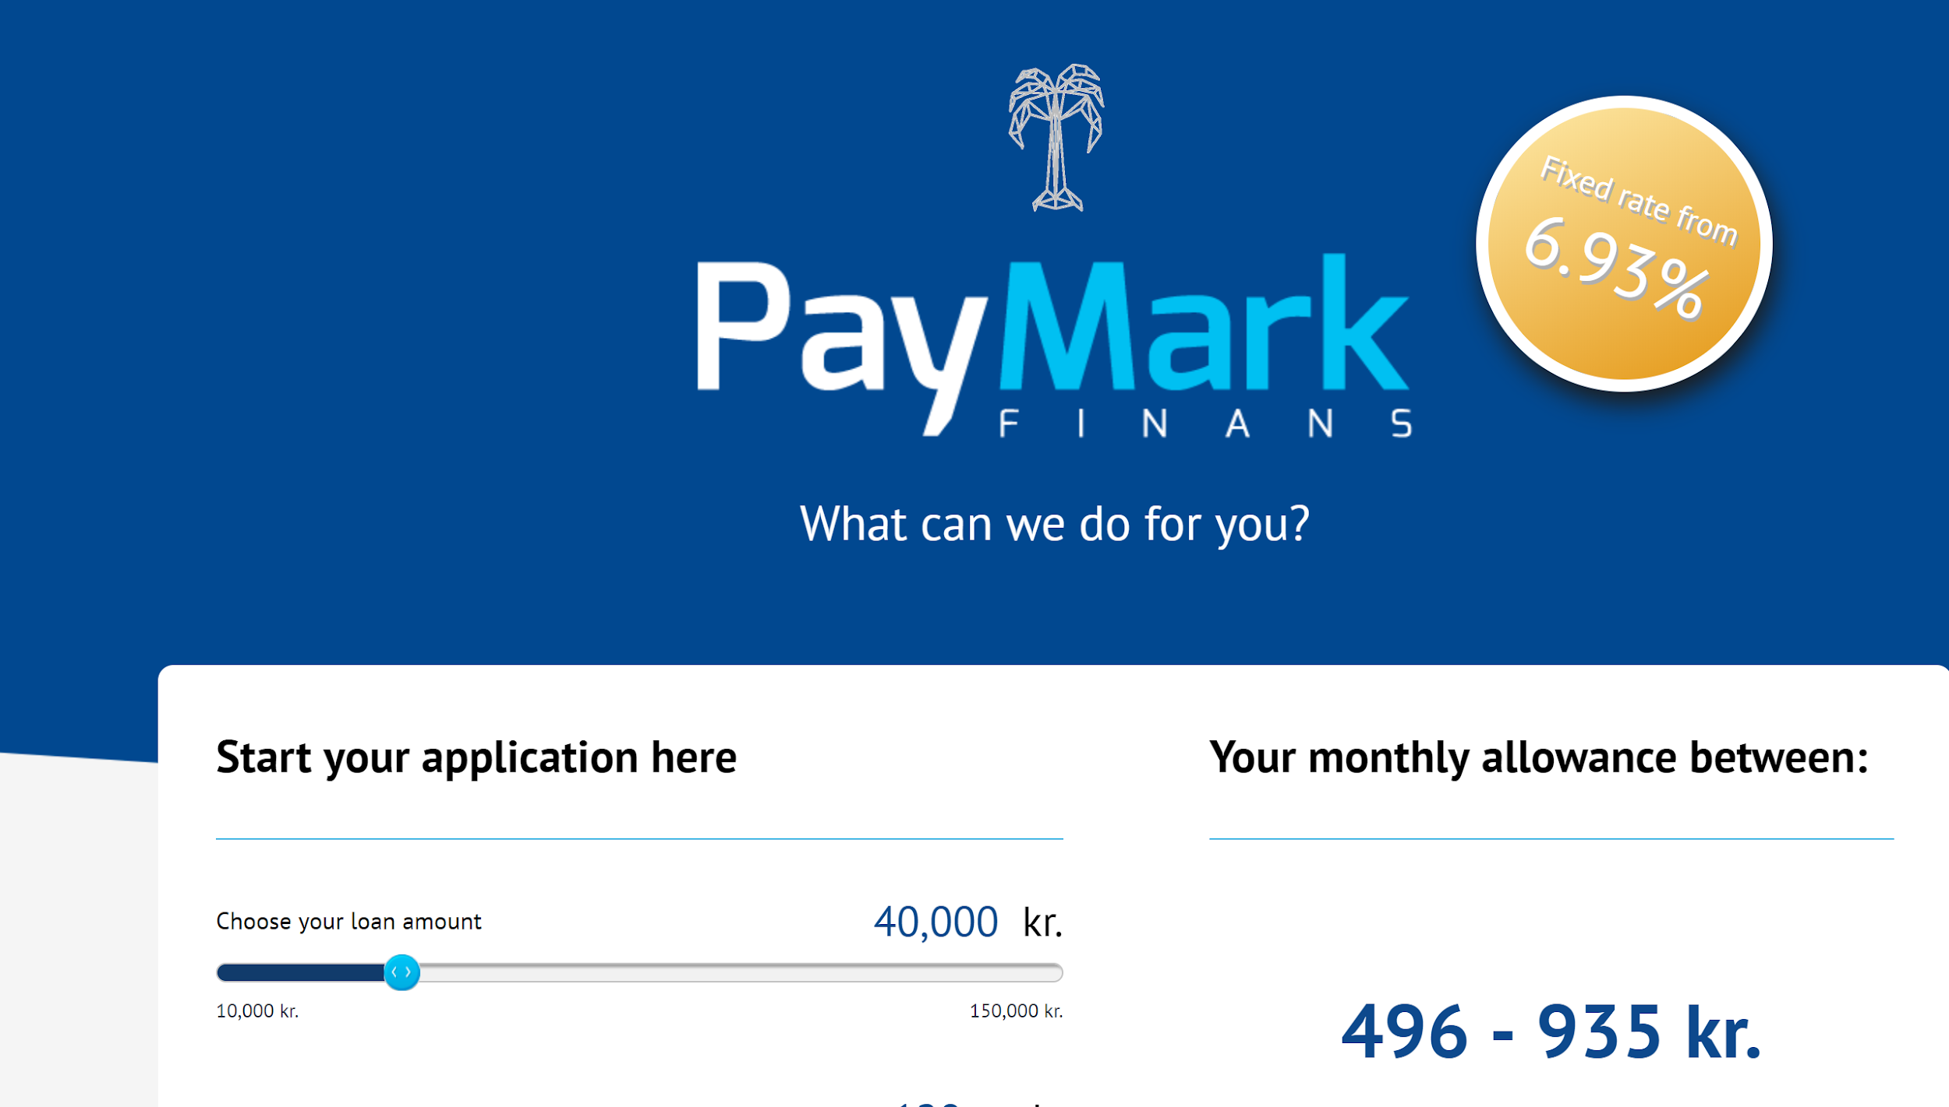
We interviewed a lender and surveyed 14 payday lending websites to understand and evaluate business models
Lender Interview
Website Survey/Evaluation
Notes:
Knighton
To evaluate the business models of payday companies, we interviewed one payday lender, who gave us insight of their customer profile, credit check process, and path of revenues
We also did an website survey to better understand the current business model for online payday lending in denmark

Slide 11
We conducted interviews and a marketing survey to identify prominent customer acquisition methods
Lender, Behavioral Specialist Interview
32 Video Advertisements
Notes:
Mitch:
A large portion of the business model is customer acquisition. We interviewed a lender to determine their forms of customer acquisition we also interviewed a behavioral specialist and analyzed ads to determine how these lenders market their product
Similar to our website survey we also survey ads. From these ads we documented The main selling points of the ads, the age of the people in the ads, as well as any special offers or phrases used to make the product more appealing. From this we coded the advertisements to determine the target audience and other psychological advertisement strategies that the companies used
Cu

Slide 12
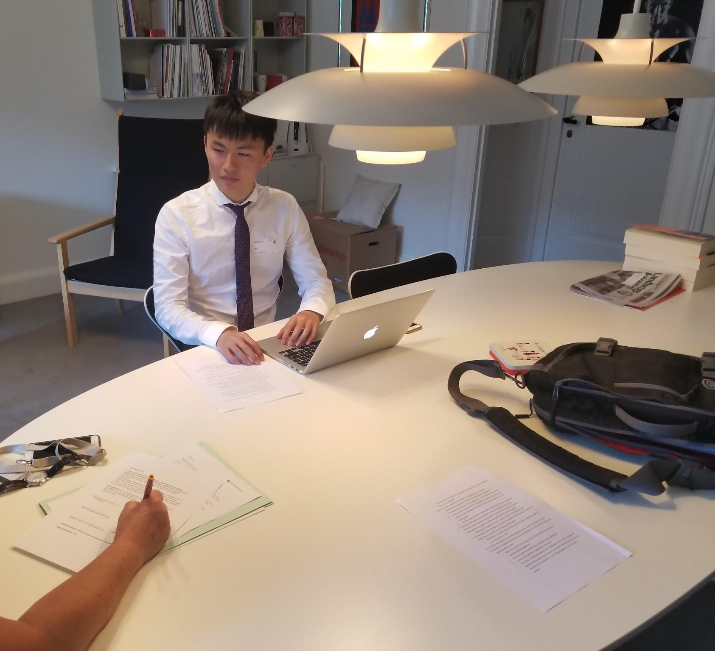
Interviews and secondary research gave insight into the problems targeted by various regulations
Notes:
Robert:
Parliament members interview
We conducted three interviews with members of the Danish parliament. We interviewed a member from the left, right, and center to get the range of opinions on the subject.
Financial advisors from Danish Consumer Council
We interviewed the Financial Advisors from the Danish Consumer Council. From this interview we got more of a consumer perspective and how financial advisors would like to tackle this problem. They were in favor of educating consumers in school and having a safety net for consumers who find themselves trapped in a cycle.
Secondary Research on Legislation
We researched different initiatives taken in Australia, the United Kingdom, Sweden, and Denmark to get an idea of how countries have regulated this problem. We also looked into which aspects of payday lending these regulations try to limit or prevent.

Slide 13
Results

Slide 14
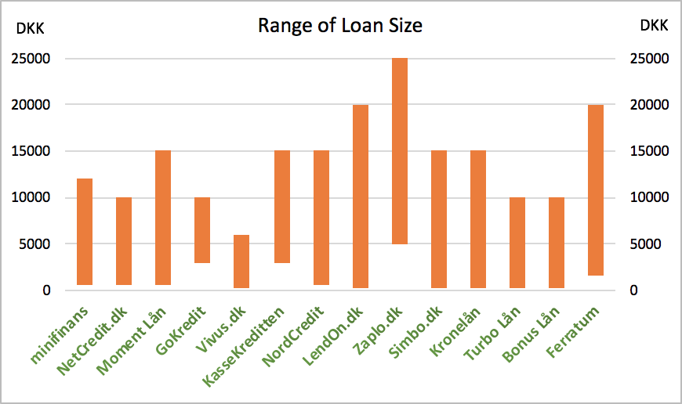
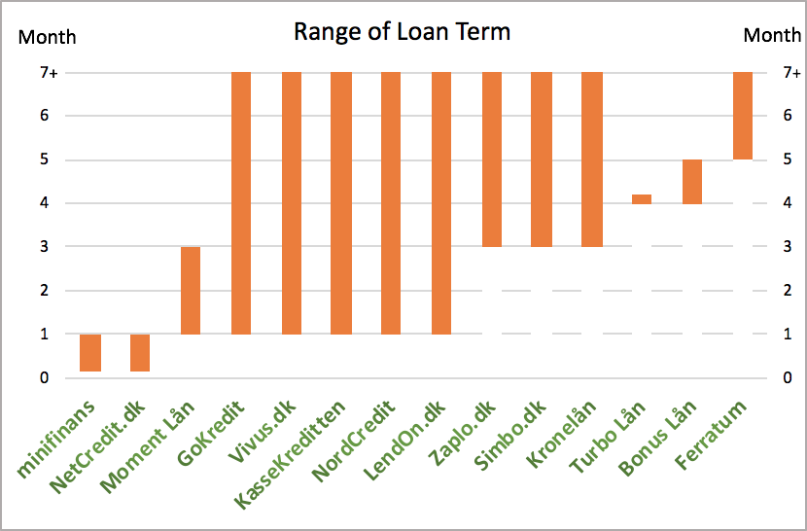
High interest rate and fast application process pose hazards to Danish consumers
Average APR = 610%
Notes:
Our research looked at 14 Danish payday lending companies, which covered the majority of Danish payday lending market. Through our website survey, we gathered information of their various products such as the size of their loans and the term for their loans. One key finding is that these loans have an average apr of 610%, while their applications are very short with only 6 information fields on average. These short application combined with their high aprs pose a hazard to danish consumers.

Slide 15
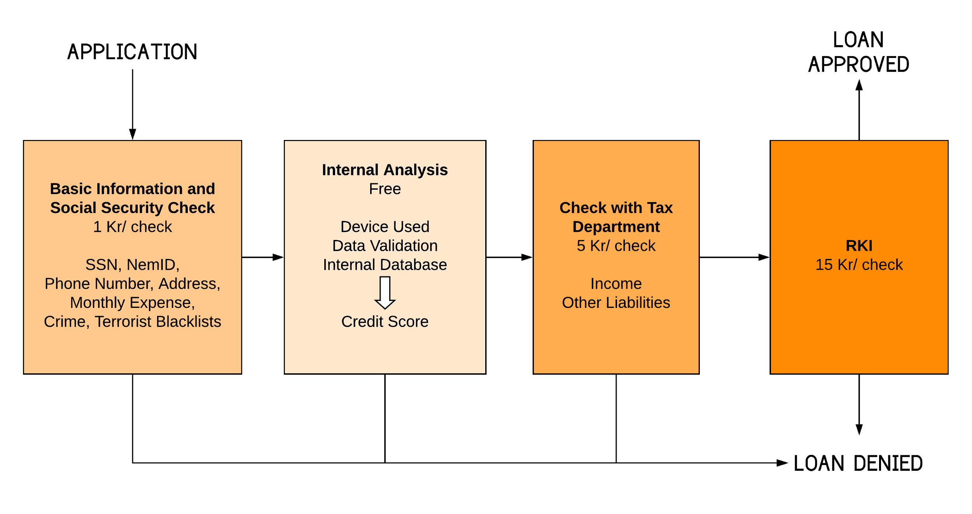
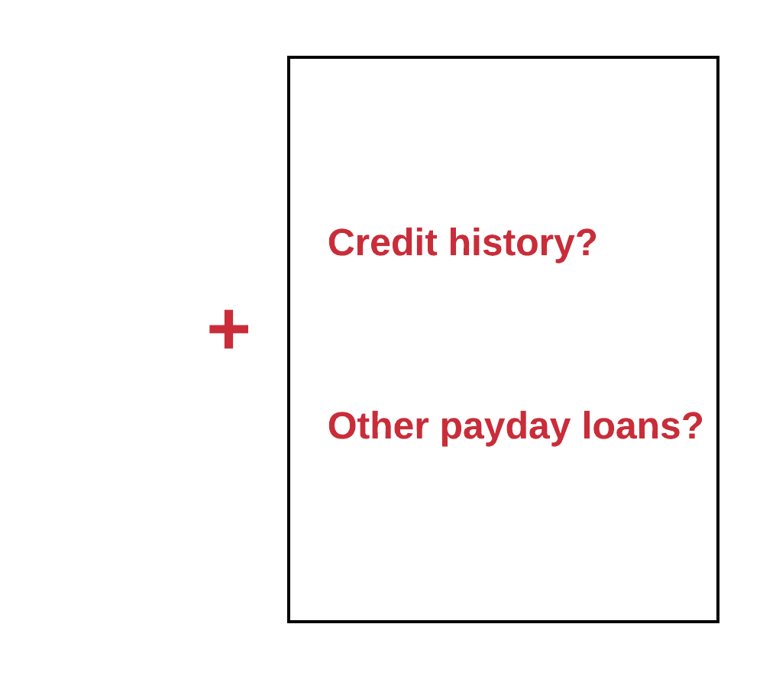
Payday lenders perform an incomplete sequence of credit checks
Database
Less Expensive
More expensive
Notes:
Knighton:
Except for the short application and high aprs, payday lenders performed an incomplete sequence of credit checks. Payday lenders start their check with customers’ basic information then, they go into their internal database to see customers history and generate an internal credit score. After this, they pay the tax department to check the borrowers’ income information including income for the year before and salaries for recent months. Finally, they will go to RKI, which is a bad payer registry, to see if the customer has any outstanding debt. This credit checking process is incomplete because it doesn’t require a credit history from the borrowers. so people with bad or no credit history can still take out payday loans. Also, lenders can’t tell if borrowers have taken out other payday loans from other places. Therefore, this system does not guarantee a high credit standard from customers. One possible solution to improve this system is establishing a government-run database to share loan information Because Without enough information, this incomplete credit check would allow consumers to borrow unaffordable loans and lead them to be delinquent.

Slide 16
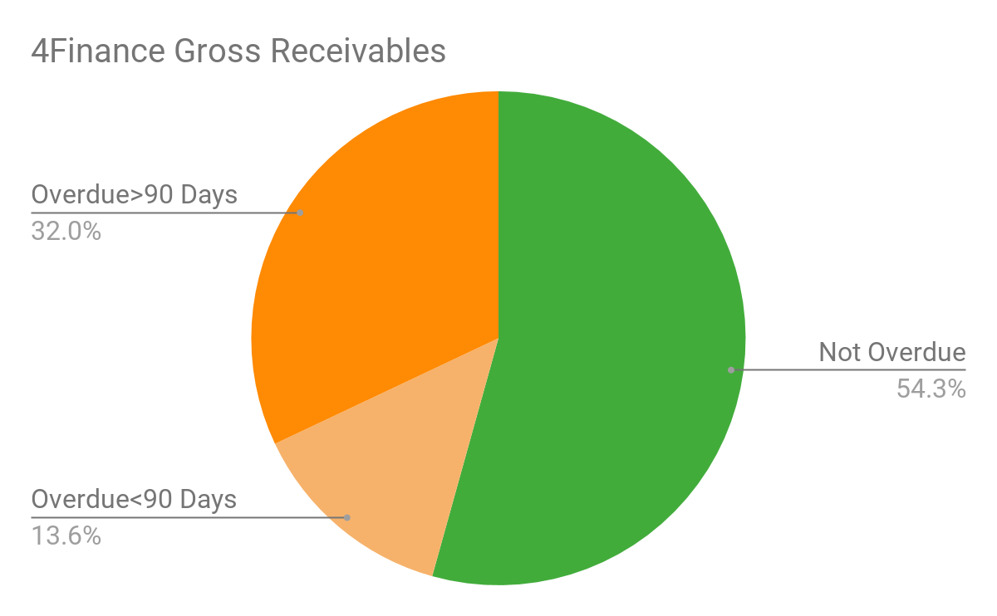
4Finance has many delinquent payers
Danish Payday Lender
Anonymous
“...defaults is the biggest expense.”
Notes:
Ethan:
These delinquencies occur at a very high rate
For instance, 4Finance, a Danish Payday Lender saw 46% of borrowers were delinquent in payment 30 days or more.
Additionally the lender interviewed said they were their biggest expense
Because these loans are so expensive people struggle to pay them back.
It was found that in the uk the average payday loan was 28% of the average borrowers monthly income.

Slide 17
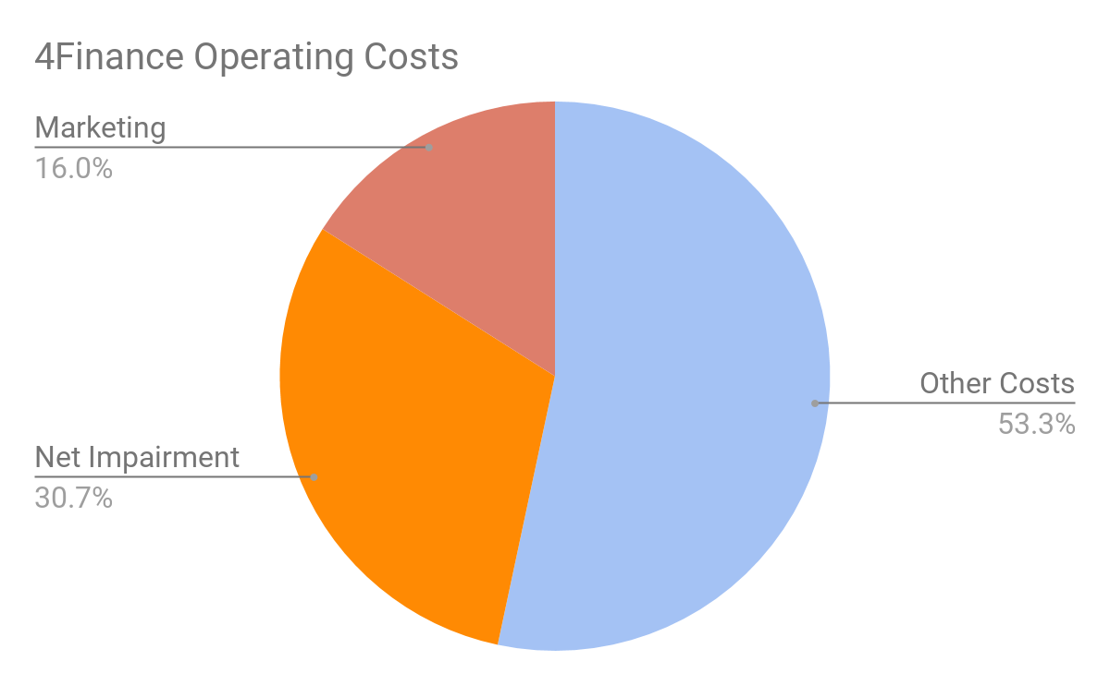
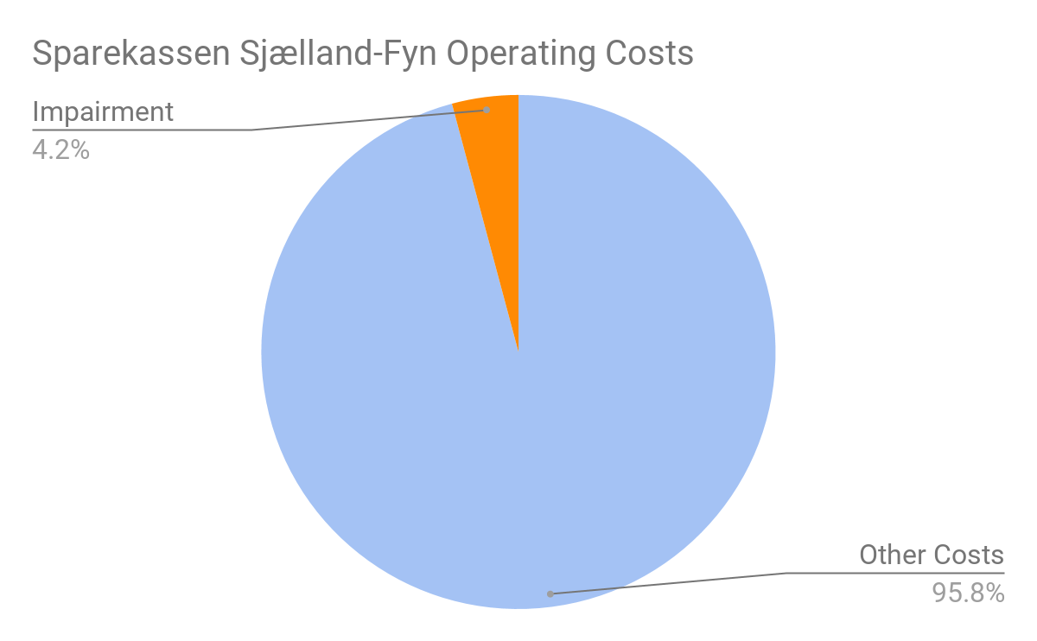
Payday lending has high impairment costs
Payday Lender
4Finance
Midsize Bank
Sparekassen Sjælland-Fyn
Notes:
Ethan:
Impairments are a way for banks to account for future delinquencies and defaults in their expenses.
Impairments are over 30% of the payday lenders overall expenses.
Also notice the payday lender’s marketing as a percent of expenses is quite high particularly when compared the the european bank
marketing being a large portion of overall expenses The midsize bank in this comparison had negligible marketing costs
Lower credit checking standards and Higher APR cause higher default costs
With these spensive loans people cant pay em back (Robert Dwan, 2018)
After default rates are linked to credit checks
Ethan:
This is a comparative analysis of expenses from a payday lender and a consumer lending bank. The size of each box represents the relative value of expenses in each category.
Key takeaways are:
Payday lenders have high marketing and default costs,
These findings are reinforced by our interview with the payday lender who ranked default costs as their highest expense

Slide 18
Payday lending companies only profit from repeat borrowers
Customer
Lifetime
Value
Value customer brings to the company throughout their use of the product
Customer Acquisition
Costs
Money required to get a customer to use the product
Notes:
Ethan:
Marketing is a portion of customer acquisition cost which is the amount of money it takes to get a customer to use the product once
A company only makes money on a customer when the customer lifetime value is greater than the customer acquisition cost
BREAK EVEN point in the UK was found to be after 3 loans
CYCLE OF DEBT Companies are incentivized to create repeat borrowers
High customer acquisition costs
Customer Acquisition Strategies are:
Any cost associated with gaining a customer can include the following:
Processing initial applications
‘Refer a Friend’ programs
Lower or deferred fees on first loan
Lead Purchase
General marketing

Slide 19
Payday loan companies target impulsive individuals

Slide 20
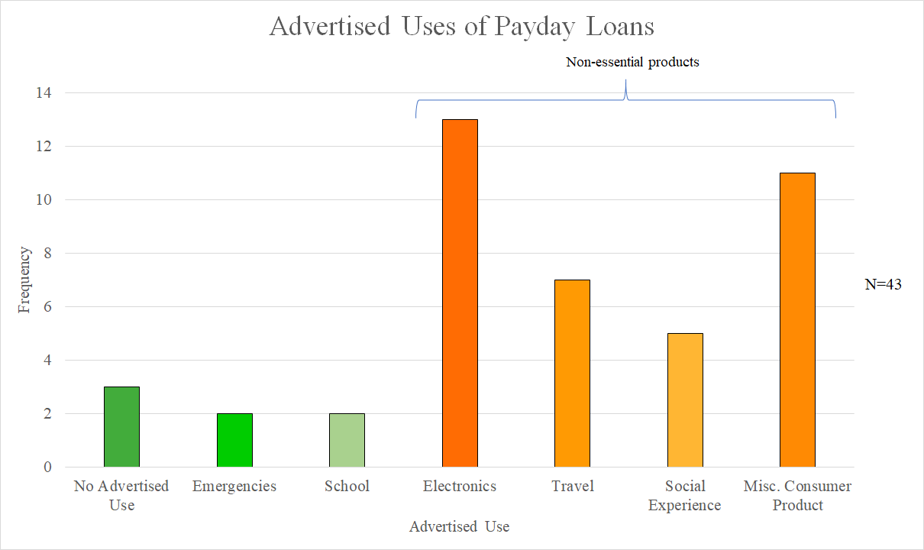
Advertising focuses on non-essential purchases
Notes:
Mitch:
From our advertising survey and the 32 video advertisements that were analyzed there were 40 instances where the loan had an advertised use and 3 where there was no use. 36 of the Advertised uses were for non-essential goods which appear in orange on this graph. This shows that the videos advertise towards impulsive people.

Slide 21
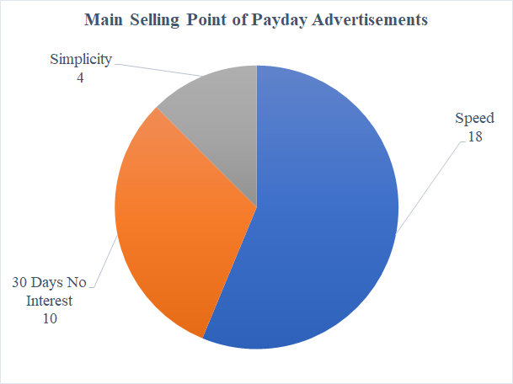
Payday loan advertisements have 3 main selling points
Rook, D. W., & Hoch, S. J. (1985). Consuming impulses. Advances in Consumer Research, 12(1), 23-27.
n=32
Notes:
Robert:
The 32 advertisements also contained three main selling points. Simplicity, 30 days of no interest, and the speed to apply for a loan. 4 of the ads focus on the simplicity of the application process, 10 focus on the 30 days of not interest and 18 of the ads focused on the speed aspect. Having a strong focus on speed also entices impulsive people because they can get money here and now for immediate use
This focus on speed is backed up by our interviews where speed was named as the primary competitive factor in the payday market, much more than the cost of the loan (AOP)
30 days no interest is an example of customer acquisition cost because a month of interest is lost for each loan.

Slide 22
Legislation

Slide 23
Many countries have taken initiatives to regulate payday loans
Interest Rate Cap
Cool Down Period
Extension Limit
Warning Statement
Charge Cap
Cool Off Period
Interest Rate Cap
Cool-Down Period
Extension Limit
Warning Statement
Charge Cap
Cool-Off Period
✓
✓
✓
✓
✓
✓
✓
✓
✓
✓
✓
✓
✓
Notes:
Robert: Many countries have taken initiatives to help regulate payday loans. The Australis, the UK, and Sweden have all implemented some kind of APR caps. For Example, the Uk has a daily cap, Australia has a monthly cap, and Sweden has an APR based on the national banks. These three countries have also enacted the need for warning statements on websites and advertisements and charge caps. The charge caps are a cap on the amount a borrower would owe for a loan. Australia has enacted a cool-down period which is a period of time between consecutive loans. Denmark has only implemented a 48 hour cool-off period which is a period of time between being accepted for a loan and receiving the money. This gives the consumer time to think over the loan and the ability to cancel at no cost.
Mitch - Australia:
Interest rate cap where the maximum percent on the initial loan was 20% with a 4% maximum on the monthly charges
People Who default can’t be charged more than twice the loan amount
Cooldown period where borrow can’t have more than 2 loans within 90 days
Warning statement requirement when borrowers take out a loan
Knighton - United Kingdom:
UK implemented a series of regulation in 2014, including an interest rate cap at 0.8%/ day, a maximum default charge to be 126 danish kr., an interest cost cap at 100%, meaning that the total interest cost can never exceed the loan amount, then a cap of 2 on the number of rollovers, and a mandatory warning and price comparison that every sites should include.
Ethan - Denmark:
March 2016 - 48 hour cool off period where the consumer does not have access to the funds and can cancel the transaction. Payday lenders offered new products which have ways to get around this
Robert - Sweden:
Interest Rate Cap (9/1/2018) Section 19a
APR Interest rate and default interest rate cannot exceed more than 40% of the what the bank’s interest rate is at the time.
Cost Ceiling (9/1/2018) Section 19b
For high-cost credit, costs may not exceed the credit amount
Extension limit (9/1/2018) Section 36a
Cannot be extended more than once
Can only be extended if
It is no cost to the consumer
There is a reasonable repayment plan
Marketing (9/1/2018) Section 7b
Must clearly express it is a high-cost credit
Should contain information of the risk of debt
Should also say where the consumer can go to get help with debt
You can see Denmark has different options when it comes to regulation and they tried in December 2017 to Pass an APR interest rate cap of 15% plus the federal bank interest rate however this did not get a majority vote.

Slide 24
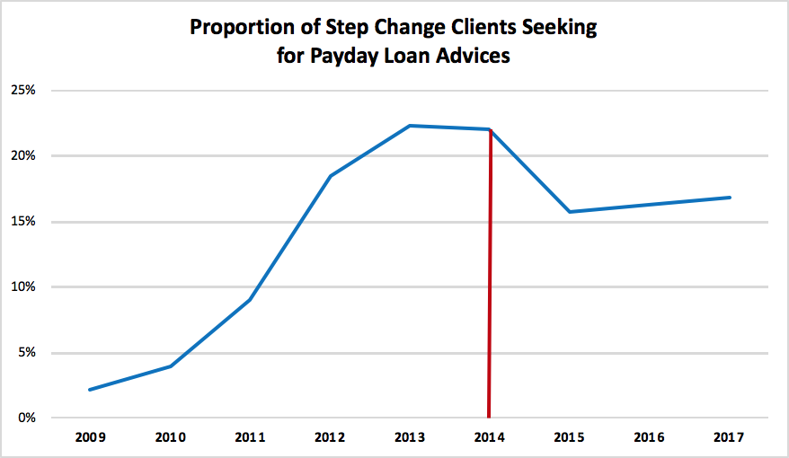
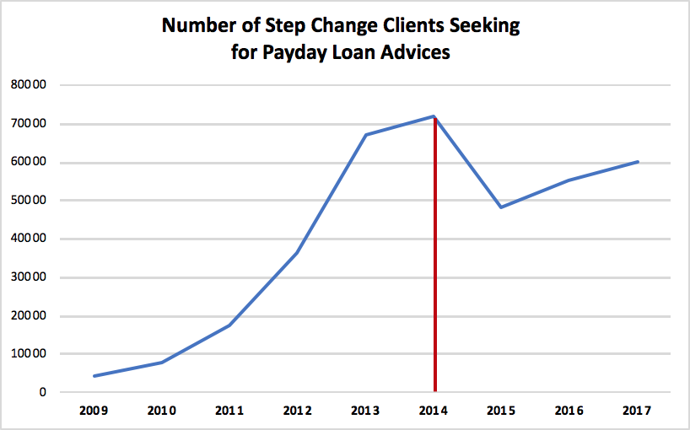
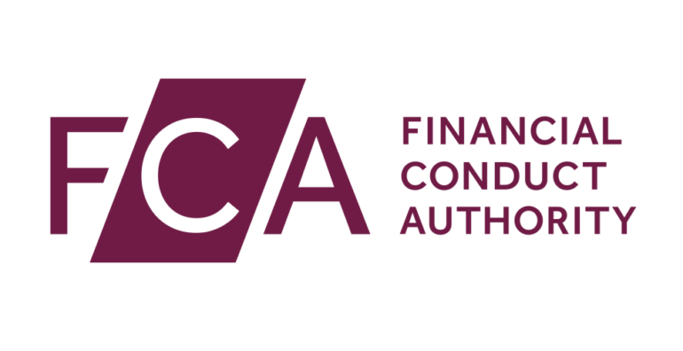
The 2014 UK regulations on payday lending were effective
Notes:
Knighton:
Looking at the UK regulations in 2014 specifically, evidence was found to prove that the regulations were effective in protecting consumers. The UK financial conduct authority, who put the regulations into action, did a review in 2017 and found a healthier lending market under the new regulations. They found that less interest is paid by customers, loans are repaid on time more often, and the approval rate for payday loan application dropped by 20%. Another evidence comes from step change, which is the largesting debt charity in UK that provide debt advices. We look into their annual reports found that the number of clients and proportion of clients seeking for payday loan advices both dropped significantly following the legislation. This suggest that the regulation is effective in protecting consumers, while we do acknowledge that the effect is not long lasting based the graphs above.

Slide 25
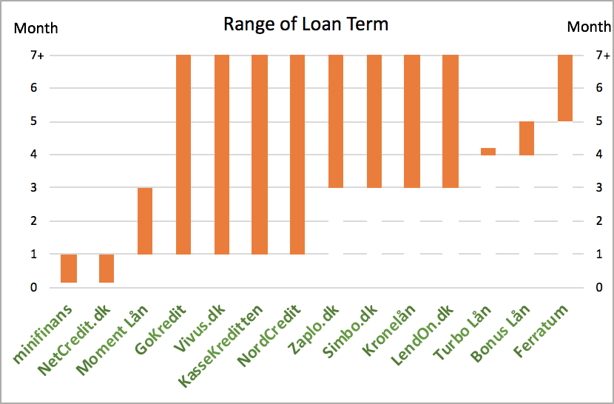
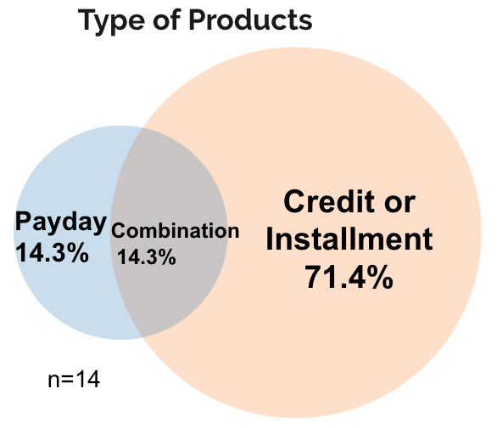
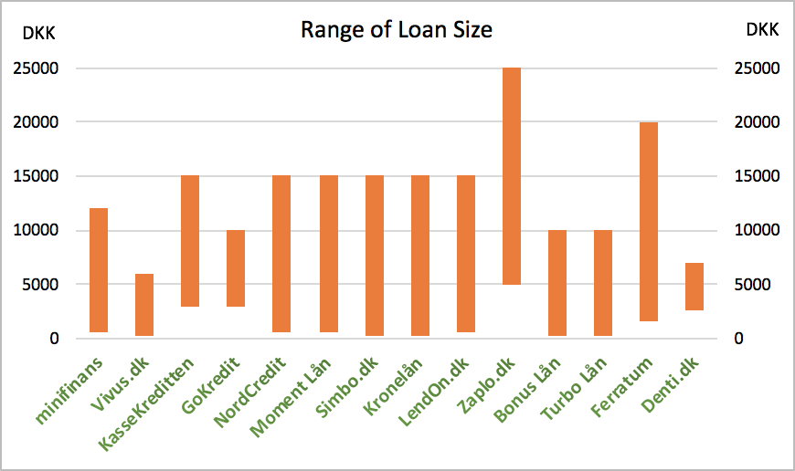
Payday products were adjusted to circumvent the 48 hour cool-off period
Notes:
Robert: The 48 hour cool-off period implemented in Denmark was not effective as lenders found a way around this. Payday lenders circumvented the previous regulation with products longer than 3 months; they introduced new credit products, which is the majority of what they are providing now, to get around the previous regulation on payday loans. On average, the size of a payday loan is from 1250 kr to 13500 kr, term of loans are from 3 months to unlimited time. Average min age is 21 years old.
introduce a 48-year report more within which a borrower can not accept a bid for commercial loans. Kviklån are defined in the report as loan without collateral and without condition of purchase of one product or service where the maturity is not longer than three months

Slide 26
A charge cap Is more favorable among Stakeholders than an APR Limit
Notes:
Fundamental to each of the other nations regulatory implementations has been an Interest rate cap. However the Charge cap achieves a very similar outcome and has a broader base for support.

Slide 27
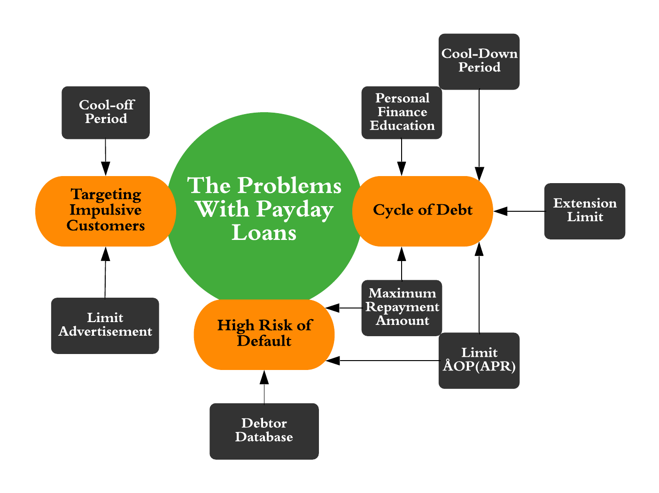
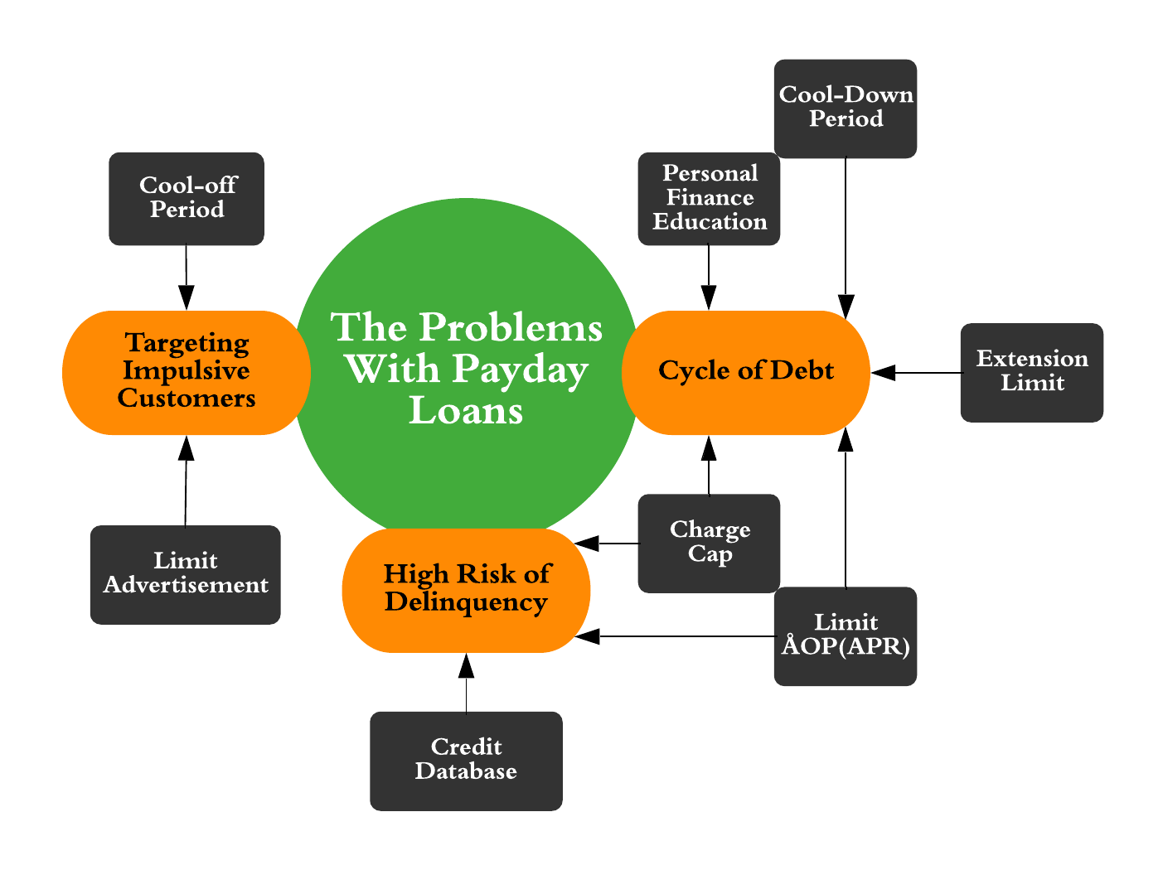
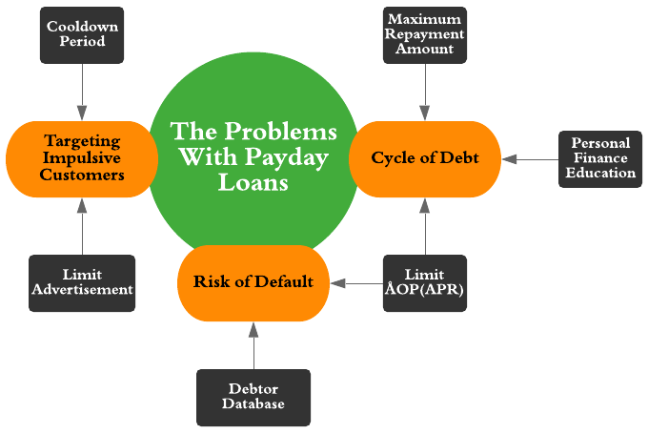
Initiatives are designed to target specific problems with payday loans
Notes:
From Our research and interviews we identified major problems with the payday lending market and possible solutions to those problems
The Cooldown period and Limit on advertisement would help deal with the targeting of impulsive consumers
The APR cap and Debtor Database which would list all loans someone has would help with default risks
A maximum repayment amount APR limit and personal finance education would all target the cycle of debt.

Slide 28
Suggestions

Slide 29
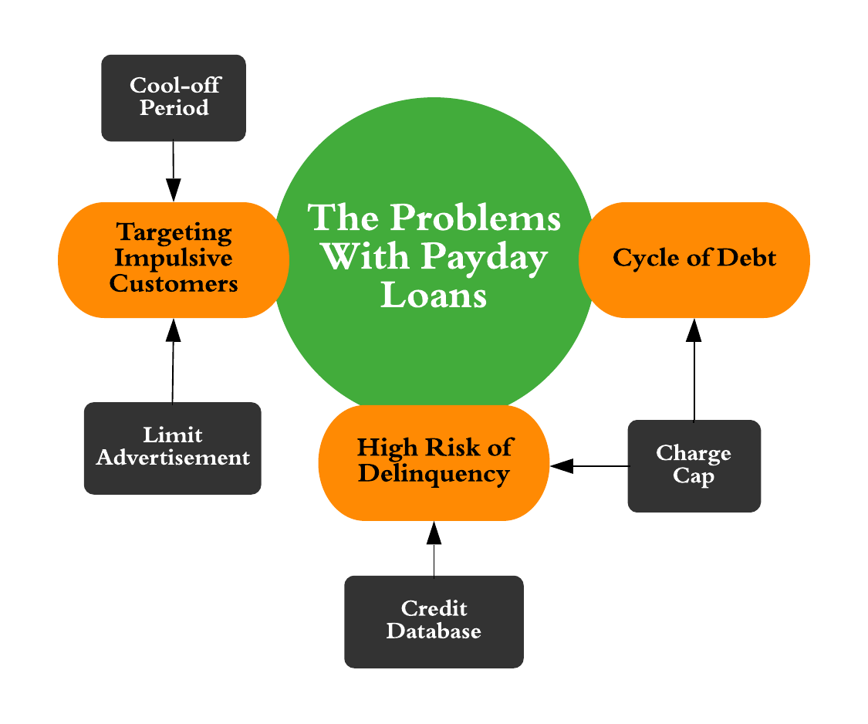
The advertising limit helps limit the targeting of impulsive consumers

Slide 30
Cool Off Period

Slide 31
An 100% charge cap will help prevent the cycle of debt

Slide 32
A debtor database will reduce delinquency and defaults
Notes:
We recommend implementing A government run credit database. This database will include the debts of all loan users. Lenders will be able to query this database by entering a borrowers information and in return will get more detailed information on their credit history. Numerous studies have shown that when more borrower information is shared defaults and late payments decrease
Concerns about privacy and

Slide 33
Multipronged legislation is key to protecting Danish consumers
Notes:
Moving on to Our suggestions which consists of 4 initiatives the first of which is a Limits on advertising that would prevent payday lenders from advertising with images. This would prevent impulsive consumers from being enticed by attractive images for non-essential goods
We believe that these 4 initiatives will work well together to prevent consumer indebtedness as a result of payday loans because all of the problems are addressed by an initiative with some problems being addressed by multiple initiatives

Slide 34
Acknowledgements
Sponsor
Morten Brunn Pedersen
Danish Consumer Council
Advisors
Professor Ault
Professor Foo
Denmark Preparation
Professor Kurlanska
Professor Hansen

