Slide 2
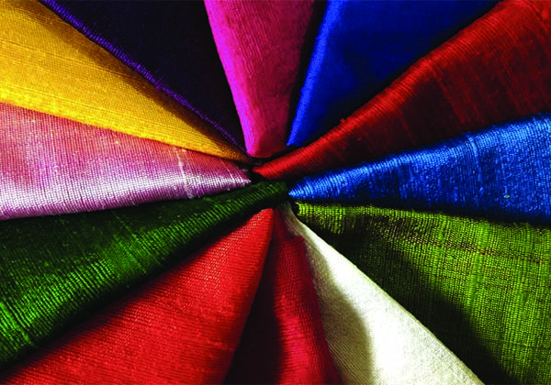
Textiles: From Waste To Resources in Denmark
Christine Carbone
Charles Hill
Caroline Meyer
Leah Morales

Slide 3
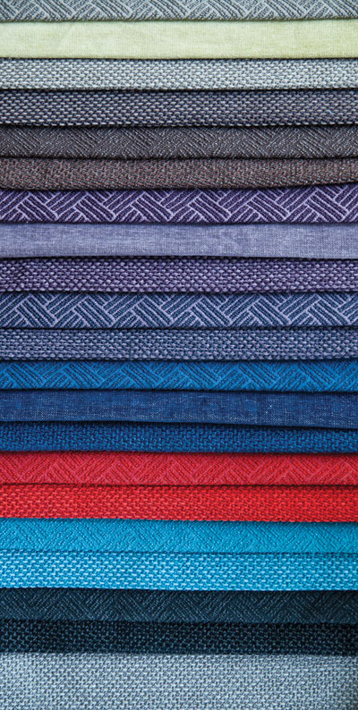
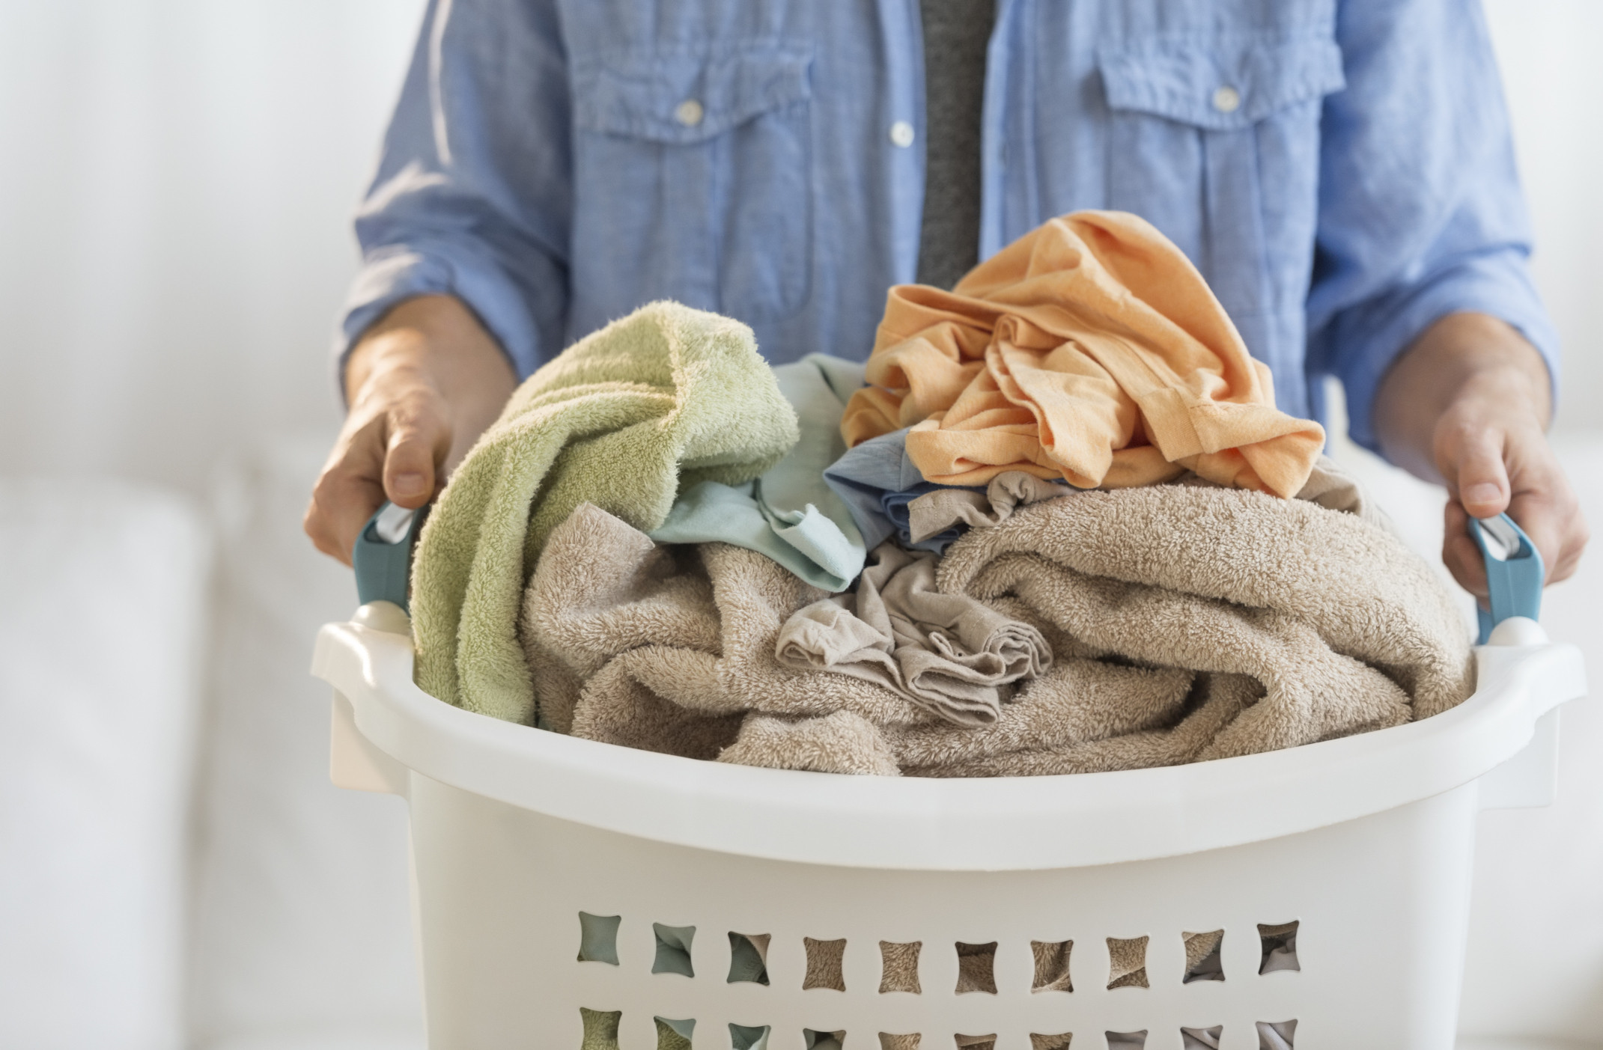
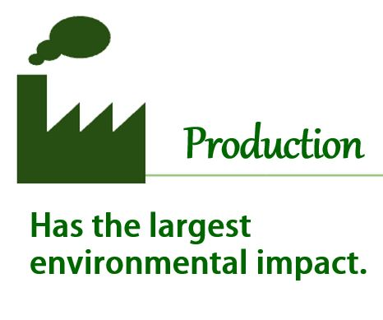
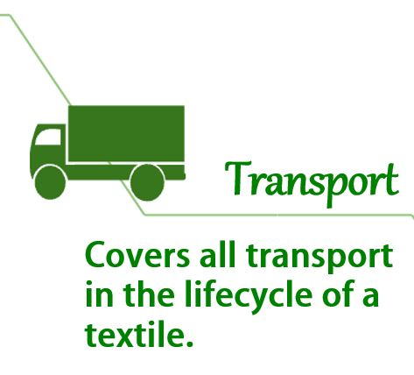
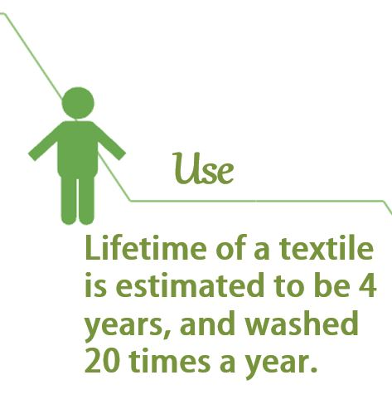
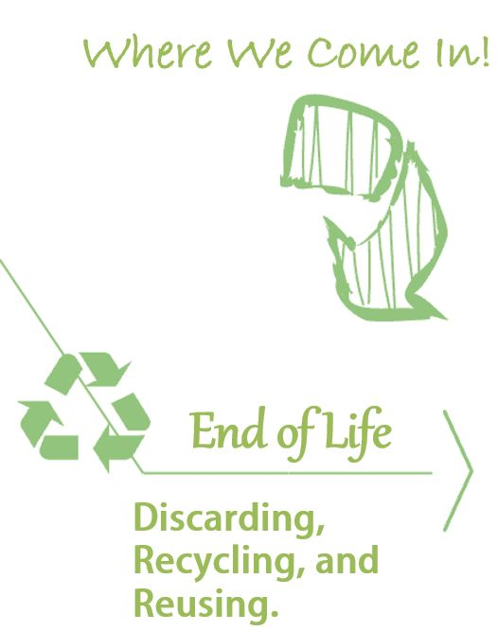
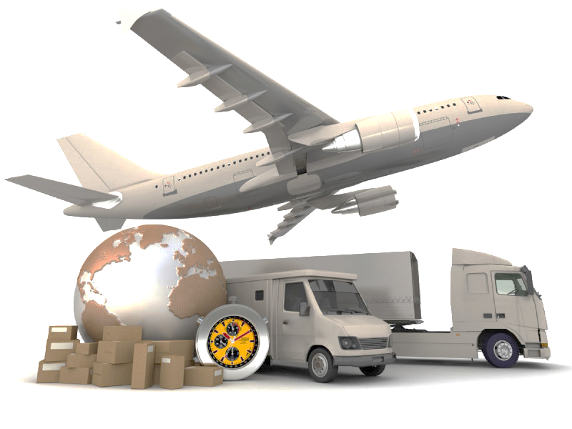
Lifecycle of a Textile
It takes 4,527 liters of water to produce 1 kg of textiles
(Neilsen et al 2014)

Slide 4
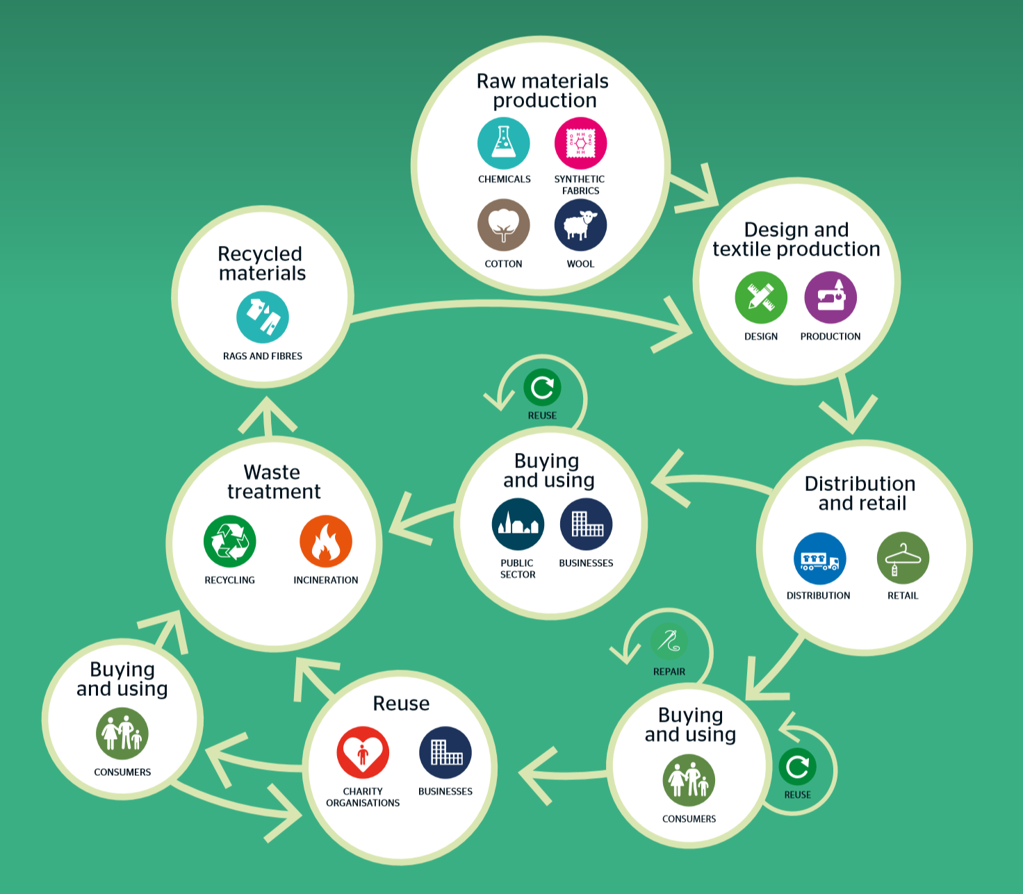
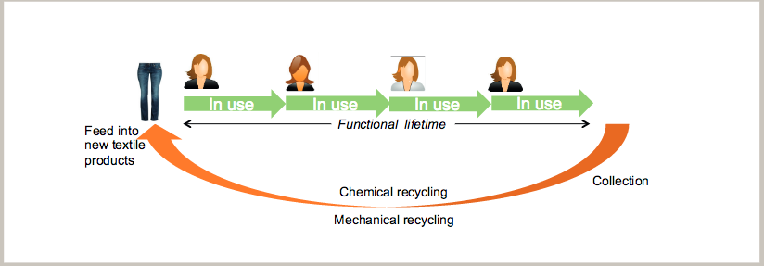
Lifecycle of a Textile
Overall goal for treatment of textiles to lower environmental burden (Watson, 2014).
Denmark Without Waste II 2015

Slide 5
Mission Statement
Reduce environment footprint
Increase reuse and subsequent recycling
Optimize collection methods
Improve cooperation among stakeholders
Notes:
Can we make this into a diagram?

Slide 6
Objectives
Objective 1
Assess current reuse and recycling systems
Objective 2
Compare textile reuse and recycling among different organizations
Objective 3
Facilitate stakeholder cooperation through workshop

Slide 7
Assessing the Current System
Vestforbrænding
Spoke with Morten Strandlod at Vestforbrænding on 3/15/16
Semi-structured Interviews
Amager Resource Center
Spoke with Linda Rebien at ARC on 4/4/16
Semi-structured Interviews
Dansk Affald
Spoke with Jesper Vange Heinzl at Dansk Affald on 3/29/16
Semi-structured Interviews
Notes:
Should speak about their current system before going into who we talked to. So begin with “Denmark’s current system is not bad, but it could be better. Currently 46% of textiles are being separately collected, but this number could climb to 75, or 90%”

Slide 8
Assessing the Current System
Arwos
Spoke with Halfdan Neumann at Arwos on 3/29/16
Semi-structured Interviews
Renosyd
Spoke with Poul Pedersen at Renosyd on 3/30/16
Semi-structured Interviews

Slide 9
Assessing the Current System
Danish Church Aid
Spoke with Morten Ebbesen at Danish Church Aid on 3/30/16
Semi-structured Interviews
Red Cross
Spoke with Tina Donnerberg at Red Cross on 4/20/16
Semi-structured Interviews

Slide 10
Assessing the Current System
UFF
Spoke with Kaj Pihl at UFF on 4/7/16
Semi-structured Interviews
Trasborg
Spoke with Steen Trasborg on 4/13/16
Semi-structured Interviews

Slide 11
Assessing the Current System
PlanMiljø
Spoke with David Watson at the Danish Waste Association on 3/15/16
Semi-structured Interviews
EPA
Spoke with Anne-Mette Lysemose Bendsen on 4/14/16
Semi-structured Interviews
Isobro
Spoke with Vibeke Anderson at Danish Waste Association on 4/7/16
Semi-structured Interviews
Notes:
Should speak about their current system before going into who we talked to. So begin with “Denmark’s current system is not bad, but it could be better. Currently 46% of textiles are being separately collected, but this number could climb to 75, or 90%”

Slide 12
Compare and Contrast Systems
Content Analysis
Background Research
Gain insight
Site Visits Interviews
Municipalities, Privately Owned Organizations, and Humanitarian Organizations
Cost Benefit Analysis
Evaluation of Increased Collection
Notes:
dido

Slide 13
Facilitate Stakeholder Cooperation
Results
Compiled information
Projections
With increased collection
Problem Areas
The current gaps in the system
Workshop
Come up with solutions together

Slide 14
Results
A thematic code was created in order to quantify responses from the interviews conducted
89% of those interviewed had a positive attitude towards cooperation

Slide 15
Results
Cost or benefit | How we will monetize and evaluate them
Cost to separately collect textiles that are currently being placed in bulky waste | - Additional collection bins set up for humanitarian organizations - Collection bags given to households
Cost to sort collected textiles from different waste streams | - Labor to sort textiles from recycled streams
Profit from selling collected textiles | - Amount of collected textiles that are: reusable, recyclable, or energy recoverable - Selling price of collected textiles per ton - Price municipalities charge humanitarian organizations per ton of textiles
Environmental Benefits from increased collection of textiles | - Percent of collected textiles that are: reusable, recyclable, or energy recoverable - CO2 savings per ton of textiles separately collected - Water savings per ton of textiles separately collected

Slide 16
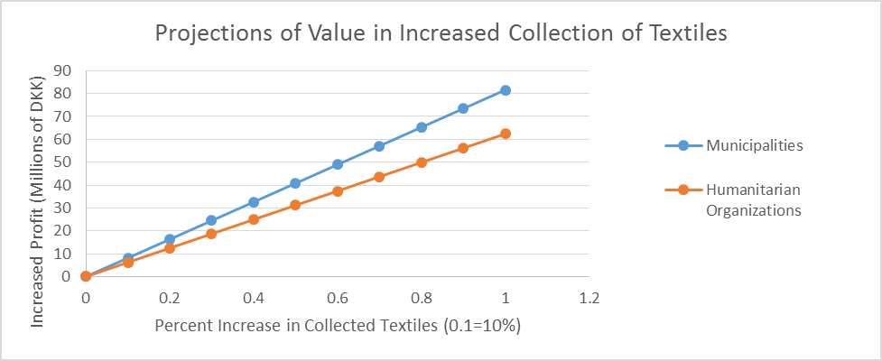
Projections

Slide 17
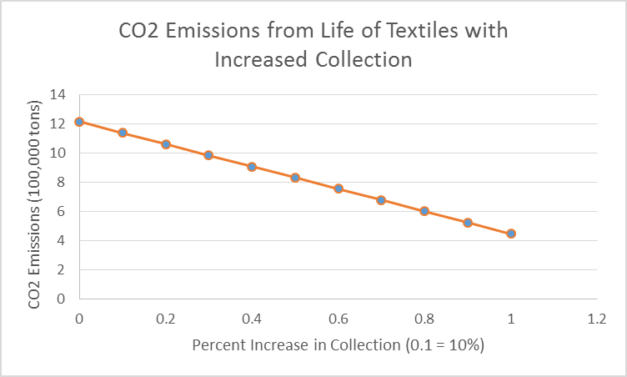
Projections

Slide 18
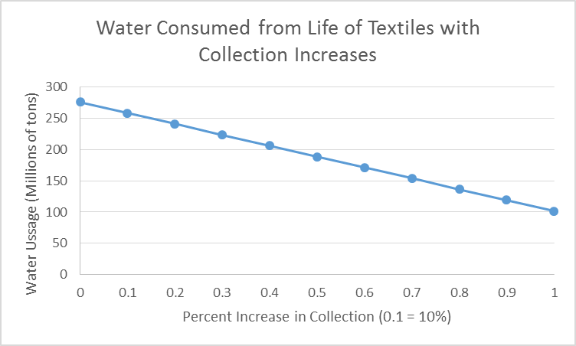
Projections

Slide 19
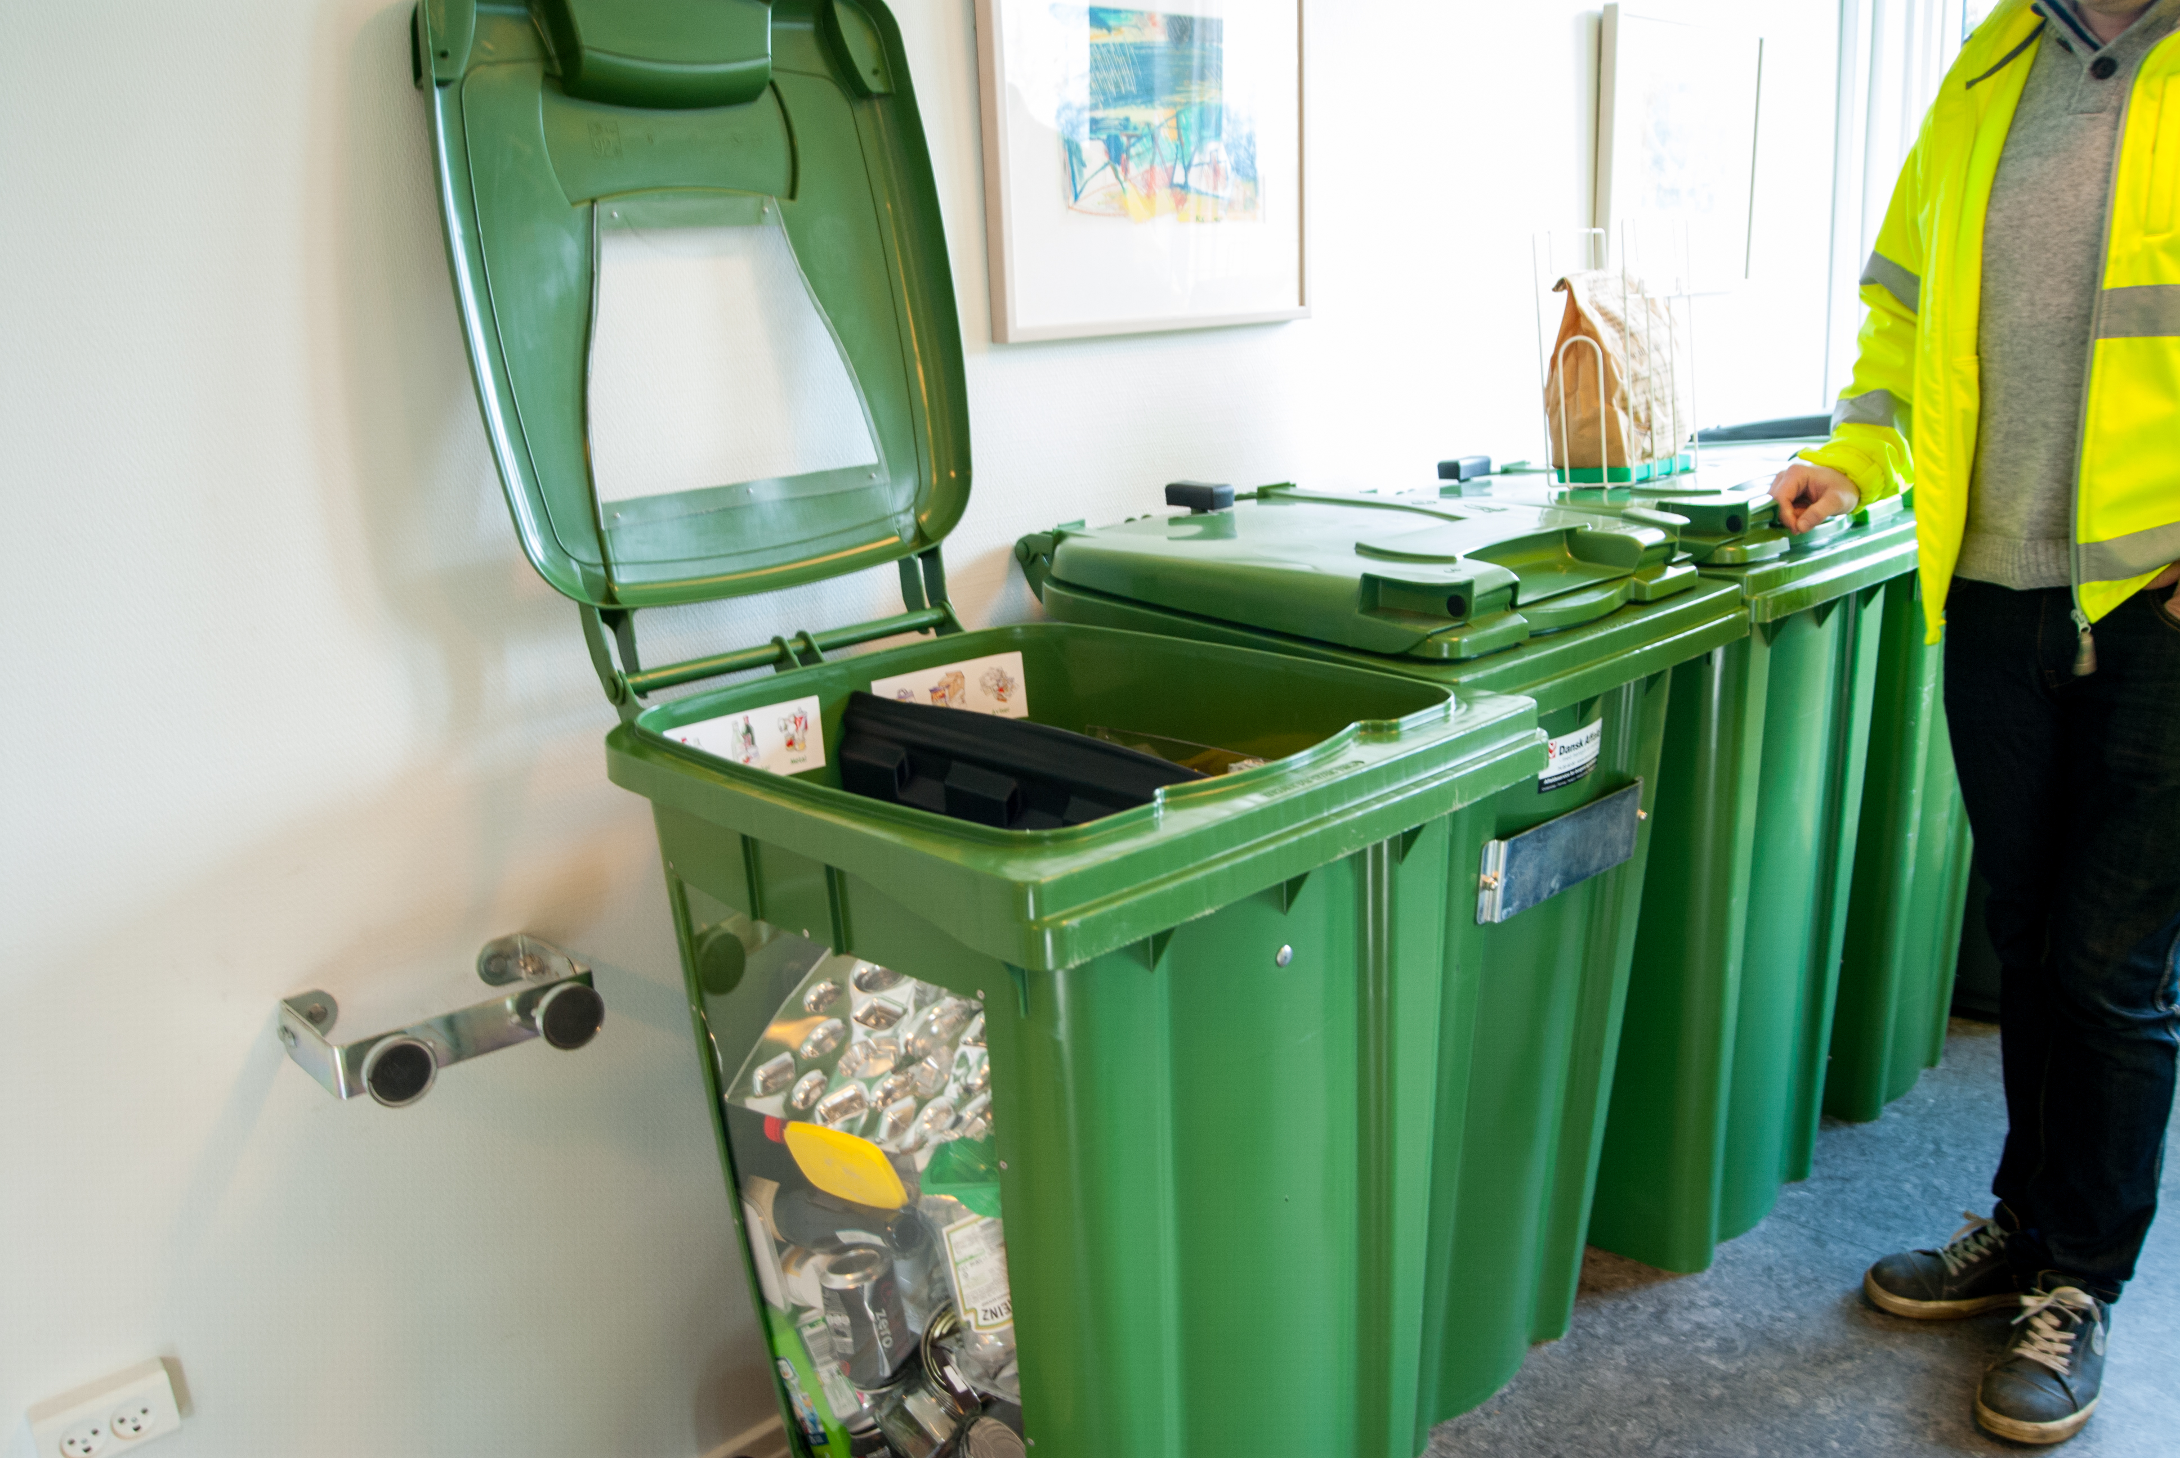
Increasing Collection
How?
Residents respond to convenience
Dansk Affald's Duoflex™ system is already implemented at 550 homes. When asked if they would be willing to also separate textiles, 90% responded positively
https://www.google.com/maps/d/edit?mid=zmNvq02Uwj6Y.ktV4YwAisVRM

Slide 20
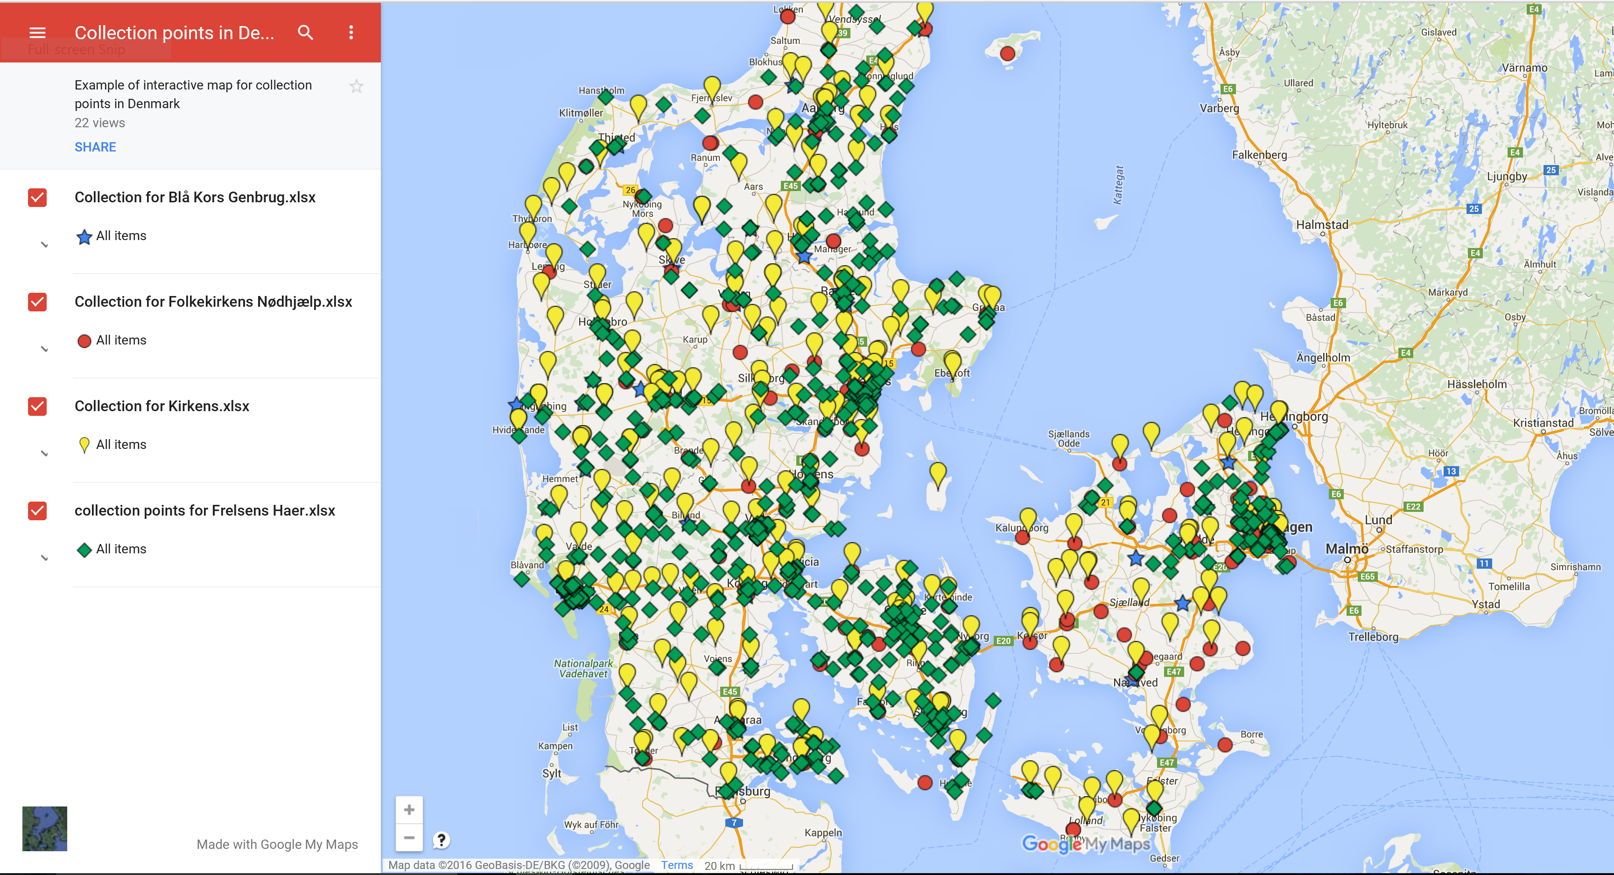
Increasing Collection

Slide 21
Consumer Behavior
Denmark without Waste II reports that from 2003-2010 consumption of textiles increased 36%
Notes:
Not only mention the increase, but also how marketing could be used to change the consumers mindset, and how exporting affects their thoughts “exporting their guilt”

Slide 22
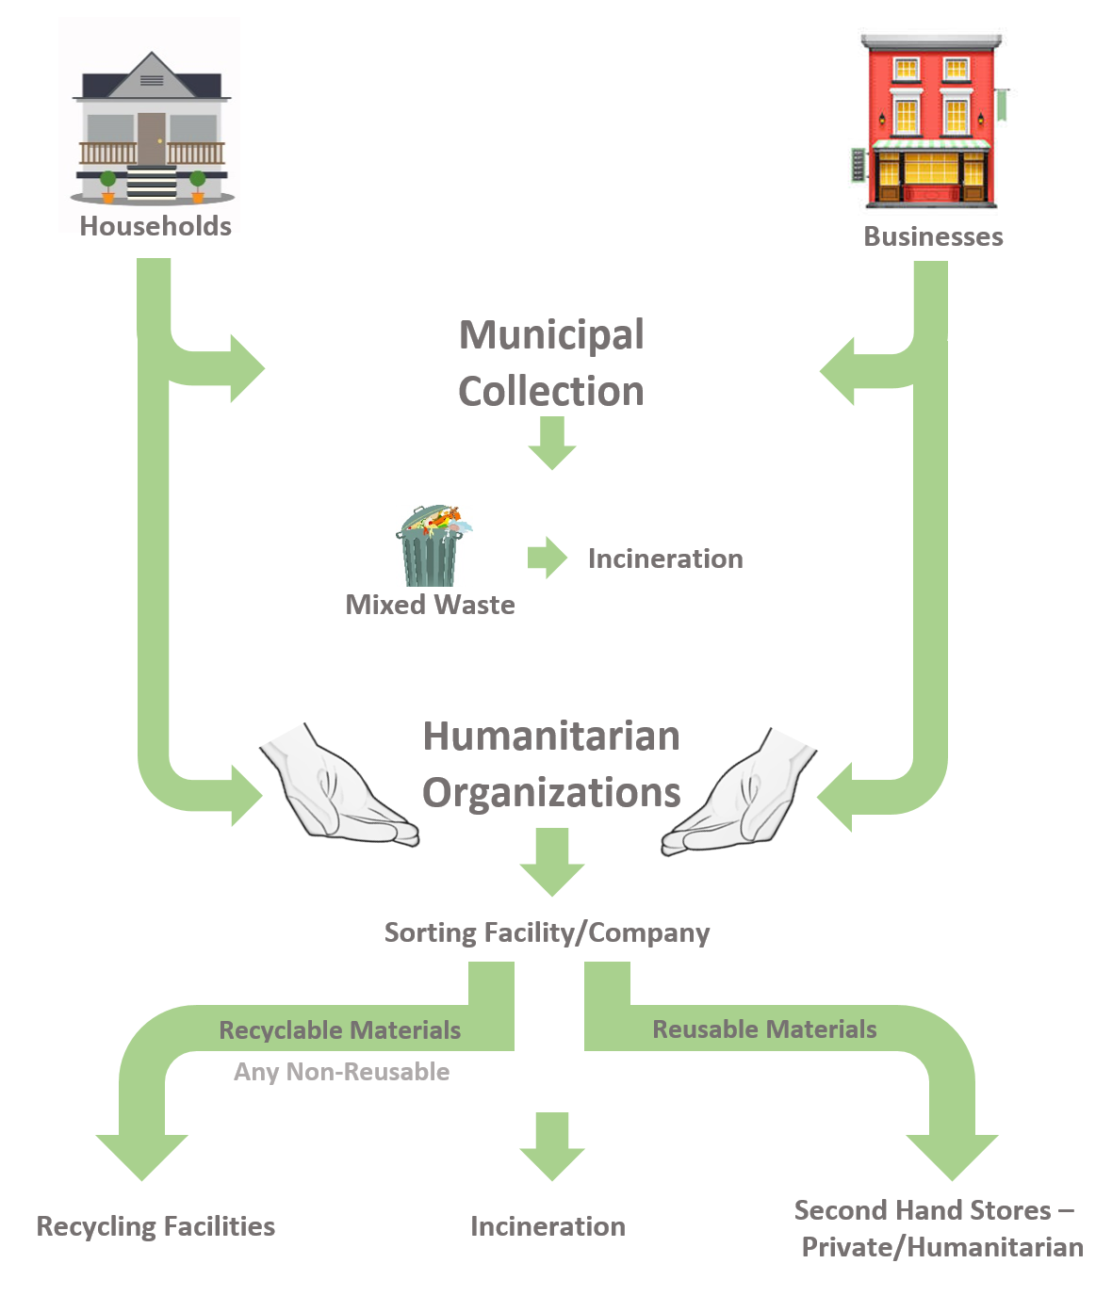
Current Flow

Slide 23
Factors to Consider
How can...
Convenience increase for consumers, and correspondingly increase the volume of collected textiles?
Contamination be minimized?
Benefits be shared?
The humanitarian organizations be included?
Waste be defined, and who has ownership?
VAT-free status be maintained?
The impact of exportation on the consumer be reduced?

Slide 24
References
Ekström, K. M., & Salomonson, N. (2014). Reuse and Recycling of Clothing and Textiles—A Network Approach. Journal of Macromarketing, 34(3), 383-399. doi:10.1177/0276146714529658
Farrant, L., Olsen, S. I., & Wangel, A. (2008). Environmental benefits from reusing clothes. The International Journal of Life Cycle Assessment, 15(7), 726-736. doi:10.1007/s11367-010-0197-y
Klepp, I. G. L., Kirsi Schragger, Michael Follér, Andreas, & Paulander, E. T., Tone Skårdal Eder-Hansen, Jonas Palm, David Elander, Maria Rydberg, Tomas Watson, David Kiørboe, Nikola. (2014). Sustainable textile initiatives and suggestions for a Nordic Roadmap: Nordisk Ministerråd.
Nielsen, R., Schmidt, A., & Norden, P. (2014). Changing consumer behaviour towards increased prevention of textile waste: Background report: Nordisk Ministerråd.
Rowe, R. G. (2000). Textile recycling machine. Retrieved from http://wpi.summon.serialssolutions.com/
Tojo, N., Kogg, B., Kiørboe, N., Kjær, B., Aalto, K., Special, a., . . . Särskilda, v. (2012). Prevention of Textile Waste. Material flows of textiles in three Nordic countries and suggestions on policy instruments. (Dissertation/Thesis), Copenhagen.
Woolridge, A. C., Ward, G. D., Phillips, P. S., Collins, M., & Gandy, S. (2006). Life cycle assessment for reuse/recycling of donated waste textiles compared to use of virgin material: An UK energy saving perspective. Resources, Conservation & Recycling, 46(1), 94-103. doi:10.1016/j.resconrec.2005.06.006
Background image (http://media.progressivebusinessmedia.com/photo/122/122358-g-reilly-textiles-novatex-asia.jpg)
Title slide image (http://www.itochu.ru/images/departments/01_textile.jpg) found by googling textile pictures

Slide 25
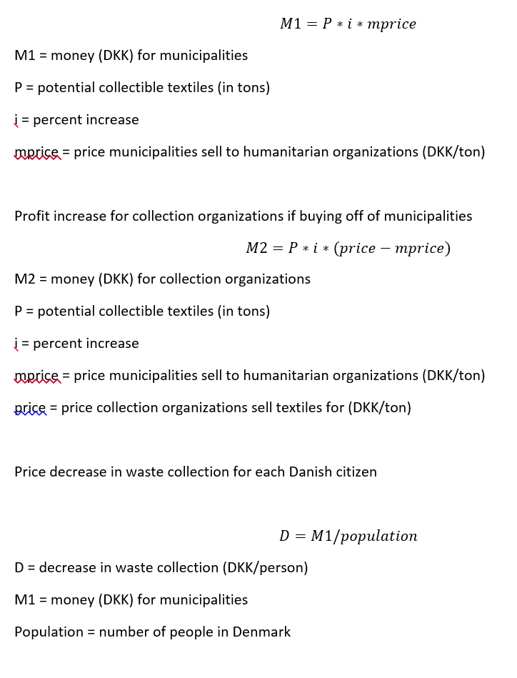
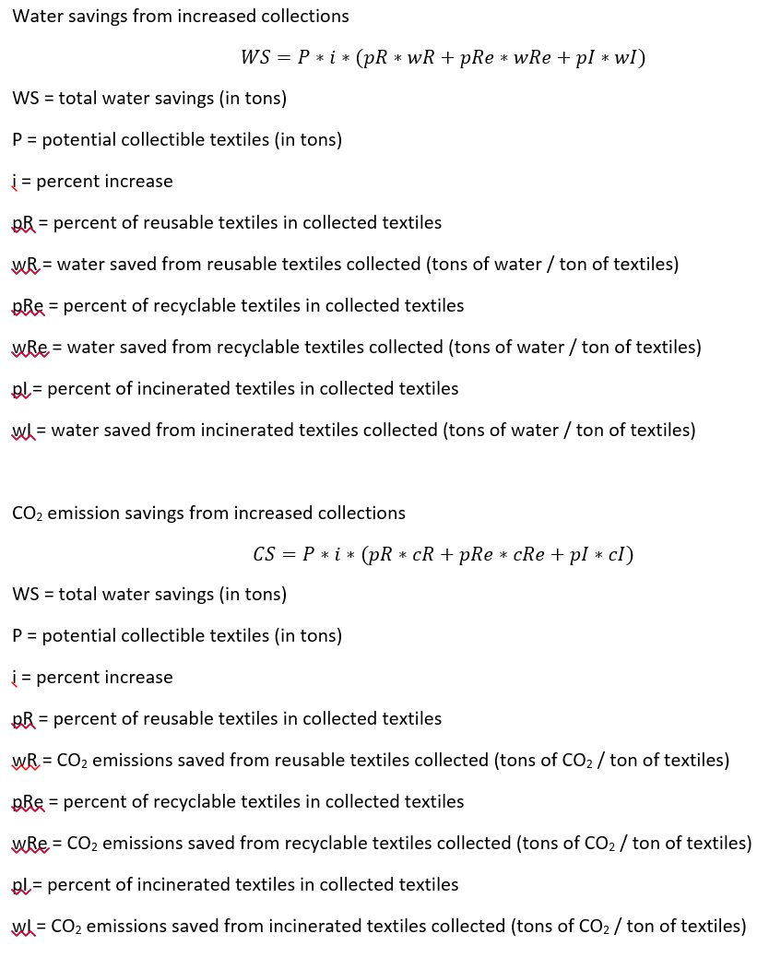
Appendices

