Slide 1
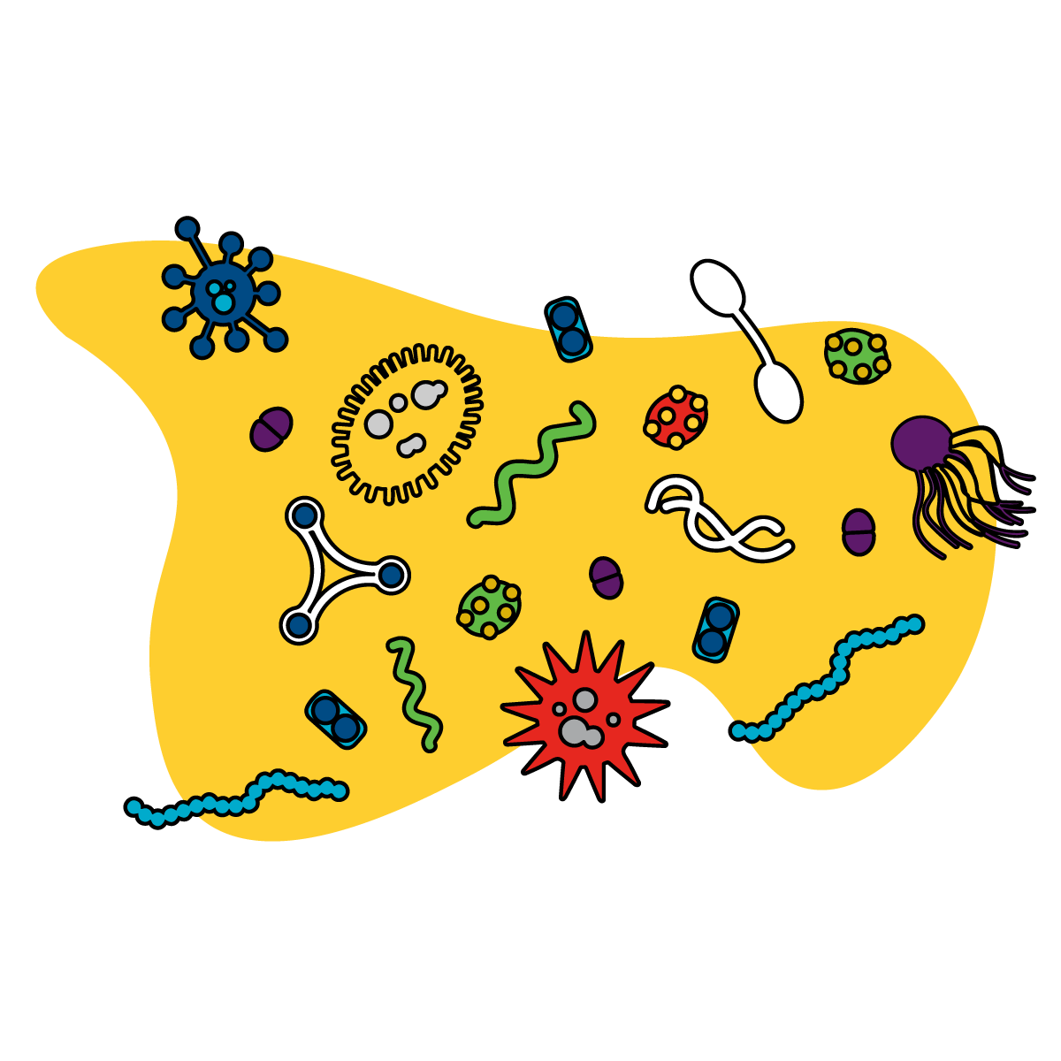
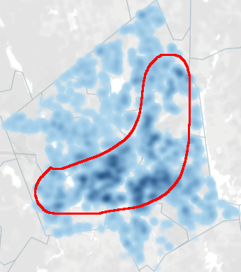
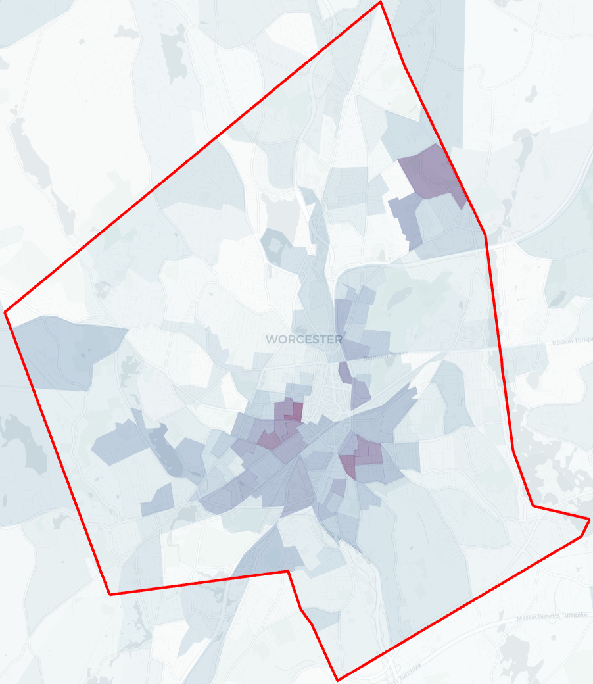
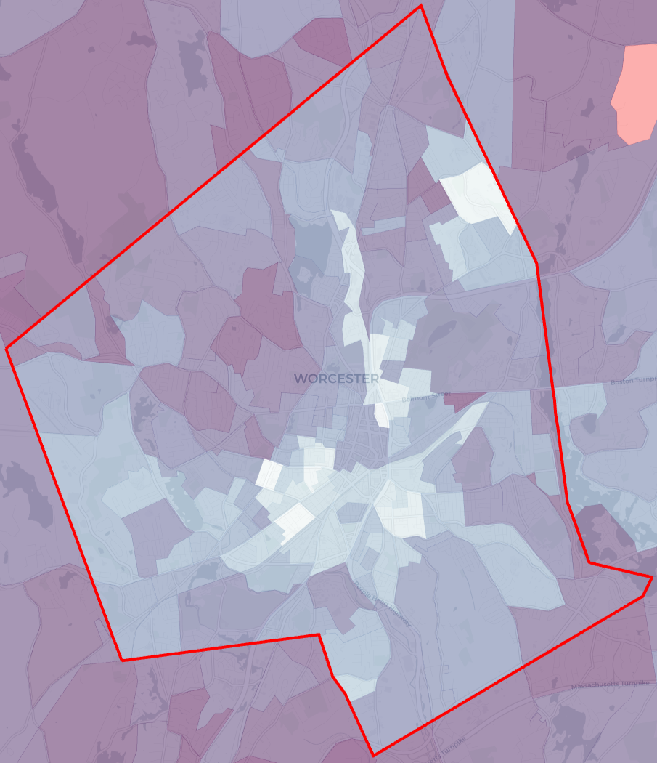
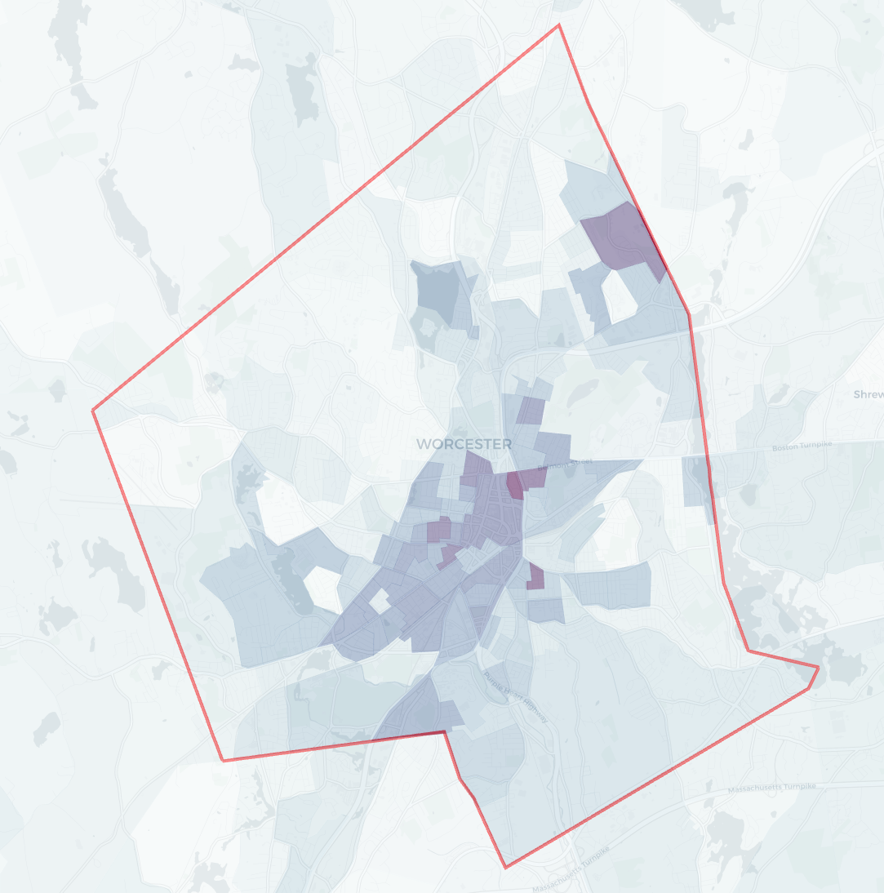
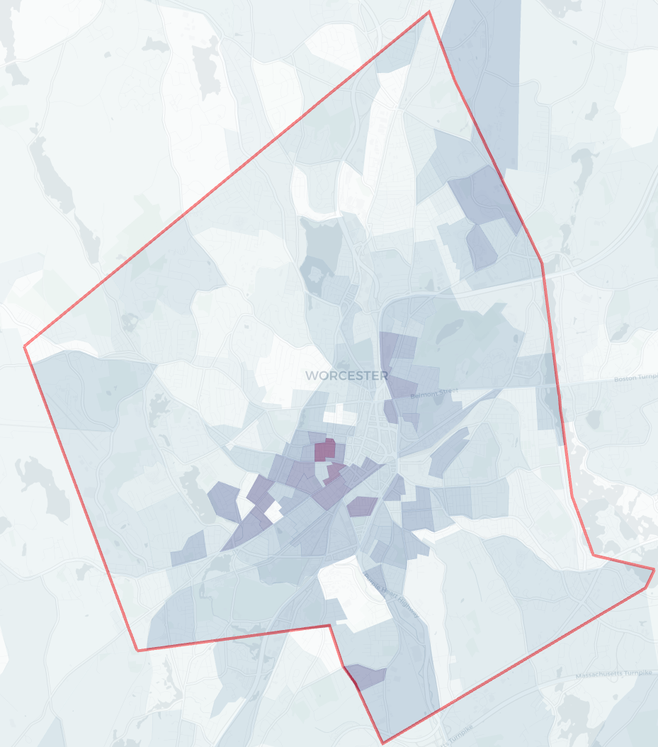
From Macro to Micro: Social Determinants of COVID-19 & Nasopharyngeal Features Associated with Disease Progression
A Study of COVID-19 in Worcester, Massachusetts
Christopher Tocci (Biology/Biotechnology & Professional Writing)
Advisors: Brenton Faber (WPI), Reeta Rao (WPI), John Haran (UMass), Evan Bradley (UMass)
IS YOUR HEALTH IN YOUR HANDS?
HYPOTHESES
METHODOLOGY
There are oral microbiome signatures associated with the need for respiratory support.
Social determinants of health correlate with COVID-19 prevalence and density in Worcester Massachusetts.
1
Patients with COVID-19 or those exhibiting symptoms had a nasopharyngeal swab ordered upon admission to the UMass Memorial Hospital Emergency Department. Following this, patients were prompted by research staff to enroll in the study. To map the microbiota of each participant, whole DNA/RNA extraction using ZymoBIOMICS DNA/RNA Miniprep Kits was carried out, followed by Illumina sequencing. Illumina reads generated were used by the bioinformatics core at UMass to build a model for determining differences in microbial abundance as a predictor of respiratory support. The model generated used a machine learning algorithm and was trained using half the data collected. The other half of the data was used to generate an F1 score. With a relatively high F1 score of 0.85 the model was used to generate median importance values for a series of clinical factors, and microbial features found in the patients. To discern how specific microbes predicted the need for respiratory support or not, the model was also used to measure differences in abundancy levels of each microbe.
In order to determine what social factors may be correlated to COVID-19, an analysis of the most abundantly cited factors related to general health outcomes was performed. Following this, data collected from local and state agencies, and the U.S. Census survey were aggregated and overlayed over maps of Worcester, MA (These maps came from various private data collecting sites). To draw correlations between these social factors and COVID-19 prevalence, these maps were compared to a COVID-19 density map provided by the Worcester Department of Public Health.
2
Genetics
RESULTS
DISCUSSION
Multiple Social Factors Are Correlated With COVID-19 Prevalence
Differences in Microbial Species’ Abundancies May Act as Better Health Predictors Than Age, BMI, and CCI
COVID-19 Update: March 14, 2020 First Case
1
1
2
Microbiome
Microbiome
Transportation
Education
Crime
Nutrition
Environment
Income
Figure 2: Predictor (Y) vs. Median Importance Graphs (X) – Represents the relative importance of each health-related feature with respect to a dichotomous outcome: Need for respiratory/oxygen support or not. Graph 1 includes race in the series of predictors; graph 2 does not include race. Prevotella salivae was the best predictor of the need for respiratory support or not in both bins. Following P. salivae were age, BMI, and several other microbes. In Graph 1, when race was accounted for, it acted as a better predictor than more than half of the microbial features. In both Graphs 1-2, the Charles Comorbidity Index (CCI) was ranked below several microbial features, age, and BMI. In Graph 2, a higher number of microbial features acted as better predictors of the need for respiratory support or not over CCI than when race was accounted for.
In addition to behaviors, genetics, the environment, and medical care, COVID-19 prevalence (as shown from Spring 2020 to present) in Worcester is correlated to multiple social factors as well as patients’ microbiomes.
2
3
Certain Microbial Species May Exhibit Protective Attributes Within The Nasopharynx
This supports previous studies that highlight the effects of the microbiome on disease progression. Additionally, this supports epidemiological findings that correlate individual life circumstances with health outcomes.
1
2
3
4
It is important to fund research for new and innovative treatment options, medications, and technologies. It is equally as important to understand how the world within and outside of us determine our health.
Behavior
Further Research
4
5
Further investigations in microbiology and epidemiology are needed to fully understand the role that both the microbiome and social determinants of health play within people’s lives.
5
6
7
8
How do some microbes protect the individual from worsening COVID-19-associated respiratory distress?
Are there some microbes not found in this population that are highly associated with the need for respiratory support following COVID-19?
Can we detect causal relationships between social factors and the spread of infectious disease? Chronic disease?
What can we do to ensure health-related decisions take into account social factors such as those described in this study?
Medical Care
Figure 1: Social Determinants Correlated to COVID-19 Density in Worcester Massachusetts – Represents different social factors relevant to the spread of disease and poor health. Darker regions represent higher prevalence of the associated determinant. Graph 1 represents COVID-19 density/prevalence. Graph 2 represents Hispanics Alone; Graph 3 represents Whites Alone; Graph 4 represents Income Below Poverty; Graph 5 represents Less Than High School Education.
Figure 3: Microbial Feature Abundance (Y) vs. Dichotomous Outcome (X): Need for respiratory support or not – Represents the relative abundance of particular microbial features associated with either no need for respiratory support (0, blue), or the need for respiratory support (1, red). Box-and-whisker plots should not be compared within the same graphs, as there is no statistical significance in their differences. Additionally, each graph is associated with its own relative scale. Rather, each relative abundance and outcome should be viewed independently of one another. Graph 1 (P. salivae) shows that a higher abundance of microbe in patients is associated with an absence of the need for respiratory support. Similar findings are also seen for the microbial species in Graphs 2-6, 8. In Graph 7 differences in abundances of bacteria were poorly associated with both the need or the absence of the need for respiratory support.
COVID-19 Update: April 22, 2021 23,047 Cases
Social Factors
Notes:
Previous research on the gut and oral microbiomes have shown many correlations between species abundance and health-related outcomes, pathogenic proliferation, and viral infection. To better understand correlations between SARS-CoV-2’s effects on respiration and the nasopbody,
Prevalence of COVID-19 is correlated to social factors outside of the healthcare, as well as a person’s microbiome

Slide 2
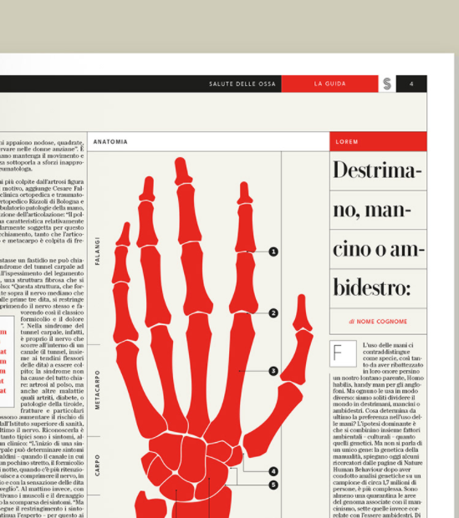

Slide 3
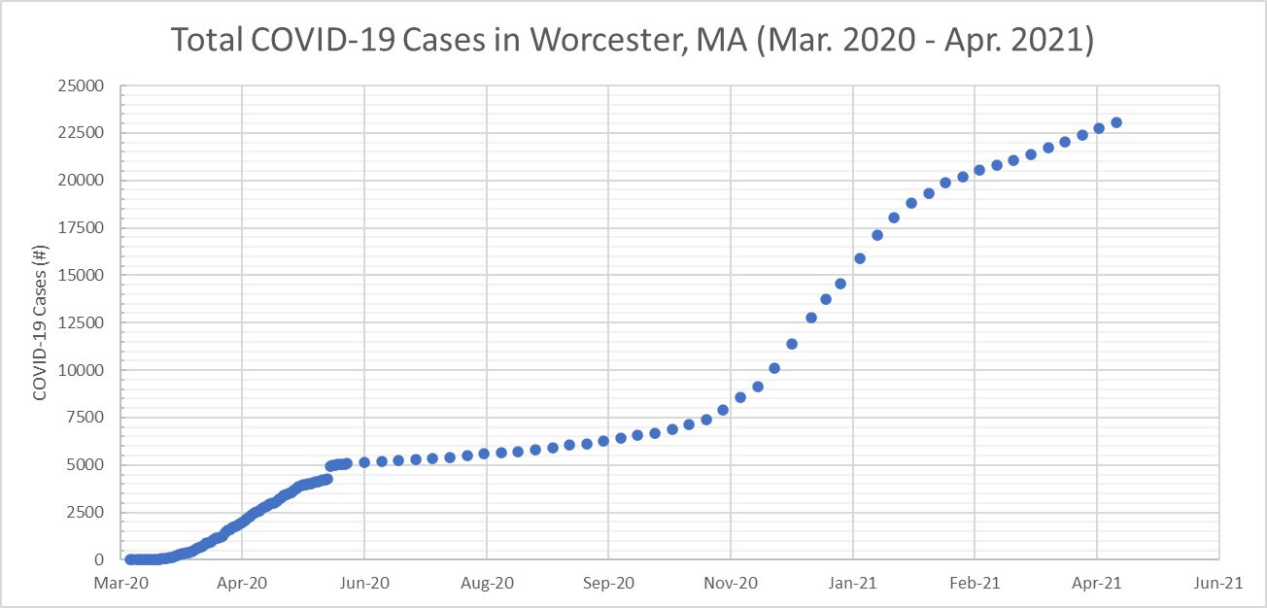

Slide 4
