Slide 1
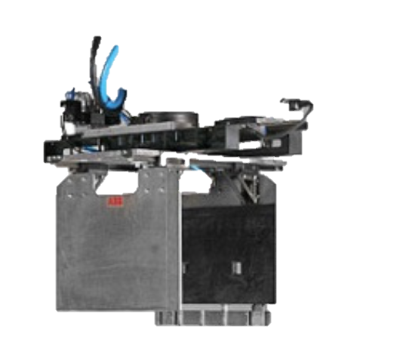
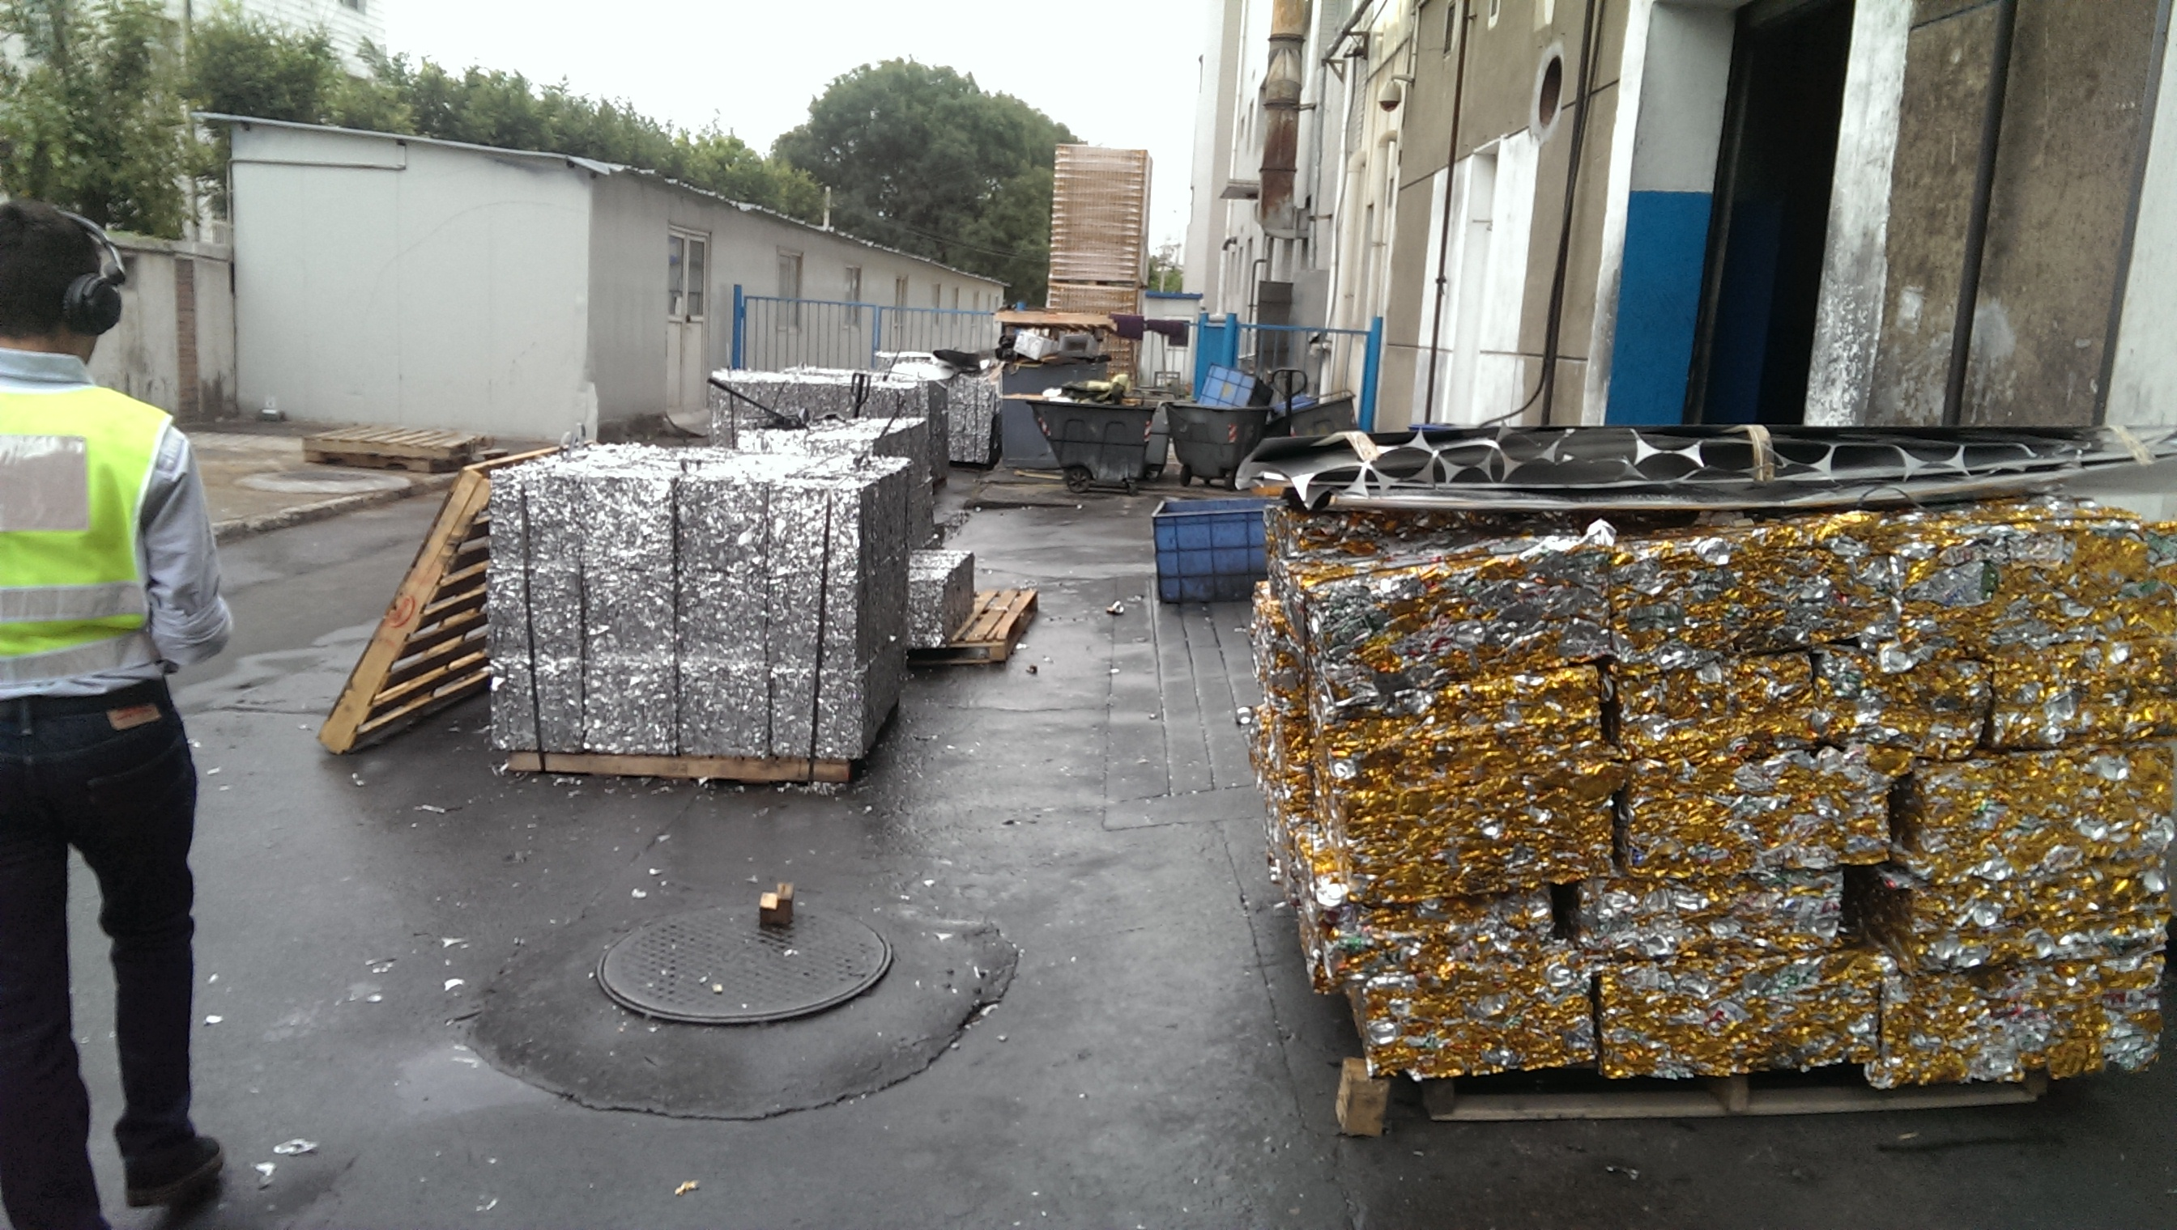
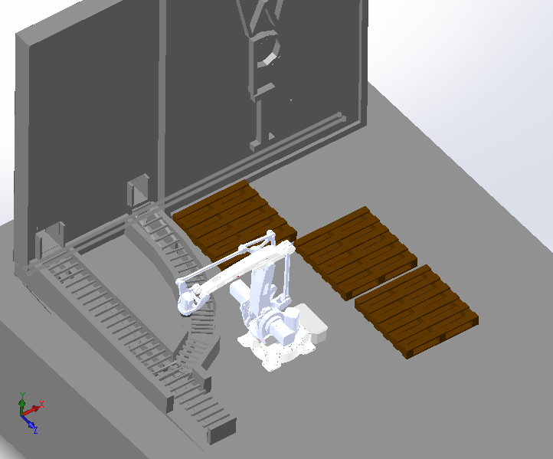
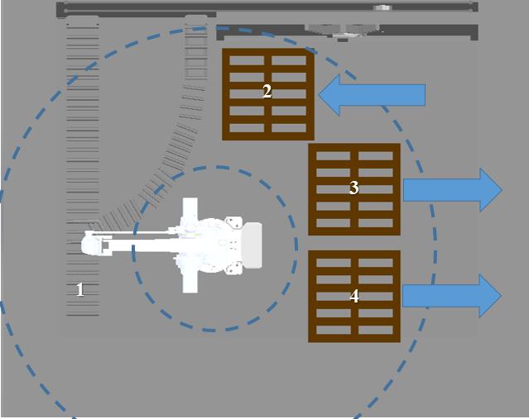
Designing a Robotic Arm for Moving and Sorting Scraps at Pacific Can in Beijing
Mohamad Alblaihess (IE) William Farrar (ME)
Fernando González (ME) Yifan Shao (ME)
Advisors: Professor Jianyu Liang (ME) & Professor Amy Zeng (IE)
Abstract
In modern industry, innovation by automating processes provides companies with competitive advantages in speed, efficiency, and production value. This Major Qualifying Project studied the potential of a robotic, palletizing arm to help Pacific Can Company Ltd. replace their manpower-driven operation of moving and stacking unpainted and painted blocks of scrap metal. Focus areas of the project included work area design, block distinction, alarm systemization, as well as robotic arm and end of arm tool selection.
Methodology
Define:
Sorting and stacking aluminum blocks is completed by four workers.
Workers are easily exhausted.
Measure:
Providing a Detection system.
Providing an Alarm systems.
Measuring work area, environment, block size, and productivity.
Sponsor: Pacific Can
Pacific Can Company Limited was founded in Hong Kong, 1991 by Mr. Glenn Yee, a WPI alumnus and a few of his colleagues.
6 facilities in China produce over 6500 million cans a year.
The local Beijing plant produces 2000 million cans a year.
As an industry leader it has begun to expand its use of automation within the plant to improve efficiency, reduce downtime and cost. The company wants a robot that can sort move and stack the blocks independently without human interaction for long periods of time.
Analyze:
Applying SMART decision model to select the most appropriate robot from available alternatives.
Building a room to ensure protection from the environment.
Setting up a conveyer belt for the arm to retrieve, sort, and stack the blocks.
Improve:
Investigating the current technology to pick the most cost-effective and efficient arm.
Designing a work area to allow the robot to reach all components needed to execute the tasks.
Control:
Conducting a ROI/cost analysis
Compiling a set of recommendations for successful implementation and future advancements.
Results & Recommendations
Robotic Arm: ABB’s IRB 460 is the most cost effective & efficient option.
EOAT: ABB’s Flex Gripper Clamp Single Zone
Need to build enclosure to create conditions for optimal performance.
ROI analysis:
Human labor force: Human labor yearly cost $20,000 ¥124,200 Cost in 15 years : $426,730 ¥2,650,000
IRB 460 Robot: Robot Price: $50,000 ¥310,000 FlexGripper: $8,052 ¥50,000 Visual Detection: $12,882 ¥80,000 Overhaul cost: $11,066 ¥68,724 Cost in 15 years $104,679 ¥649,004
Breakeven point is reached after 4 years.
Profit
Money saved in 15 years is equal to $322,570 ¥1,999,936
ROI is 308%
Recommended Work Area
Goals and Objectives
Design an optimized work area
Select robotic arm and end of arm tooling to pick up and stack scrap blocks onto pallets faster and thus improve productivity.
Perform Return On Investment (ROI) analysis to determine if robotic arm is a worthwhile investment.
Gain experiences in real-world, global engineering practice and multi-cultural teamwork
Major References
ABB Robotics. (2011a) . Robotics IRB 460 Industrial Robot. Retrieved from:
https://library.e.abb.com/public/95c9da16ac8a4d92c1257838002bf7ef/ROB0206EN_A_IRB%20460%20data%20sheet.pdf
ABB Robotics. (2011c) . Robotics Flex Gripper – Clamp Palletizing Gripper. Retrieved from:
https://library.e.abb.com/public/d7e12bca36dfaa02c1257850005821b5/ROB0208EN_A_FlexGripper%20Clamp%20data%20sheet_final.pdf
Niku, S. B. (2010). Introduction to Robotics: Analysis, Control, Applications. Hoboken, N.J.: Wiley
Pacific Can, Pacific Can China Holding Limited, 2011. Web. May 5, 2015.

