Slide 1
MarViva:
Designing a Sustainable Shrimping Policy
David Burgos, Laura Bünger, Angela Haith, and Sebastian Royo

Slide 2
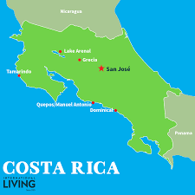
The IQP Experience
Notes:
Angela
-IQP stands for Interactive Qualifying project, and it is a required part of the WPI curriculum
-Students from all majors are grouped into interdisciplinary teams and travel to various locations around the world to not old broaden our experience with hands on project work, but also with our exposure to different cultures and working environments

Slide 3
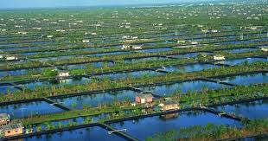
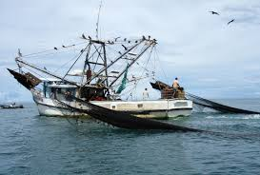
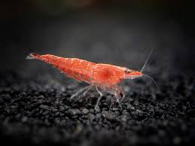
Project Goal
The goal of our project is to determine and analyze potential alternatives to bottom trawl shrimping in Costa Rica, and how these alternatives might best be implemented in the local context.
Notes:
LAURA

Slide 4
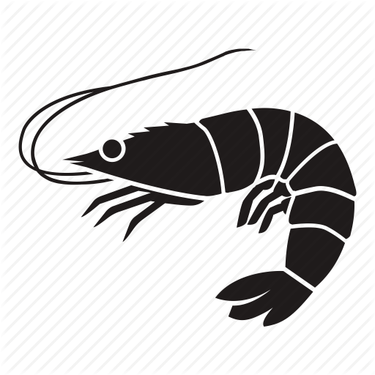
Shrimp Farming
Extensive
Semi-Intensive
Intensive
Wild larvae, tidal water exchange, and natural aeration
½ wild larvae, ½ from hatchery, less tidal action
The most technical, all larvae from hatchery, mechanical aeration, heavy feeding rates
Notes:
Angela
Through independent research completed before arriving to Costa Rica, learned about one of the main alternatives to shrimp fishing aka shrimp farming:
-3 methods: stocking density and yield
-Though the terminology may vary over different regions, the methods are identified as extensive, semi-intensive, and intensive.
-extensive shrimp farming. This process traditionally relies on the natural obtainment of shrimp postlarvae, gathered from wild sources.
-semi-intensive. Semi-intensive shrimp farming tends to involve some shrimp postlarvae being stocked from a hatchery during the first stage
-intensive shrimp farming. more advanced systems; it relies on a heavy feeding rate of many shrimp (high density), artificially stocked, mechanical aeration and sometimes utilizes water recirculation and treatment. usually stationed above high-tide level, produces the most shrimp
-With this information we had a general understanding of shrimp farming that prepared us for when we personally interacted with any shrimp farmers while completing our studies here

Slide 5
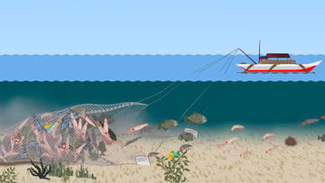
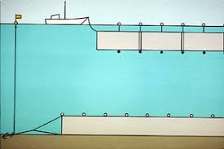
Current Shrimp Fishing Methods
Bottom Trawls
Gill Netting
Notes:
David
Set and drift gill nets
TED and FED
Was the dominant fishing method until 2013, outlawed

Slide 6
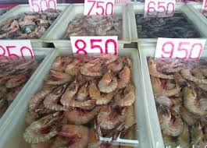
Shrimp and the Costa Rican Economy
Shrimp production has notably increased
In 2003, 4582 metric tons of shrimp were produced in Costa Rica compared to 272 metric tons produced in 1980.
Mostly Consumed locally but large shrimp exported to US and Europe.
Costa Rica exported 46% of all the exportable shrimp to the US, 43% to Spain, and 9% to Belgium
2,500 Jobs in Fishing and Aquaculture
780 Jobs directly to shrimp
Diminutive shrimp sales in Costa Rica
Free Trade agreements/Import Competition
Diesel Fuel costs
No universal labeling system for fish products
Notes:
Sebastian
Between the years of 2012 and 2014, Costa Rica exported 293.65 more kilograms of shrimp than it imported.

Slide 7
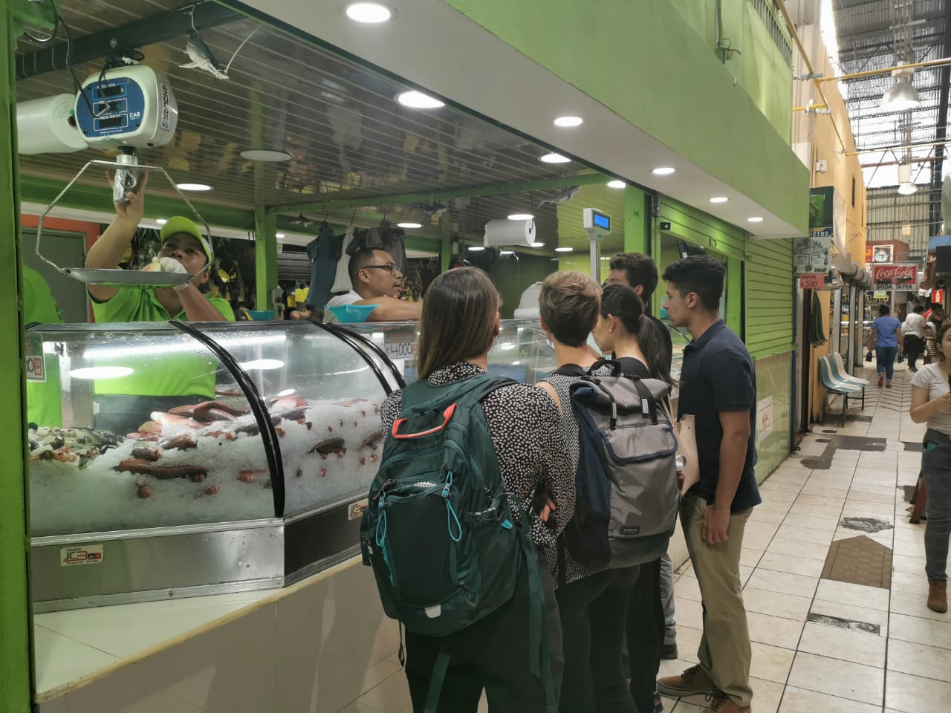
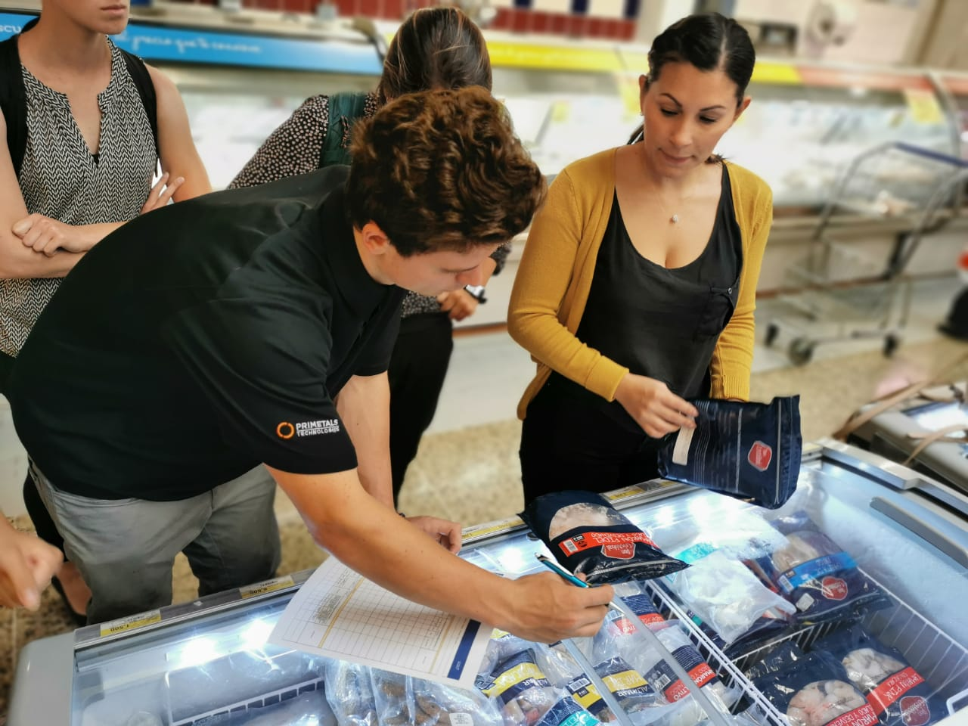
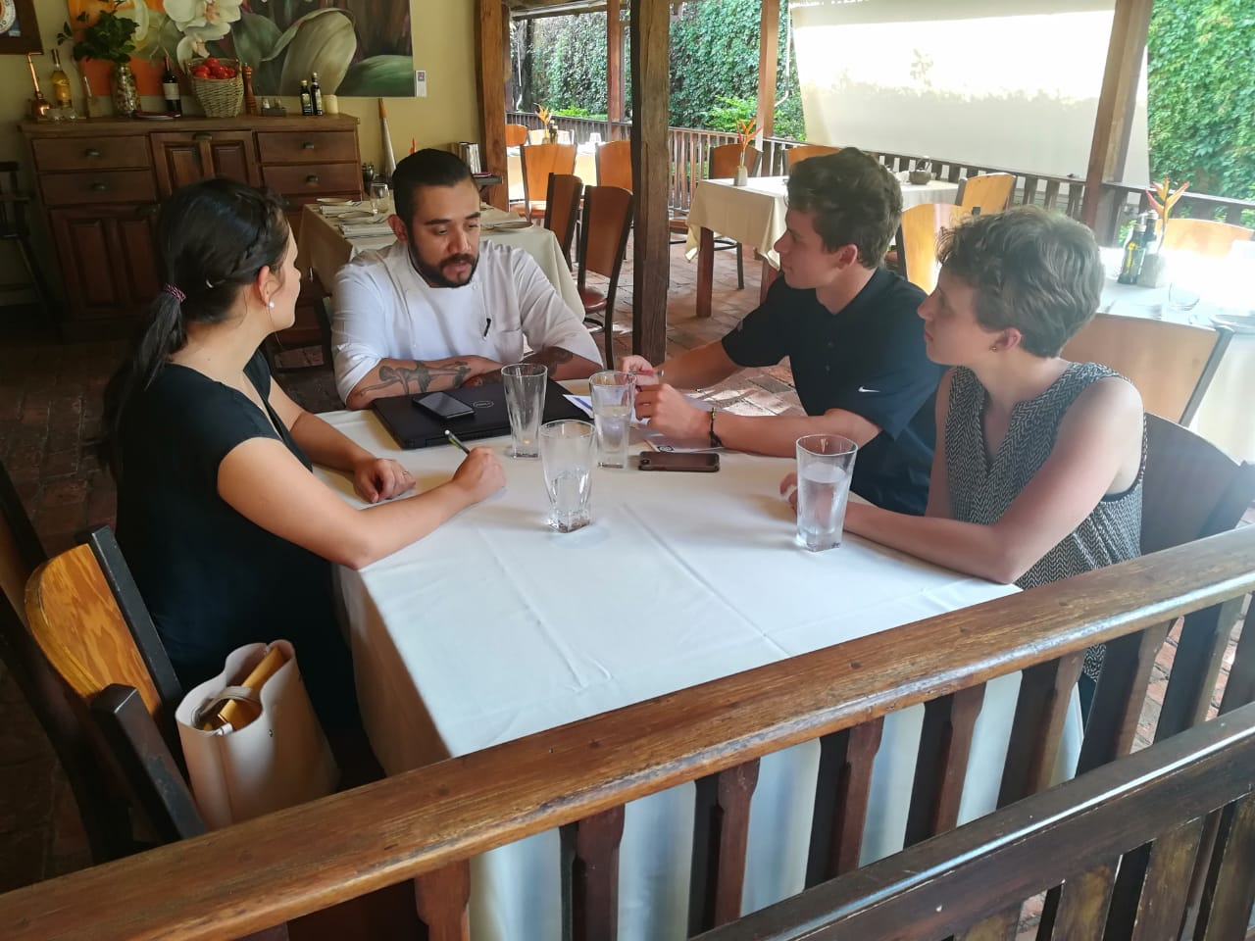
Methodology
Economic Impact
Public Opinion and Preference
Environmental Impact
Data Analysis and Recommendations
Notes:
Laura
Overall, methodology mostly involved interviews with those directly involved with the industry. In this section, we’ll explain our methods and reasoning for the data we collected over the course of our time here to address the following points as they relate to our project: economic impact, public opinion and preference, and environmental impact. Finally, we analyzed this data and used our findings to determine a set of recommendations.

Slide 8
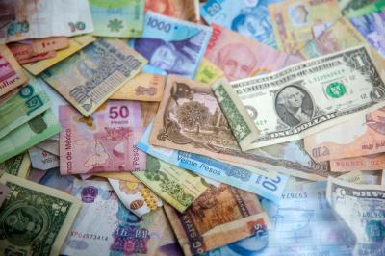
Methodology: Economic Impact
Spoke with representatives from restaurants, grocery stores, and other businesses
Researched online sources: PROCOMER, INCOPESCA
Consumer survey data

Slide 9
Methodology: Public Opinion and Preference
Interviewed business owners
Consumer survey
Interviewed fishermen in the Gulf of Nicoya

Slide 10
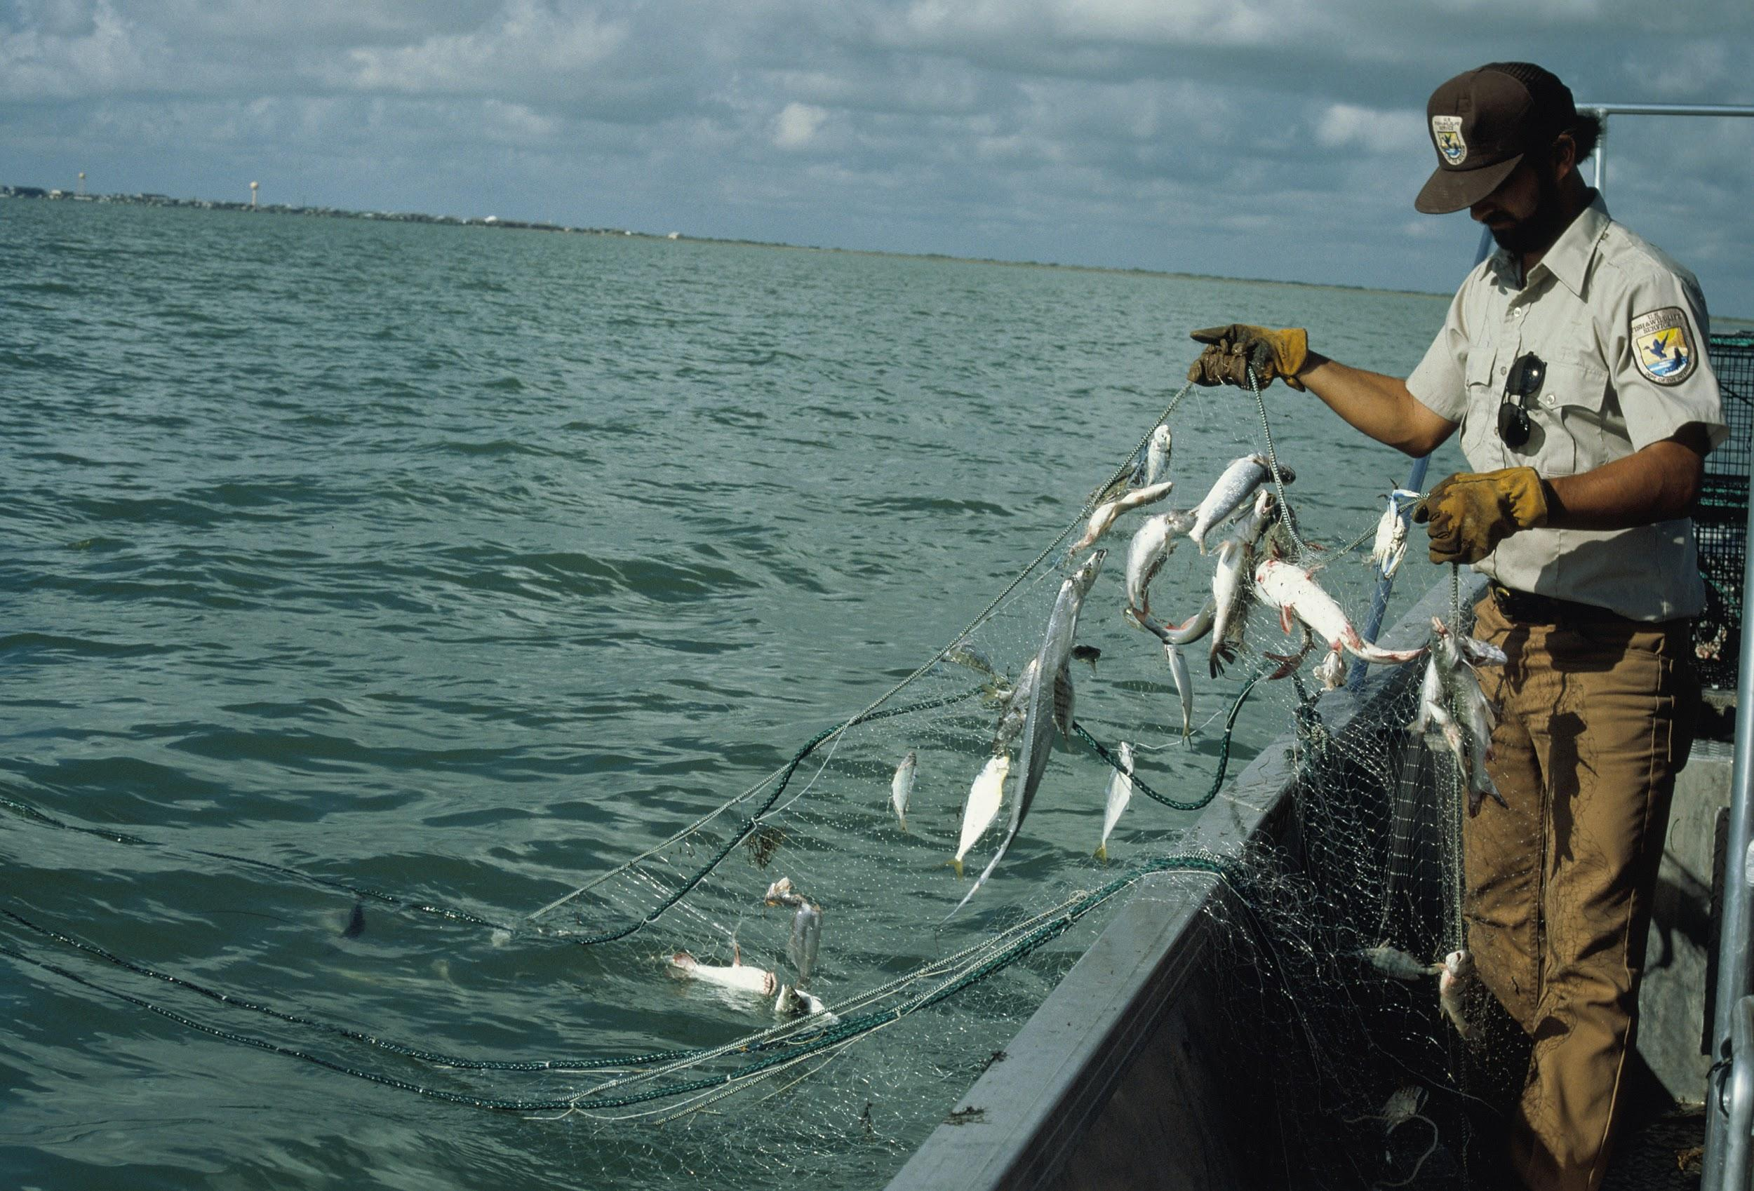
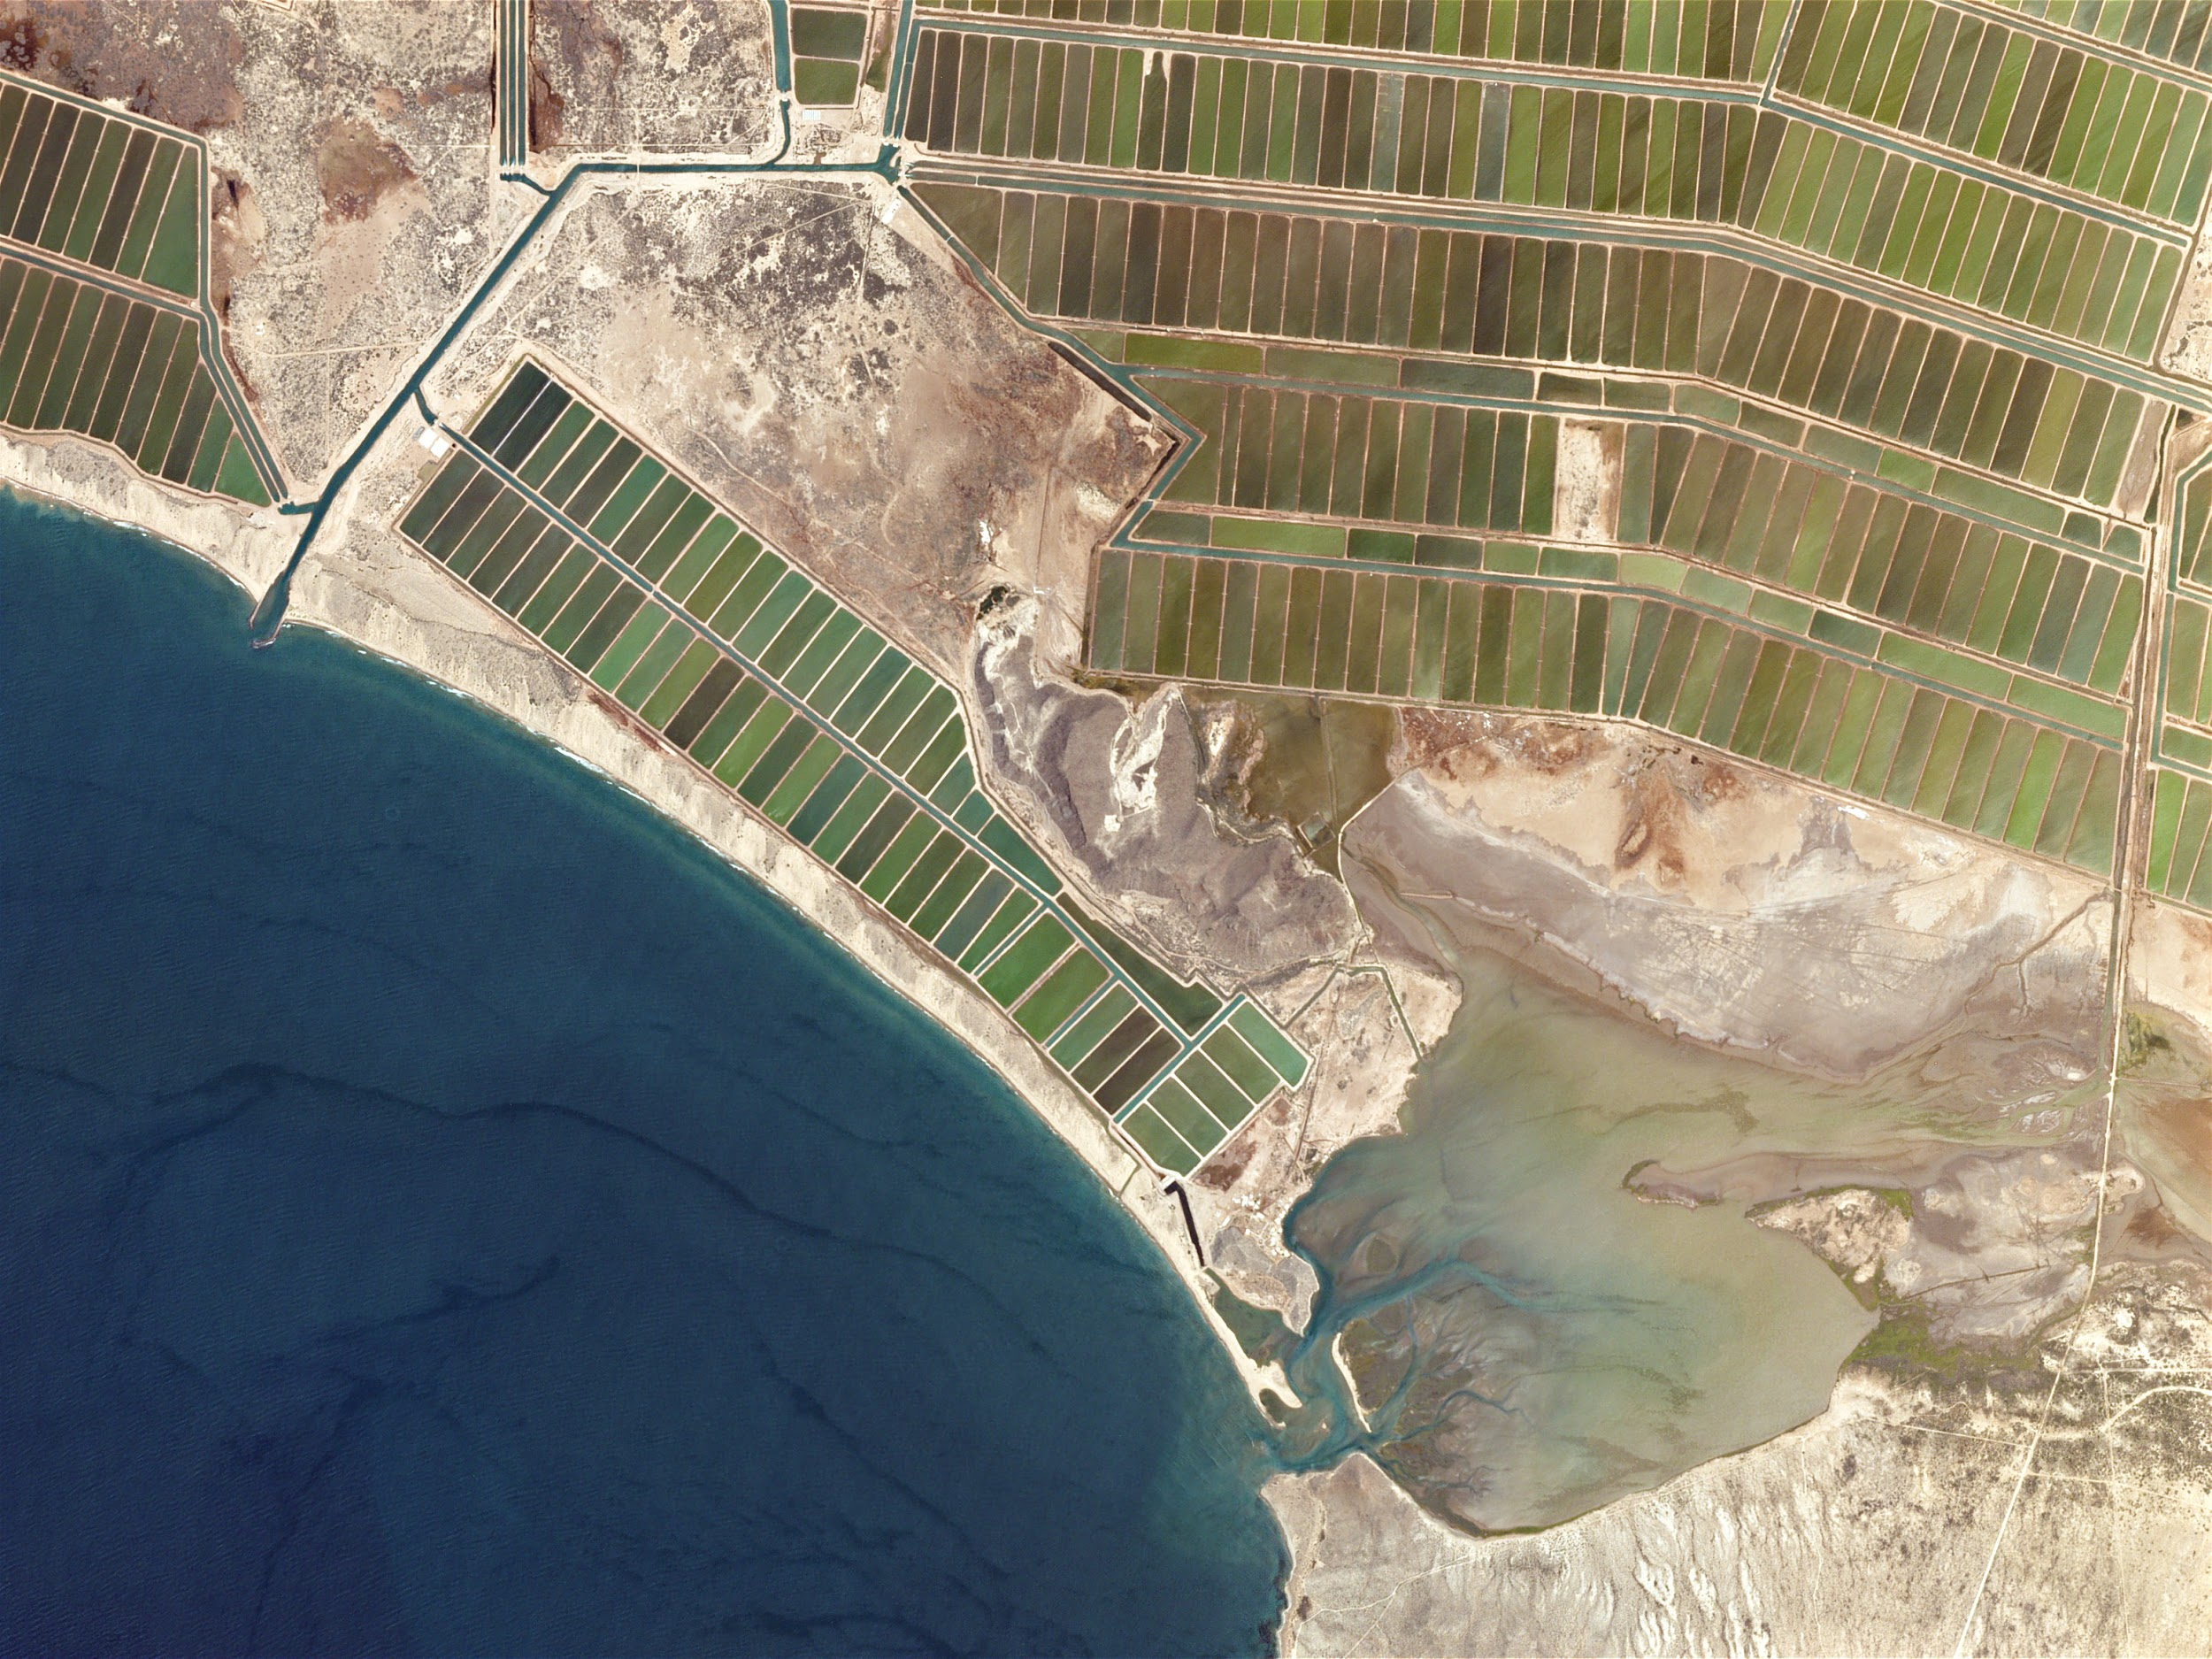
Methodology: Environmental Impact
Sought to further investigate shrimp farming
Interviewed shrimping businesses, consumers, and distributors around San Jose
Interviews with fishermen in Puntarenas

Slide 11
Methodology: Data Analysis/Recommendations
Analyzed data collected using the described methods
Used key findings to develop a set of recommendations to address our project goal

Slide 12
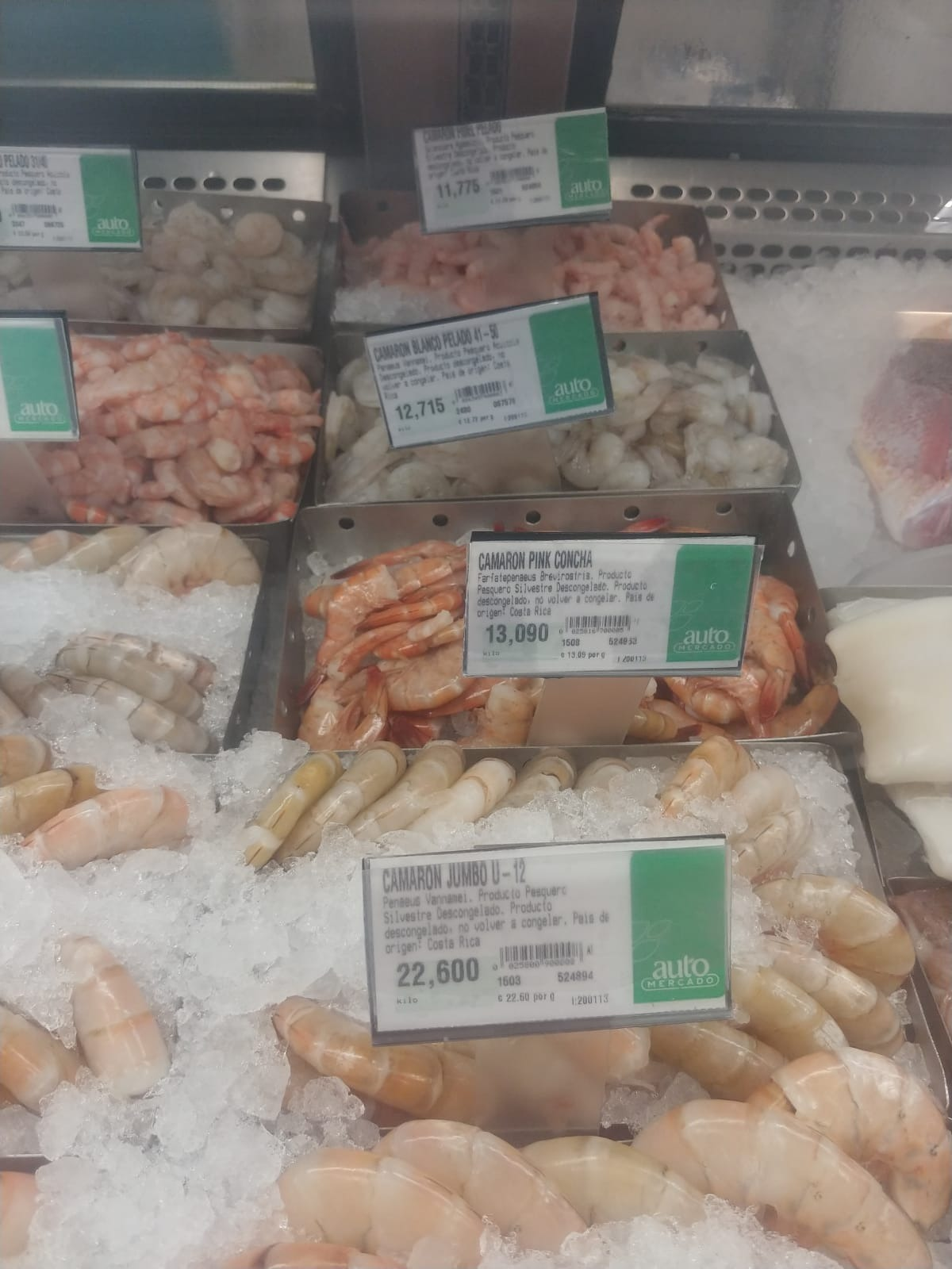
Findings: Economic
 | Ocean Caught Shrimp | Shrimp Farms
Costs to Produce | ₡15,941.18 per trip | ₡5,600,000 per harvest (90 days)
Production | 60 kilograms per 90 days | 4,000 Kilos per harvest (90 days)
Fisherman/Farmer Selling Price | ₡9,909 per kilogram | ₡2,000-₡2,500 per kilogram
Consumer Value | ₡12,000-₡15,000 per kilogram | ₡4,500 per kilogram
Notes:
Sebastian
Of the shrimp imported to Costa Rica, 94% of that from the top three countries is cultivated. For the top three countries Costa Rica exports shrimp to, over 99% of these exports in the last two years have been cultivated.

Slide 13
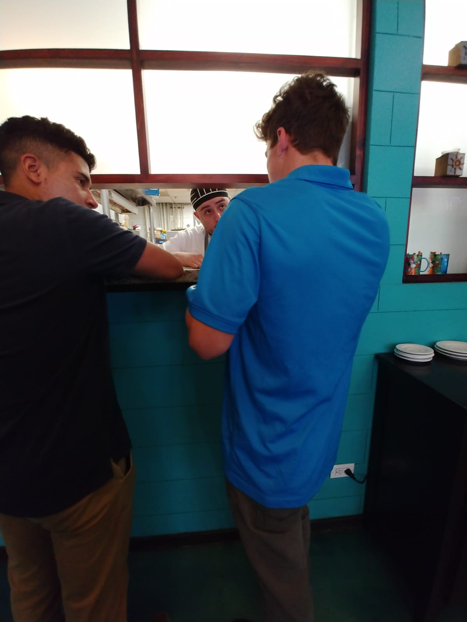
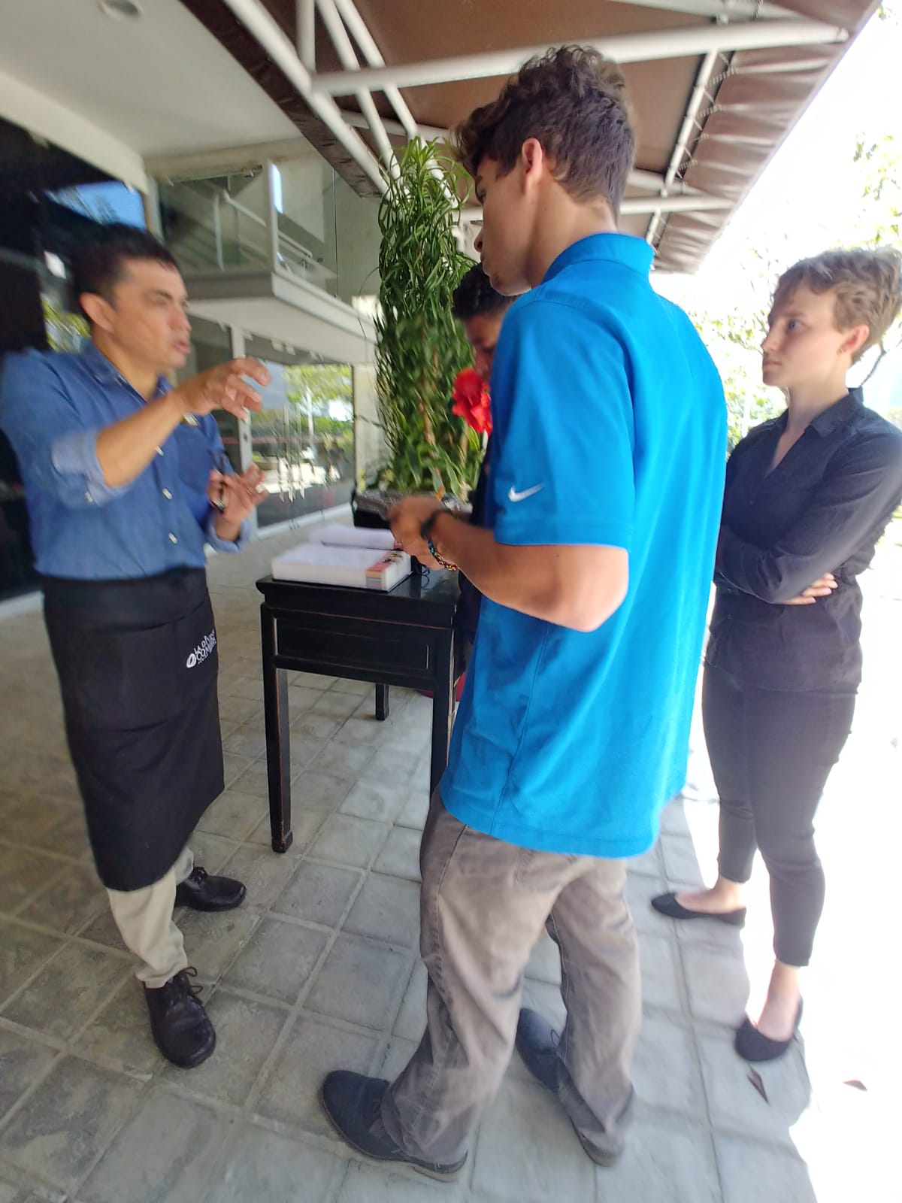
Findings: Public Opinion
Restaurants
Preferred shrimp caught from ocean that cultivated shrimp, due to the quality
Bacchus got tuna from a fish farm, this could lead to better sustainable farming practices
Grocery Stores
Willing to spend more money for sustainably caught shrimp
Fishermen
Open to changes in capturing shrimp
Main issue is financial investment
Consumer surveys
63% stated that they were informed on how shrimp was caught
81% stated that they would buy sustainably caught shrimp even for an increase in price
Notes:
David
Go briefly into results of consumer surveys, interviews with restaurants and interviews with local supermarkets and what thier opinions were on how shrimp were caught, what

Slide 14
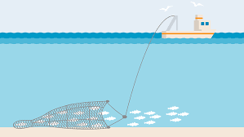
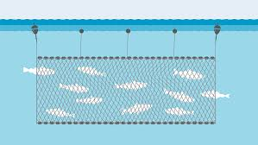
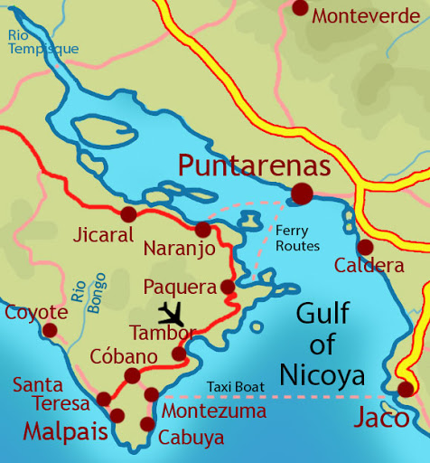
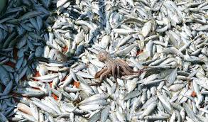
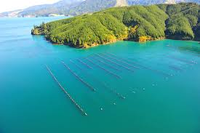
Findings: Environmental
X
Notes:
Angela
-interviews with fishermen in the Gulf of Nicoya: environmental impacts of various methods of shrimp fishing.
-preferred method gillnetting, which is known to be somewhat more sustainable and less damaging
-effects are insignificant especially compared to bottom trawling.
-bycatch - commercial purposes, ensuring nothing goes to waste.
-the majority of the fishermen stated that they would be open to improving their methods even further. This attitude contributes greatly to the steps away from bottom trawling and those towards a more environmentally sustainable future for the marine industry.
-San Jose and Heredia - shrimp distributors.
-One restaurant, though most of their purchased shrimp comes from the ocean, buys all of their tuna - farms that are clean, sustainable, efficient, and overall as natural as possible.
-raised in large ponds where they are able to swim freely, and are fed live bait, removed from the ponds in a very humane and sustainable way - health of the fish - a more desirable product
-not usually the case with shrimp farms - Many are densely packed with shrimp, heavy feeding rates, feeding the shrimp various chemicals
-Knowing this, steps can be taken to address the discrepancies between farms to raise the standard for cultivated marine organisms is sustainable and overall ecological.
Sebastian: shrimp farm
Shrimp Farm owner along with 4 workers harvest shrimp when they weigh 17-18 grams which takes up to 90 days
Process

Slide 15
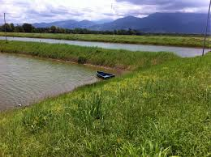
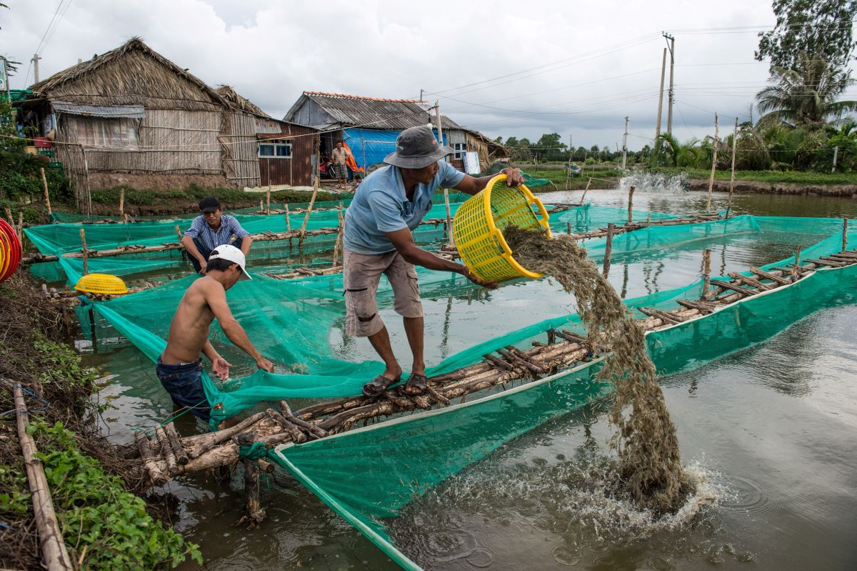
Findings: Environmental
Fish Farm Process:
Eggs imported from primarily Ecuador and Guatemala
Sent to a lab to undergo mutation to become larvae
Sent to fish farms and placed into a temperature regulated tank
Placed into a lagoon - 12 larvae per square meter
Water freshness and oxygen regulated
Fed manufactured feed
Shrimp are regulated for parasites and diseases
Shrimp removed roughly after 90 days when shrimp grow to 17-18 grams in weight

Slide 16
Recommendations and Long Term Effects
Contact authorities
More explicit labelling identifying where and how shrimp are obtained (Similar to UK)
Regular checkups by authorities to additionally hold vendors accountable and ensure truthful labeling
Work with government officials to institute a ban on importations of bottom trawled shrimp
Educational programs for workers, businesses and the general public to raise awareness about the effects of shrimp farming vs bottom trawling
Improve standard of shrimp farms to replicate the natural marine environment
Work with shrimp fishers to ensure more sustainable practices
A study to identify any nutritional and taste differences between cultivated and fished shrimp
Project Limitations
Time
Sample sizes: potential bias
Nonresponse
Notes:
David and Laura
Work with authorities to push a ban on importations on bottom trawled shrimp

Slide 17
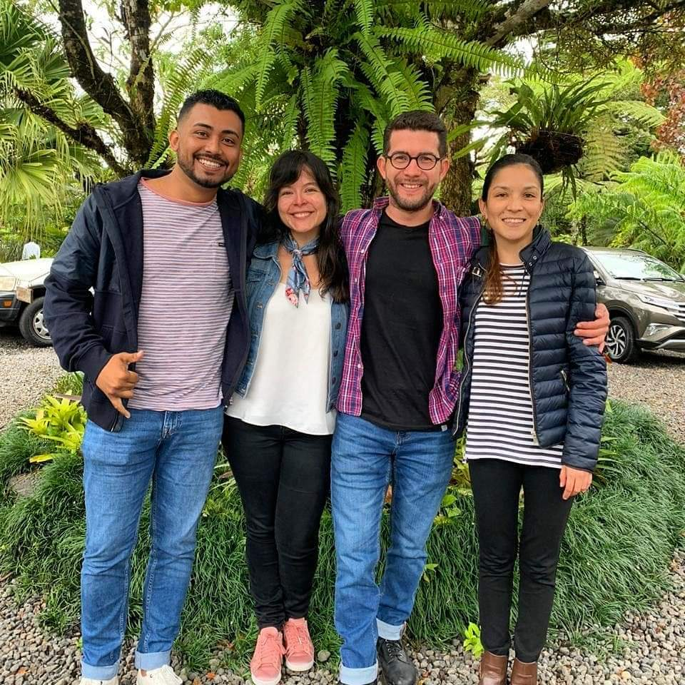
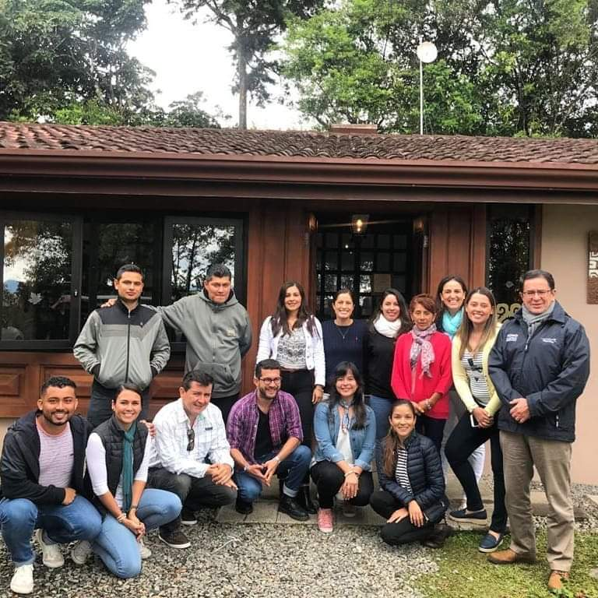
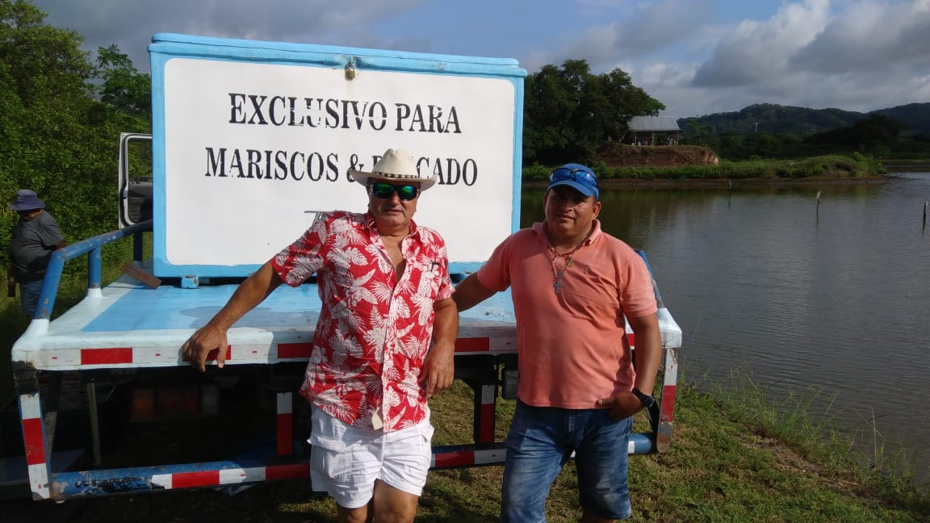
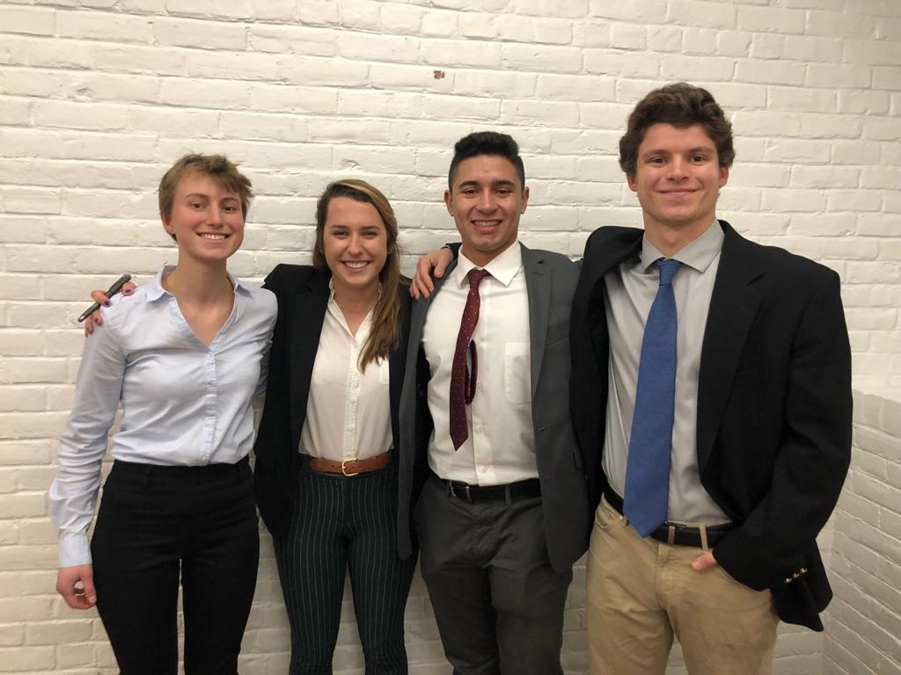
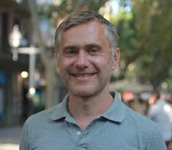
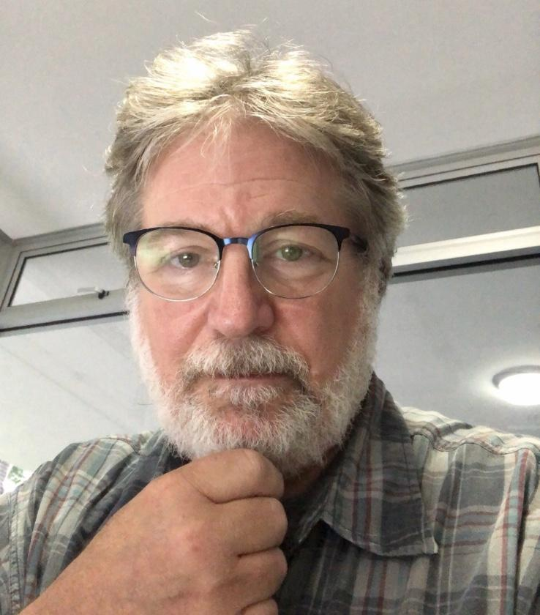
Acknowledgments
¡Gracias!
Notes:
David
Write down everyone to acknowledge:
-thank our sponsor, MarViva,
-MarViva Advocacy Manager Katherine Arroyo Arce
-Social Science Professional Felix Alberto Fonseca
-Science Program Manager Gustavo Arias Godinez
-Project Monitoring Manager Andres Santana
-MarViva Market Program Manager Hellen Arroyo
-Previous Shrimp farmer Juan Torres
-Additional gratitude to Professor James Chiarelli and Professor Darko Volkov

Slide 18
Questions?

