Slide 1
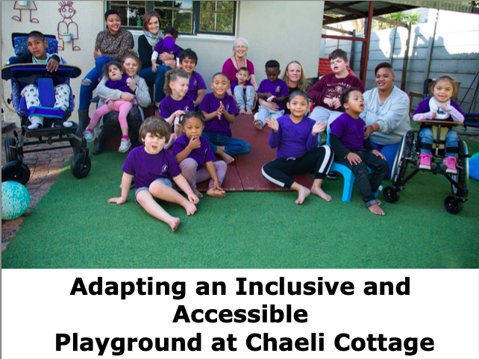
Adapting an Inclusive and Accessible Playground at Chaeli Cottage
Nick Battaglino, Amanda Borden, Kayla Condon, Henry Sniezek
Notes:
Nick

Slide 2

Our Goal
Notes:
Our goal was to adapt a playground to be more inclusive to preschool children of all abilities at Chaeli Cottage to further the educational and outreach purposes of the school.
Nick

Slide 3
Our Objectives
Identify the needs of all users on the playground
Expand The Chaeli Campaign’s fundraising opportunities
Create and test and inclusive and accessible playground design
Notes:
To meet our goal, we identified three objectives that guided our work.
Identify the needs of all users on the playground
Expand The Chaeli Campaign’s fundriaisng opportunities
Create and test an inclusive and affordable playground design
Nick

Slide 4
Methodology Overview
Research
Interviews
Observation
Notes:
Background research, interviews, meetings, observation
Different methods we did and why we did them
Nick

Slide 5
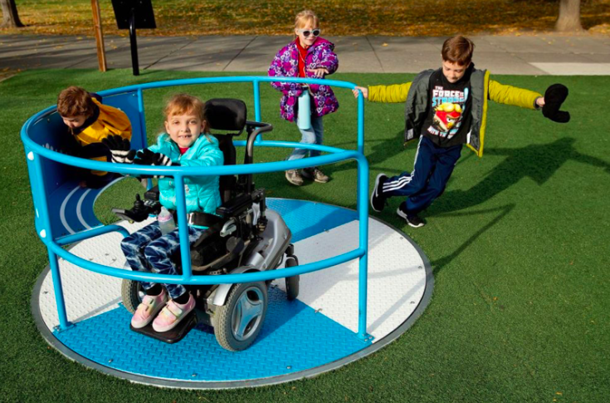
Background Research
Notes:
HOW WE RESEARCHED
Playgrounds and childhood development,
Goal of this
Kayla

Slide 6

Site Observations
Chaeli Cottage
Ocean View
Masiphumelele
Notes:
No findings,
FIELD TRIPS, observation at Chaeli Cottage, our tour
Kayla

Slide 7
Interviews with Professional Staff
Interviewees
Occupational Therapist
Physio Therapist
Principal
Speech Therapist
Teacher
Notes:
Who we talked to , why we talked to them,, what we asked, etc
What our goal was
NO ANALYSIS
Henry

Slide 8



Researched Grants in the U.S.
Notes:
What grants we found, what tools we found,
Kayla
Who we interviewed, why,
What was our goal
Henry

Slide 9


Aided in Fundraising Events
Notes:
Golf day, giving Tuesday, did this to expand our knowledge and help the organization
Who we interviewed, why,
What was our goal
Nick

Slide 10
Findings Overview
User Needs and Challenges on the
Playground
Further Opportunities for The Chaeli
Campaign’s Fundraising
A Playhouse and Communication Poster:
An Inclusive Playground Design
Notes:
Summarize findings, 1. User needs and challenges on a playground. 2. Further opportunities for the Chaeli Campaigns Fundraising. 3. Playhouse/Communication poster; Inclusive playground design
… our methodology was successful as we found. A lot of good information to implement
Kayla

Slide 11
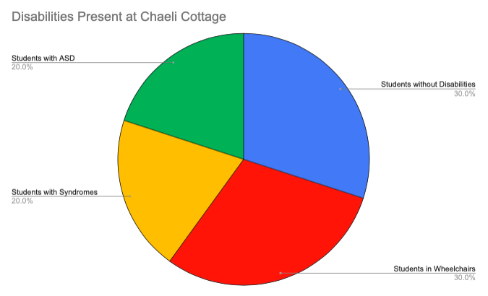
User Needs and Challenges
Notes:
After meeting with Faizah, we learned that not all students can speak, so they have a hard time telling adults what they want to do on the playground. We learned that some students use other forms of communication, such as looking at things or pointing to them. So we decided that a picture poster would be a good thing to add.
Add graph of disbailites at Chael Cottage and say this is what we learned
Amanda

Slide 12
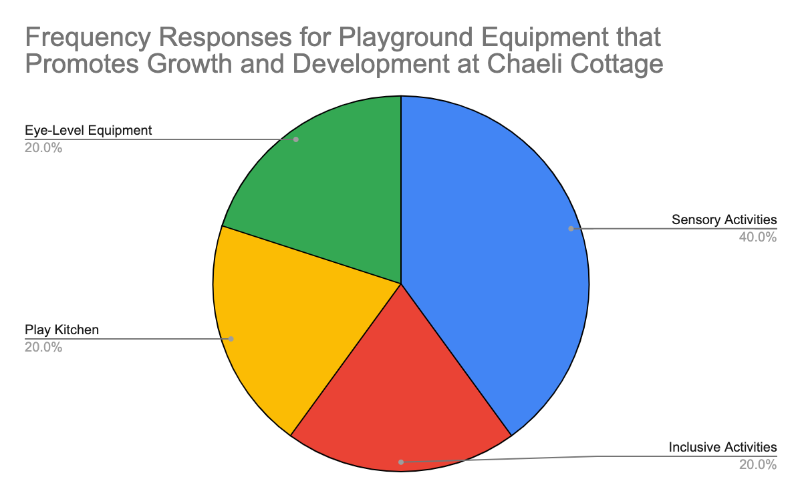
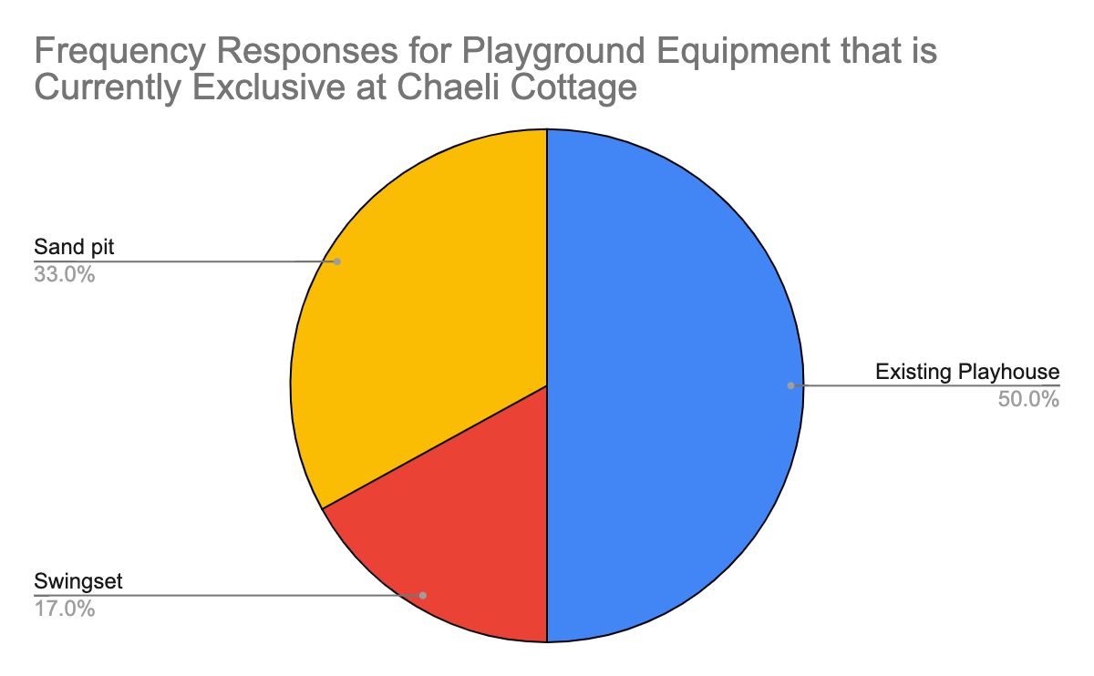
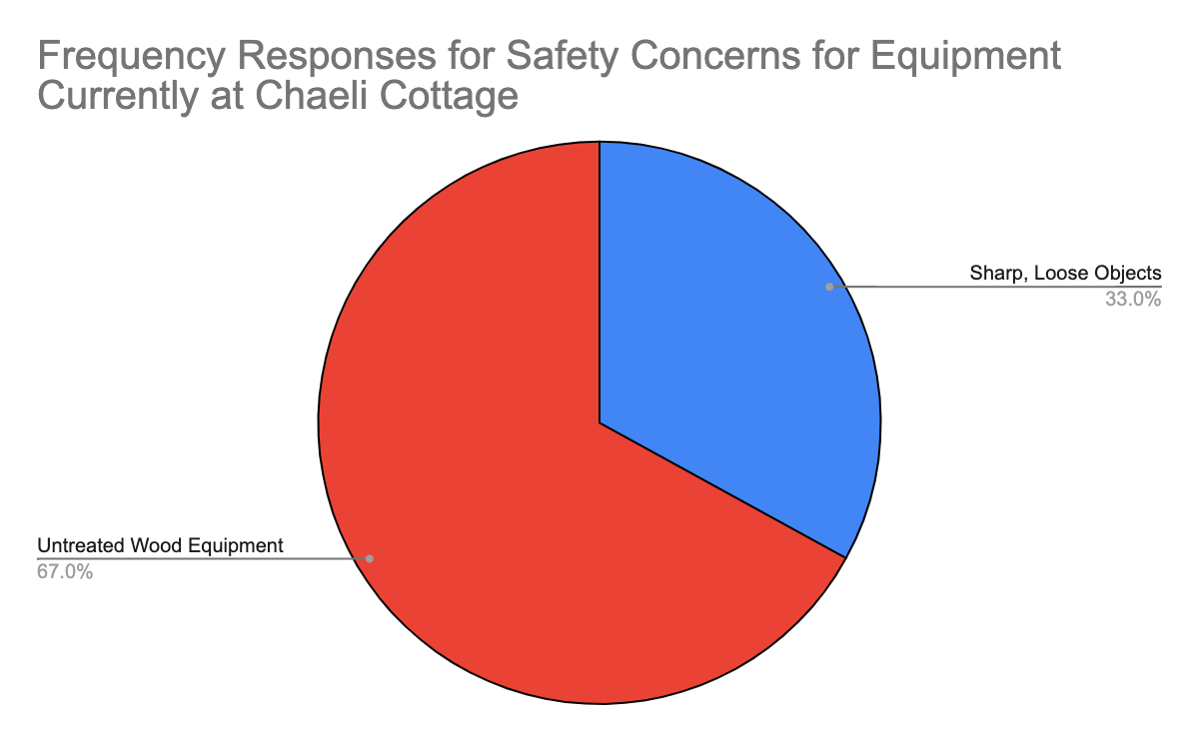
Inclusivity of Existing Playground
Notes:
Mostly inclusive, but certain people were left out… this is what we noticed
3 graphs from interviews
Talk abou that/ summarize thos findings
Amanda

Slide 13
Communication
of students have difficulty communicating verbally
52.6%
Notes:
10/19 students have difficulty communicating verbally, what we learned from this interview
Nick

Slide 14
Current Fundraising Strategies
Grants
Goal-Oriented Fundraisers
Long-Term Strategies
Notes:
3 types, they can’t afford the subscription anymore,
BE NICE AND CONSIDERATE
Henry

Slide 15
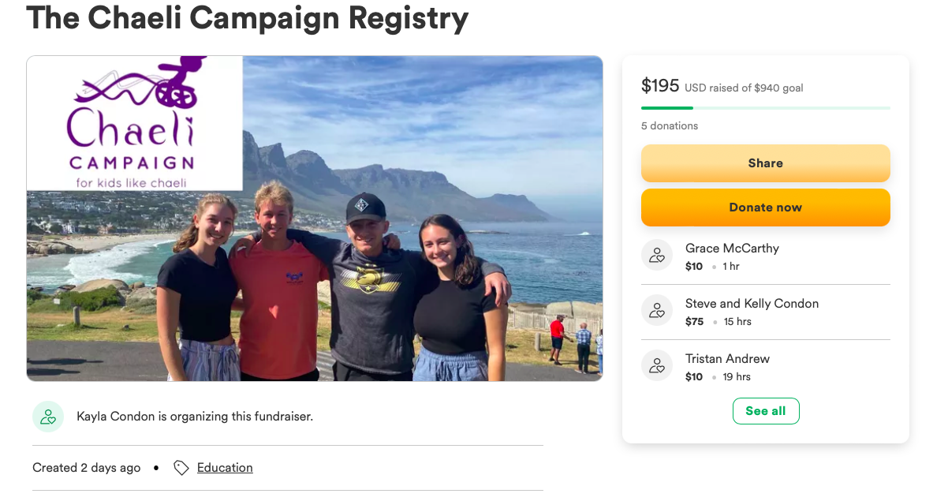
Registry
Notes:
Due to the need to increase funds for day-to-day operations… made a registry
GoFundMe, how we advertised, purpose of it (2 months), what we’ve made so far… funds are still coming in
Amanda

Slide 16
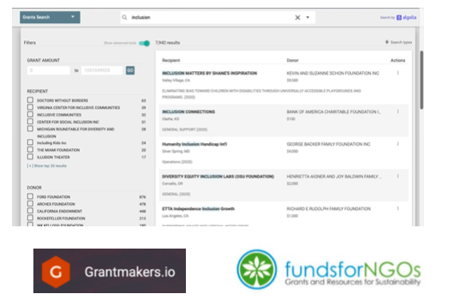
Grant Documentation
Notes:
What grants we found… what the document looks like what information is on it
Kayla

Slide 17
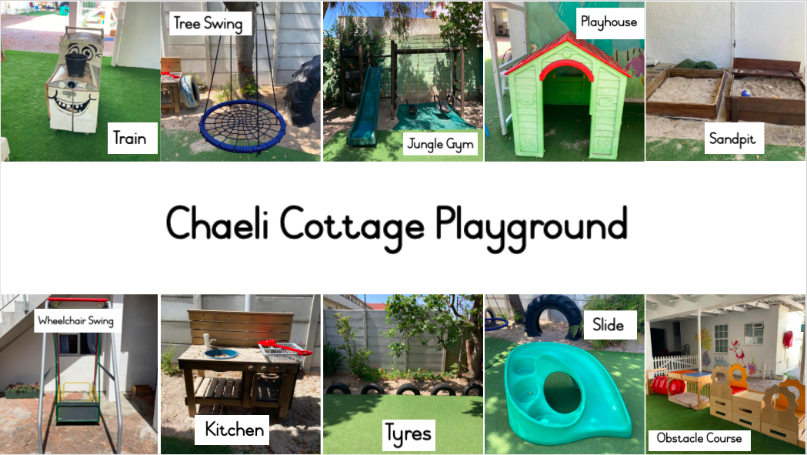
Communication Poster
Notes:
Why we did it, what we did (got feedback from speech therapist, etc), process of creating
Henry

Slide 18
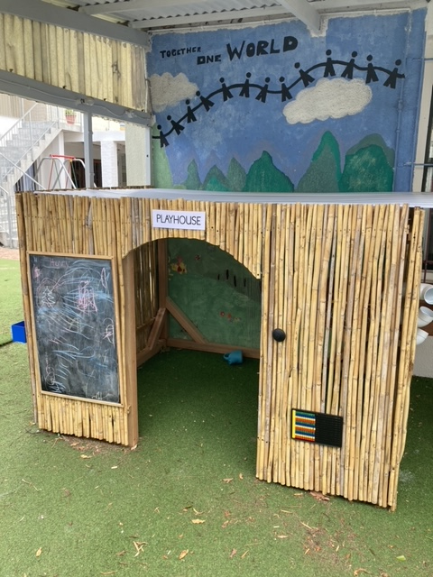
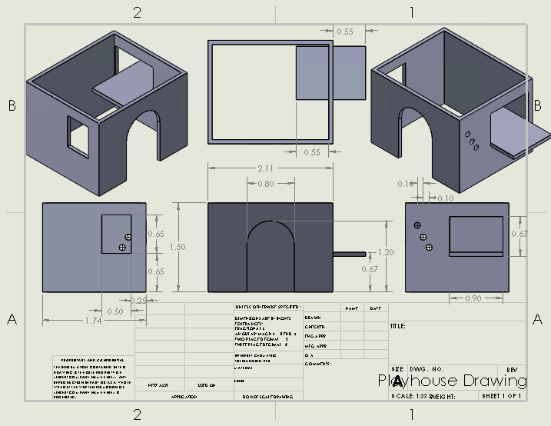
Playhouse Design
Notes:
Why we chose a playhouse,
Graph of what they want, what activities we added to it and why
The goal of it
Add CAD drawing and hand drawings??
Amanda

Slide 19
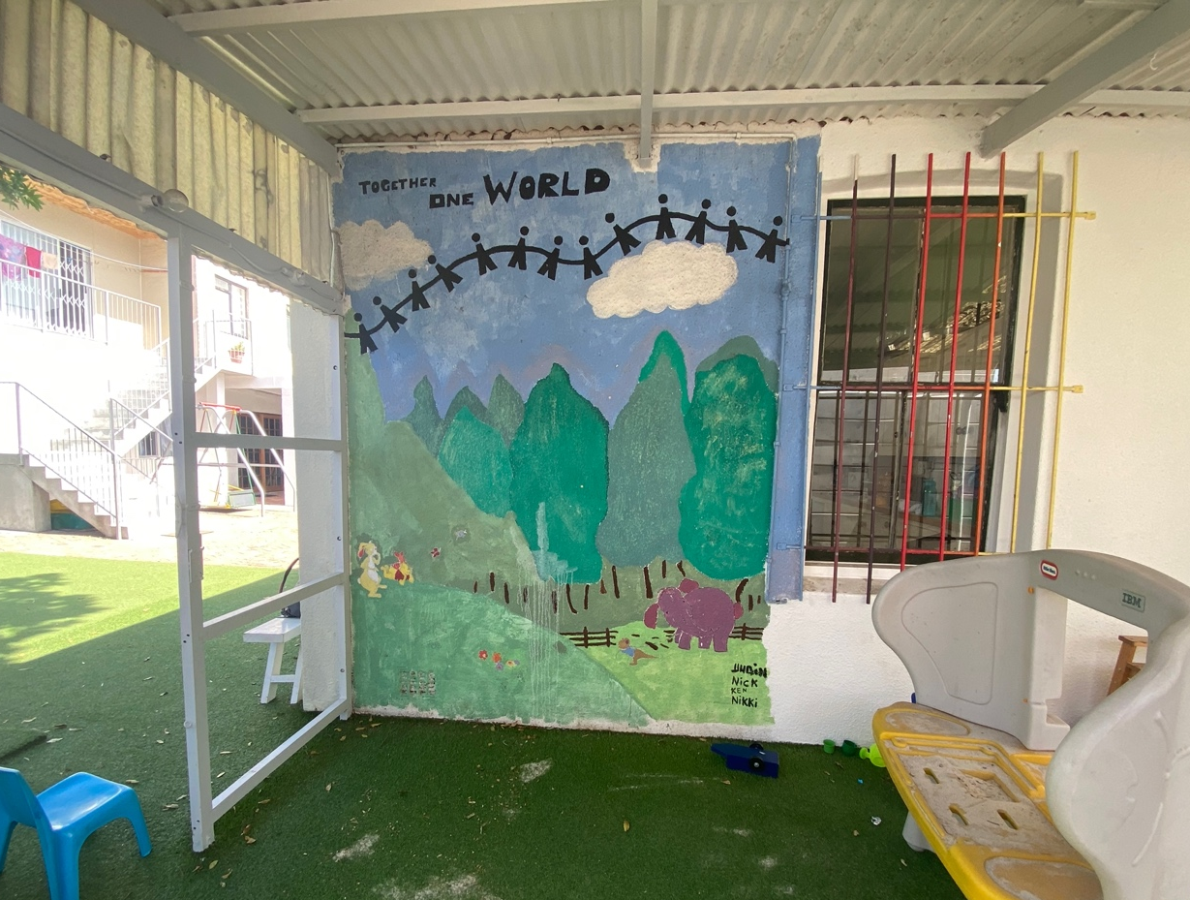
Playground Location
Notes:
Why we chose the space we did
Roof, sand, available space, structure etc
Amanda

Slide 20
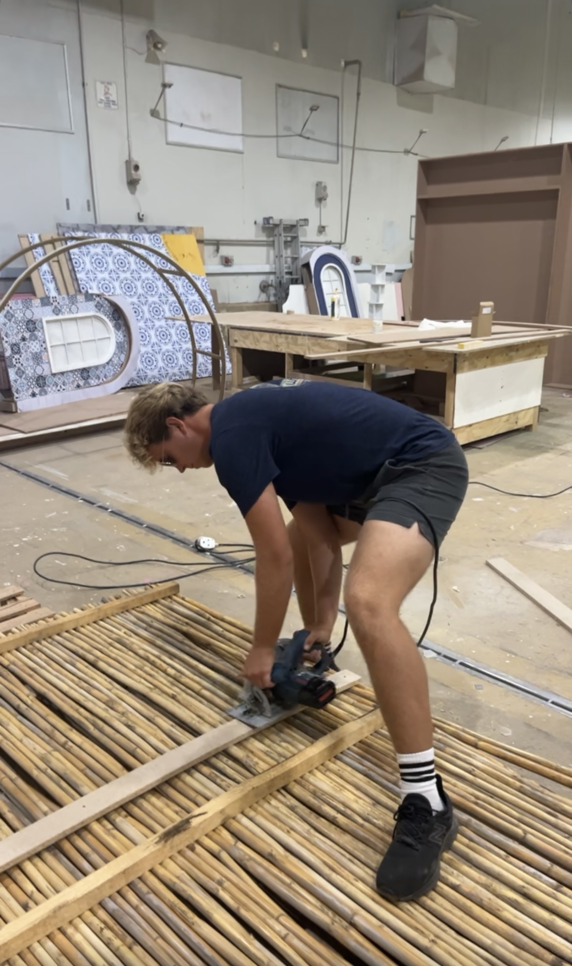
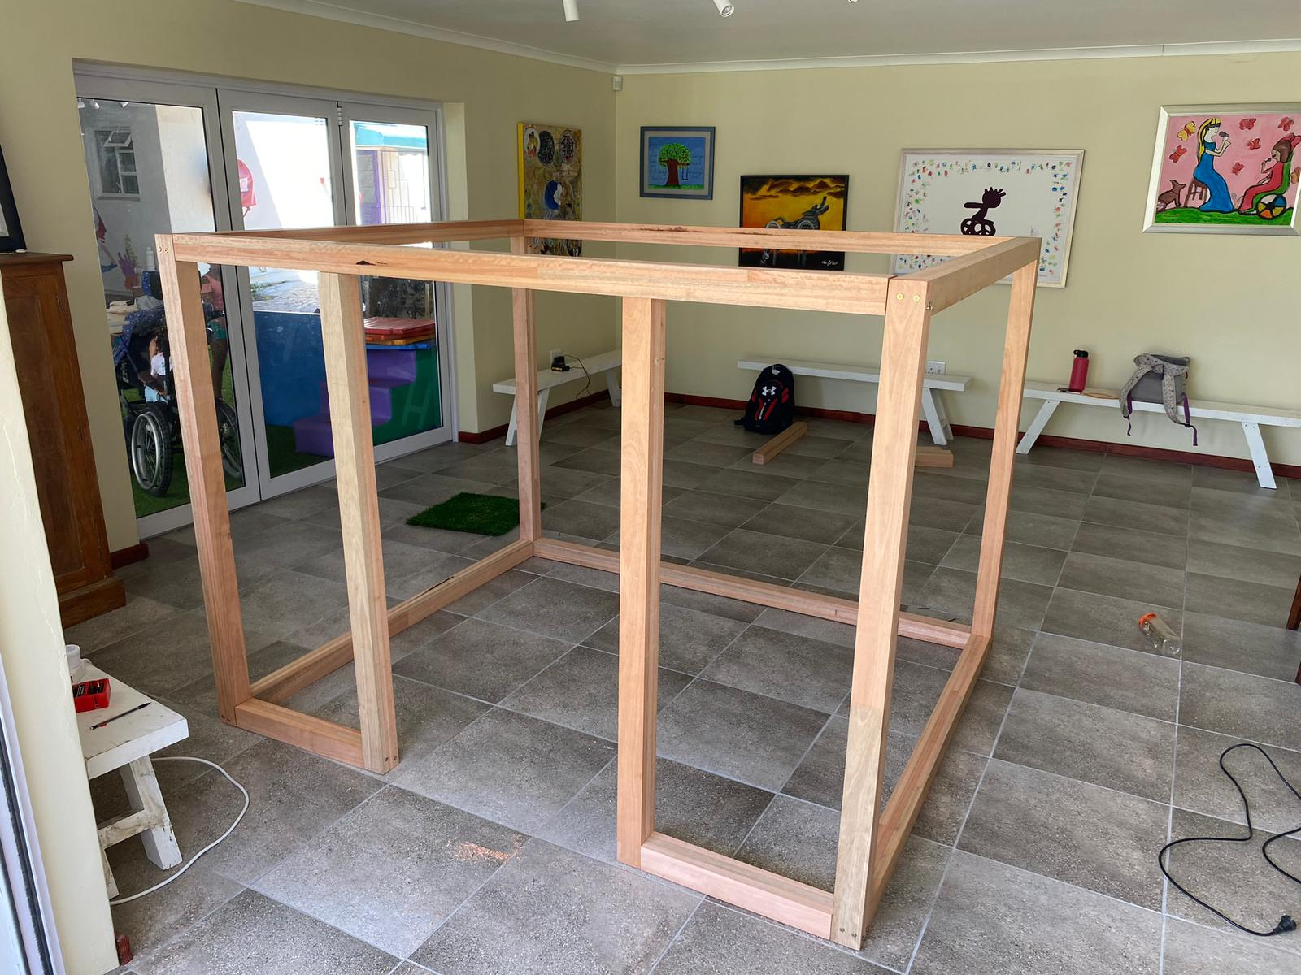
Materials and Building Process
Notes:
List of materials (put a picture of this here), where we got our money (acknowledge 2008 GE Foundation Fund)
Go through what each material is and why we chose it, how it was actually built (the screws hold it this way… reinforced by wood glue… etc)
After the presentation we will invite you outside to get a tour of the playhouse
Nick

Slide 21
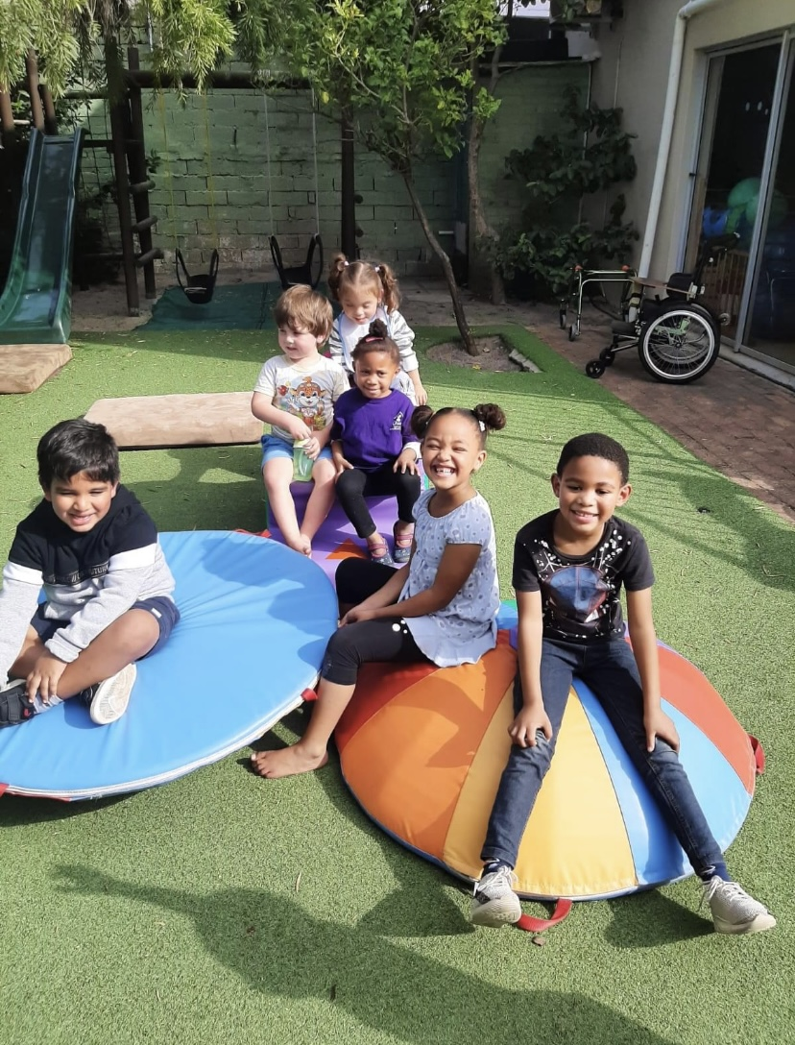
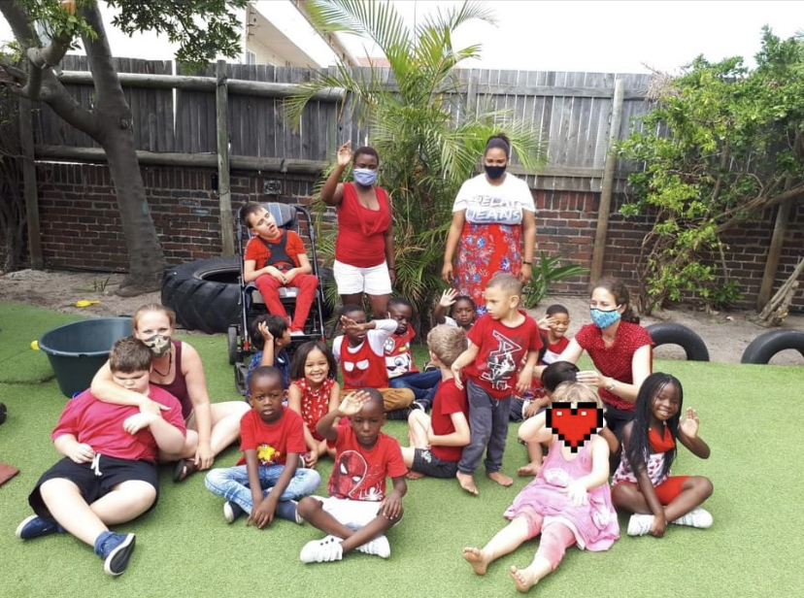
Limitations
Notes:
Henry

Slide 22
Concluding Remarks
Notes:
Recomedations and conclusion
Acknowledge and thank Warren and happinest
Nick

Slide 23
Thank you!
We now invite you
to take a tour
of the playhouse.
Notes:
Invite everyone outside for a tour of the playhouse

